Slide 1
Data Interoperability and Semantics
< Part 2. Data Formats >

Slide 2
Data Interoperability and Semantics Outline
< Part 2. Data formats >
Part 2.1 Generalities
Part 2.2. Delimiter-separated values
Part 2.3. Extensible Markup Language (XML)
Part 2.4. JavaScript Object Notation (JSON)
Part 2.5. Configuration file formats
Part 2.6. YAML Ain’t Markup Language (YAML)
Part 2.7. Lightweight markup languages
Part 2.8. Compressed formats
Part 2.9 Multimedia formats
Part 2.10 3D models
ICM – Computer Science Major – Course unit on Data Interoperability and Semantics
M1 Cyber Physical and Social Systems – Course unit on Data Interoperability and Semantics
Maxime Lefrançois https://maxime-lefrancois.info
Course unit URL: https://ci.mines-stetienne.fr/cps2/course/data

Slide 3
Data Interoperability and Semantics
Part 2. Data Formats
Part 2.1 Generalities

Slide 4
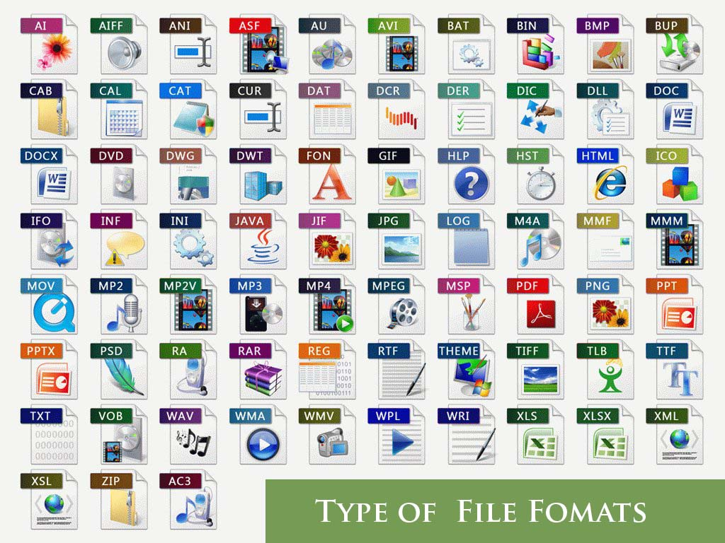
File format
standard way that information is encoded for transfer or storage in a computer file
A format is what enables an application to interpret the raw data contained in a file. It is the mode of representation of these data
File formats are marked in the extension of the file name

Slide 5
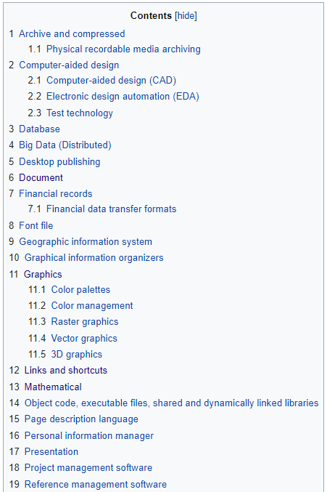
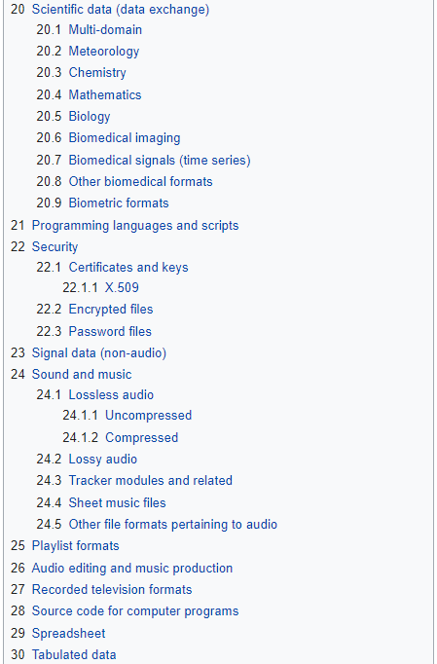
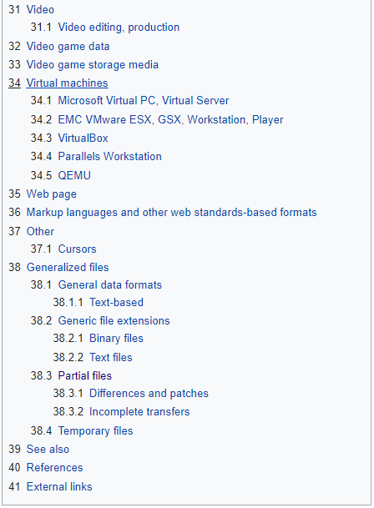
ToC of https://en.wikipedia.org/wiki/List_of_file_formats

Slide 6
Proprietary file formats vs free file formats
Proprietary file format
Data encoding, s.t. one needs the company’s software to decode and interpret it. Either the data encoding specification is secret, or restricted through license.
Examples of proprietary file formats
mp3: open standard, but subject to patents in some countries
dwg: non documented, AutoCAD
psd: documented, Adobe Photoshop’s native image format
rar: partially documented, archive and compression file format owned by Alexander L. Roshal
zip (newest versions have patented features)
gif: CompuServe's Graphics Interchange Format, patent expired in 2004
pdf: open since 2008 ISO 320000-1. Still some features proprietary by Adobe (forms, scripts)
doc, xls, ppt: formerly closed/undocumented, now Microsoft Open Specification Promise
https://en.wikipedia.org/wiki/Proprietary_format

Slide 7
Open vs unpublished file formats
Open file format
published specification usually maintained by a standards organization.
Linux Information Project: “any format that is published for anyone to read and study but which may or may not be encumbered by patents, copyrights or other restrictions on use”
US government: “An open format is one that is platform independent, machine readable, and made available to the public without restrictions that would impede the re-use of that information”
FR government: loi n° 2004-575 du 21 juin 2004 pour « la confiance dans l’économie numérique »: « On entend par standard ouvert tout protocole de communication, d’interconnexion ou d’échange et tout format de données interopérable et dont les spécifications techniques sont publiques et sans restriction d’accès ni de mise en œuvre. »

Slide 8
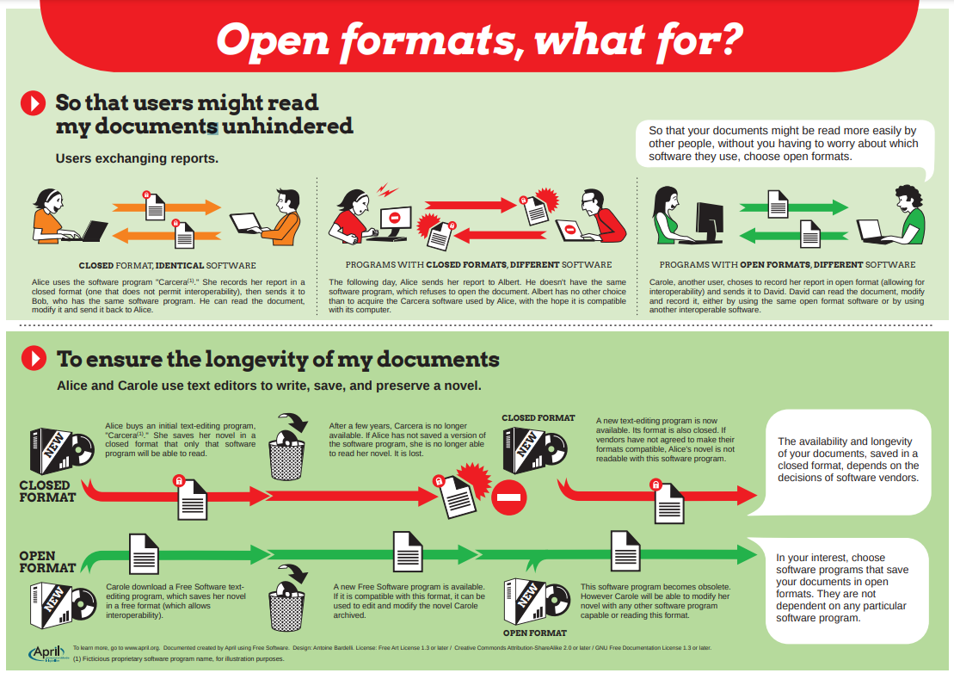
https://www.april.org/en/open-formats

Slide 9
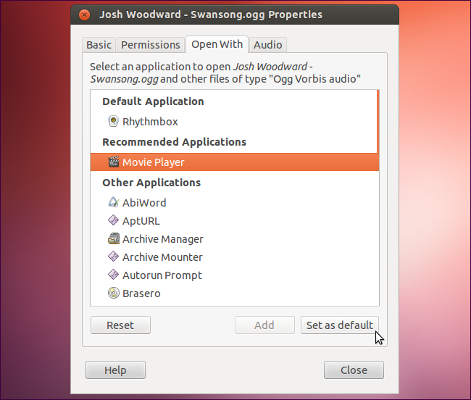
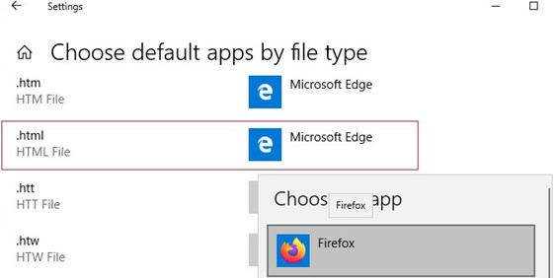
How to identify a file type ?
Filename extensions
See https://en.wikipedia.org/wiki/List_of_filename_extensions
Look up or browse categories https://www.file-extension.info/
Windows / linux desktops: applications association to filename extension

Slide 10
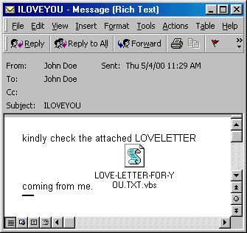
How to identify a file type ?
Filename extensions
See https://en.wikipedia.org/wiki/List_of_filename_extensions
Look up or browse categories https://www.file-extension.info/
Windows / linux desktops: applications association to filename extension
reason why .htm vs .html ? the 8.3 filename format
OS hide the extensions + associate applications = creates security issues

Slide 11
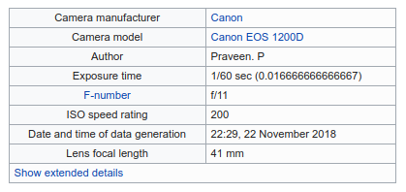

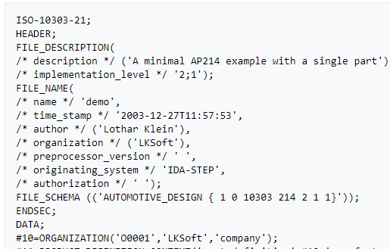

How to identify a file type ?
File header
may contain metadata about the file and its content
ex., Exif metadata: image format, size, resolution color space, ...
ex., AVI header format: https://www.filefix.org/format/avi.html#header
Character-based documents may be opened in text editors, and their header interpreted
ex., Exif metadata
https://en.wikipedia.org/wiki/Exif
ex., head of a XML file
ex., head of a iCalendar file
https://en.wikipedia.org/wiki/ICalendar
ex., head of a ISO 10303-21 STEP file
https://en.wikipedia.org/wiki/ISO_10303-21

Slide 12
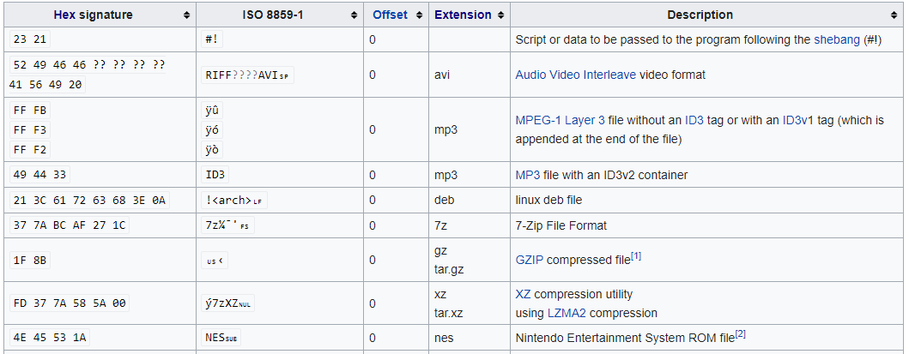
How to identify a file type ?
File’s first bytes: Magic numbers
the first few bytes may be distinctive enough
Example of file signatures - https://en.wikipedia.org/wiki/List_of_file_signatures

Slide 13
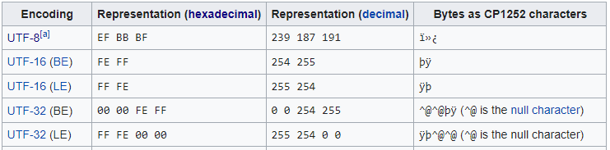
How to identify a file type ?
File’s first bytes: Magic numbers
the first few bytes may be distinctive enough
ex., a file that starts with a Byte Order Mark (BOM) tells the system:
Highly probable that the text stream is Unicode
Describes the byte order, or endianness, of the text stream: Big-endian (BE) vs Little-endian (LE)
Distinguish between Unicode character encoding (UTF-8, UTF-16, UTF-32, ...)
https://en.wikipedia.org/wiki/Byte_order_mark

Slide 14
How to identify a file type ?
Example: the gzip file format starts with:
a 10-byte header, containing:
magic number (0x1f8b),
the compression method (0x08 for DEFLATE),
1-byte of header flags,
a 4-byte timestamp,
compression flags and
the operating system ID.
optional extra headers as allowed by the header flags, including the original filename, and a comment field,

Slide 15
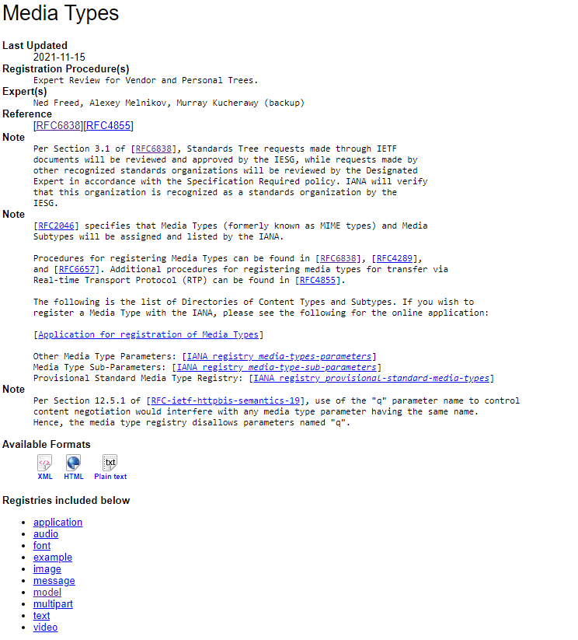
How to identify a file type ?
MIME type = Media types
managed by Internet Assigned Numbers Authority (IANA)
example: text/html, image/gif, font/woff2, ...
used by many internet protocols
demo with your browser: with the Network tab of the developer tools open, see HTTP response headers of requests when accessing https://fonts.google.com/
https://www.iana.org/assignments/media-types/media-types.xhtml

Slide 16
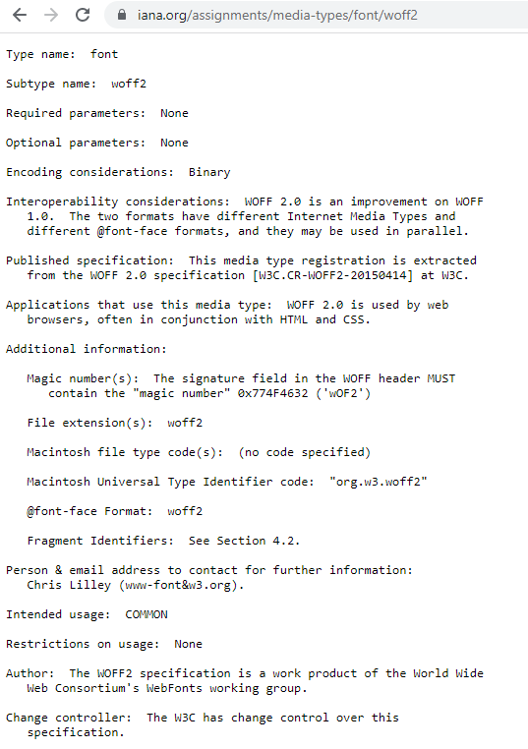
font/woff2

Slide 17
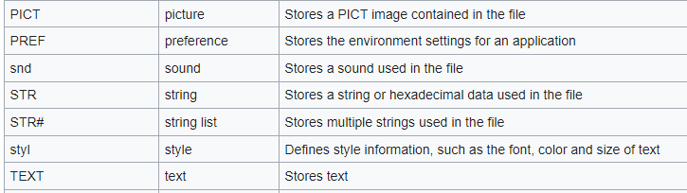
font/woff2
Macintosh file type code(s)
Apple Computer, Inc., "Mac OS: File Type and Creator Codes, and File Formats", Apple Knowledge Article 55381, June 1993, last accessed 17/05/2008 https://web.archive.org/web/20080517021842/http://www.info.apple.com/kbnum/n55381
https://en.wikipedia.org/wiki/Resource_fork#Major_resource_types

Slide 18
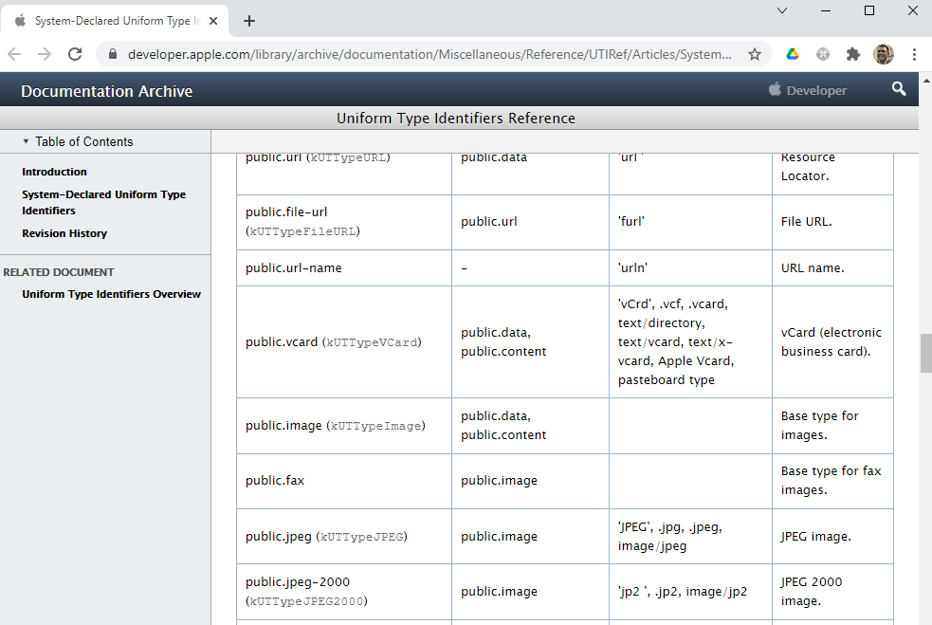
font/woff2
Macintosh Universal Type Identifier code
reverse-DNS naming structure
public UTIs, and organization-specific UTIs
multi-heritance
https://developer.apple.com/library/archive/documentation/Miscellaneous/Reference/UTIRef/

Slide 19
Data Interoperability and Semantics
Part 2. Data Formats
Part 2.2. Delimiter-separated values

Slide 20
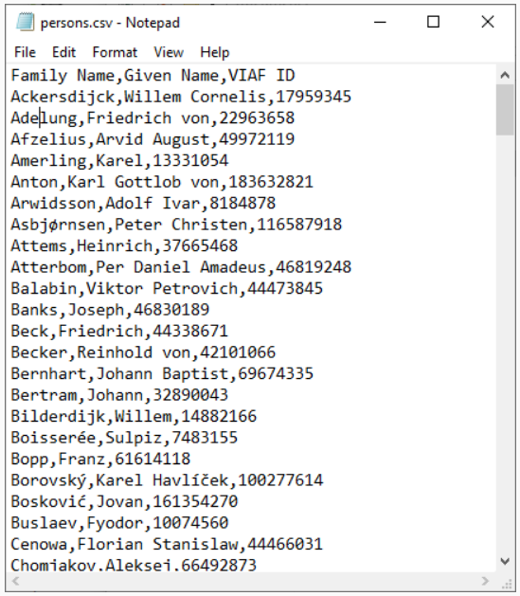
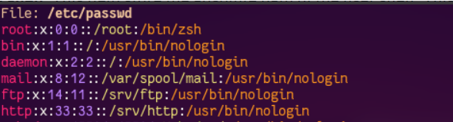
Delimiter-separated values
separator character
comma Comma-separated values (CSV) ex: Microsoft Excel csv export¹
semicolon ex: Microsoft Excel csv export²
tab Tab-separated values (TSV)
colon ex: Linux $ cat /etc/passwd
¹ unless the decimal point of the locale is a comma (ex., France)
² when the decimal point of the locale is a comma

Slide 21




Delimiter-separated values
RFC 4180
separator character
records separated by CRLF
optional header file
fields enclosed in double quote
escaping cell character
or

Slide 22
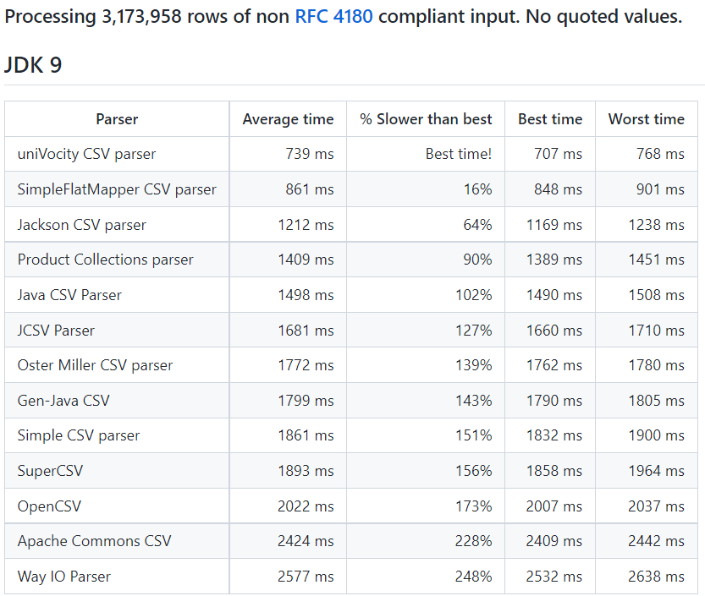
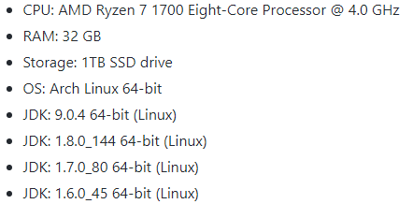
Delimiter-separated values
Comparison Java libraries: https://github.com/uniVocity/csv-parsers-comparison

Slide 23
Data Interoperability and Semantics
Part 2. Data Formats
Part 2.3. Extensible Markup Language (XML)

Slide 24
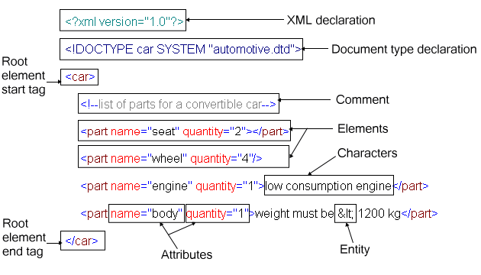
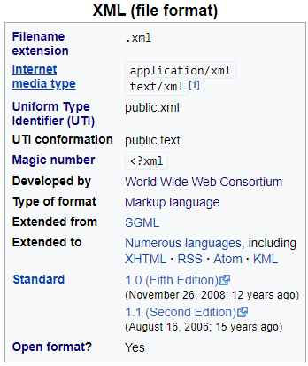
Extensible Markup Language
v1.0 in 1998, still extensively used in many verticals
numerous formats based on XML (418 registered on IANA) https://en.wikipedia.org/wiki/List_of_XML_markup_languages application/atom+xml application/rdf+xml ...
verbosity, complexity and redundancy

Slide 25
Extensible Markup Language
Characters and escaping
unicode implementations: <?xml version="1.0" encoding="UTF-8"?>
escaping characters: &lt; ‘<‘ - &amp; ‘&’ - &#x2764; ‘❤’ - etc.
Syntactical correctness
well formed vs ill-formed
one root tag
correct nesting
tag names (approx) start with letter, then alphanumeric or ‘:’
Schemas and validation
valid vs invalid
DTD, or XML Schema
Namespaces
xmlns:ns1="http://example.org/ns1" xmlns:ns2="http://example.org/ns2"
allows to use different schemas together: <ns1:Tag> <ns2:Tag>

Slide 26
Extensible Markup Language
Rules of thumb for modelling with XML:
limit the number of tag types and attribute types!
use attributes for simple datatypes only
order of elements is important
group elements when appropriate
anticipate how you are going to write XPath queries
Notes:
FIN 1H30

Slide 27
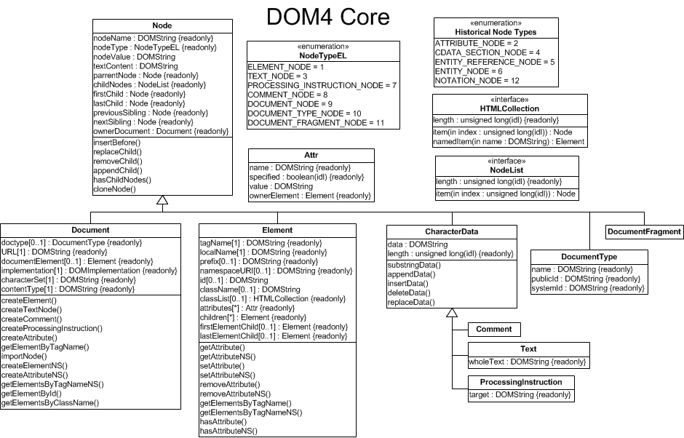
XML manipulation: Document Object Model (DOM)
W3C DOM api (version 4) - https://dom.spec.whatwg.org/

Slide 28
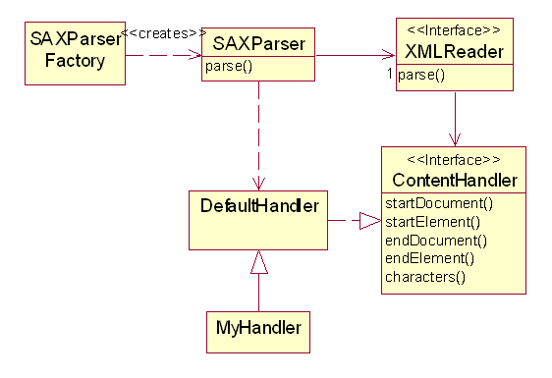
SAX (Simple API for XML)
XML traversal API
Java API for XML Processing (JAXP) – UML diagram of the API for SAX

Slide 29
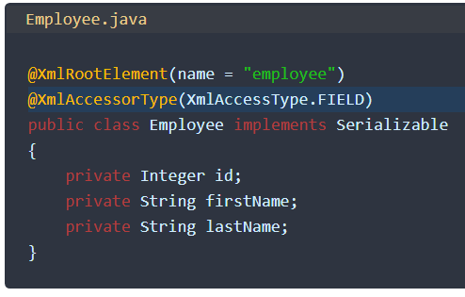
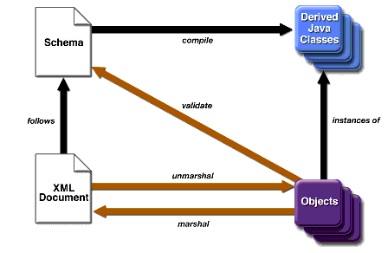
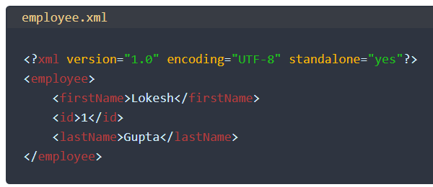
XML – OOP data binding
XML-OOP data binding
Java Architecture for XML Binding (JAXB) example https://howtodoinjava.com/jaxb/jaxb-annotations/
ex Java: https://zetcode.com/java/jaxb/

Slide 30
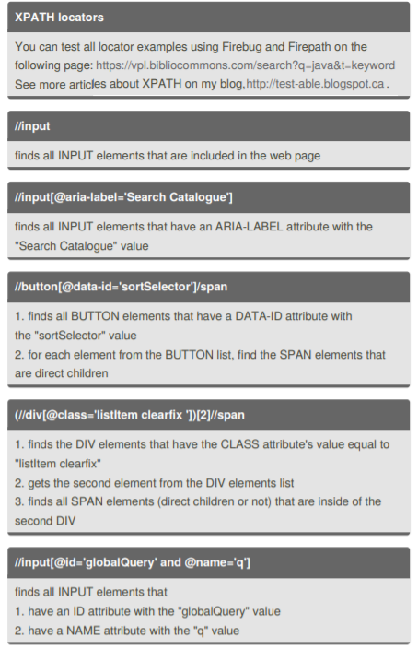
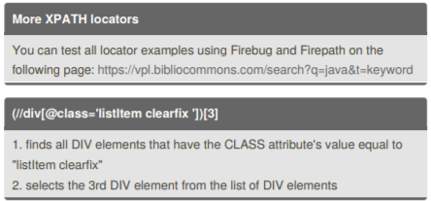
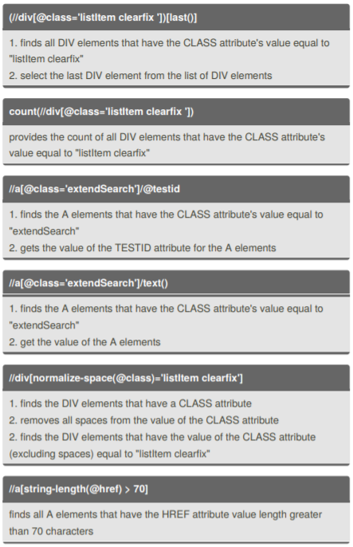
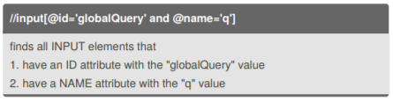
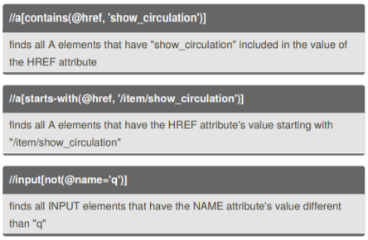
XPath: Declarative tree-traversal language
https://www.w3.org/TR/xpath/
https://cheatography.com/alexsiminiuc/cheat-sheets/xpath/pdf/
https://devhints.io/xpath

Slide 31
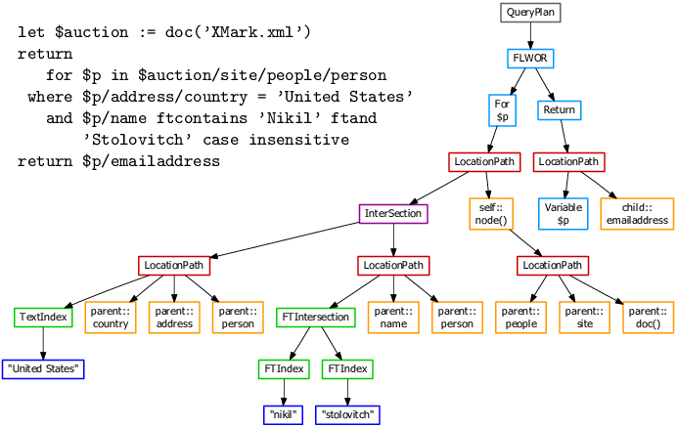
XQuery: Declarative query language

Slide 32
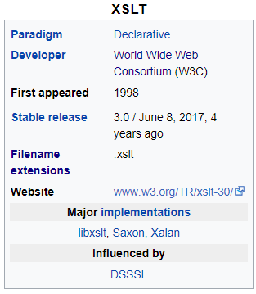
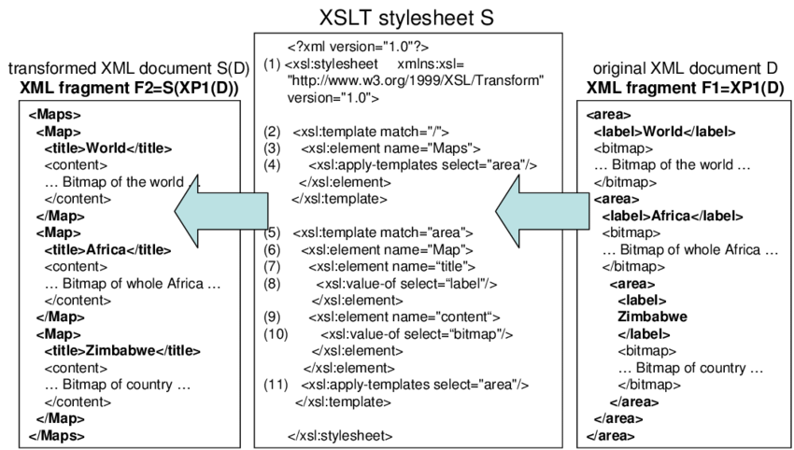
XSLT: Declarative transformation language

Slide 33
Data Interoperability and Semantics
Part 2. Data Formats
Part 2.4. JavaScript Object Notation (JSON)

Slide 34
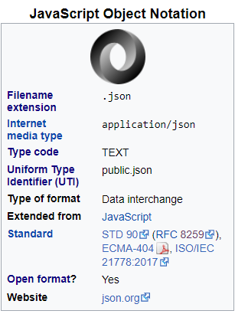
JavaScript Object Notation
since early 2000s. Now used a lot in software development
many mediatypes based on JSON (118 registered on IANA) application/geo+json application/ld+json ...
simple, human-readable
attribute–value pairs and arrays (or other serializable values)

Slide 35
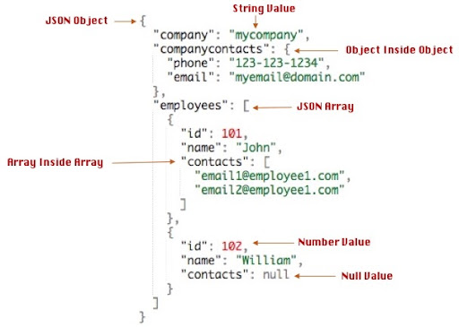
JavaScript Object Notation
since early 2000s. Now used a lot in software development
many mediatypes based on JSON (118 registered on IANA) application/geo+json application/ld+json ...
simple, human-readable
attribute–value pairs and arrays (or other serializable values)

Slide 36
JavaScript Object Notation
Characters and escaping
full Unicode character set
escaping characters \b \f \n \r \t \" \
Data types
number
string
boolean
array
object
null
Semantics
While JSON provides a syntactic framework for data interchange, unambiguous data interchange also requires agreement between producer and consumer on the semantics of specific use of the JSON syntax. One example of where such an agreement is necessary is the serialization of data types defined by the JavaScript syntax that are not part of the JSON standard, e.g., Date, Function, Regular Expression, and “undefined”

Slide 37
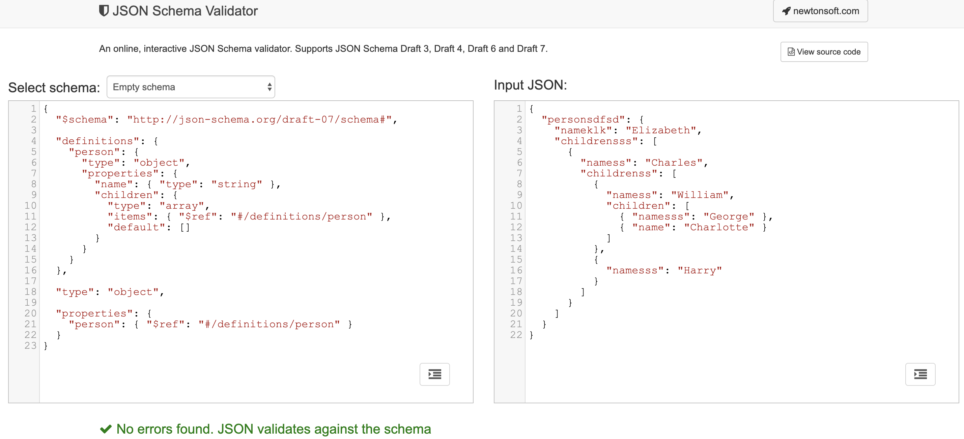
JSON Schema

Slide 38
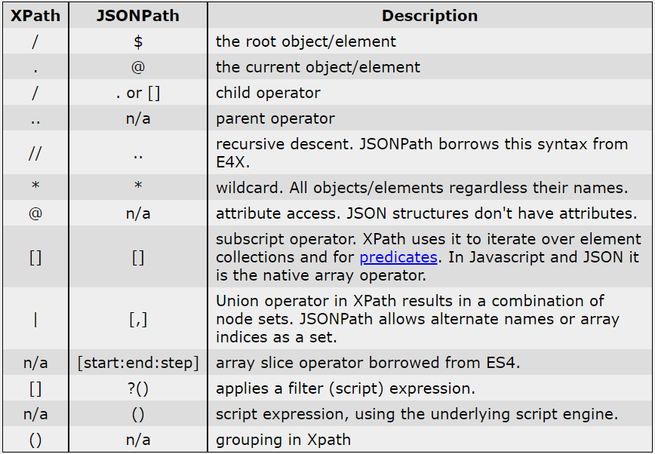
JSONPath: Declarative tree-traversal language
Examples:
$.store.book[0].title
$['store']['book'][0]['title']
$.store.book[(@.length-1)].title
$.store.book[?(@.price < 10)].title
https://goessner.net/articles/JsonPath/

Slide 39
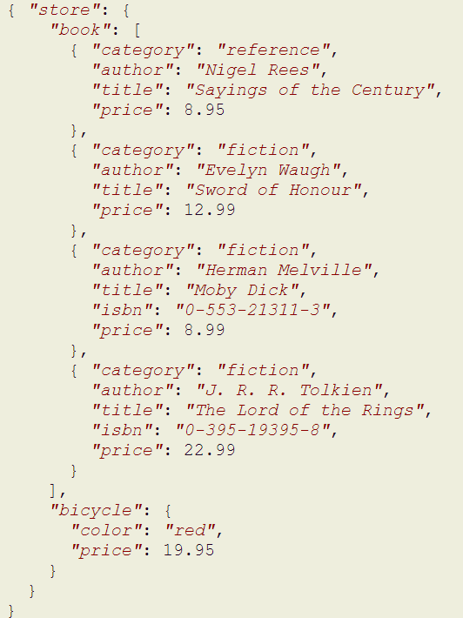
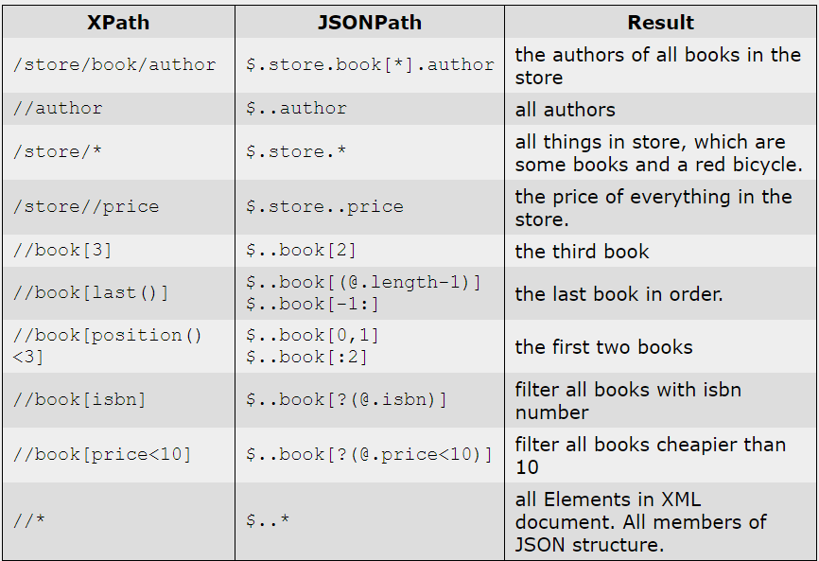
JSONPath: Declarative tree-traversal language
https://goessner.net/articles/JsonPath/

Slide 40
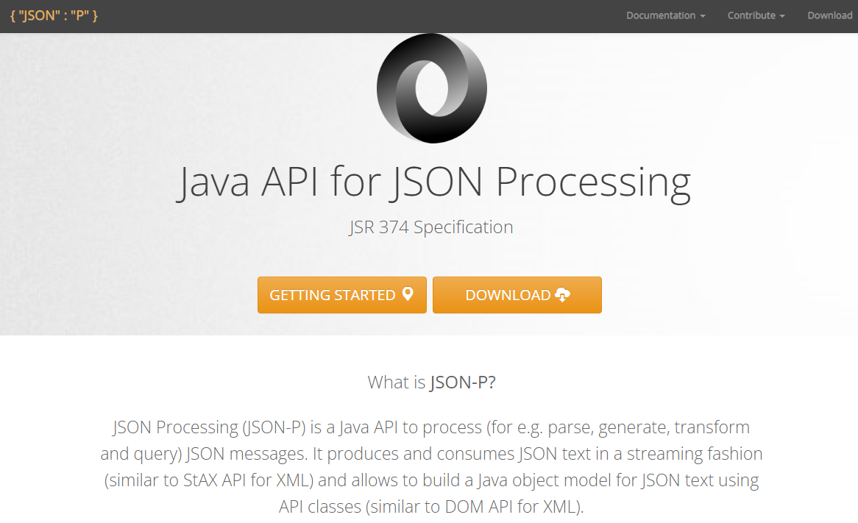
APIs for JSON Processing
example for java: https://javaee.github.io/jsonp/

Slide 41

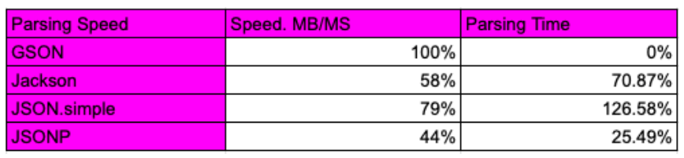
JSON – OOP data binding
JSON Document
Comparison of Java JSON libraries: Jackson vs. Gson vs. JSON-B vs. JSON-P vs. org.JSON vs. Jsonpath https://itsallbinary.com/jackson-vs-gson-vs-json-b-vs-json-p-vs-org-json-vs-jsonpath-java-json-libraries-features-comparison/
JSON-OOP data binding

Slide 42
Data Interoperability and Semantics
Part 2. Data Formats
Part 2.5. Configuration file formats

Slide 43
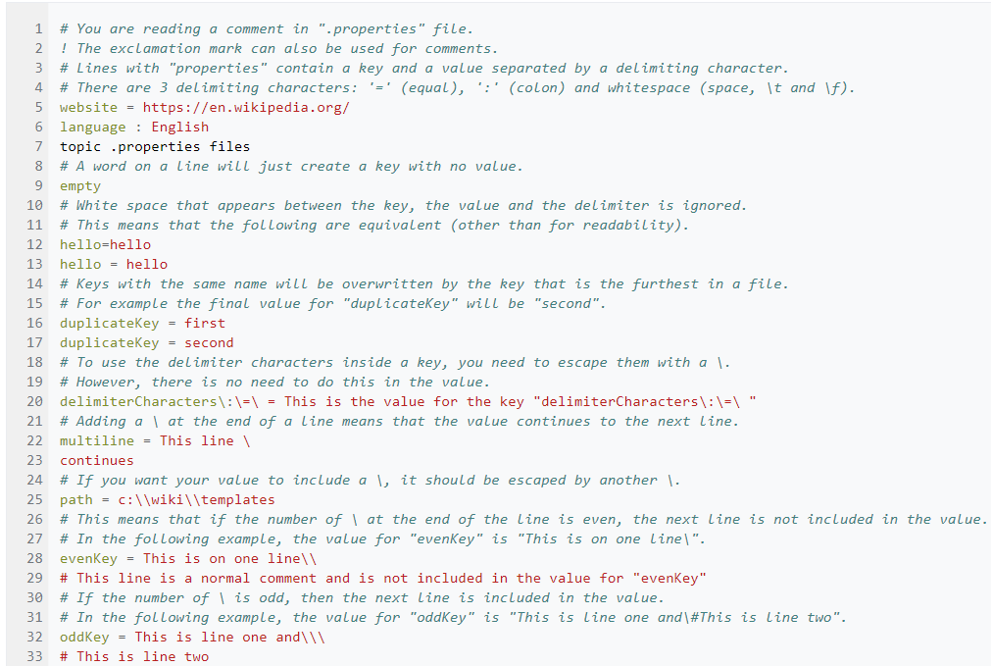

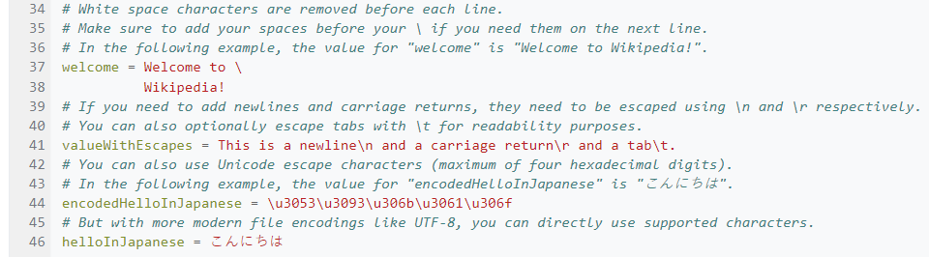
.properties files
Mainly for Java-related conf files
Ex: i18n¹ and l10n²
key=value,
key = value,
key:value,
key value
¹ i18n: internationalization
² l10n: localization

Slide 44
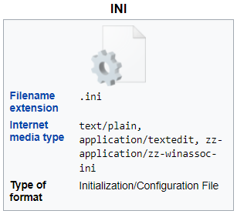
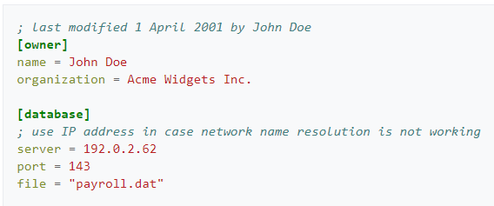
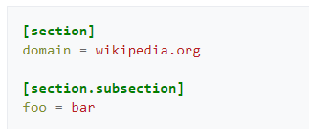
INI files
Developed for Windows for initialization: BOOT.INI, SYSTEM.INI, WIN.INI, …
Similar in Linux systems with .conf, .cfg, …
Syntax used by many programs
php.ini
ssh.conf
git.conf
…
https://en.wikipedia.org/wiki/INI_file

Slide 45
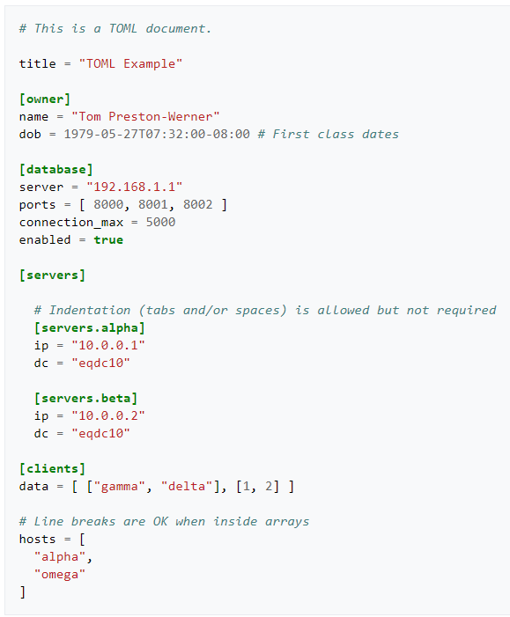
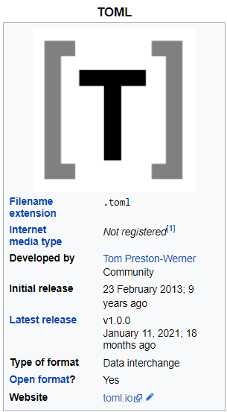

TOML files
Tom's Obvious, Minimal Language.
https://toml.io/en/
key = "value" pairs
[section names],
# comments
Datatypes:
String,
Integer,
Float,
Boolean,
Datetime,
Array,
and Table
https://en.wikipedia.org/wiki/TOML

Slide 46


TOML files
Example:
Python packaging and dependency management with Poetry
https://en.wikipedia.org/wiki/TOML
https://martin-thoma.com/pyproject-toml/

Slide 47
Data Interoperability and Semantics
Part 2. Data Formats
Part 2.6. YAML Ain’t Markup Language (YAML)

Slide 48


YAML Ain’t Markup Language (YAML)
since early 2000s
used a lot for software configuration
human-readable, superset of JSON

Slide 49



YAML Ain’t Markup Language (YAML)
Whitespace indentation, tabs forbidden
end-of-line comments (#)
lists
associative arrays
or

Slide 50



YAML Ain’t Markup Language (YAML)
strings
datatypes
or

Slide 51

YAML Ain’t Markup Language (YAML)
anchors and references

Slide 52



YAML Ain’t Markup Language (YAML)
https://yaml.org/refcard.html

Slide 53

YAML Ain’t Markup Language (YAML)

Slide 54

APIs for YAML Processing
Tutorial for Java: https://www.baeldung.com/java-snake-yaml
Package for JavaScript: https://www.npmjs.com/package/yaml
Module for Python: https://pyyaml.org/wiki/PyYAMLDocumentation

Slide 55
Data Interoperability and Semantics
Part 2. Data Formats
Part 2.7. Lightweight markup languages

Slide 56

Lightweight markup languages

Slide 57

Lightweight markup languages

Slide 58

Lightweight markup languages

Slide 59
Data Interoperability and Semantics
Part 2. Data Formats
Part 2.8. Compressed formats

Slide 60
Compression
A compressed file is an archive that contains one or more file that have been reduced in size.
many different file compression types: zip, arc, arj, rar, cab, tar.gz, ...
lossless file compression
reduce redundancy without loosing data
ex. AAABBBBBCC -> A3B5C2
lossy file compression
ok to loose some data
ex. video, audio, images

Slide 61

How compression works

Slide 62




Slide 63


+

Slide 64
Data Interoperability and Semantics
Part 2. Data Formats
Part 2.9 Multimedia formats

Slide 65

https://en.wikipedia.org/wiki/Template:Compression_formats

Slide 66


Image file formats
https://en.wikipedia.org/wiki/Image_file_formats

Slide 67

Raster vs Vector graphics
https://en.wikipedia.org/wiki/BMP_file_format

Slide 68


JPEG

Slide 69


PNG
PNG
W3C REC and ISO/IEC 15948:2003
http://www.w3.org/TR/PNG

Slide 70


PNG
W3C REC and ISO/IEC 15948:2003
http://www.w3.org/TR/PNG

Slide 71


Modern image file formats: WebP
WebP lossless images are 26% smaller in size compared to PNGs.
WebP lossy images are 25-34% smaller than comparable JPEG images at equivalent structural similarity index measure quality index.

Slide 72


Modern image file formats: AVIF
https://imageengine.io/blog/how-efficient-is-avif/

Slide 73





What is an SVG File Used For and Why Developers Should be Using Them
# Published Jan 19, 2021 - https://deliciousbrains.com/svg-advantages-developers/

Slide 74

Recommendations for images in the browser
https://developer.mozilla.org/en-US/docs/Web/Media/Formats
Photographs
AVIF*, WebP, or JPEG
Icons
SVG, Lossless WebP, or PNG
Screenshots
Lossless WebP or PNG
Diagrams, drawings, and charts
SVG, PNG
* I added AVIF here

Slide 75



Audio file formats
https://en.wikipedia.org/wiki/Audio_file_format

Slide 76




Video file formats

Slide 77


Recommendations for audio and video files
https://developer.mozilla.org/en-US/docs/Web/Media/Formats

Slide 78
Data Interoperability and Semantics
Part 2. Data Formats
Part 2.10 3D models
(focusing on Web and Cyber-Physical Systems application domains)

Slide 79





3D models

Slide 80

3D models
Many file formats
Key features of a 3D file:
geometry,
surface texture,
scene details,
animation of the model
element properties,
https://all3dp.com/2/most-common-3d-file-formats-model/

Slide 81



Shape Geometry
a) Approximate Mesh Encoding
« tesselations »: decompose a surface in polygons (usually triangles)
Good for 3D printing
Files may be huge.
b) Precise Mesh Encoding
Parametric surfaces made of control points and knots. Example: non-uniform rational basis spline (NURBS)
Exact at any resolution
Slow rendering
c) Constructive Solid Geometry
Primitive shapes that are combined using Boolean operations
Good for CAD
https://www.digitalpatterning.net/dpblog/how-do-i-know-the-pattern-is-right
https://en.wikipedia.org/wiki/Non-uniform_rational_B-spline
https://en.wikipedia.org/wiki/Constructive_solid_geometry
https://all3dp.com/2/most-common-3d-file-formats-model/

Slide 82



Surface Textures
https://www.creativebloq.com/3d-tips/find-high-res-textures-1232646
a) Texture Mapping
every point in the 3D model’s surface (or the polygonal mesh) is mapped to a two-dimensional image.
b) Face Attributes
each face of the mesh has a set of attributes
Color, texture, material type, reflection, refraction,…
https://metalbyexample.com/textures-and-samplers/
https://www.blendernation.com/2021/11/05/realistic-glass-shader-in-blender-eevee-tutorial/

Slide 83

Scene detail
layout of the 3D model in terms of cameras, light sources, and other nearby 3D models
https://www.creativeshrimp.com/light-texture-tutorial-1-lighting-book.html

Slide 84


Animation
skeletal animation: skeleton + joints
Unified Robot Description Format (URDF) in Visual Studio Code
https://microsoft.github.io/Win-RoS-Landing-Page/hiwin_case_study.html
http://www.downloads.redway3d.com/downloads/public/documentation/wf_skeletal_animation.html

Slide 85



Popular 3D file formats: STL (“stereolithography”)
Popular for 3D printing
Triangular mesh,
No color information
ASCII or Binary representation
Superseded by OBJ, 3MF, AMF, …
https://en.wikipedia.org/wiki/STL_(file_format)

Slide 86




Popular 3D file formats: Wavefront OBJ file format
OBJ file open in Microsoft 3D Builder
Popular for 3D printing and 3D graphics
Triangular mesh
+ other kinds of interpolation: Tayolr, B-splines…
No animation, no deformation
Reference to companion file MTL (Material Template Library)
https://en.wikipedia.org/wiki/Wavefront_.obj_file
https://people.sc.fsu.edu/~jburkardt/data/mtl/mtl.html

Slide 87


Popular 3D file formats: Autodesk 3DS Max file format
https://en.wikipedia.org/wiki/.3ds
Autodesk 3D Studio MAX 1996
Popular for architecture, engineering, education, manufacturing
geometry, appearance, scene, and animation
Triangular mesh, total 65536 triangles
Directional light sources are not supported
Reference: http://paulbourke.net/dataformats/3ds/
Tree structure made of chunks
In binary :
6 byte Chunk header:
1-2 = chunk ID
3-6 = little-endian length of the chunk
Next bytes: chunk’s data, including sub-chunks

Slide 88



Popular 3D file formats: ISO 10303-21 STEP-files
https://en.wikipedia.org/wiki/ISO_10303-21
Popular for in many engineering domains that rely on CAD
Mechanical engineering
AECOO industry (Architecture, Engineering, Construction, Owner Operator)
ASCII, not storage-efficient
Schema defined separately in the EXPRESS data modeling language ISO 10303-11

Slide 89
Data Interoperability and Semantics
</ Part 2. Data Formats >

