Slide 1
Data Interoperability and Semantics
< Part 3. Data schemas and semantics >

Slide 2
Data Interoperability and Semantics Outline
< Part 3. Data schemas and semantics >
Part 3.1. Data schemas
Part 3.1.1. XML Schema
Part 3.1.2. JSON Schema
Part 3.2. Semantics
Part 3.2.1. Heterogeneities and data conflicts
Part 3.2.2. Controlled vocabularies and ontologies
Part 3.2.3. Resource Description Framework
Part 3.2.4. RDFa: Rich structured data markup for web documents
Part 3.2.5. JSON-LD: JSON for Linking Data
ICM – Computer Science Major – Course unit on Data Interoperability and Semantics
M1 Cyber Physical and Social Systems – Course unit on Data Interoperability and Semantics
Maxime Lefrançois https://maxime-lefrancois.info
Course unit URL: https://ci.mines-stetienne.fr/cps2/course/data

Slide 3
Data Interoperability and Semantics
< Part 3. Data schemas and semantics >
Part 3.1. Data schemas

Slide 4
Data Interoperability and Semantics
< Part 3. Data schemas and semantics >
Part 3.1. Data schemas
Part 3.1.1. XML Schema

Slide 5
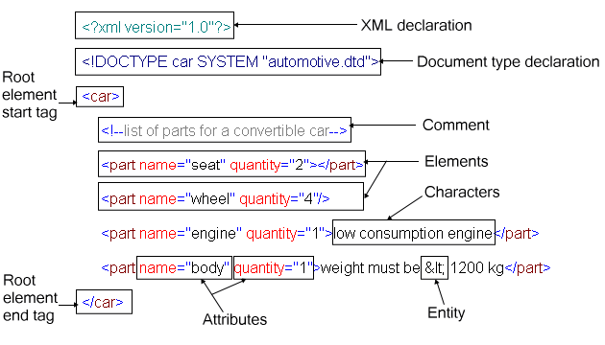
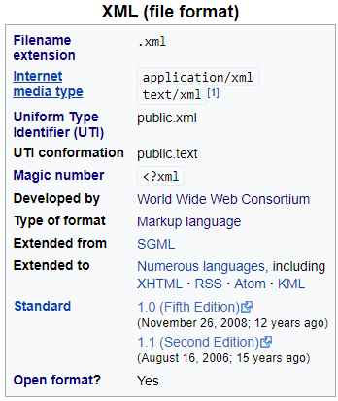
Extensible Markup Language
reminder
v1.0 in 1998, still extensively used in many verticals
numerous formats based on XML (418 registered on IANA) https://en.wikipedia.org/wiki/List_of_XML_markup_languages application/atom+xml application/rdf+xml ...
verbosity, complexity and redundancy

Slide 6
Extensible Markup Language
reminder
Characters and escaping
unicode implementations: <?xml version="1.0" encoding="UTF-8"?>
escaping characters: &lt; ‘<‘ - &amp; ‘&’ - &#x2764; ‘❤’ - etc.
Syntactical correctness
well formed vs ill-formed
one root tag
correct nesting
tag names (approx) start with letter, then alphanumeric or ‘:’
Schemas and validation
valid vs invalid
DTD, or XML Schema
Namespaces
xmlns:ns1="http://example.org/ns1" xmlns:ns2="http://example.org/ns2"
allows to use different schemas together: <ns1:Tag> <ns2:Tag>

Slide 7
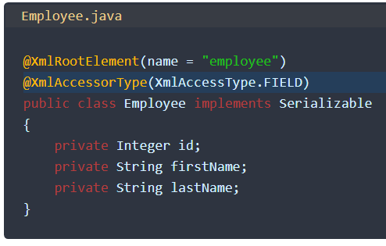
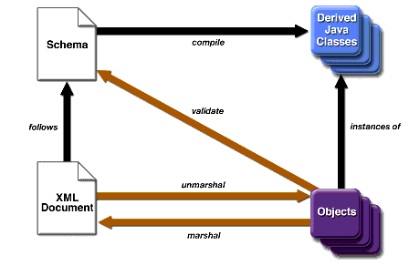
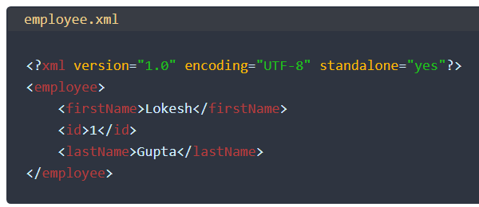
XML – OOP data binding
reminder
XML-OOP data binding
Java Architecture for XML Binding (JAXB) example https://howtodoinjava.com/jaxb/jaxb-annotations/
ex Java: https://zetcode.com/java/jaxb/

Slide 8
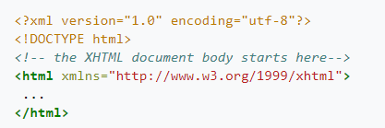


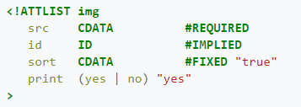
XML Schema
Document Type Definition (DTD, 2008)
link to some .dtd document
[...]
HTML 5 : no more link to a DTD
[...]
[...]

Slide 9
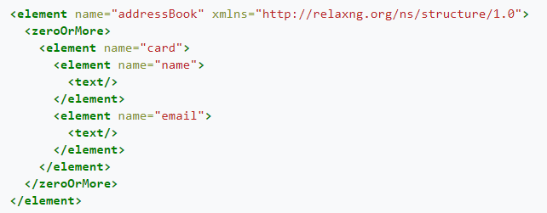
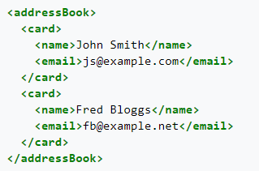
XML Schema
Regular Language for XML Next Generation (RELAX NG, 2001)
https://relaxng.org/
RELAX NG document
Valid XML document

Slide 10
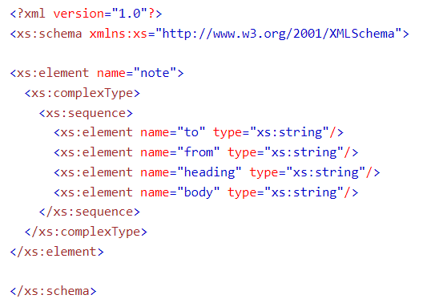
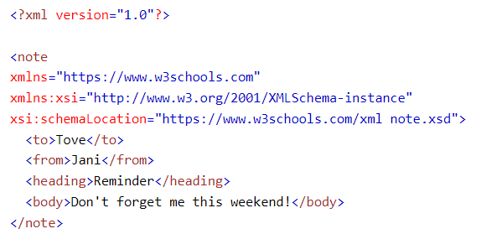
XML Schema
XML Schema (W3C, 2003)
The only one you should use (if you need to)
Valid XML document
XML Schema document
https://www.w3schools.com/xml/schema_intro.asp

Slide 11
XML Schema
Tutorials
https://www.tutorialspoint.com/xml/xml_schemas.htm
https://www.w3schools.com/xml/schema_intro.asp
...
What to do with XML Schemas
validate documents
generate forms
generate classes (any OOP language)
...
https://www.w3schools.com/xml/schema_intro.asp

Slide 12
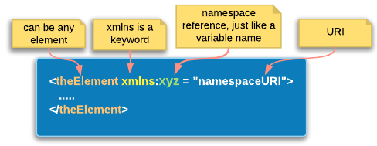
Multiple XML Schemas ?
How to combine different XML schemas in a single file?
Using XML namespaces

Slide 13
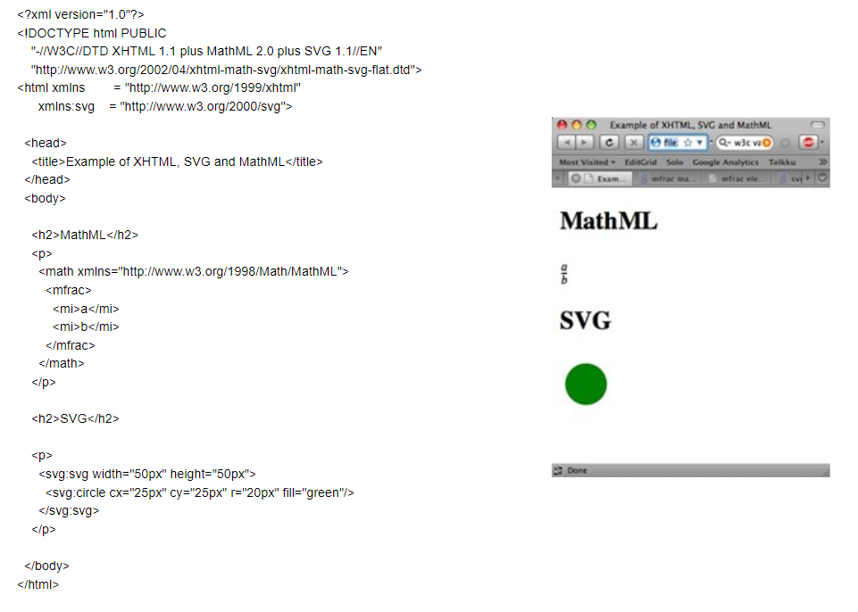
Example: A document with XHTML + MathML + SVG

Slide 14
Data Interoperability and Semantics
< Part 3. Data schemas and semantics >
Part 3.1. Data schemas
Part 3.1.2. JSON Schema

Slide 15
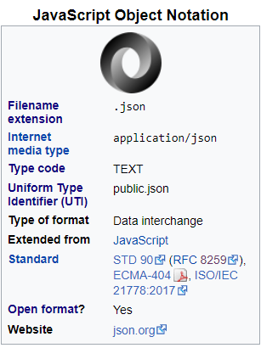
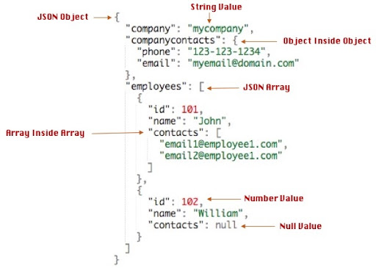
JavaScript Object Notation
reminder

Slide 16
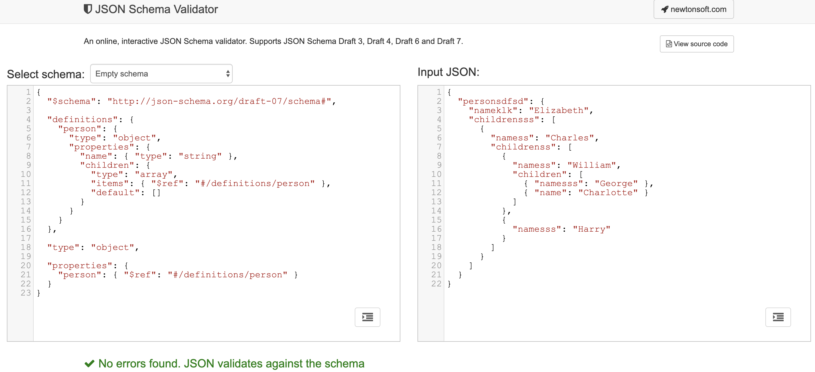
JSON Schema

Slide 17

JSON – OOP data binding
JSON Document
JSON-OOP data binding

Slide 18
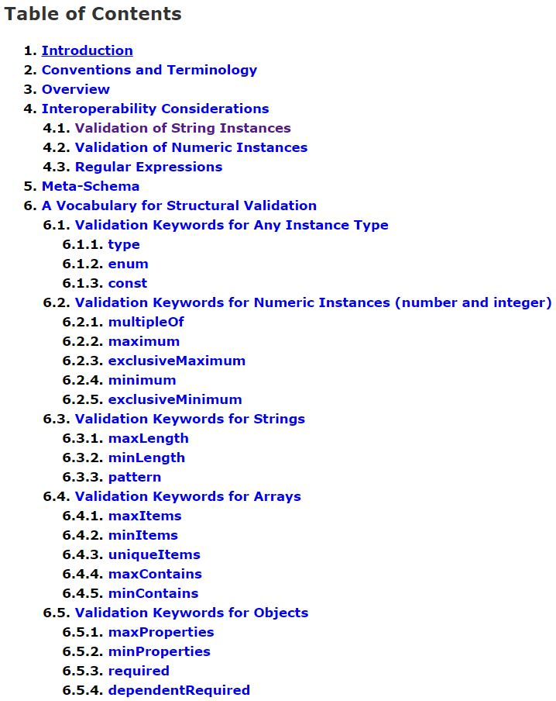
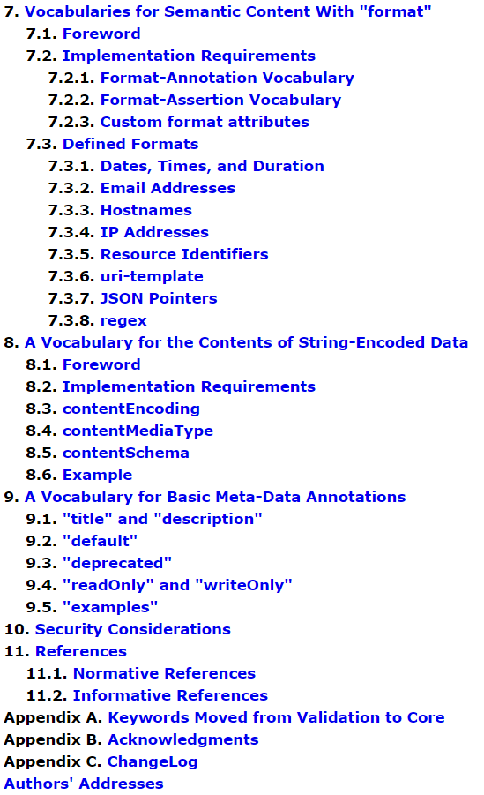
JSON Schema Specification (latest) https://json-schema.org/draft/2020-12/json-schema-validation.html

Slide 19
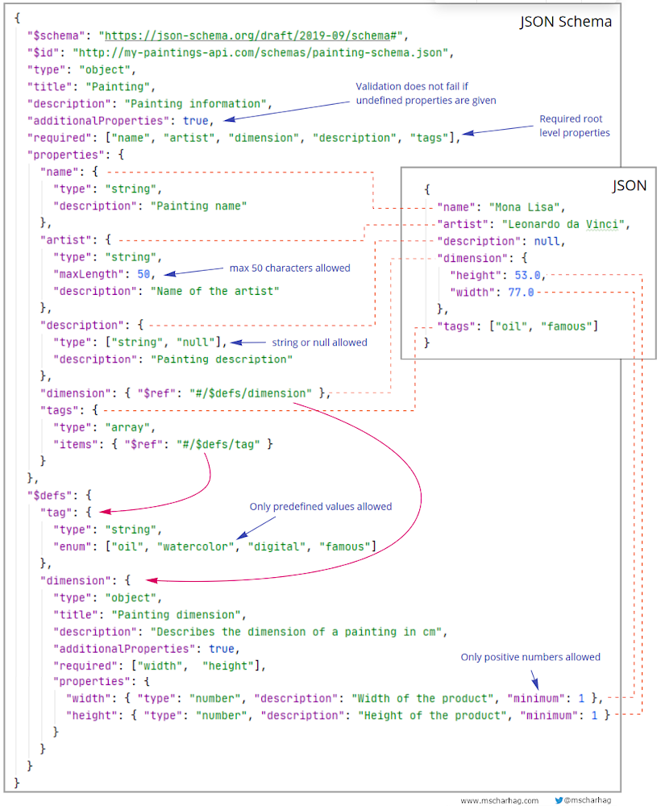
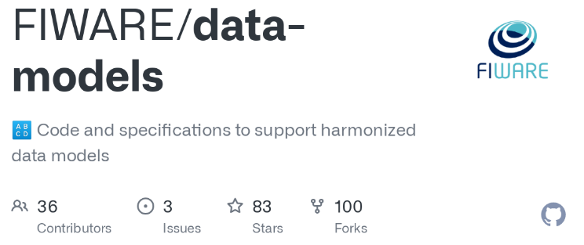
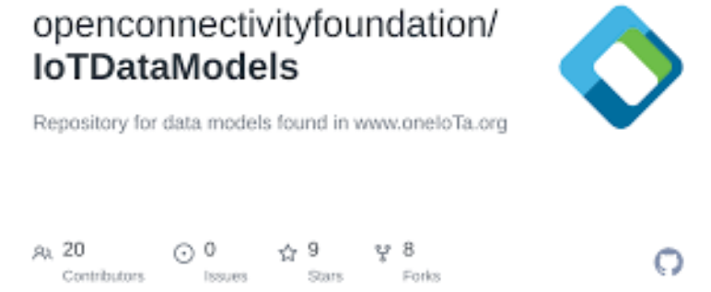
JSON Schema
Examples:
https://json-schema.org/learn/miscellaneous-examples.html
https://www.fiware.org/developers/data-models/
https://oneiota.org/

Slide 20
Data Interoperability and Semantics
< Part 3. Data schemas and semantics >
Part 3.2. Semantics

Slide 21
Data Interoperability and Semantics
< Part 3. Data schemas and semantics >
Part 3.2. Semantics
Part 3.2.1. Heterogeneities and data conflicts

Slide 22
DEMO: Compare JSON documents
https://samples.openweathermap.org/data/2.5/weather?id=2172797&appid=b6907d289e10d714a6e88b30761fae22
and
https://www.prevision-meteo.ch/services/json/lausanne
and
https://github.com/smart-data-models/dataModel.Weather/blob/master/WeatherForecast/examples/example-normalized.json

Slide 23
DEMO: Compare JSON documents
Different modeling choices were made, which make these two services completely non-interoperable:
the lat/long coordinates: string vs number
the UNIX timestamps vs dates and times
the choice of keys and the semantics (meaning) of the values
the units of temperature, pressure, wind speed, …​
the semantics of wind direction
the value for "icon": "03n" - (if we follow our nose on the website, we may figure out it refers to http://openweathermap.org/img/w/03n.png )
the country codes ISO 3166-1 ALPHA-2 and ISO 3166-1 ALPHA-3 (example of Australia and Austria)

Slide 24
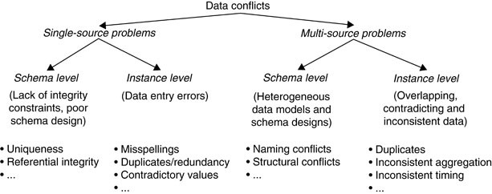
Data conflicts
Data conflicts are deviations between data intended to capture the same state of a real-world entity. Data with conflicts are often called “dirty” data and can mislead analysis performed on it.
Do HH. (2009) Data Conflicts. In: LIU L., ÖZSU M.T. (eds) Encyclopedia of Database Systems. Springer, Boston, MA. https://doi.org/10.1007/978-0-387-39940-9_97

Slide 25
Data Interoperability and Semantics
< Part 3. Data schemas and semantics >
Part 3.2. Semantics
Part 3.2.2. Controlled vocabularies, thesauri, taxonomies

Slide 26
Controlled vocabularies
… an established list of standardized terminology for use in indexing and retrieval of information
— OECD
… an organized arrangement of words and phrases used to index content and/or retrieve content through browsing or searching
— Getty institute
… an standardized – yet dynamic – set of terms and phrases authorized for use in an indexing system to describe a subject area or information domain
— SCIP
vocabulary for which the entries, i.e. definition/term pairs, are controlled by a Source Authority based on a rulebase and process for addition/deletion of entries
— ISO/IEC 15944-5:2008(en)
Information technology — Business Operational View

Slide 27
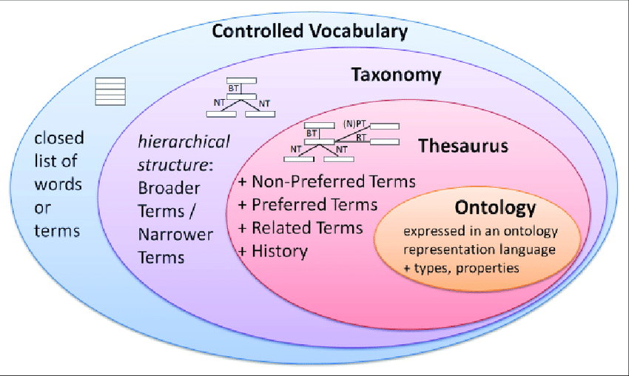
Controlled vocabulary, taxonomy, thesaurus, ontology
Kopácsi, Sándor & Hudak, Rastislav & Ganguly, Raman. (2017). Implementation of a Classification Server to Support Metadata Organization for Long Term Preservation Systems. Mitteilungen der Vereinigung Österreichischer Bibliothekarinnen und Bibliothekare. 70. 225. 10.31263/voebm.v70i2.1897.

Slide 28
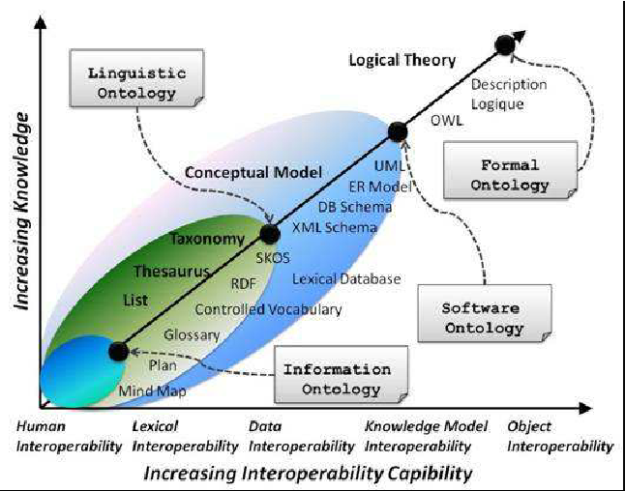
Controlled vocabulary, taxonomy, thesaurus, ontology
Roussey, Catherine & Pinet, François & Kang, Myoung-Ah & Corcho, Oscar & Falquet, Gilles & Métral, Claudine & Teller, Jacques & Tweed, Christopher. (2011). Ontologies for Interoperability. 10.1007/978-0-85729-724-2_3.

Slide 29
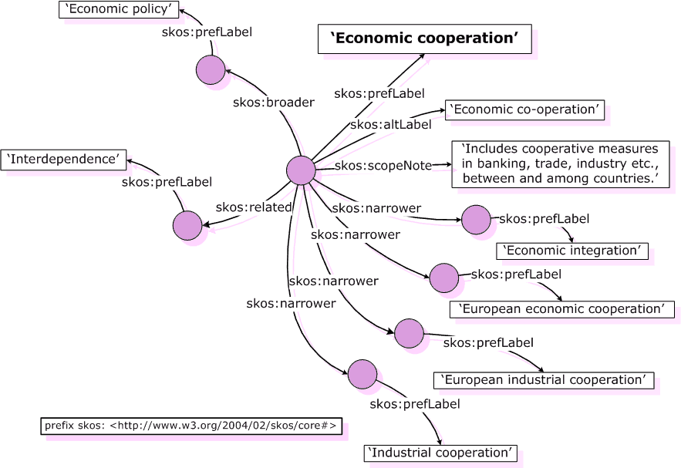
SKOS Simple Knowledge Organization System
SKOS Core Guide, W3C Working Draft 2 November 2005, http://www.w3.org/TR/swbp-skos-core-guide

Slide 30
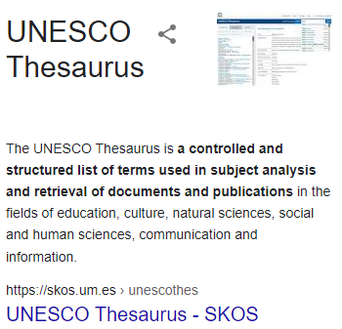


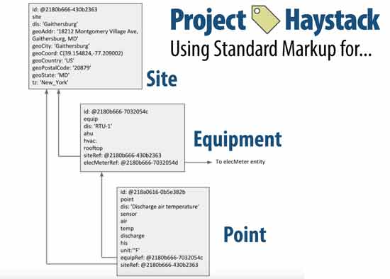
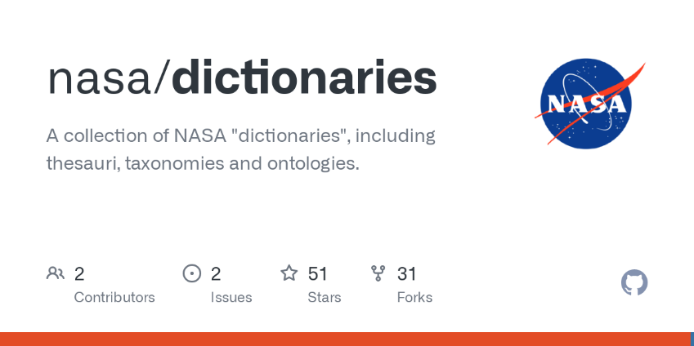
Examples of thesauri, taxonomies, …
https://www.eionet.europa.eu/gemet/en/webservices/
https://github.com/nasa/dictionaries
https://project-haystack.org/
List at https://www.w3.org/2001/sw/wiki/SKOS/Datasets

Slide 31
Data Interoperability and Semantics
< Part 3. Data schemas and semantics >
Part 3.2. Semantics
Part 3.2.3. Resource Description Framework

Slide 32
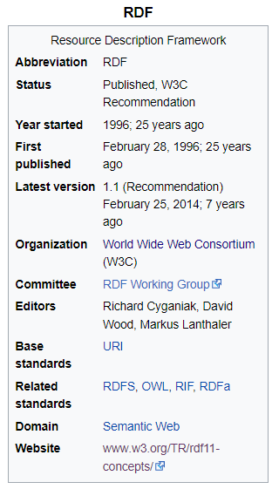
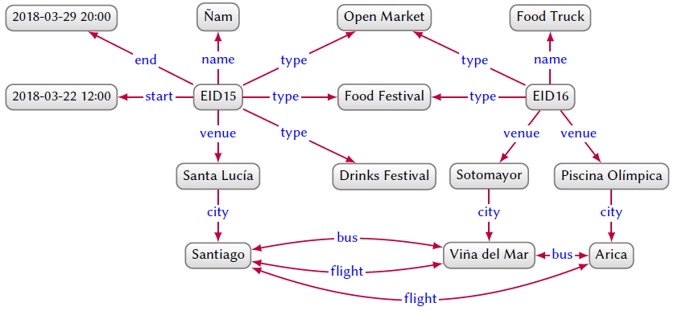

RDF - Resource Description Framework
An RDF Graph
Vertices:
Resources: Things. Uniquely identified by URIs
Literals: Unicode string + Datatype identified by URI. out-degree=0
Edges:
Relationships: connections between vertices. Uniquely identified by URIs

Slide 33
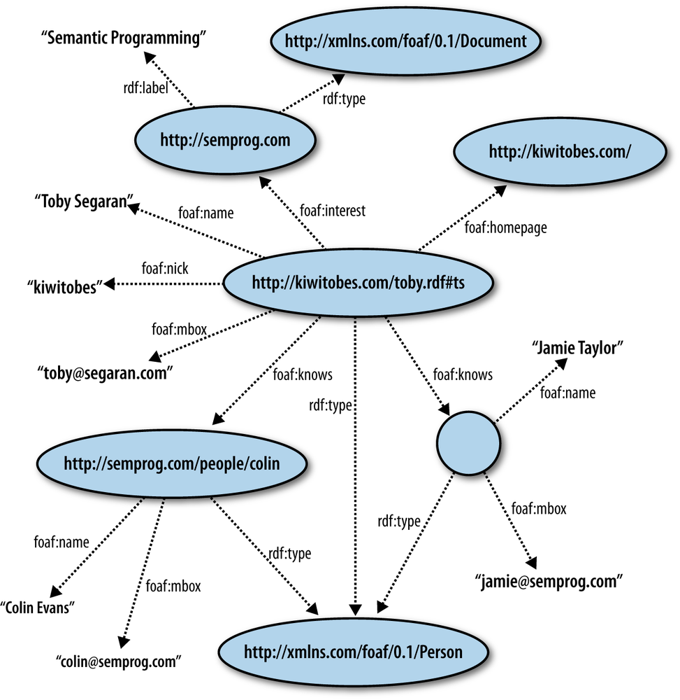
CURIE = Compact URIs
rdfs
@prefix rdf:
<http://www.w3.org/1999/02/22-rdf-syntax-ns#>.
@prefix rdfs:
<http://www.w3.org/2000/01/rdf-schema#>.
@prefix foaf:
<http://xmlns.com/foaf/0.1/>.
@prefix schema:
<http://schema.org/>.
...

Slide 34
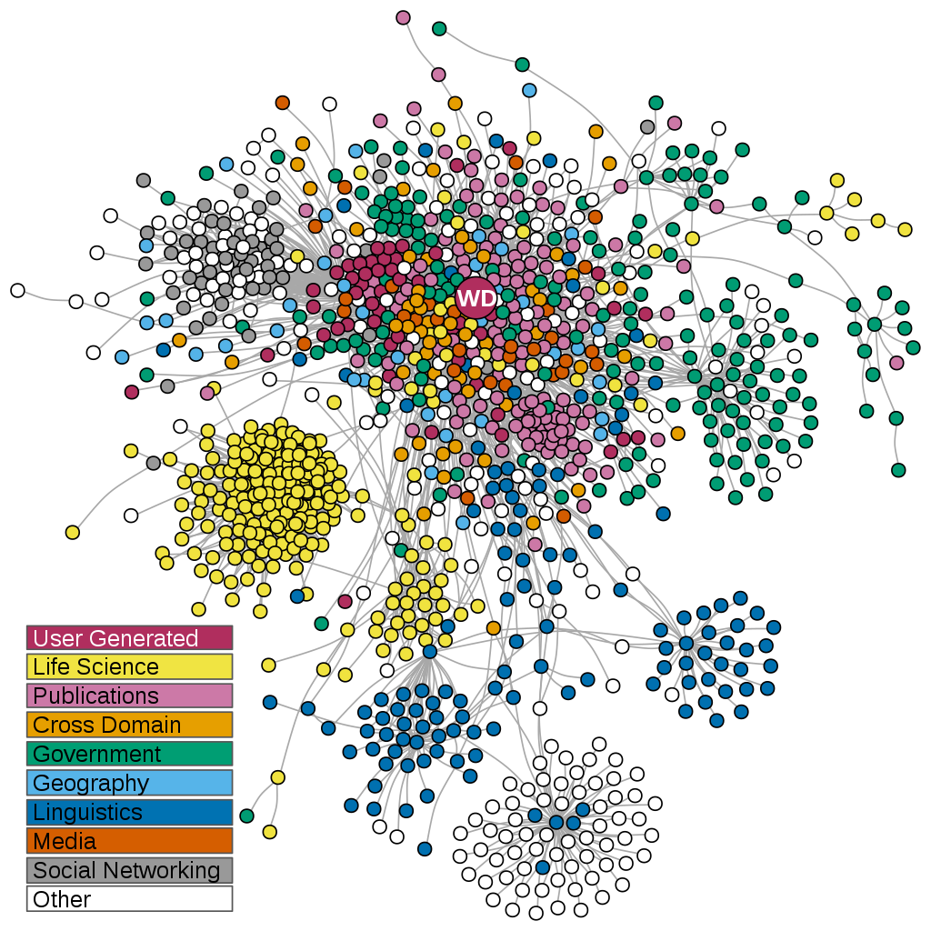
The Linked Data
It’s possible to use URIs defined in an external graph
to use a reference identification system
to augment a graph
anyone can say anything about anything
One can specify vertice co-reference with some special edges: owl:sameAs from W3C OWL vocabulary
Linked Open Data cloud visualisation: each node is a RDF dataset. Links indicate the existence of external identification links. Source: wikipedia

Slide 35
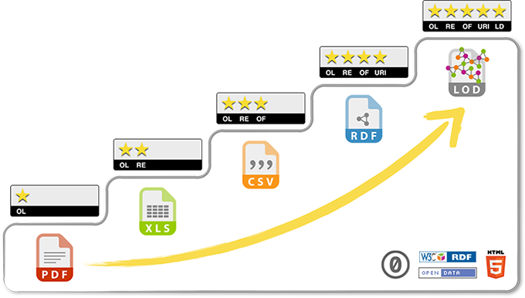
5 ★ OPEN DATA
Tim Berners-Lee, the inventor of the Web and Linked Data initiator, suggested a 5-star deployment scheme for Open Data.
https://5stardata.info/en/

Slide 36
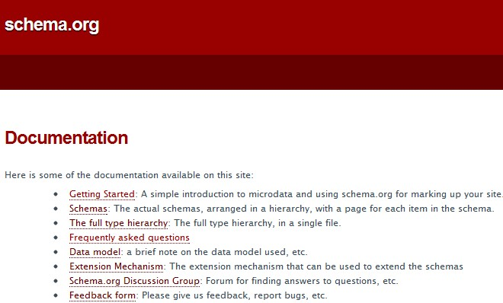
Examples of RDF vocabularies & ontologies
Over 10 million sites use Schema.org to markup their web pages and email messages. Many applications from Google, Microsoft, Pinterest, Yandex and others already use these vocabularies to power rich, extensible experiences.
Founded by Google, Microsoft, Yahoo and Yandex, 2011
Test with https://validator.schema.org/ or https://developers.google.com/search/docs/advanced/structured-data

Slide 37

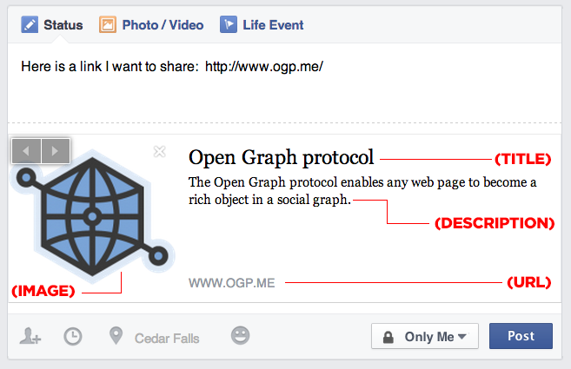
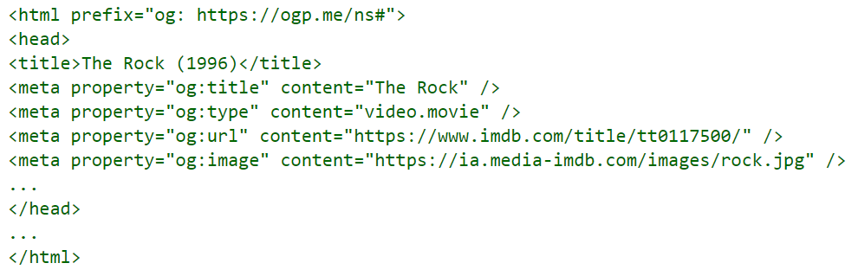
Examples of RDF vocabularies & ontologies
Open Graph Protocol https://ogp.me/ (Facebook, 2010), test with https://developers.facebook.com/tools/debug/

Slide 38
Data Interoperability and Semantics
< Part 3. Data schemas and semantics >
Part 3.2. Semantics
Part 3.2.4. RDFa: Rich structured data markup for web documents

Slide 39
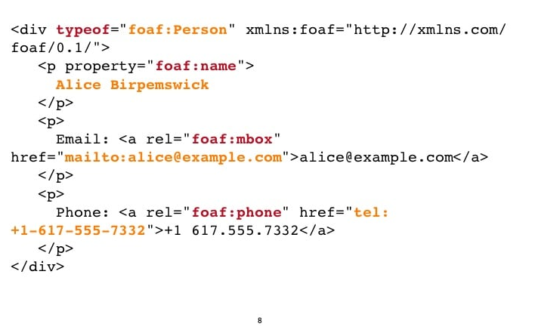
RDFa Resource Description Framework in Attributes
See RDFa 1.1 Primer - Rich Structured Data Markup for Web Documents - https://www.w3.org/TR/rdfa-primer/

Slide 40
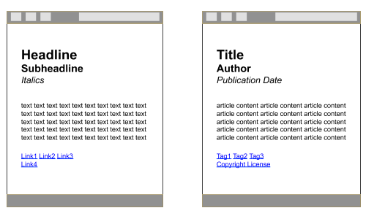
RDFa Resource Description Framework in Attributes
See RDFa 1.1 Primer - Rich Structured Data Markup for Web Documents - https://www.w3.org/TR/rdfa-primer/
The Goal
Figure 1: On the left, what browsers see. On the right, what humans see. Can we bridge the gap so that browsers see more of what we see?

Slide 41
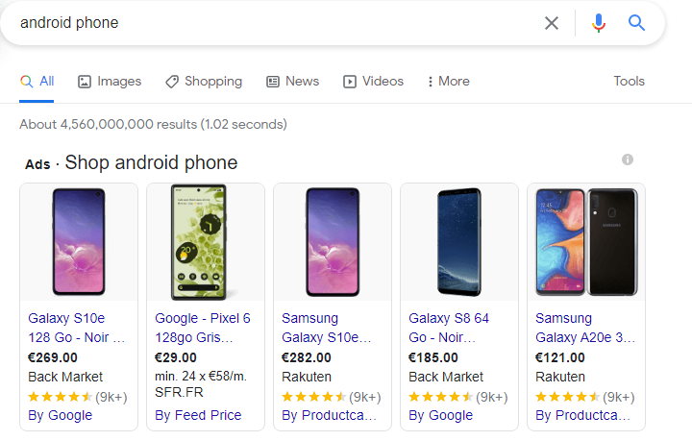
RDFa Resource Description Framework in Attributes
See RDFa 1.1 Primer - Rich Structured Data Markup for Web Documents - https://www.w3.org/TR/rdfa-primer/
The Result
Google can extract structured data from e.g., e-commerce websites, and “understand” its meaning

Slide 42
Data Interoperability and Semantics
< Part 3. Data schemas and semantics >
Part 3.2. Semantics
Part 3.2.5. JSON-LD: JSON for Linking Data

Slide 43
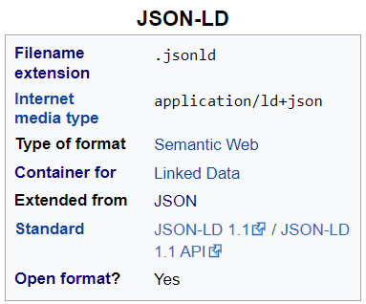
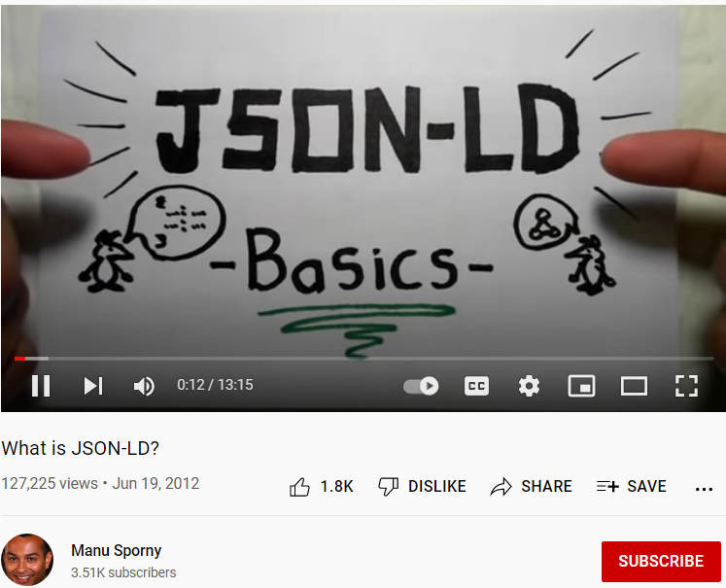
JavaScript Object Notation for Linked Data
See JSON-LD 1.1 - A JSON-based Serialization for Linked Data - https://www.w3.org/TR/json-ld11/
https://json-ld.org/learn.html

Slide 44
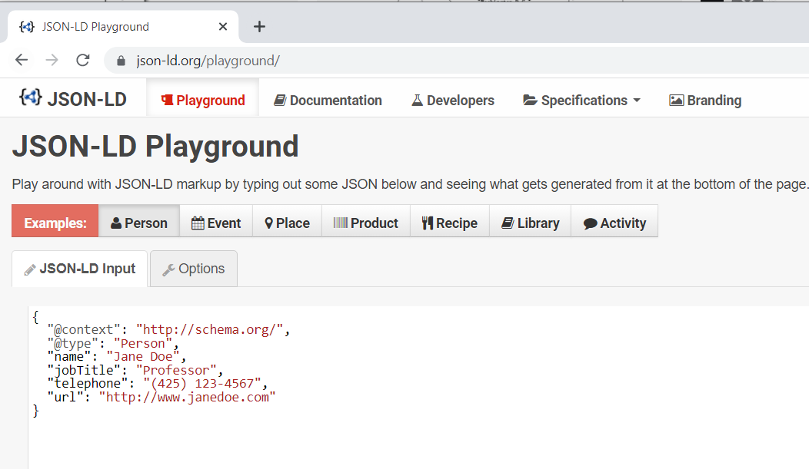
JavaScript Object Notation for Linked Data
https://json-ld.org/playground/

Slide 45
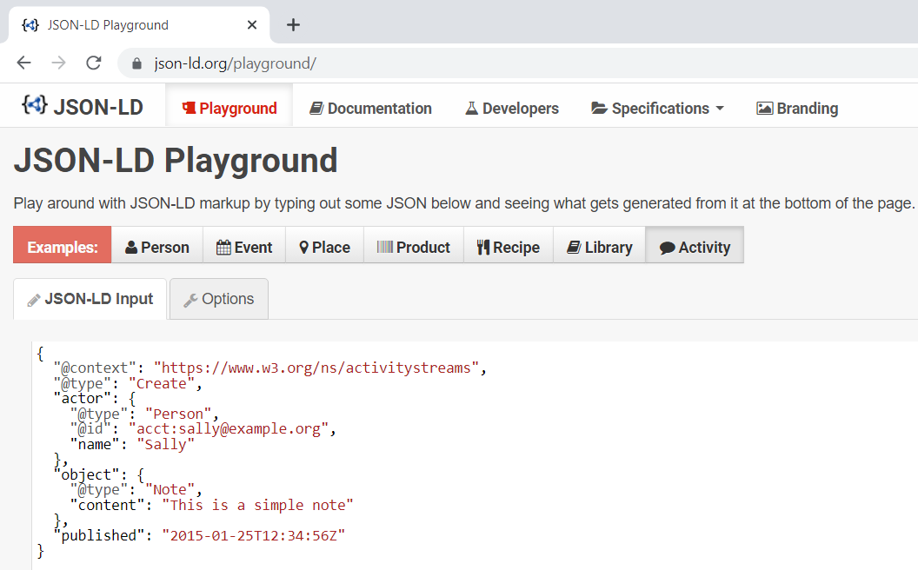
JavaScript Object Notation for Linked Data
https://json-ld.org/playground/

Slide 46
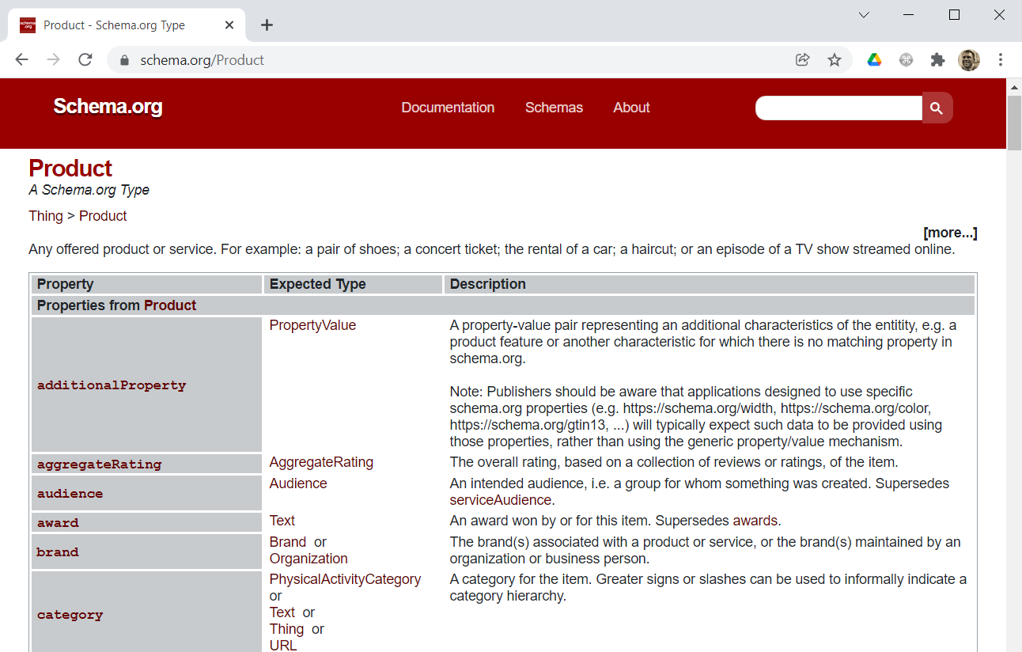
JSON-LD and schema.org

Slide 47
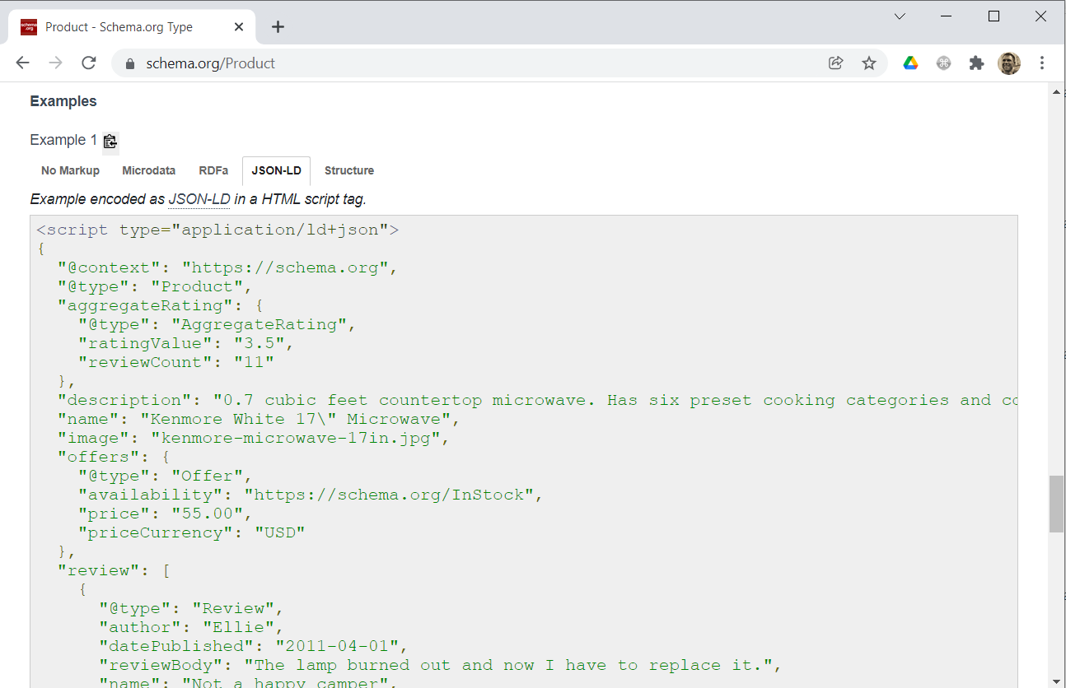

Slide 48
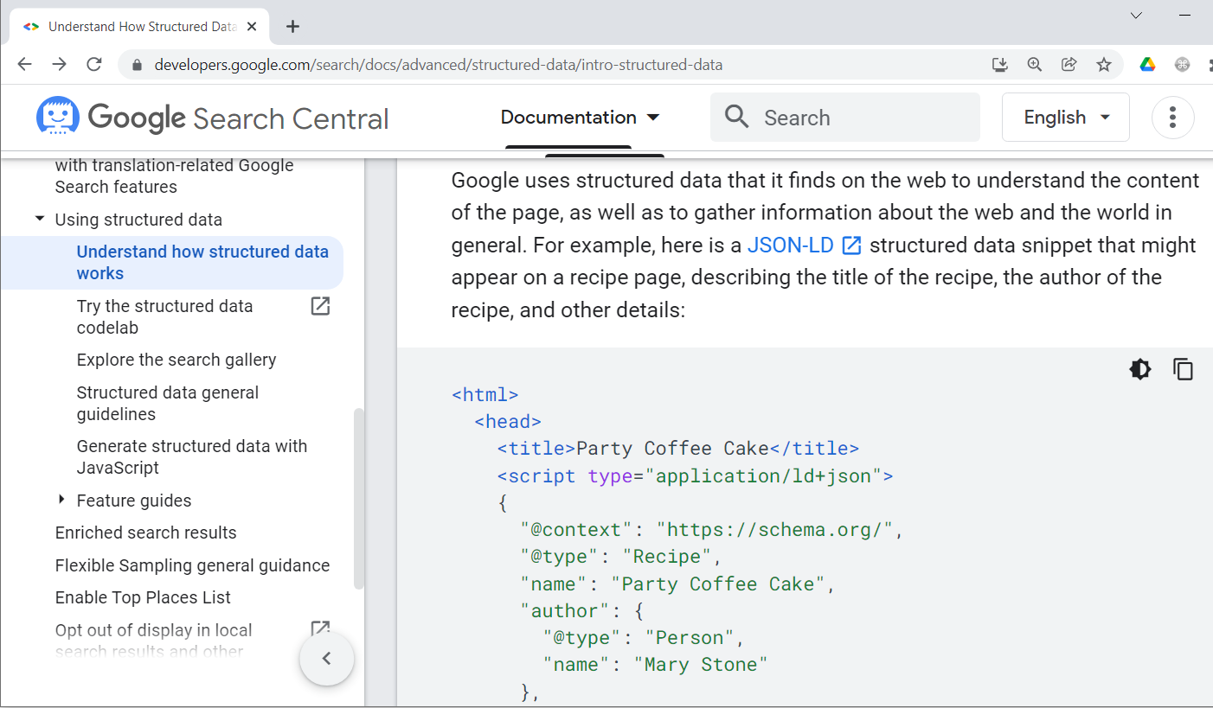
JSON-LD and Google

Slide 49
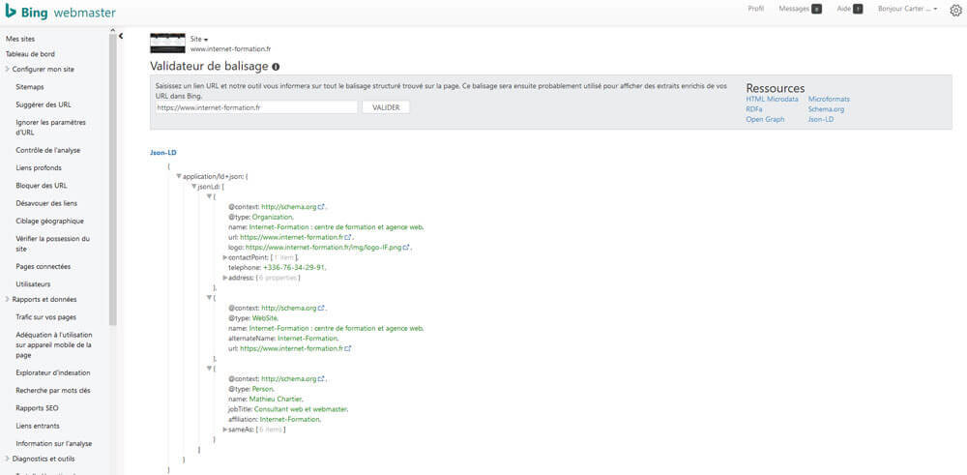
JSON-LD and Bing

Slide 50
Data Interoperability and Semantics
</ Part 3. Data schemas and semantics >

