Slide 1
Data Interoperability and Semantics
< Part 4. The value of data >

Slide 2
Data Interoperability and Semantics Outline
< Part 4. The value of data >
Part 4.1. Value as one of the V’s of Big Data
Part 4.2. Data, Information, Knowledge, Metadata, …
Part 4.3. Interoperability unlocks the value of data
Part 4.4. Open data generates economic and societal value
Part 4.5. Machine-actionability of data increases its value
ICM – Computer Science Major – Course unit on Data Interoperability and Semantics
M1 Cyber Physical and Social Systems – Course unit on Data Interoperability and Semantics
Maxime Lefrançois https://maxime-lefrancois.info
Course unit URL: https://ci.mines-stetienne.fr/cps2/course/data

Slide 3
Data Interoperability and Semantics
Part 4. The value of data
Part 4.1. Value as one of the V’s of Big Data

Slide 4
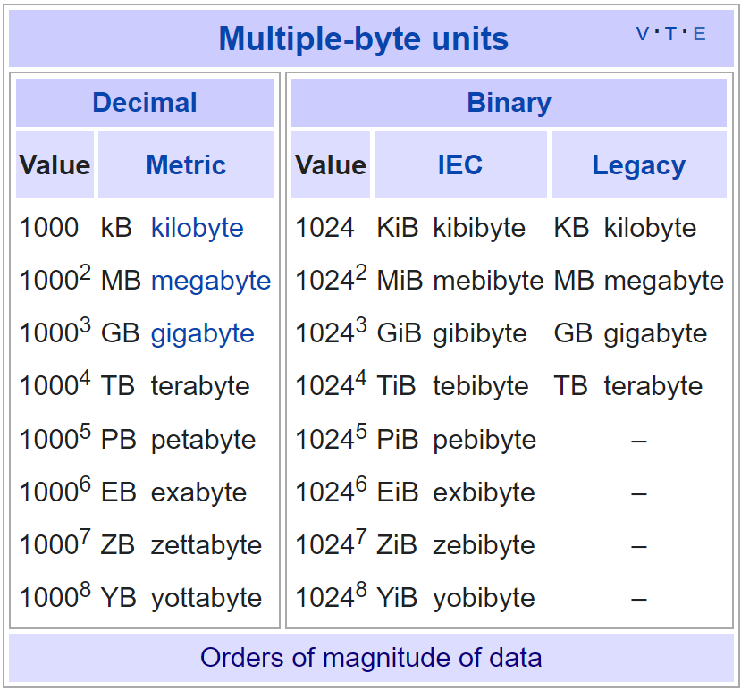
Orders of magnitude of the total amount of data created, captured, copied, and consumed globally ?

Slide 5
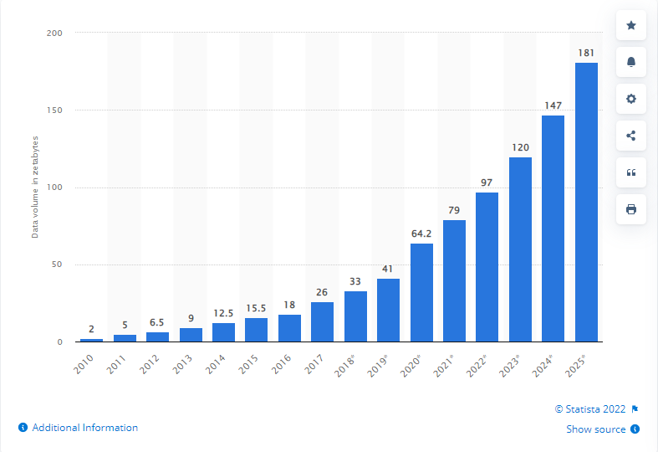
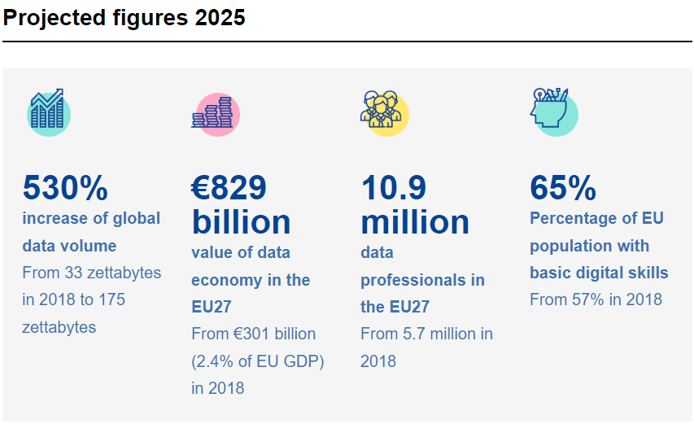
Projected figures 2025 for the total amount of data created, captured, copied, and consumed globally
https://www.statista.com/statistics/871513/worldwide-data-created/
https://ec.europa.eu/info/strategy/priorities-2019-2024/europe-fit-digital-age/european-data-strategy_en#projected-figures-2025

Slide 6
Projected figures 2025
https://ec.europa.eu/info/strategy/priorities-2019-2024/europe-fit-digital-age/european-data-strategy_en#projected-figures-2025

Slide 7
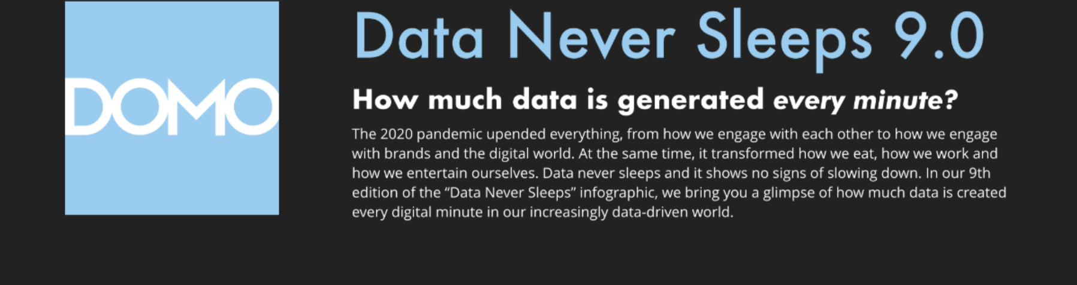
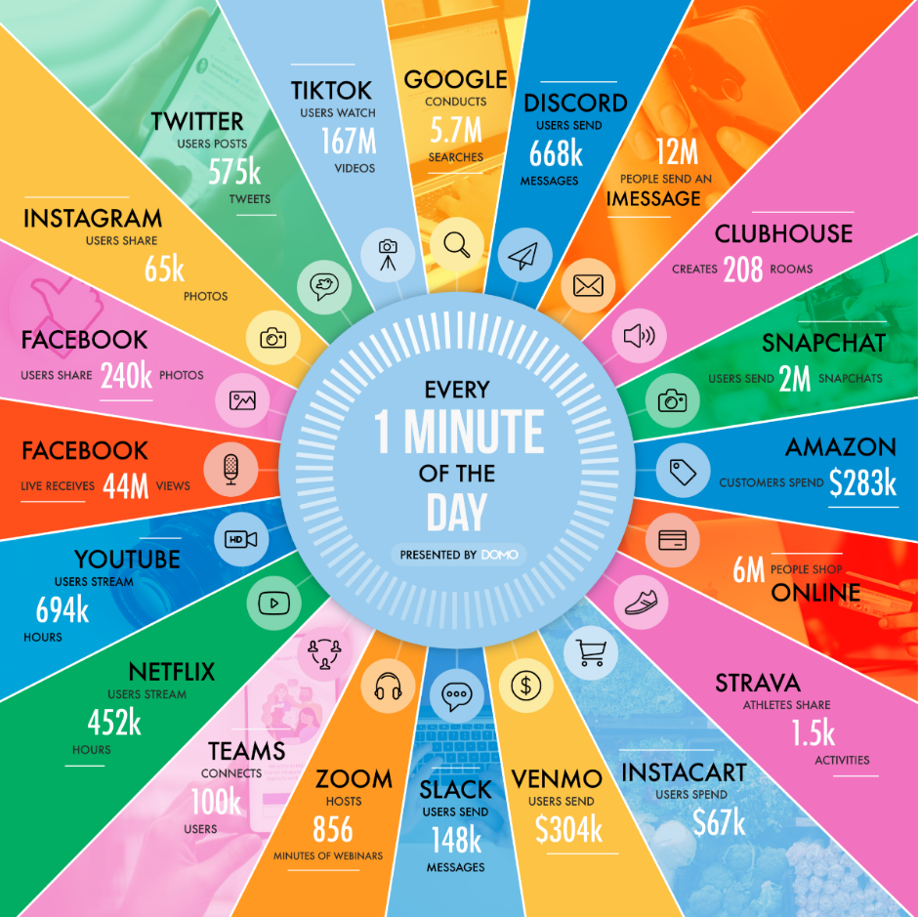
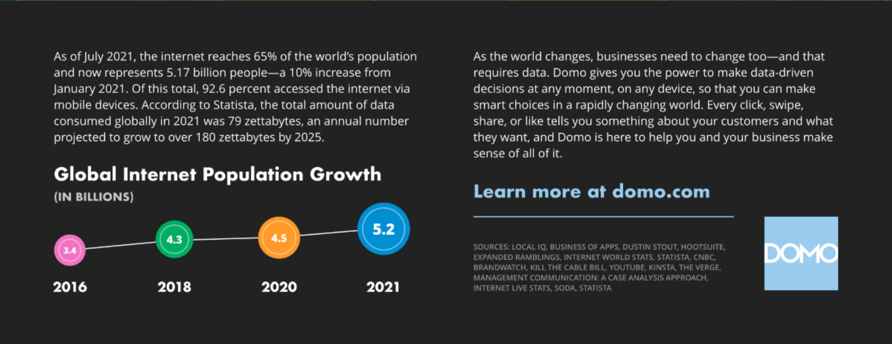
This happens every minute of every day, according to DOMO (Source: Data Never Sleeps 9.0)
https://www.domo.com/learn/infographic/data-never-sleeps-9

Slide 8
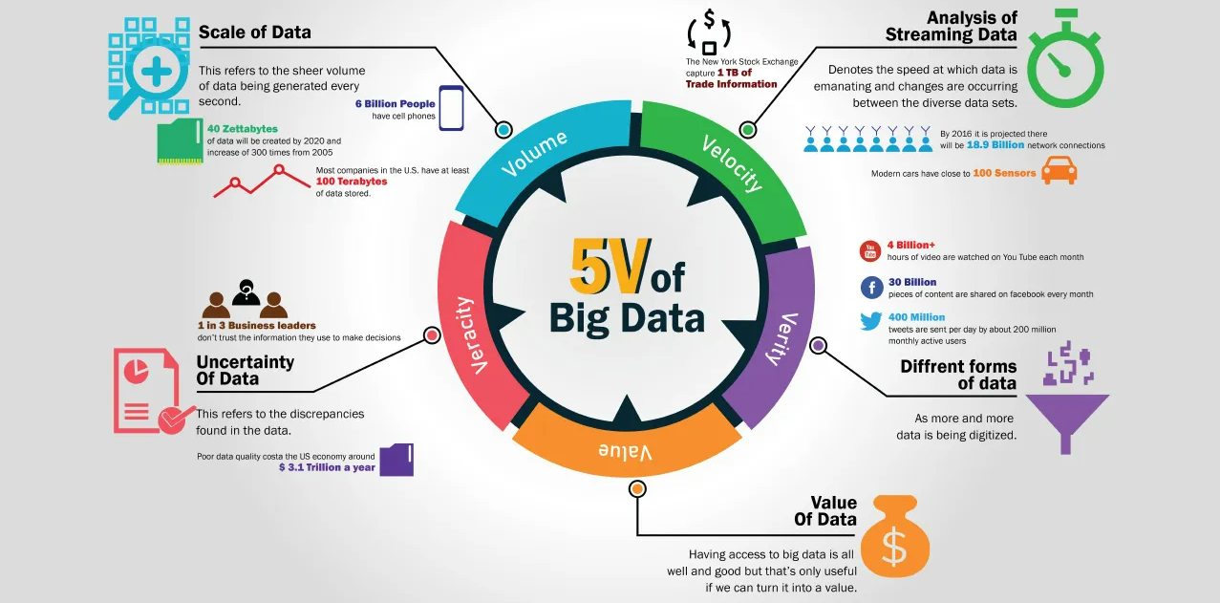
The 5 V’s of Big Data ?
https://medium.com/analytics-vidhya/5vs-of-big-data-to-a-non-it-person-c498f8b56c86

Slide 9
Data Interoperability and Semantics
Part 4. The value of data
Part 4.2. Data, Information, Knowledge, Metadata, …

Slide 10
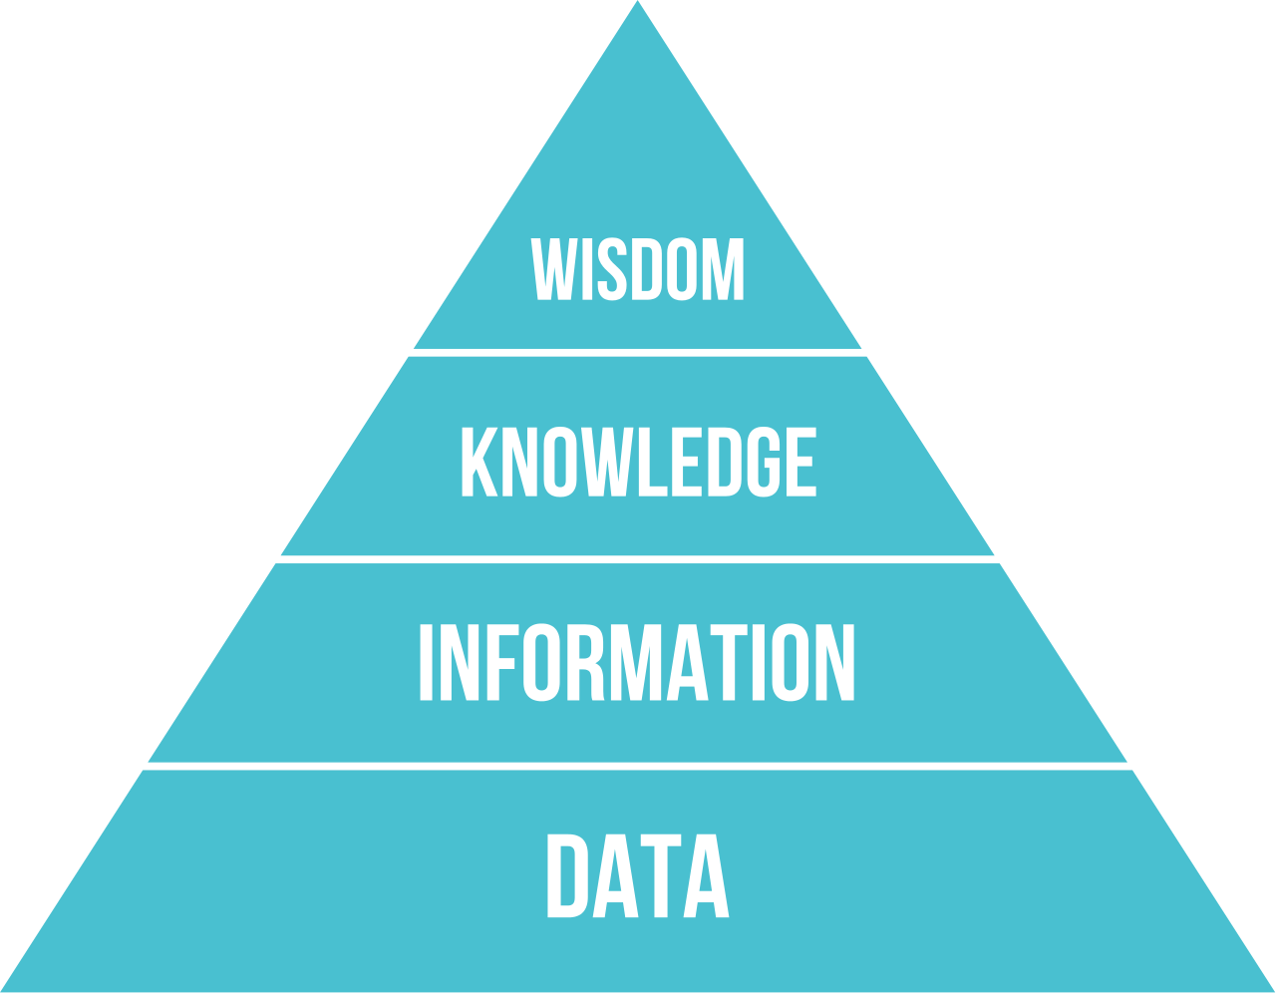
The DIKW pyramid (~1982)
useless.
symbols or signs, representing stimuli or signals, that are "of no use until...in a usable (that is, relevant) form
https://en.wikipedia.org/wiki/DIKW_pyramid , and chosen definitions

Slide 11
The DIKW pyramid (~1982)
useful. knowledge by description ("information is contained in descriptions")
useless.
symbols or signs, representing stimuli or signals, that are "of no use until...in a usable (that is, relevant) form
https://en.wikipedia.org/wiki/DIKW_pyramid , and chosen definitions

Slide 12
The DIKW pyramid (~1982)
information having been processed, organized or structured in some way, or else as being applied or put into action
useful. knowledge by description ("information is contained in descriptions")
useless.
symbols or signs, representing stimuli or signals, that are "of no use until...in a usable (that is, relevant) form
https://en.wikipedia.org/wiki/DIKW_pyramid , and chosen definitions

Slide 13
The DIKW pyramid (~1982)
integrated knowledge—information made super-useful
information having been processed, organized or structured in some way, or else as being applied or put into action
useful. knowledge by description ("information is contained in descriptions")
useless.
symbols or signs, representing stimuli or signals, that are "of no use until...in a usable (that is, relevant) form
https://en.wikipedia.org/wiki/DIKW_pyramid , and chosen definitions

Slide 14
The DIKW pyramid (~1982)
Still...
we often use
« Data »
to generalize

Slide 15
Definitions on Data
— ISO/IEC20546:2019 (Big data – Overview and vocabulary)
Dataset
Identifiable collection of data available for access or download in one or more formats
Data
Re-interpretable representation of information in a formalized manner suitable for communication, interpretation, or processing
Note 1 to entry: Data can be processed by humans or by automatic means.
Metadata
Data about data or data elements, possibly including their data descriptions and data about data ownership, access paths, access rights and data volatility
Information
Data that are processed, organised and correlated to produce meaning.
Note 1 to entry: Information concerns facts, concepts, objects, events, ideas, processes, etc.
Notes:
Information includes data and metadata.

Slide 16
Metadata
"data that provides information about other data"
Descriptive metadata – the descriptive information about a resource.
For discovery and identification.
Ex: title, abstract, author, keywords.
Structural metadata – containers of data, how compound objects are put together
Ex, how pages are ordered to form chapters.
Ex: types, versions, relationships, and other characteristics of digital materials.
Administrative metadata – the information to help manage a resource
Ex: resource type, permissions, time, when and how it was created.
Reference metadata – contents and quality
For quality assessment of the data
Ex: conceptual metadata, quality metadata, methodological metadata.
Statistical metadata, also called process data,
May describe processes that collect, process, or produce statistical data.
Number of rows, columns, etc.
Legal metadata –
Ex: license, creator, copyright holder
https://en.wikipedia.org/wiki/Metadata

Slide 17
Data Interoperability and Semantics
Part 4. The value of data
Part 4.3. Interoperability unlocks the value of data

Slide 18
Data Analytics vs Data Processing
— ISO/IEC20546:2019 (Big data – Overview and vocabulary)
Data Analytics
Composite concept consisting of data acquisition, data collection, data validation, data processing, including data quantification, data visualisation and data interpretation
Data Processing
Systematic performance of operations upon data
Note 1 to entry: Example: Arithmetic or logic operations upon data, merging or sorting of data, or operations on text, such as editing, sorting, merging, storing, retrieving, displaying, or printing.
Notes:
Processing operations involve
o accepting various input information,
o applying calculations and transformations and
o producing one or more output information.
Processing operations involve metadata, which are parts of input information andwhich are created as part of output information and related to the processing ofinput information. Examples of metadata are purpose, provenance, or ownership.
Other operations such as storing, retrieval, display, or printing are distinctoperations that are no processing operations. They can also involve specificmetadata. Examples of metadata are access rights, visibility, retention, replicabilityor cache-ability policies.

Slide 19
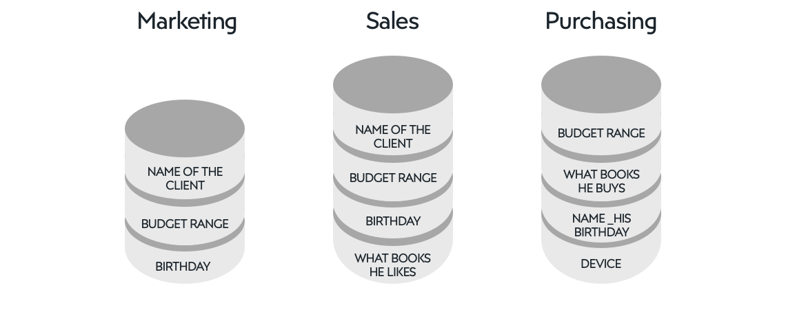
Data silos problem illustrated
Repositories of fixed data that are isolated, incompatible, or not integrated
Example of silos https://factory.dev/pimcore-knowledge-base/whitepaper/data-silos

Slide 20
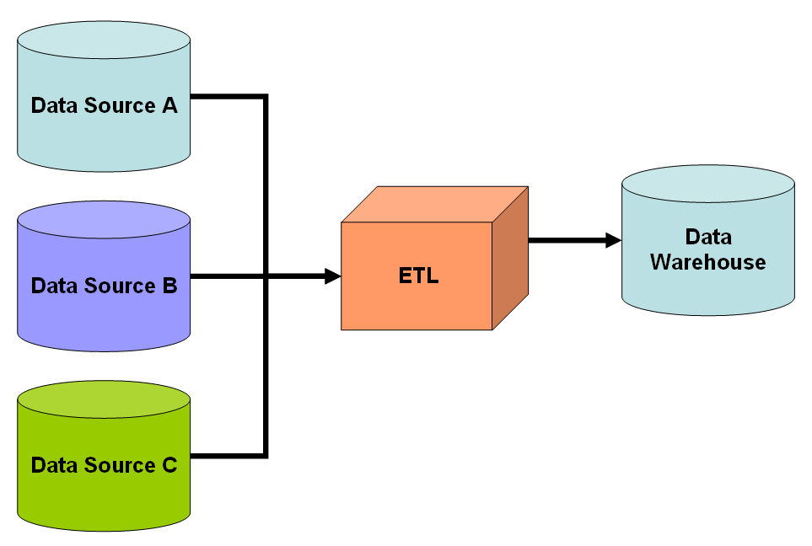
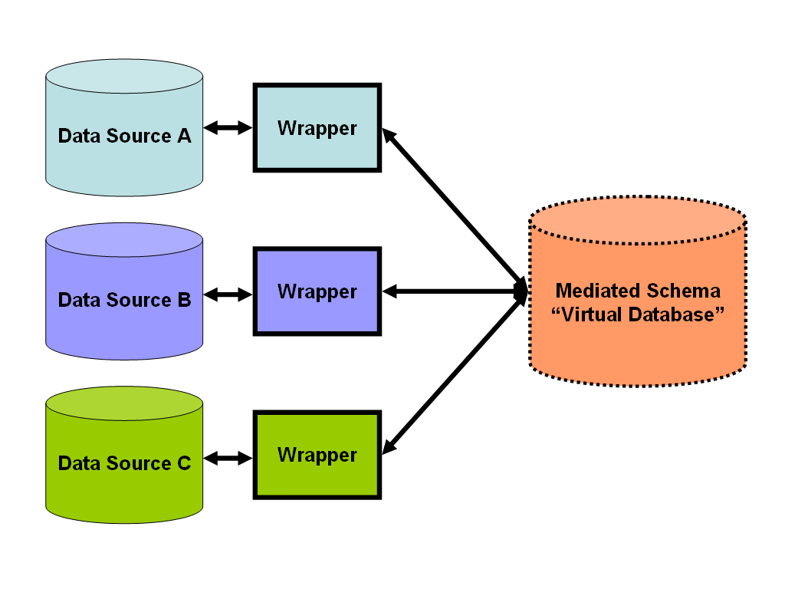
Data integration
combining heterogeneous data and providing users with a unified view of them.
Simple schematic for a data warehouse.
The Extract, transform, load (ETL) process extracts information from the source databases, transforms it and then loads it into the data warehouse.
Sub-areas:
Data warehousing
Data migration
Enterprise application/information integration
Master data management
Simple schematic for a data-integration solution.
A system designer constructs a mediated schema against which users can run queries. The virtual database interfaces with the source databases via wrapper code if required.
https://en.wikipedia.org/wiki/Data_integration

Slide 21
Interoperability vs Portability
— IEEE Standard Computer Dictionary
— ISO/IEC19941:2017 (Cloud computing – interoperability and portability)
Interoperability
Ability of two or more systems or components to exchange information and to mutually use the information that has been exchanged
Portability
Ability to easily transfer data from one system to another without being required to re-enter data

Slide 22
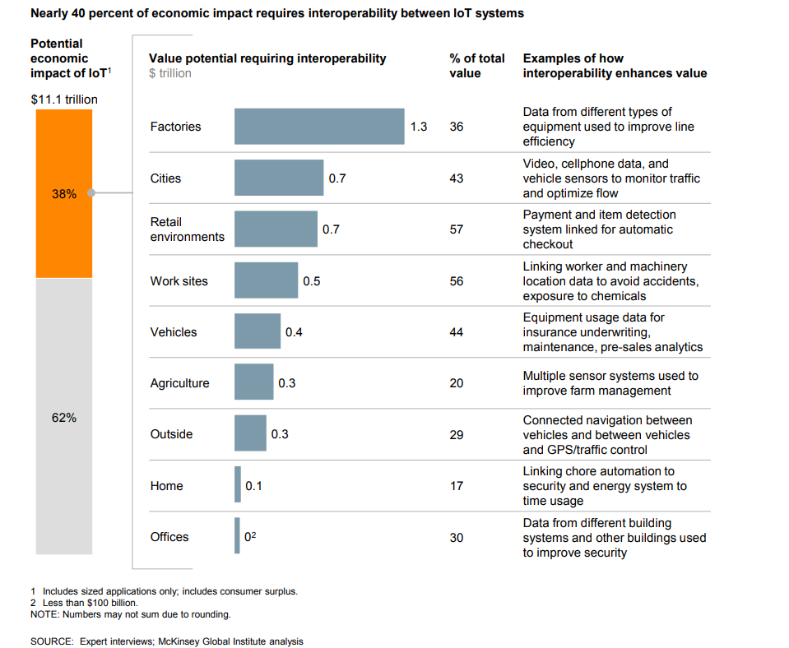
Interoperability as an enabler for the potential value of data ex: Internet of Things
https://www.mckinsey.com/business-functions/mckinsey-digital/our-insights/the-internet-of-things-the-value-of-digitizing-the-physical-world

Slide 23
Interoperability at different levels: from the hardware to policies
Policies: Laws, regulations, norms, ...
Behaviour: Processus, services, operations, ...
Semantic: Knowledge domain vocabularies, taxonomies, ontologies, ...
Syntactic: Encoding, Formats, Schemas, ...
Transport: see also Open Systems Interconnections (OSI) network layers
OS: Kernel, File systems,...
Hardware: Instruction Set Architectures, ...

Slide 24
ISO/IEC definitions of interoperability
Transport interoperability
interoperability where information exchange uses an established communication infrastructure between the participating systems
— ISO/IEC 22123-1:2021, Cloud computing — Part 4: Vocabulary
Syntactic interoperability
interoperability such that the formats of the exchanged information can be understood by the participating systems
— ISO/IEC 22123-1:2021, Cloud computing — Part 4: Vocabulary
Semantic data interoperability
interoperability so that the meaning of the data model within the context of a subject area is understood by the participating systems
— ISO/IEC 22123-1:2021, Cloud computing — Part 4: Vocabulary
Behavioural interoperability
interoperability so that the actual result of the exchange achieves the expected outcome
— ISO/IEC 22123-1:2021, Cloud computing — Part 4: Vocabulary
Policy interoperability
interoperability while complying with the legal, organizational, and policy frameworks applicable to the participating systems
— ISO/IEC 22123-1:2021, Cloud computing — Part 4: Vocabulary

Slide 25
Data Interoperability – a definition
Data interoperability addresses the ability of systems and services that create, exchange and consume data to have clear, shared expectations for the contents, context and meaning of that data.
— https://datainteroperability.org/
Syntactic interoperability
interoperability such that the formats of the exchanged information can be understood by the participating systems
— ISO/IEC 22123-1:2021, Cloud computing — Part 4: Vocabulary
Semantic data interoperability
interoperability so that the meaning of the data model within the context of a subject area is understood by the participating systems
— ISO/IEC 22123-1:2021, Cloud computing — Part 4: Vocabulary

Slide 26
Norm-based interoperability
Hardware and/or software standards
Standard = Detailed set of technical requirements intended to establish a certain uniformity (in a field of hardware or software development)
Standard ---- Norm: no clear boundary
docx: Microsoft
HTML, XML: World Wide Web consortium (W3C)
SIM cards: European Telecommunication Standard Institute (ETSI)
Postscript became standardized after release
De facto standards (not produced by a standard development organization). example: csv, json, rar, pdf, java, flash

Slide 27
Data Interoperability and Semantics
Part 4. The value of data
Part 4.4. Sharing data generates economic and societal value

Slide 28

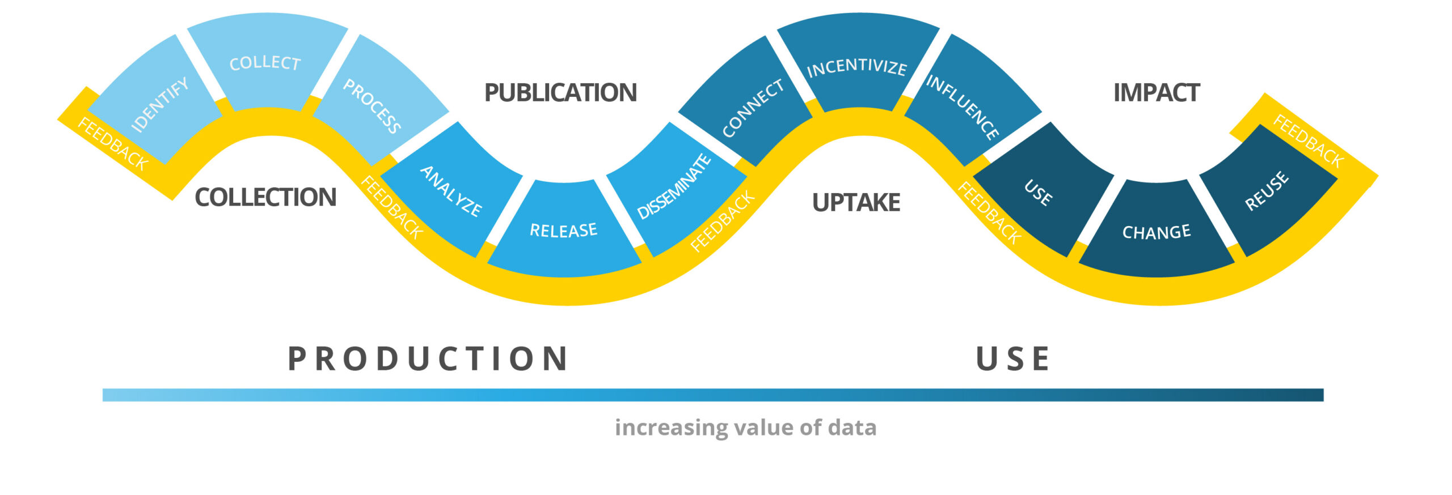
The Data Value chain
Open Data Watch. "The data value chain: Moving from production to impact." Data2X.
https://opendatawatch.com/publications/the-data-value-chain-moving-from-production-to-impact (2018).

Slide 29
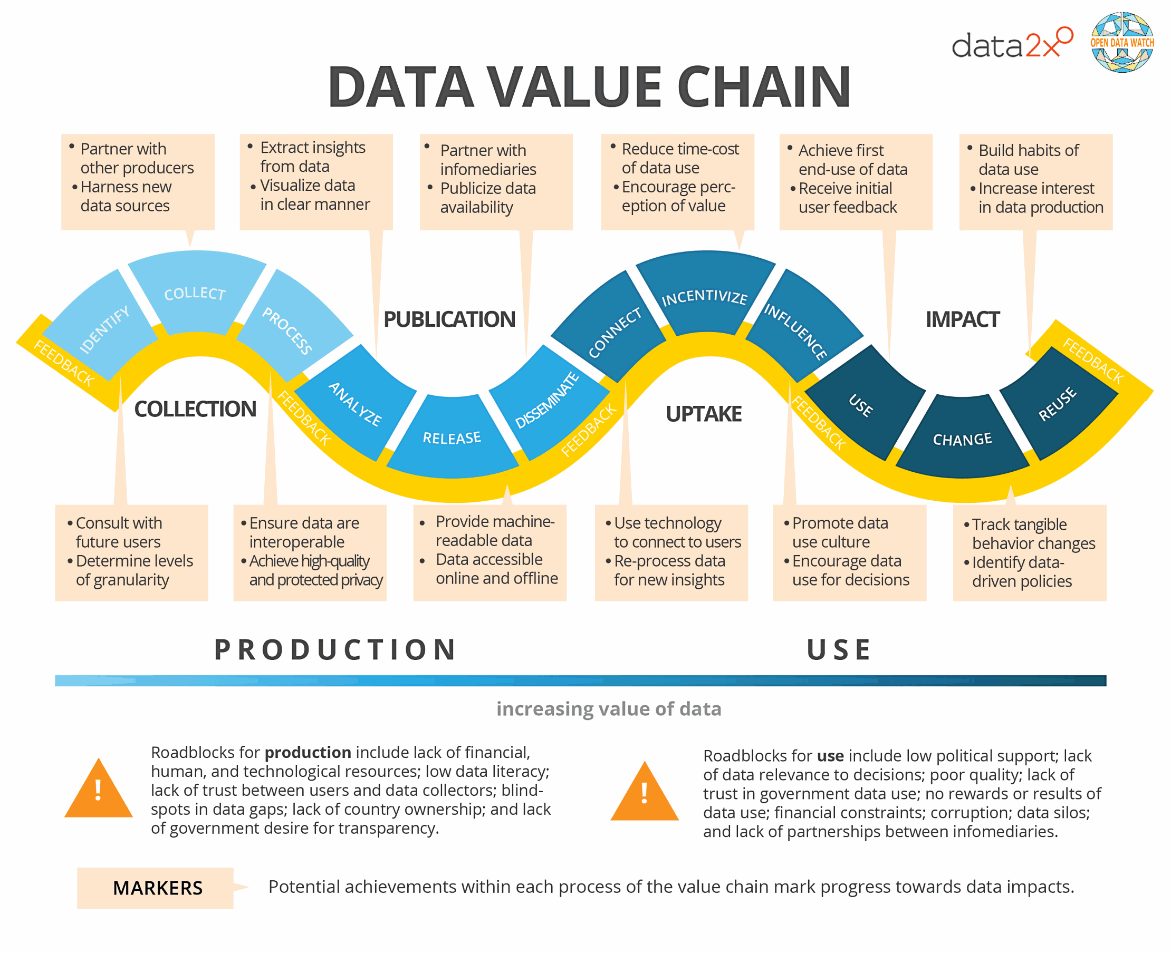
The Data Value chain
Open Data Watch. "The data value chain: Moving from production to impact." Data2X.
https://opendatawatch.com/publications/the-data-value-chain-moving-from-production-to-impact (2018).

Slide 30
The Data Value roadblocks
Open Data Watch. "The data value chain: Moving from production to impact." Data2X.
https://opendatawatch.com/publications/the-data-value-chain-moving-from-production-to-impact (2018).

Slide 31
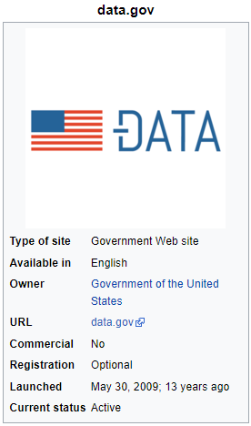
Open Data in the US
Data.gov 2009
Legal framework:
The U.S. Open Government Directive of December 8, 2009, required that all agencies post at least three high-value data sets online and register them on Data.gov within 45 days
OPEN Government Data Act, as part of the Foundations for Evidence Based Policymaking Act (2019)

Slide 32
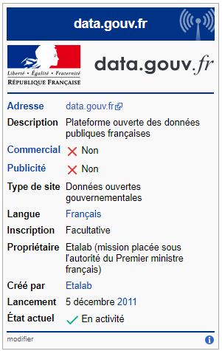
Open Data in France
France at the forefront of Open Data in Europe:
Légifrance 1999
Legal framework:
"The society has the right of requesting account from any public agent of its administration.” (Declaration of rights of man and of the citizen of 1789)
Law on the liberty of access to administrative documents (1978)
Euopean directove 2003 + French Law 2005 + Decree 2011
Bill on a Digital Republic (2016)
The law on Energy Transition (2015)
2014: Chief Data Officer in the French public administration

Slide 33
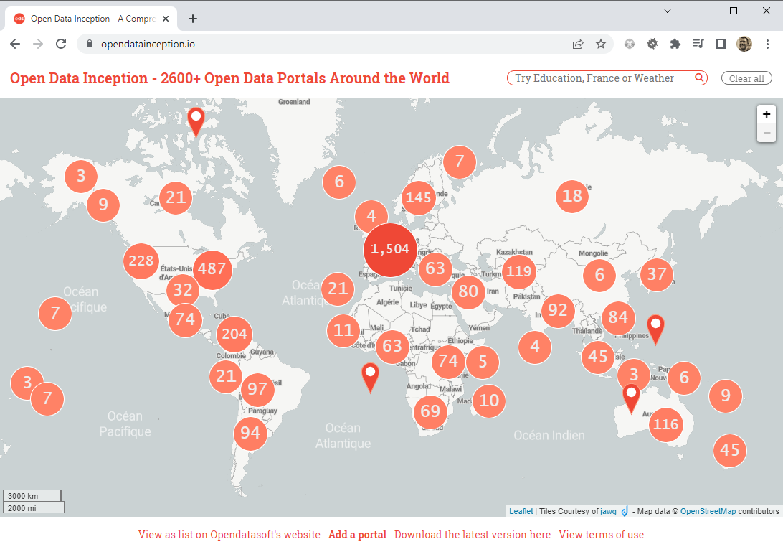
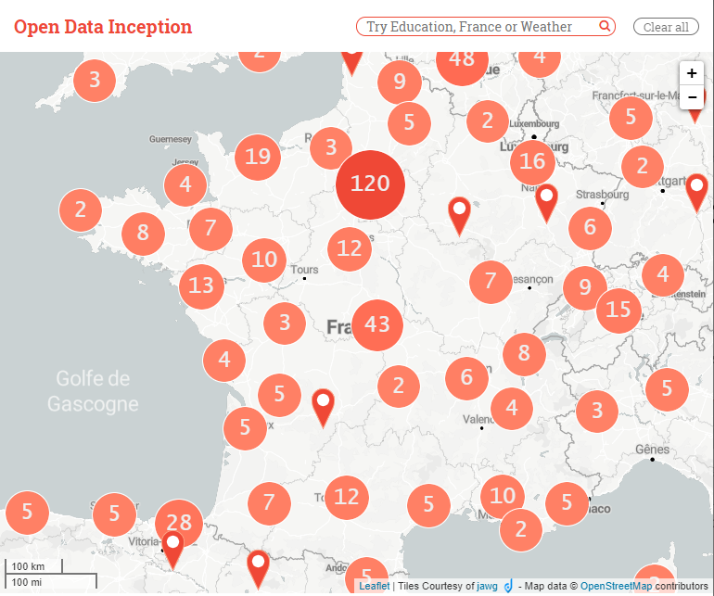
https://opendatainception.io/

Slide 34
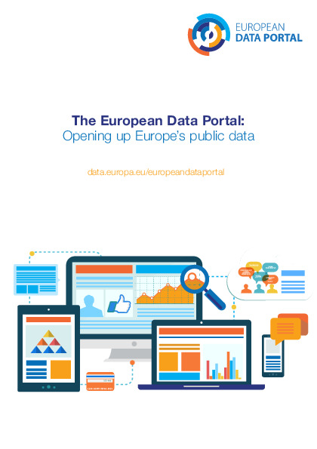

Open Data in Europe

Slide 35
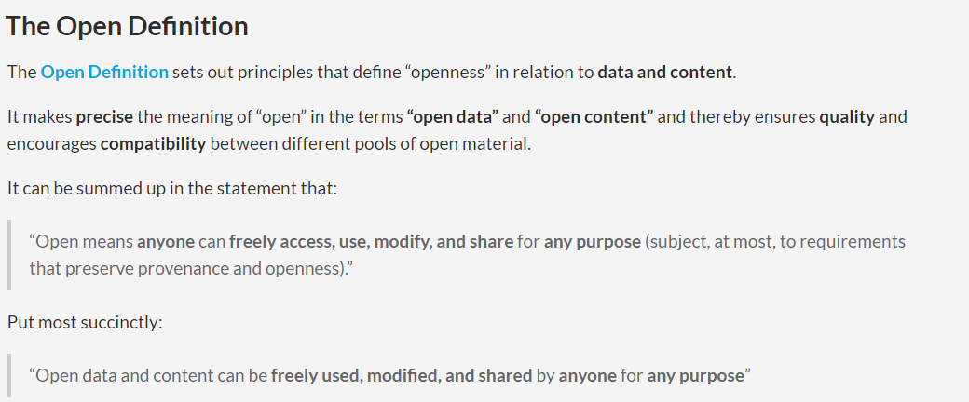
Open Data, Open Content, and Open Knowledge
http://opendefinition.org/

Slide 36
Open Work
Open License or Status
The work must be in the public domain or provided under an open license
Access
The work must be provided as a whole and at no more than a reasonable one-time reproduction cost, and should be downloadable via the Internet without charge.
Machine Readability
The work must be provided in a form readily processable by a computer and where the individual elements of the work can be easily accessed and modified.
Open Format
The work must be provided in an open format.
http://opendefinition.org/

Slide 37
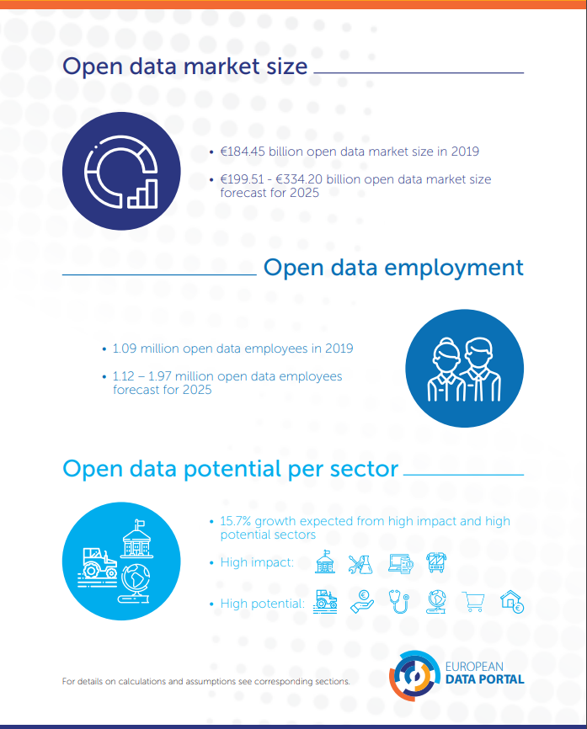
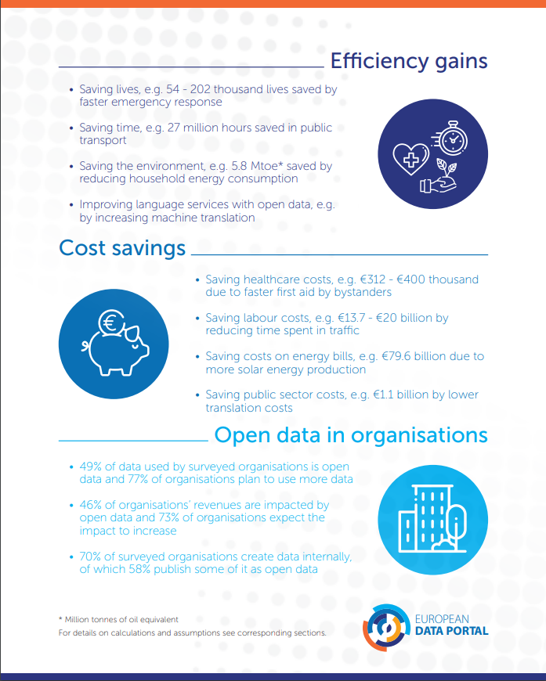
Economic impact of Open Data
https://data.europa.eu/sites/default/files/the-economic-impact-of-open-data.pdf
https://data.europa.eu/sites/default/files/the-economic-impact-of-open-data.pdf (2020)

Slide 38
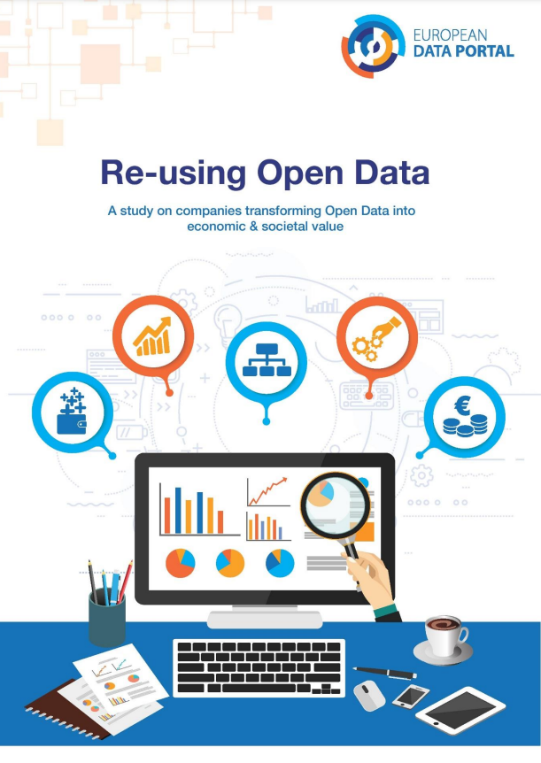
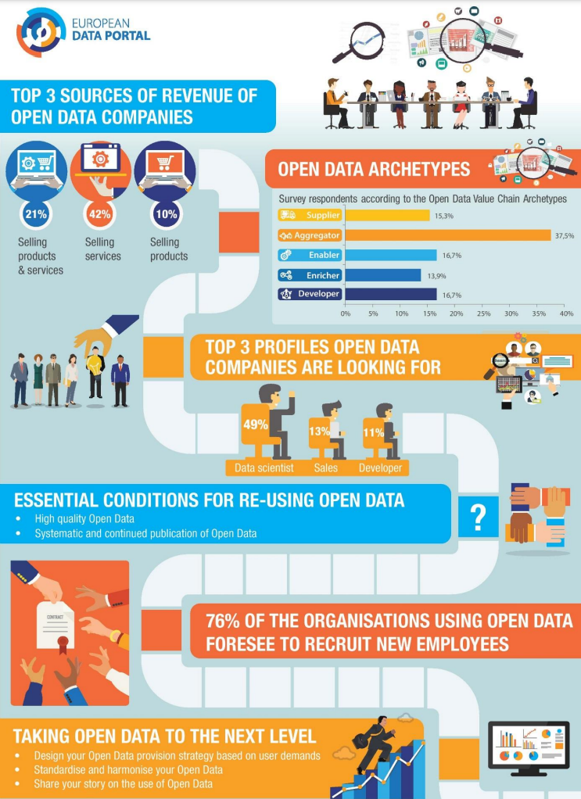
https://data.europa.eu/sites/default/files/re-using_open_data.pdf (2020)

Slide 39
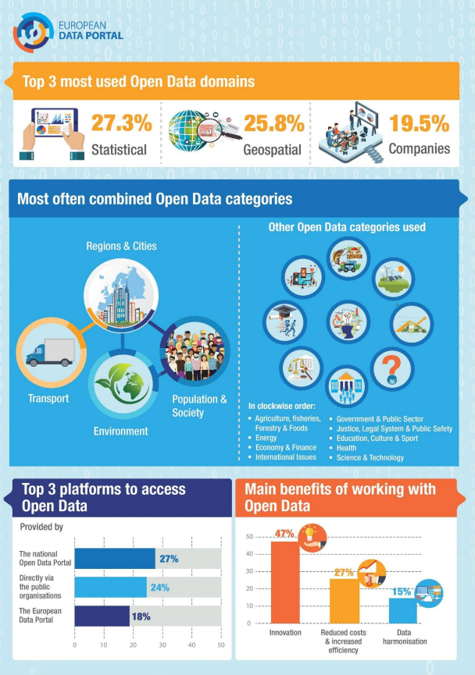
https://data.europa.eu/sites/default/files/re-using_open_data.pdf (2020)

Slide 40
Data Interoperability and Semantics
Part 4. The value of data
Part 4.5. Machine-actionability of data increases its value

Slide 41

FAIR Principles
The FAIR principles emphasize machine-actionability (i.e., the capacity of computational systems to find, access, interoperate, and reuse data with none or minimal human intervention) because humans increasingly rely on computational support to deal with data as a result of the increase in volume, complexity, and creation speed of data.
https://www.go-fair.org/fair-principles/
FAIR Guiding Principles for scientific data management and stewardship (2016)

Slide 42
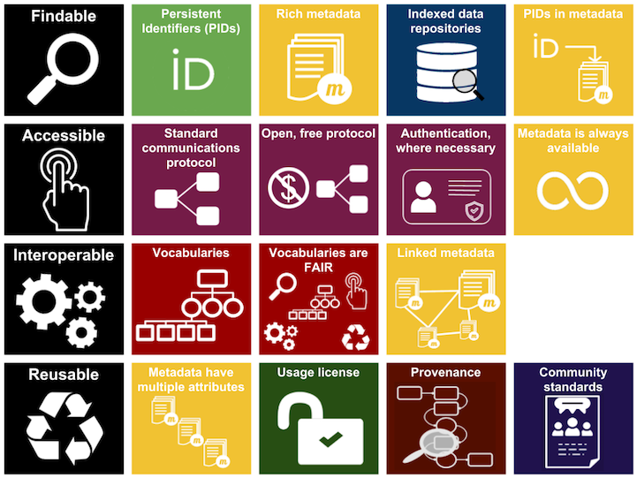
https://www.go-fair.org/fair-principles/
FAIR Guiding Principles for scientific data management and stewardship (2016)
Source : Australian National Data Service (ANDS)

Slide 43
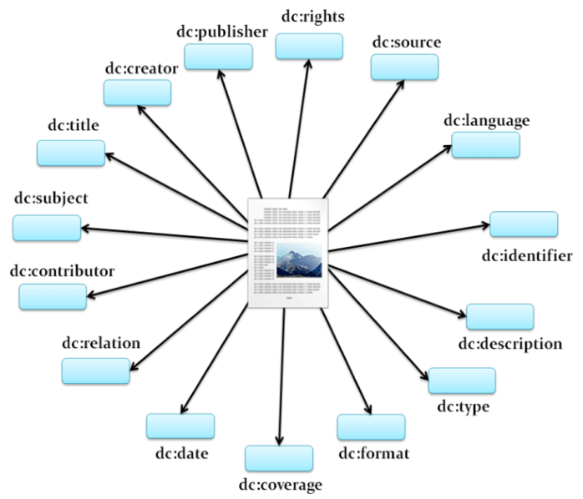
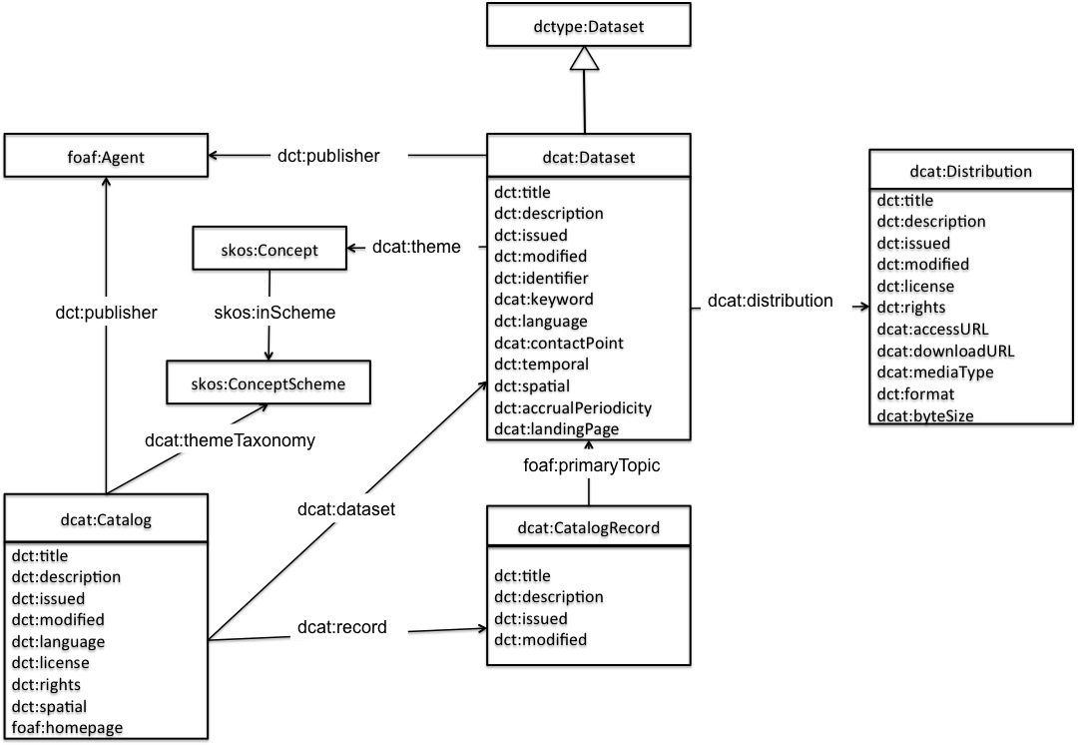
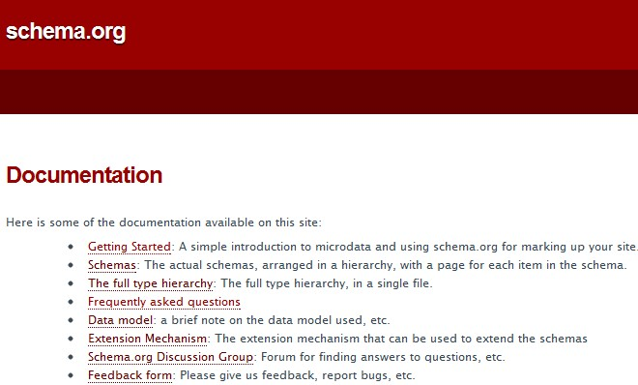
Example of standards for Metadata
Dublin Core
Data Catalog Vocabulary (DCAT) - Version 2
W3C Recommendation 04 February 2020
schema.org

Slide 44
Demo Dublin core or schema.org in web pages
Demo DCAT for open data portal catalogs

Slide 45
Data Interoperability and Semantics
< Part 4. The value of data >

