Slide 1

Data Interoperability and Semantics
< Part 5. The European Data Strategy >
A guided tour !

Slide 2
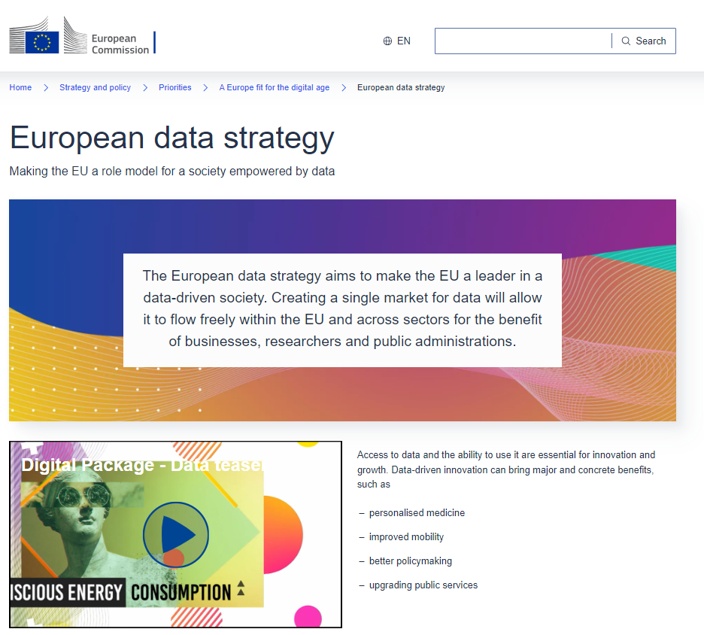
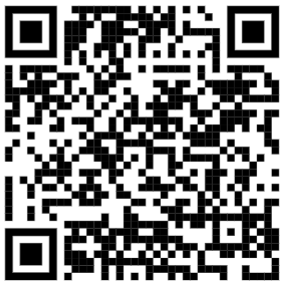
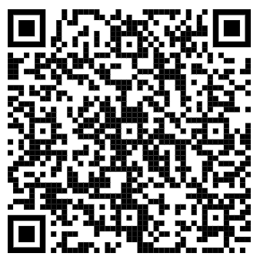
1)
https://ec.europa.eu/commission/presscorner/detail/en/fs_20_283
2)
https://commission.europa.eu/strategy-and-policy/priorities-2019-2024/europe-fit-digital-age/european-data-strategy

Slide 3
Data Interoperability and Semantics
Outline
< Part 5. The European Data Strategy >
  Part 5.1. The European legislation on open data
  Part 5.2. The General Data Protection Regulation (GDPR)
  Part 5.3. The Data Governance Act (DGA)
  Part 5.4. The Data Act
  Part 5.5. Data Spaces
ICM – Computer Science Major – Course unit on Data Interoperability and Semantics
M1 Cyber Physical and Social Systems – Course unit on Data Interoperability and Semantics
Maxime Lefrançois https://maxime-lefrancois.info
Course unit URL: https://ci.mines-stetienne.fr/cps2/course/data

Slide 4
Data Interoperability and Semantics
Part 5. The value of data
Part 5.1. The European legislation on open data

Slide 5


European legislation on open data
(adopted 05/2022 – applicable 09/2023)
The Directive on open data and the re-use of public sector information provides common rules for a European market for government-held data.
The “Open Data Directive” (EU) 2019/1024 entered into force on 16 July 2019
It replaced the Public Sector Information (PSI) Directive of 2003.
EU countries had to transpose Directive (EU) 2019/1024 by 16 July 2021.
The Commission Implementing Regulation (EU) 2023/138
adopted a list of specific high-value datasets by way of an implementing act.
1)
https://digital-strategy.ec.europa.eu/en/policies/legislation-open-data

Slide 6
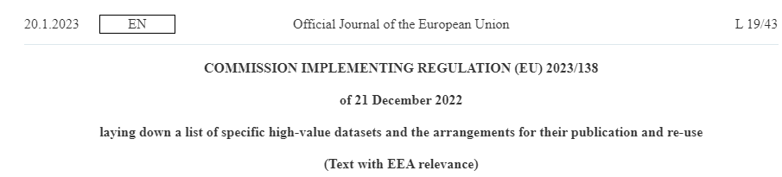

European legislation on open data
(adopted 05/2022 – applicable 09/2023)
2)
The Commission Implementing Regulation (EU) 2023/138
adopted a list of specific high-value datasets by way of an implementing act.
http://data.europa.eu/eli/reg_impl/2023/138/oj

Slide 7
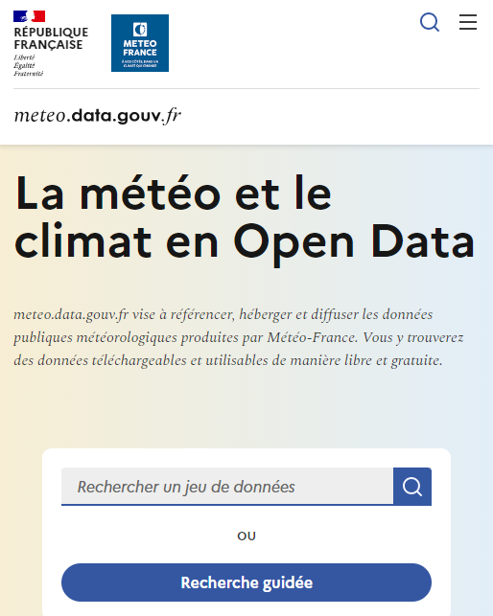
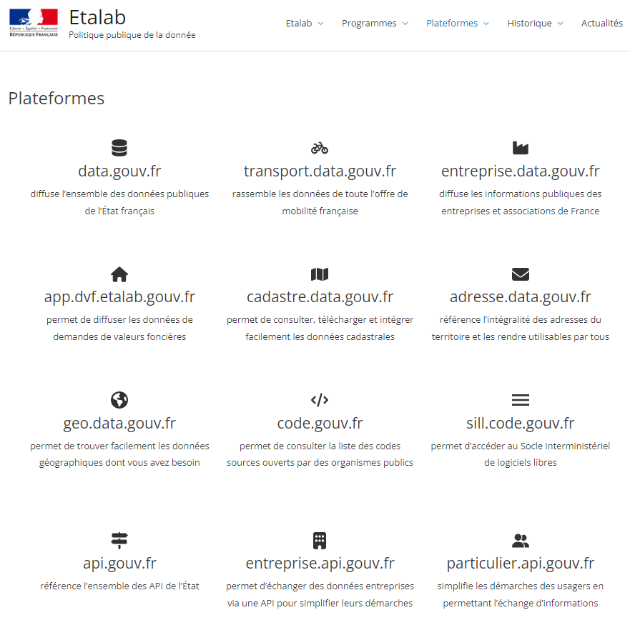
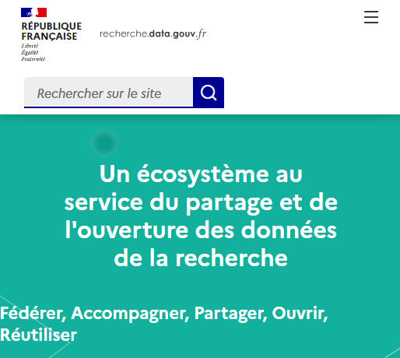
Actual impact (FR)
https://meteo.data.gouv.fr/
https://transport.data.gouv.fr/
https://www.etalab.gouv.fr/

Slide 8
Data Interoperability and Semantics
Part 5. The value of data
Part 5.2. The General Data Protection Regulation (GDPR)

Slide 9
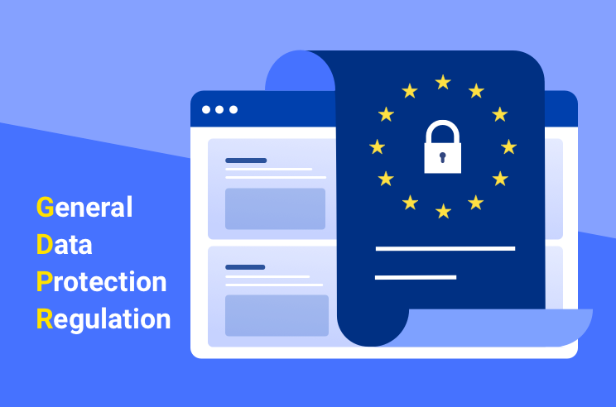
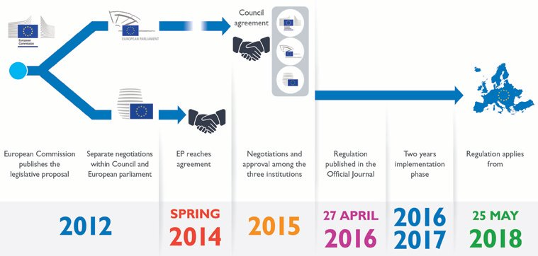
General Data Protection Regulation (GDPR) (2016)
https://gdpr.eu/
Requiring the consent of subjects for data processing
Anonymizing collected data to protect privacy
Providing data breach notifications
Safely handling the transfer of data across borders
Requiring certain companies to appoint a data protection officer to oversee GDPR compliance

Slide 10

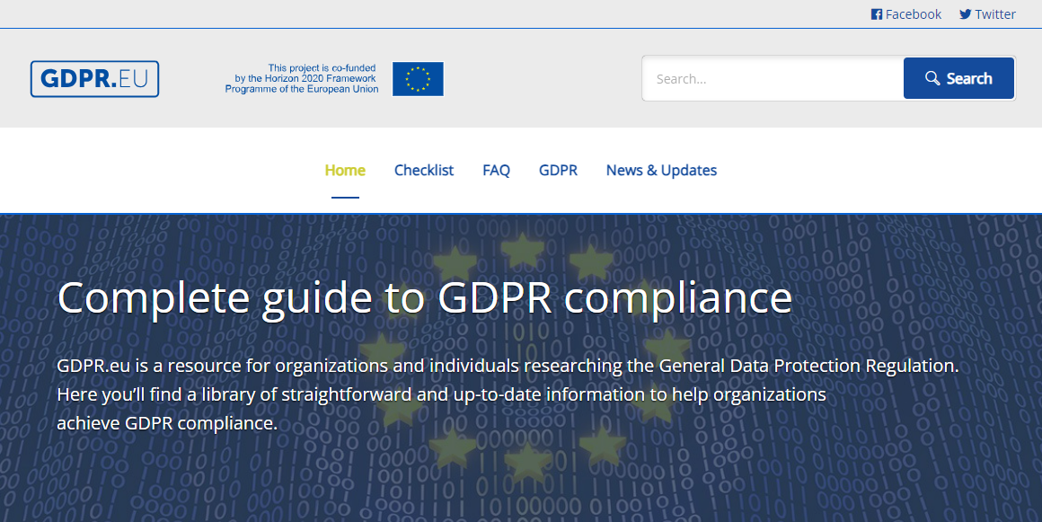
General Data Protection Regulation (GDPR) (2016)
https://gdpr.eu/

Slide 11
Data Interoperability and Semantics
Part 5. The value of data
Part 5.3. The Data Governance Act (DGA)

Slide 12

The European Data Governance Act
(adopted 05/2022 – applicable 09/2023)
1)
https://digital-strategy.ec.europa.eu/en/library/data-governance-act

Slide 13
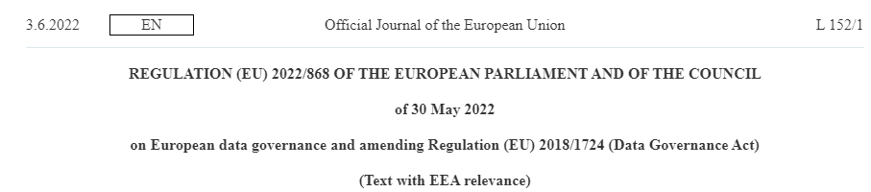
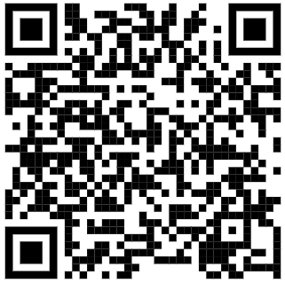
The European Data Governance Act
(adopted 05/2022 – applicable 09/2023)
http://data.europa.eu/eli/reg/2022/868/oj
2)
https://digital-strategy.ec.europa.eu/en/policies/data-governance-act-explained

Slide 14
Data Interoperability and Semantics
Part 5. The value of data
Part 5.4. The Data Act

Slide 15
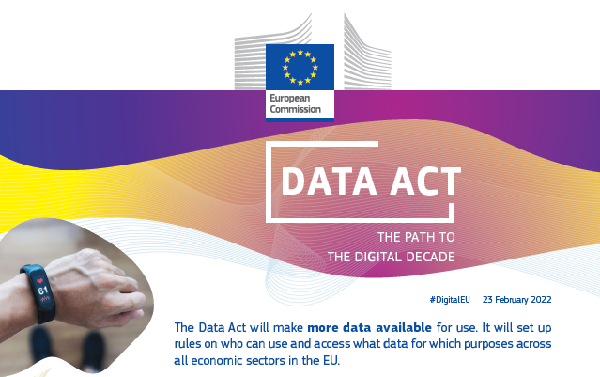

The European Data Act
(adopted 01/2024 – applicable 09/2025)
1)
https://ec.europa.eu/newsroom/dae/redirection/document/83517

Slide 16
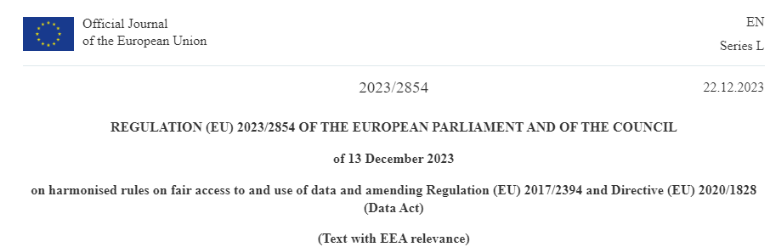
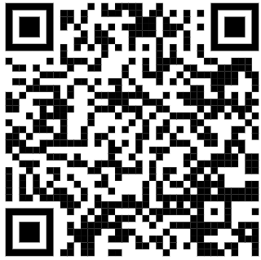
The European Data Act
(adopted 01/2024 – applicable 09/2025)
2)
http://data.europa.eu/eli/reg/2023/2854/oj
https://digital-strategy.ec.europa.eu/en/factpages/data-act-explained

Slide 17
The European Data Act
(adopted 01/2024 – applicable 09/2025)
Chapter VIII – Interoperability
Article 33 – Essential requirements regarding interoperability of data, of data sharing mechanisms and services, as well as of common European data spaces
Participants in data spaces that offer data or data services to other participants shall comply with the following essential requirements to facilitate the interoperability of data, of data sharing mechanisms and services, as well as of common European data spaces which are purpose- or sector-specific or cross-sectoral interoperable frameworks for common standards and practices to share:
the dataset content, use restrictions, licences, data collection methodology, data quality and uncertainty shall be sufficiently described, where applicable, in a machine-readable format, to allow the recipient to find, access and use the data
the data structures, data formats, vocabularies, classification schemes, taxonomies and code lists, where available, shall be described in a publicly available and consistent manner
the technical means to access the data, such as application programming interfaces, and their terms of use and quality of service shall be sufficiently described to enable automatic access and transmission of data between parties, including continuously, in bulk download or in real-time in a machine-readable format where that is technically feasible and does not hamper the good functioning of the connected product
where applicable, the means to enable the interoperability of tools for automating the execution of data sharing agreements, such as smart contracts shall be provided

Slide 18
Data Interoperability and Semantics
Part 5. The value of data
Part 5.5. Data Spaces

Slide 19
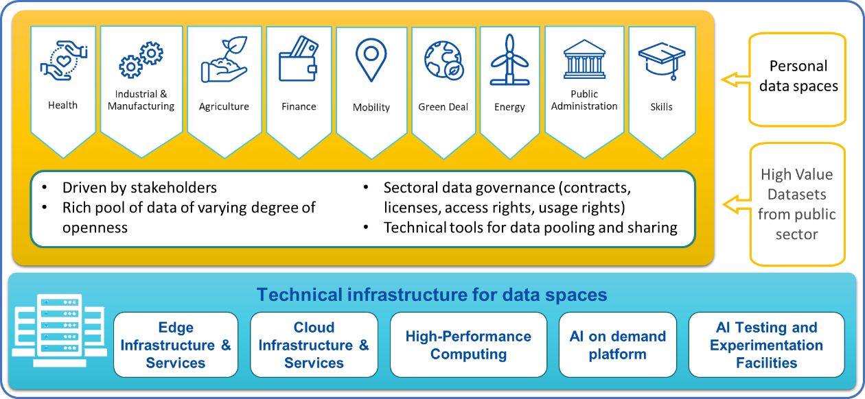
Common European data spaces
``purpose or sector specific or cross-sectoral interoperable frameworks for common standards and practices to share or jointly process data for, inter alia, the development of new products and services, scientific research or civil society initiatives.‘’
[source: Data Act]
https://digital-strategy.ec.europa.eu/en/library/building-data-economy-brochure

Slide 20
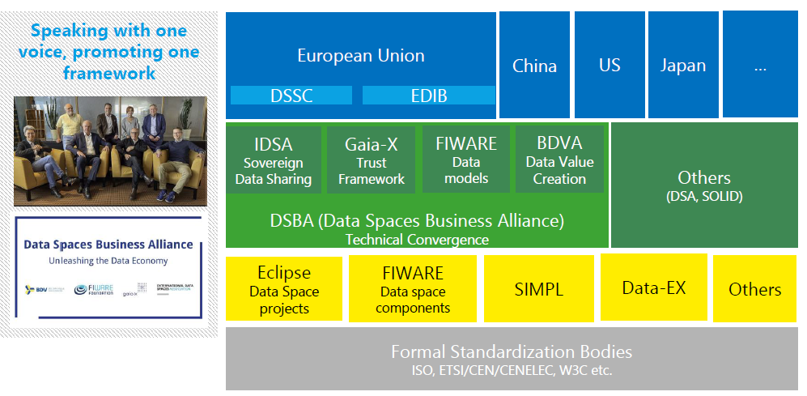
Regulatory, business, and technical foundation for Data Spaces within the Edge-Cloud-Continuum
Data regulations in economic regions
Data strategies implementation
User requirements, Voice of the communities, coordinate technical specs and business requirements, support to "business design"
Technical implementation driven by OSS,
place for the developer communities
Long-term investment security, adoption support etc. through norms and standards
https://data-spaces-business-alliance.eu/download/33968/
Adapted from a presentation by L. Nagel at the Data Spaces Symposium 2024

Slide 21
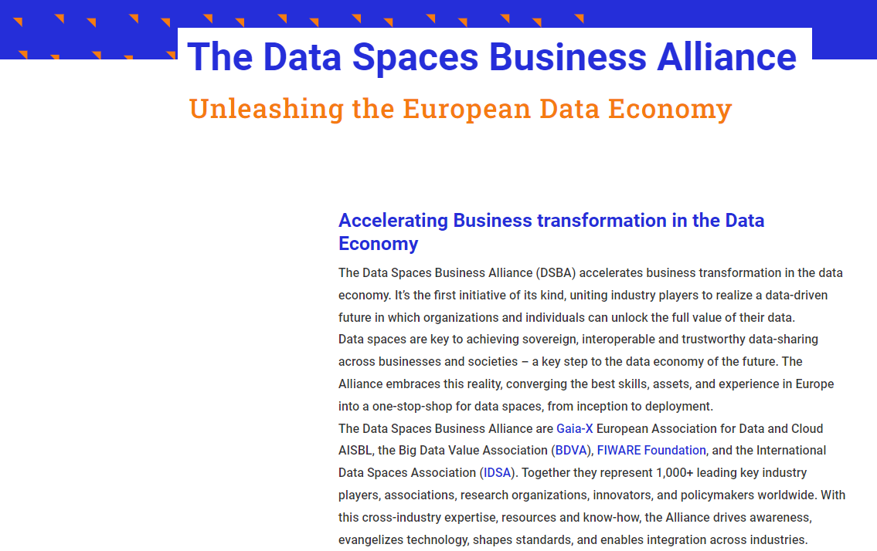

https://data-spaces-business-alliance.eu/

Slide 22

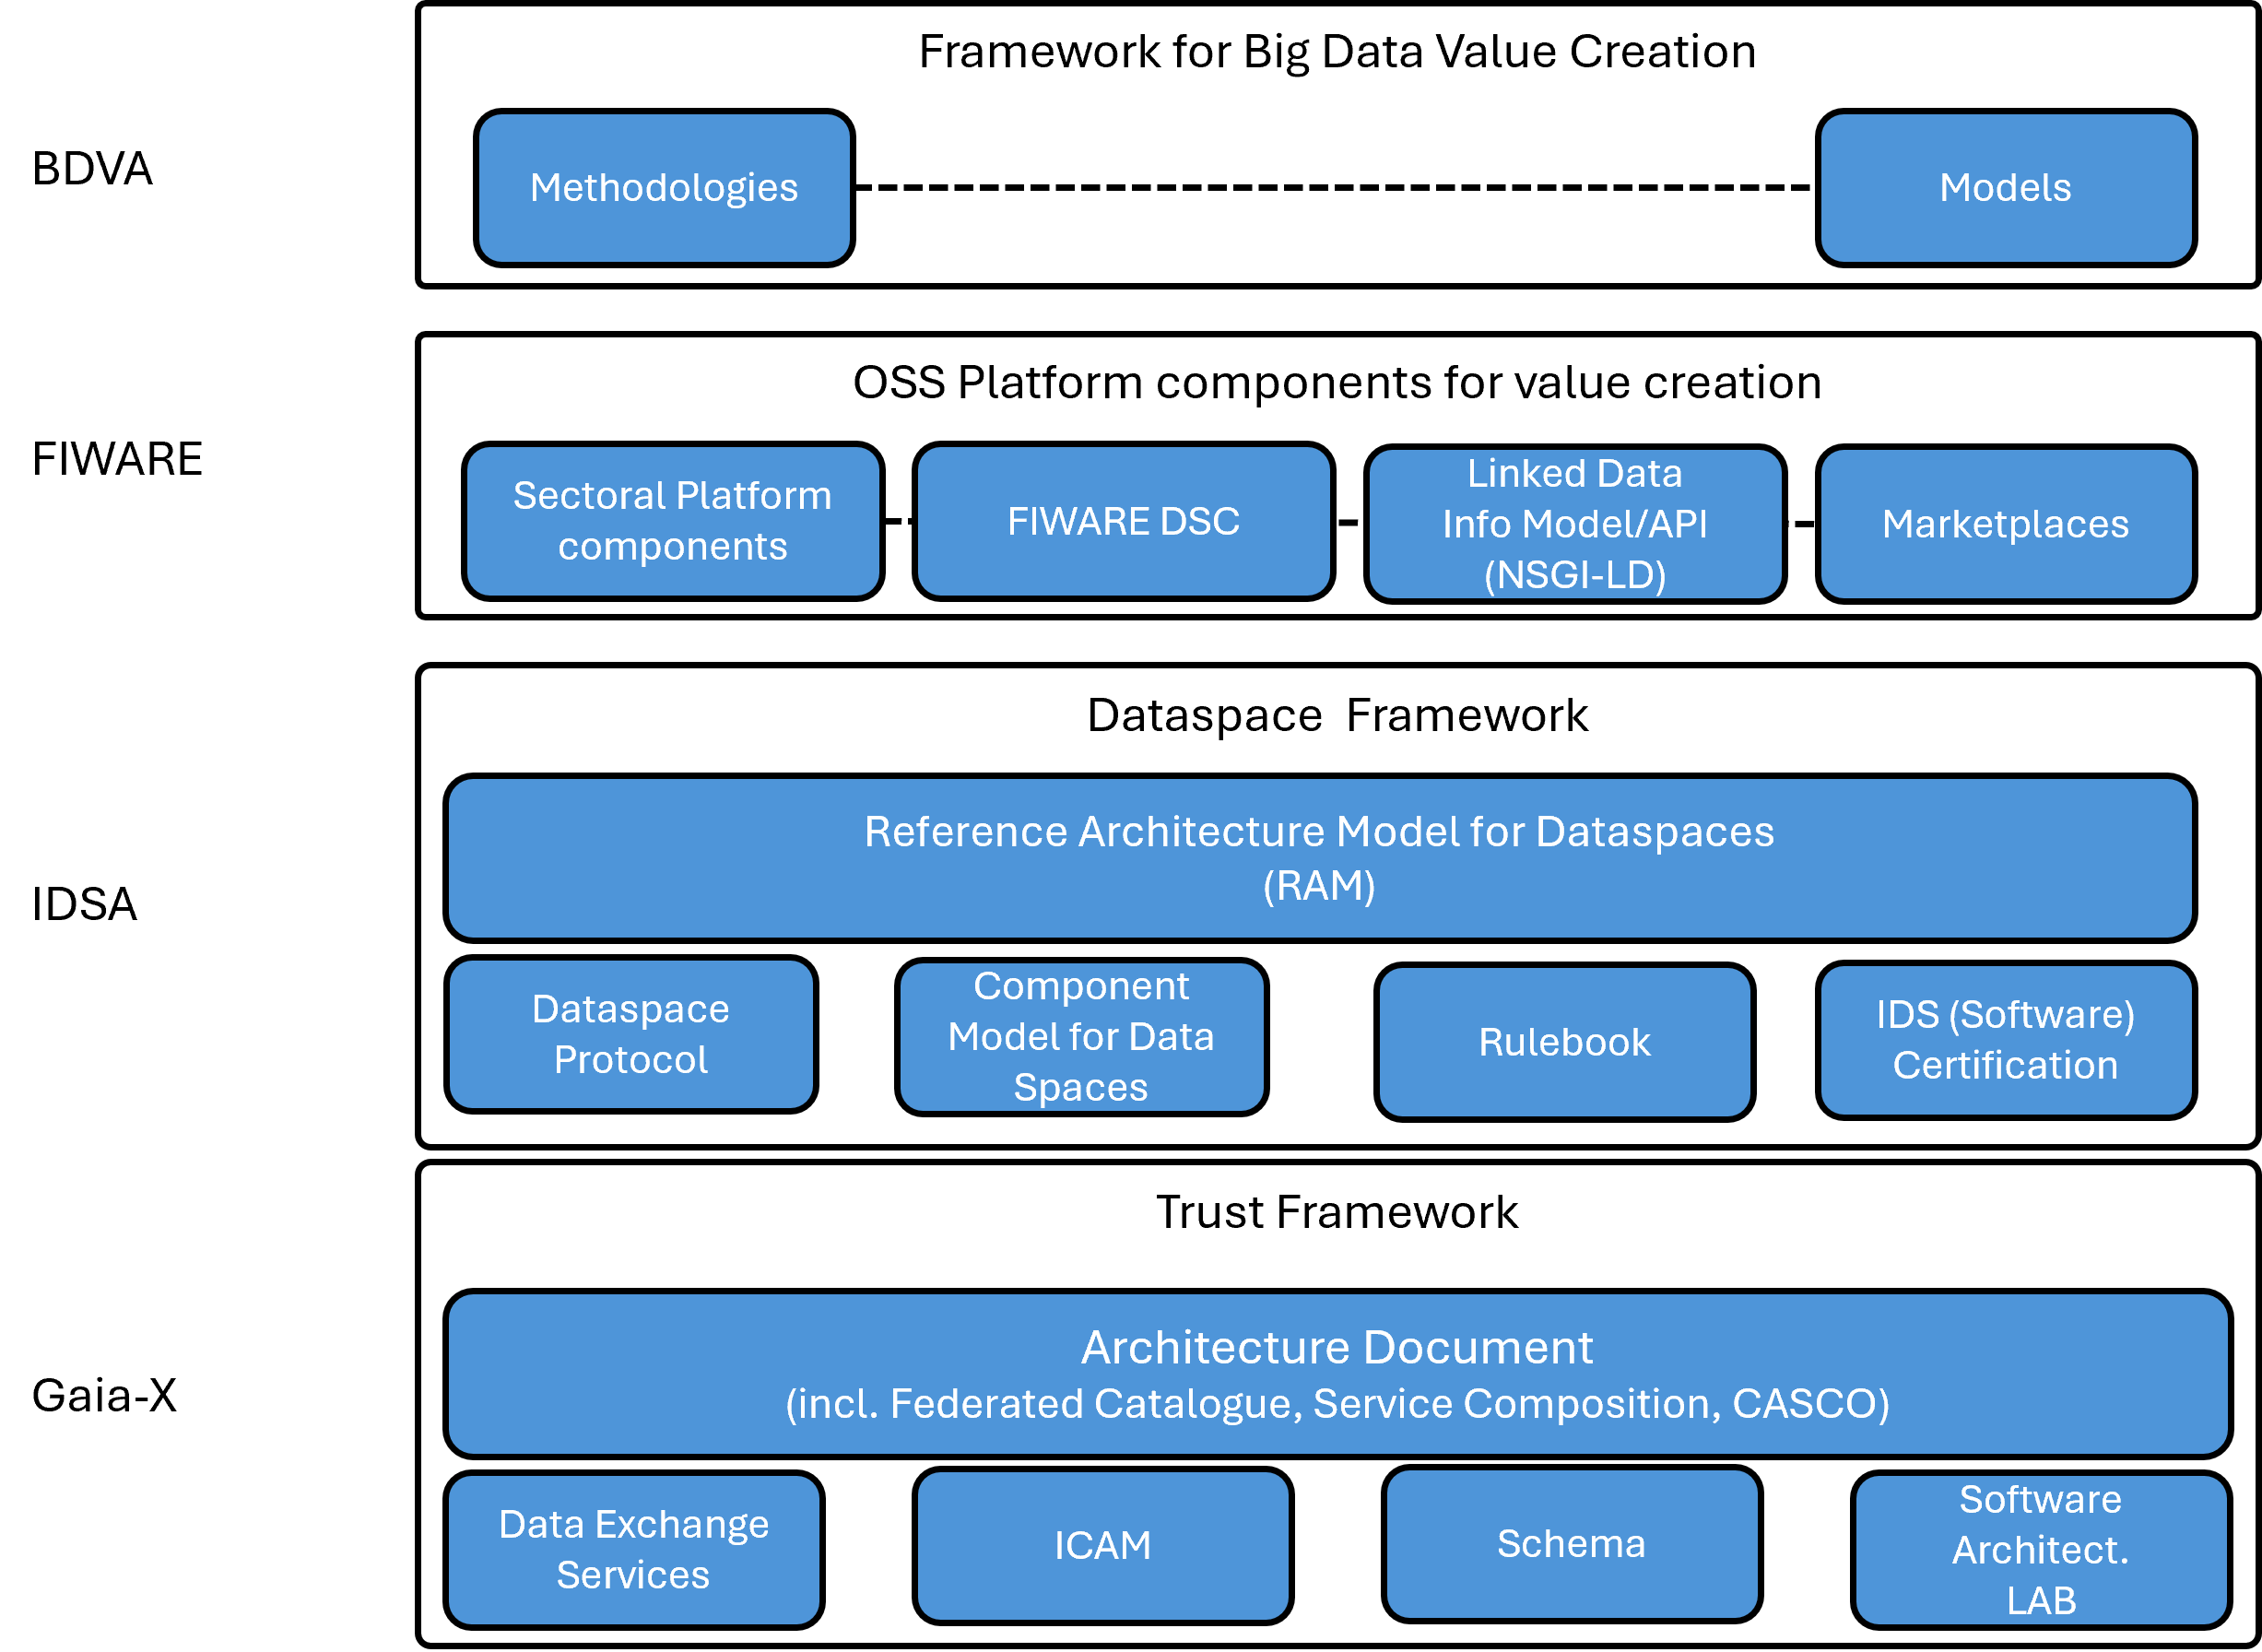



https://data-spaces-business-alliance.eu/

Slide 23
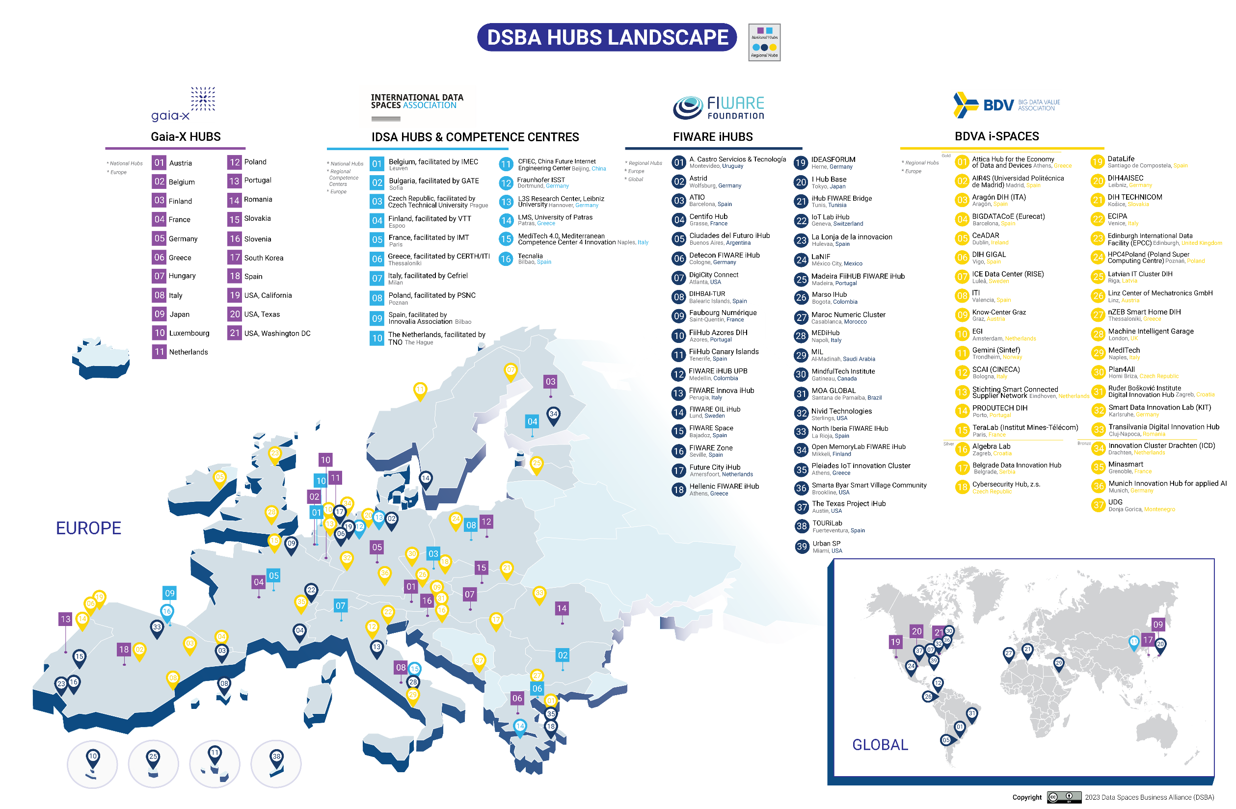

Slide 24
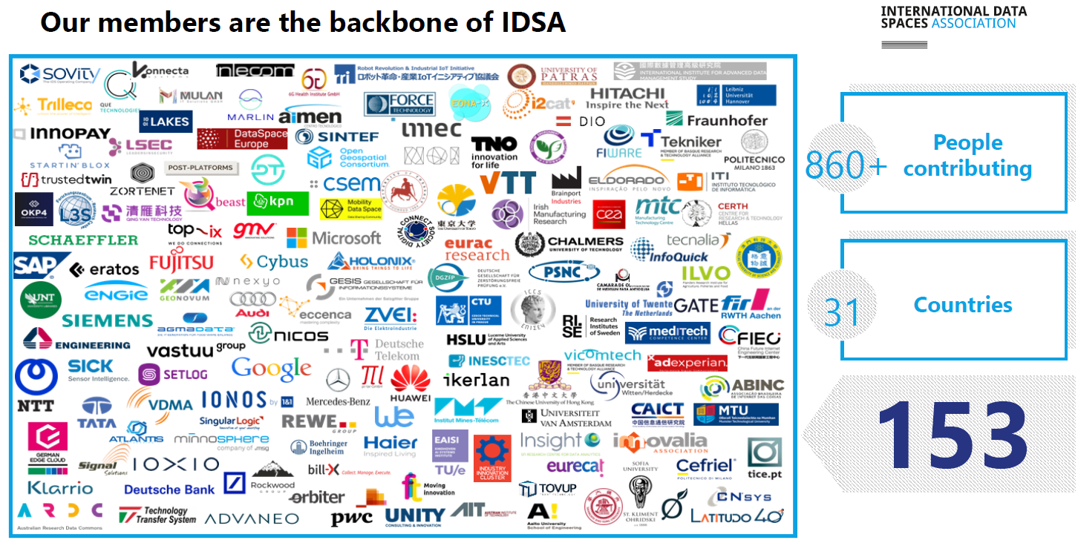
Adapted from a presentation by L. Nagel at the Data Spaces Symposium 2024

Slide 25
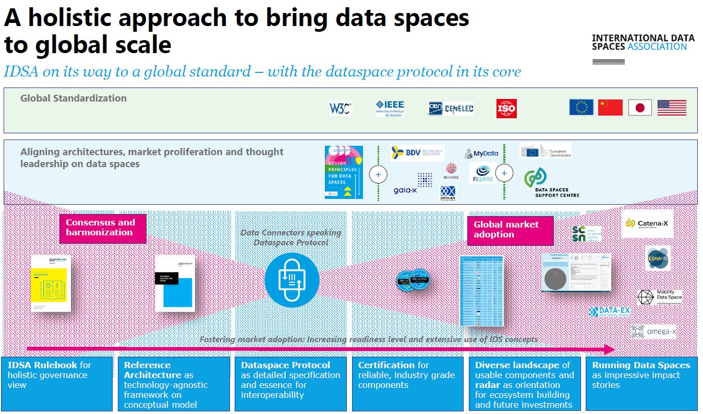
Adapted from a presentation by L. Nagel at the Data Spaces Symposium 2024

Slide 26
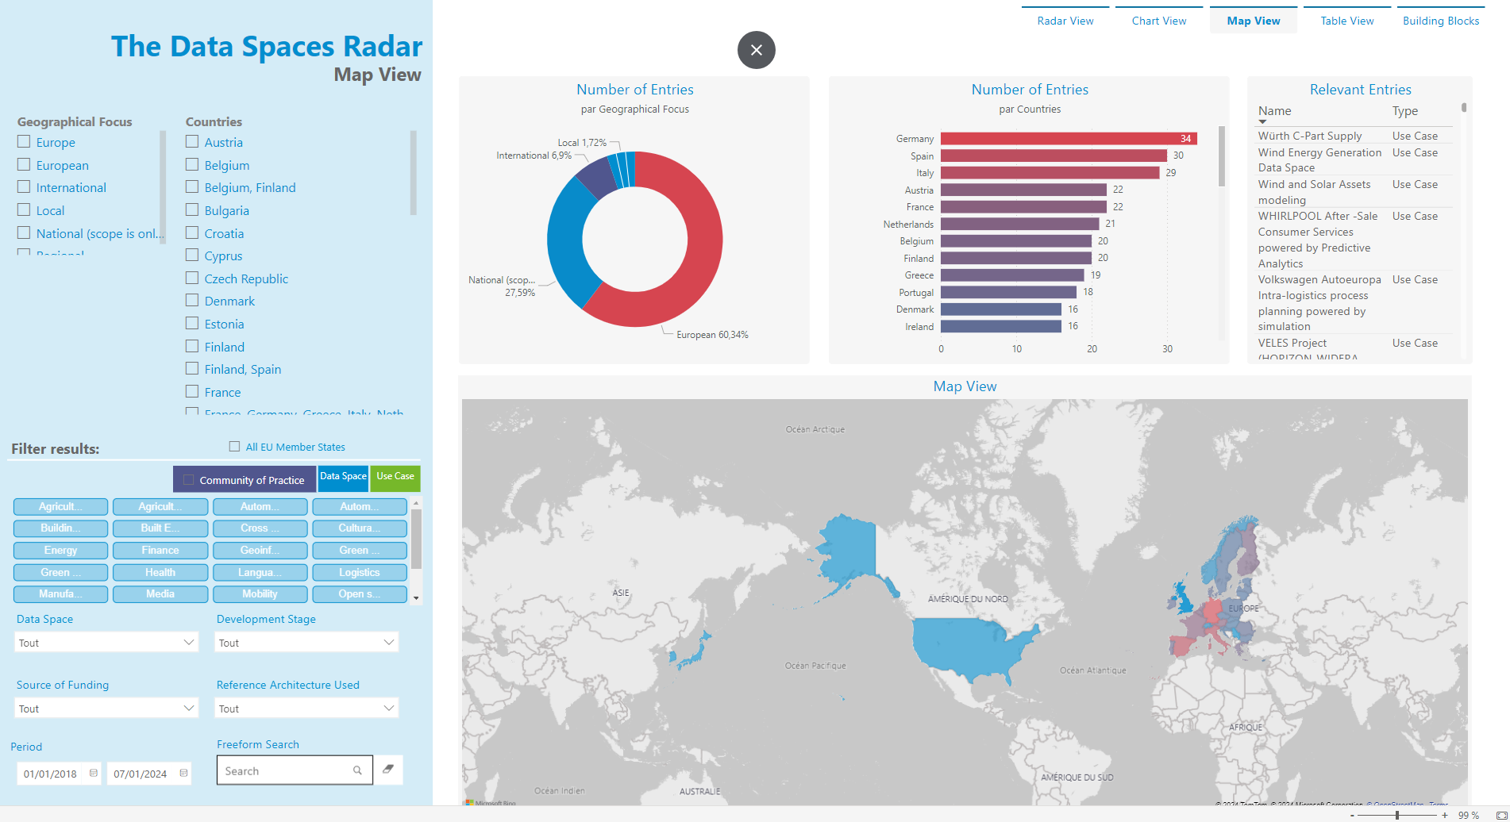

https://www.dataspaces-radar.org/

Slide 27
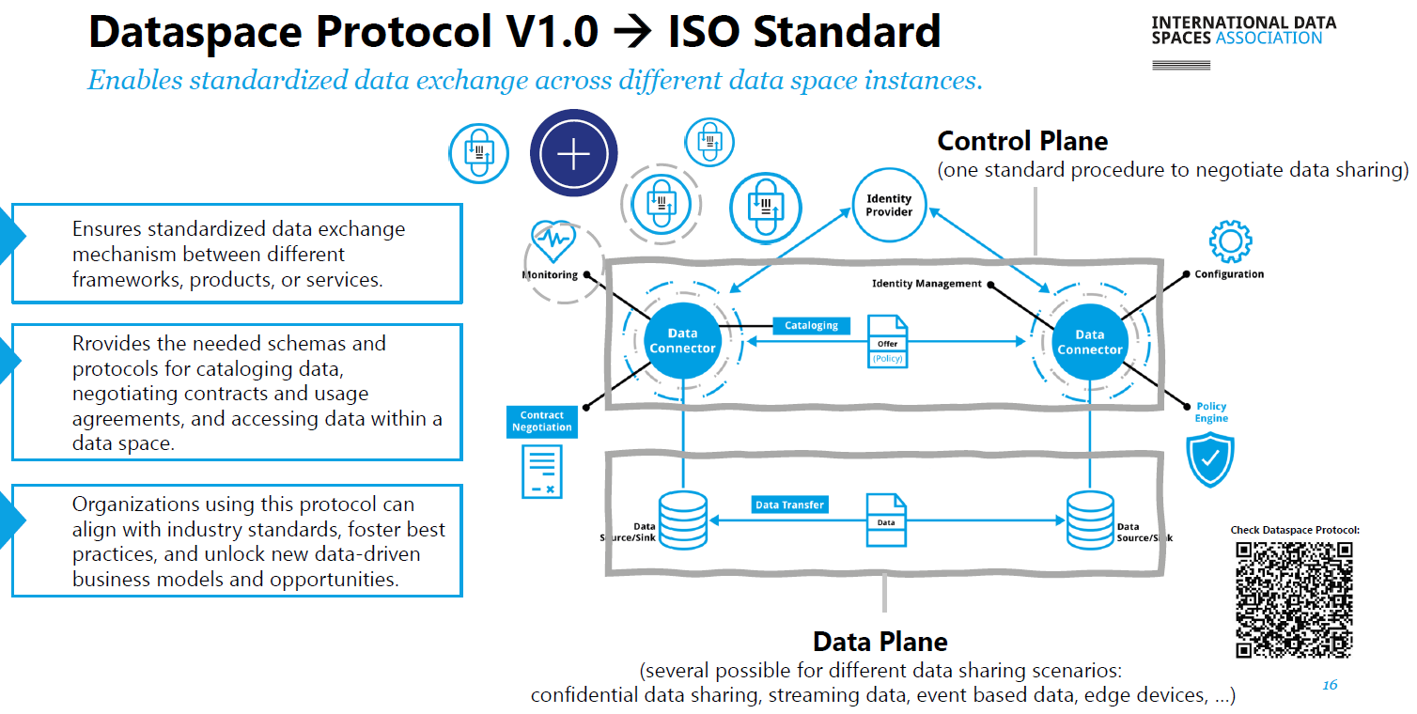
Adapted from a presentation by L. Nagel at the Data Spaces Symposium 2024

Slide 28
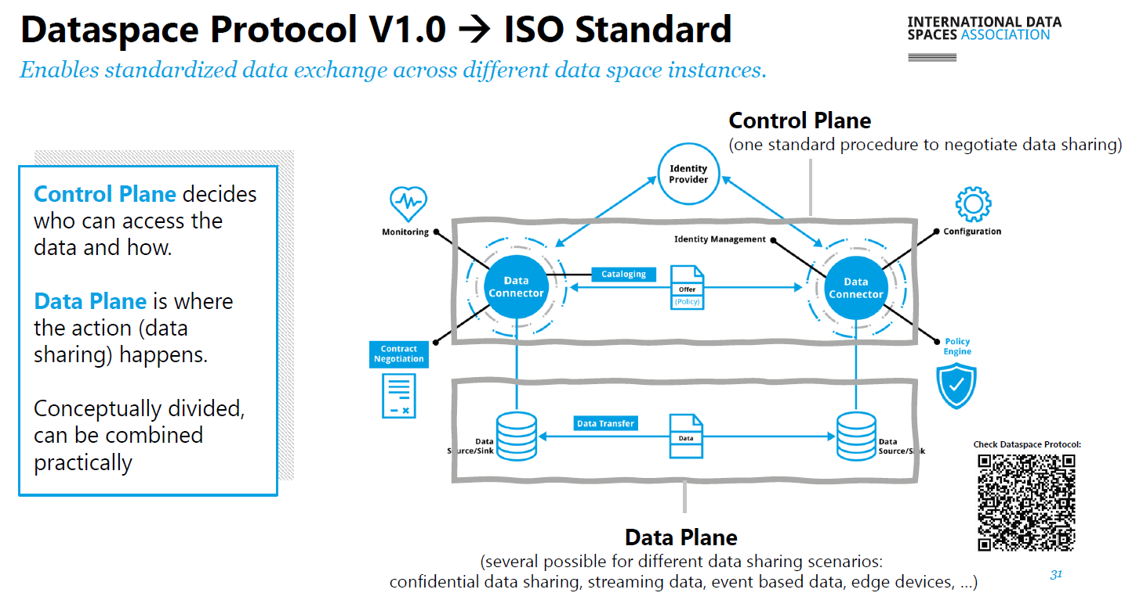
Adapted from a presentation by L. Nagel at the Data Spaces Symposium 2024

Slide 29
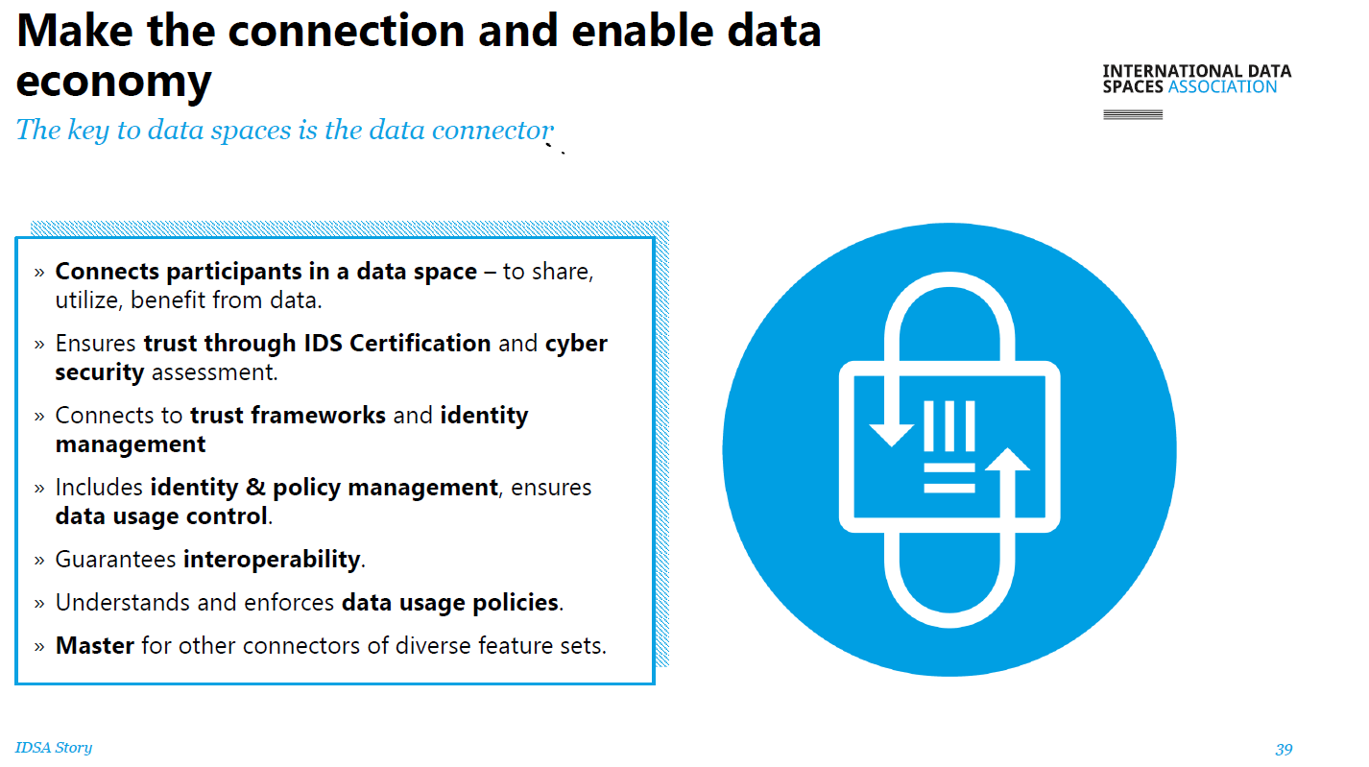
Adapted from a presentation by L. Nagel at the Data Spaces Symposium 2024

Slide 30
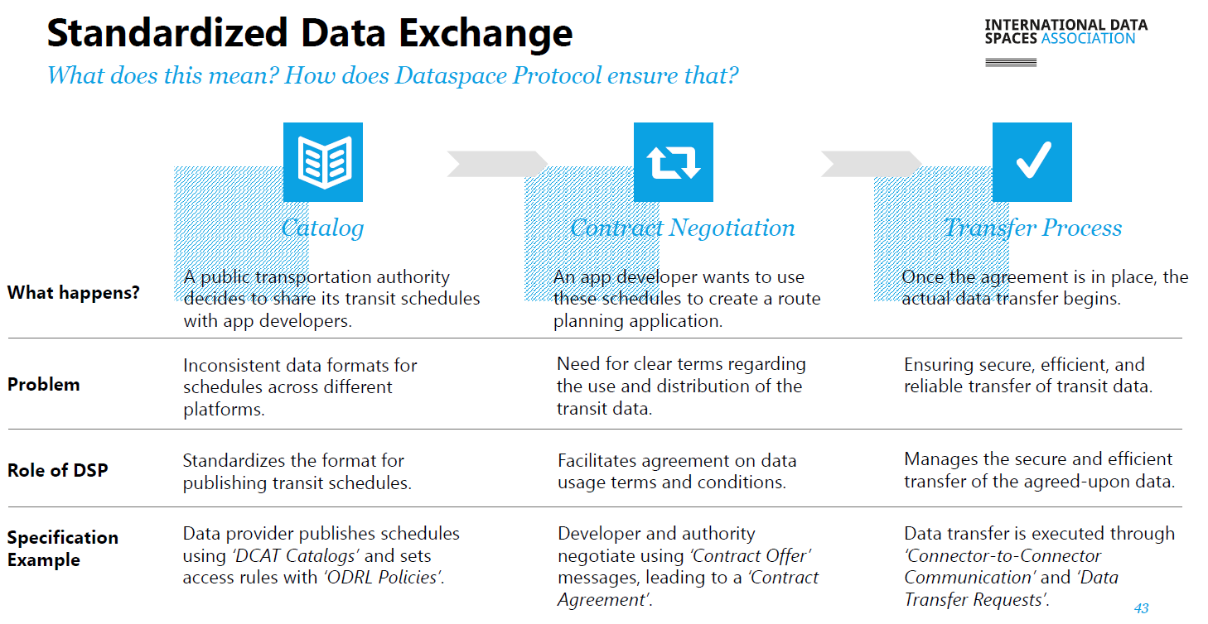
Adapted from a presentation by L. Nagel at the Data Spaces Symposium 2024

Slide 31
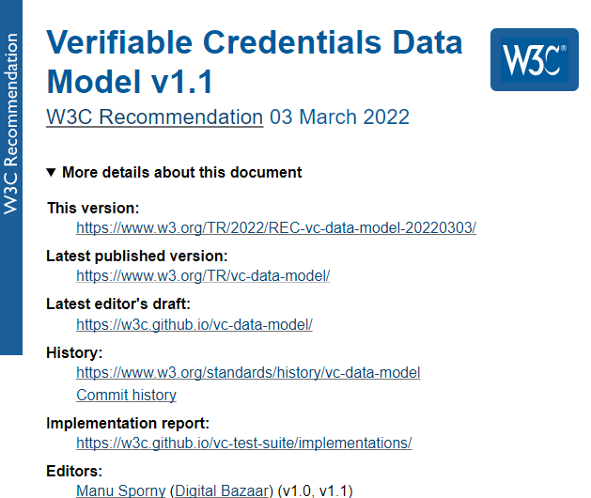
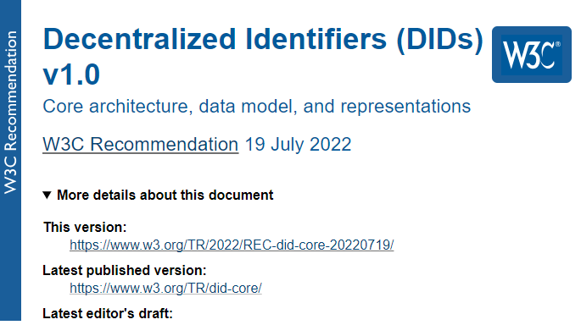
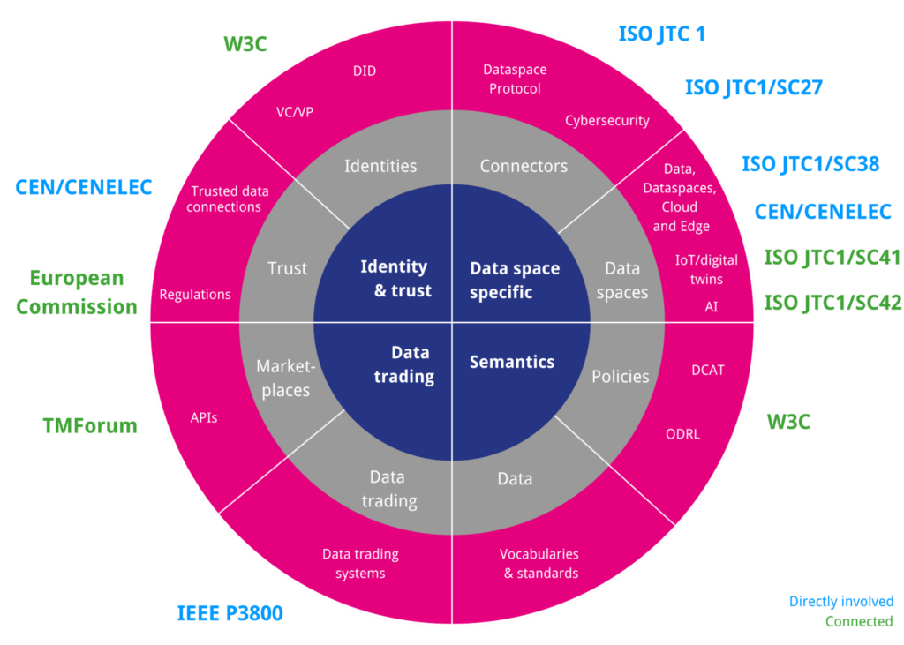
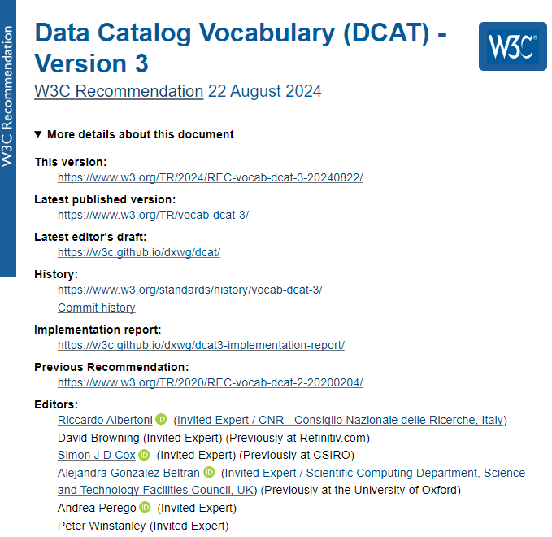
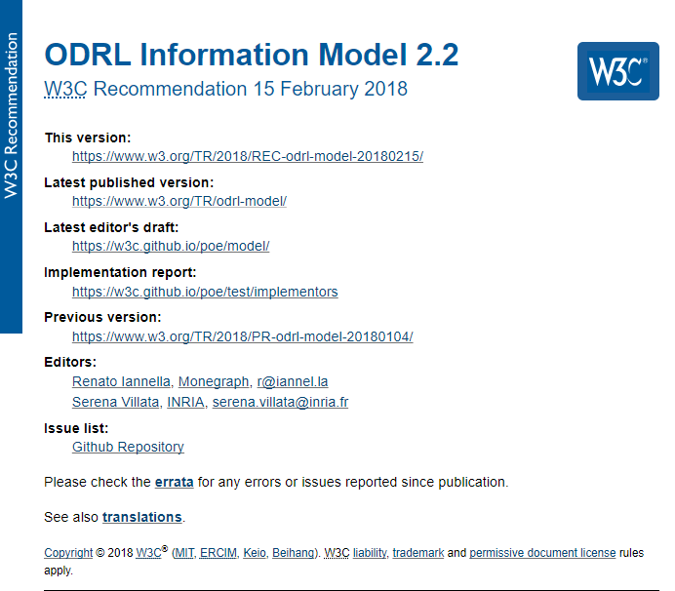
Standardization activities
Adapted from a presentation by L. Nagel at the Data Spaces Symposium 2024
Notes:
Verifiable Credentials (VCs) and Verifiable Presentations (VPs) define a standardised method for digitally presenting credentials on the internet. This page is the starting point for all VC and VP related information in the EBSI Verifiable Credentials Framework.
Decentralized identifiers (DIDs) are a new type of identifier that enables verifiable, decentralized digital identity.

Slide 32
Data Interoperability and Semantics
< Part 5. The European Data Strategy >
A guided tour !

