Slide 1
Software Engineering
ICM – Computer Science Major – Software Engineering - Part 1: Introduction
M1 Cyber Physical and Social Systems – CPS2 engineering and development - Part 3: Software Engineering
Maxime Lefrançois https://maxime.lefrancois.info
Course unit URL: https://ci.mines-stetienne.fr/cps2/course/softeng/

Slide 2
Software Engineering
Part 1 – Introduction
ICM – Computer Science Major – Software Engineering - Part 1: Introduction
M1 Cyber Physical and Social Systems – CPS2 engineering and development - Part 3: Software Engineering
Maxime Lefrançois https://maxime.lefrancois.info
Course unit URL: https://ci.mines-stetienne.fr/cps2/course/softeng/

Slide 3
Objectives of this course
The aim of this session is for you to learn about Software Engineering
Software engineering is the systematic application of engineering approaches to the development of software.
A software engineer is a person who applies the principles of software engineering to design, develop, maintain, test, and evaluate computer software. The term programmer is sometimes used as a synonym, but may also lack connotations of engineering education or skills.
— Wikipedia contributors - https://en.wikipedia.org/wiki/Software_engineering

Slide 4
60s-80s – The Software Crisis
The major cause of the software crisis is that the machines have become several orders of magnitude more powerful! To put it quite bluntly: as long as there were no machines, programming was no problem at all; when we had a few weak computers, programming became a mild problem, and now we have gigantic computers, programming has become an equally gigantic problem.
— Edsger Dijkstra, The Humble Programmer (EWD340), 1972 Turing Award Lecture

Slide 5
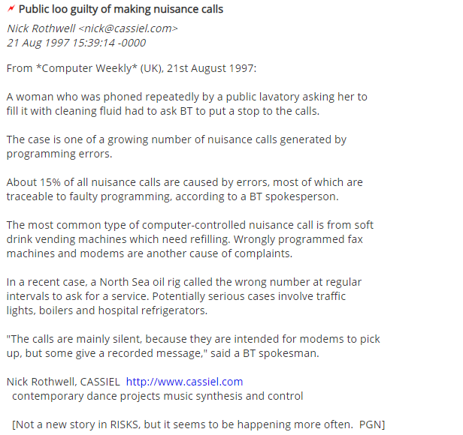
Fun story
source: http://catless.ncl.ac.uk/Risks/19.33.html%23subj1

Slide 6
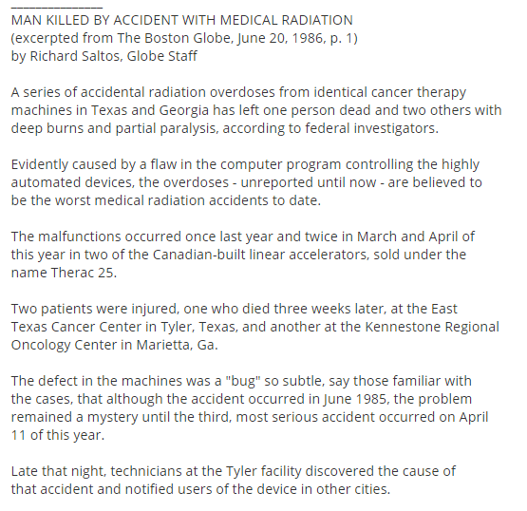
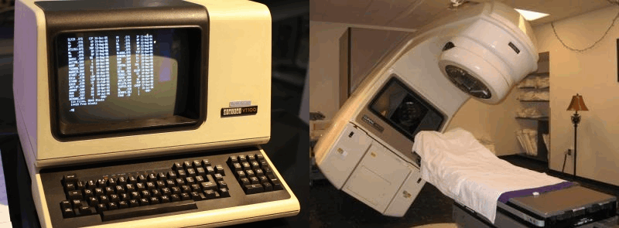
Not fun story: Therac-25
https://catless.ncl.ac.uk/Risks/3.09.html
https://en.wikipedia.org/wiki/History_of_software_engineering#1965_to_1985:_The_software_crisis

Slide 7
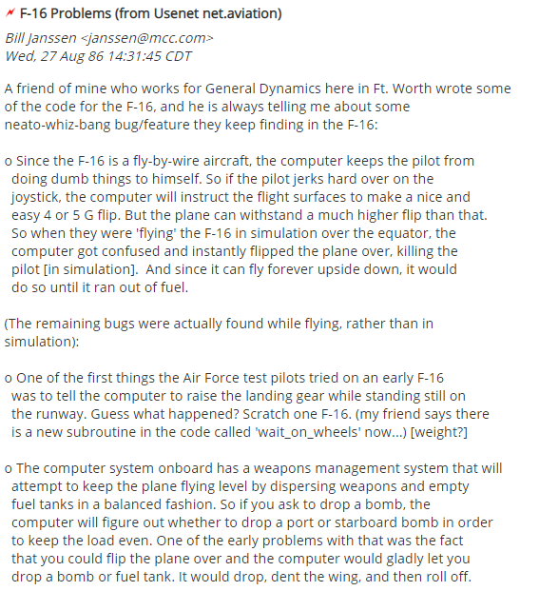

Fun bugs
https://catless.ncl.ac.uk/Risks/3.44.html

Slide 8
Many more stories: RISKS Digest
Forum on Risks to the Public in Computers and Related Systems
ACM Committee on Computers and Public Policy, Peter G. Neumann, moderator
http://catless.ncl.ac.uk/Risks/
Examples of Volume 1, 1985
Legend: ! = Loss of Life; * = Potentially Life-Critical; $ = Loss of Money/Equipment; S = Security/Privacy/Integrity Flaw
!S Arthritis-therapy microwaves set pacemaker to 214, killed patient (SEN 5 1)
*$ Mariner 18: aborted due to missing NOT in program (SEN 5 2)
*$ F18: plane crashed due to missing exception condition, pilot OK (SEN 6 2)
*$ El Dorado brake computer bug caused recall of all El Dorados (SEN 4 4)
* Second Space Shuttle operational simulation: tight loop upon cancellation of an attempted abort; required manual override (SEN 7 1)
* Gemini V 100mi landing err, prog ignored orbital motion around sun (SEN 9 1)
* F16 simulation: plane flipped over whenever it crossed equator (SEN 5 2)
* F16 simulation: upside-down F16 deadlock over left vs. right roll (SEN 9 5)
* SF BART train doors sometimes open on long legs between stations (SEN 8 5)
* IRS reprogramming cost USA interest on at least 1,150,000 refunds (SEN 10 3)
Santa Clara prison data system (inmate altered release date) (SEN 10 1).
Computerized time-bomb inserted by programmer (for extortion?) (10 3)
*$ Colorado River flooding in 1983, due to faulty weather data and/or faulty model; too much water was kept dammed prior to spring thaws.
$ 1979 AT&T program bug downed phone service to Greece for months (SEN 10 3)
Quebec election prediction gave loser big win [1981] (SEN 10 2, p. 25-26)
SW vendor rigs elections? (David Burnham, NY Times front page, 29 July 1985)
Vancouver Stock Index lost 574 points over 22 months -- roundoff (SEN 9 1)

Slide 9
Productivity and quality issues in software ...
Due to:
increase in size and complexity of systems
shorter and shorter deadlines
bigger and bigger teams, with multiple skills
Causing:
Cost and Budget Overruns
Property Damage
Life and Death

Slide 10
Productivity and quality issues in software ...
Due to:
increase in size and complexity of systems
shorter and shorter deadlines
bigger and bigger teams, with multiple skills
Causing:
Cost and Budget Overruns
Property Damage
Life and Death
… called for the development of Software Engineering
Software engineering is the application of a systematic, disciplined, quantifiable approach to the development, operation, and maintenance of software; that is, the application of engineering to software)
— ISO/IEC/IEEE 24765:2017 Systems and Software Engineering Vocabulary (SEVOCAB)

Slide 11
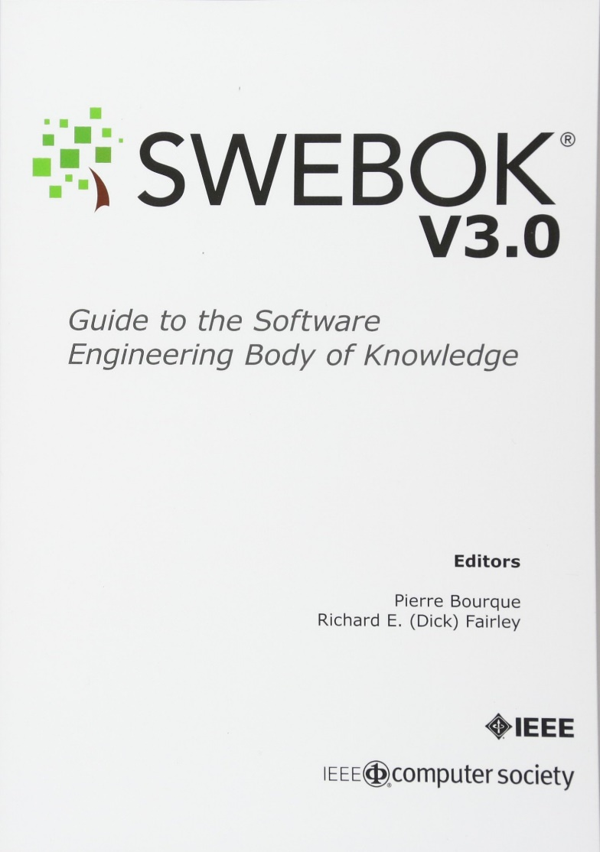
SWEBOK: Software Engineering Body of Knowledge
ISO/IEC TR 19759:2015 (v1 in 2005)
Describes 15 Knowledge Areas (KAs) in the field of software engineering
Software Requirements
Software Design
Software Construction
Software Testing
Software Maintenance
Software Configuration Management
Software Engineering Management
Software Engineering Process
Software Engineering Models and Methods
Software Quality
Software Engineering Professional Practice
Software Engineering Economics
Computing Foundations
Mathematical Foundations
Engineering Foundations
get your version here: https://www.computer.org/education/bodies-of-knowledge/software-engineering

Slide 12
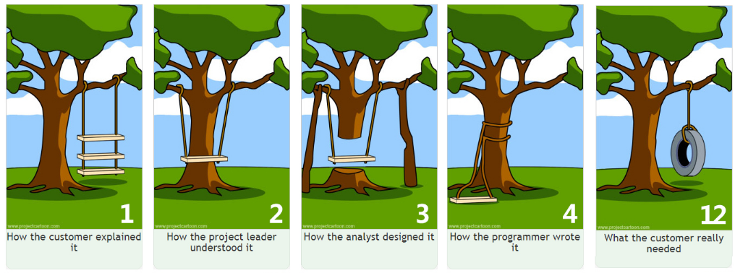
Software Engineering
source: https://www.zentao.pm/agile-knowledge-share/tree-swing-project-management-cartoon-97.mhtml
Part 2 – Software Requirements
ICM – Computer Science Major – Software Engineering - Part 1: Introduction
M1 Cyber Physical and Social Systems – CPS2 engineering and development - Part 3: Software Engineering
Maxime Lefrançois https://maxime.lefrancois.info
Course unit URL: https://ci.mines-stetienne.fr/cps2/softeng/

Slide 13
Software Requirement - definition
1. software capability needed by a user to solve a problem or to achieve an objective 2. software capability that must be met or possessed by a system or system component to satisfy a contract, standard, specification, or other formally imposed document
— ISO/IEC/IEEE 24765:2017 Systems and Software Engineering Vocabulary (SEVOCAB)
verifiable
if possible: quantifiable
verification at the individual level, or at the system level
verification may be difficult or costly
may be prioritized (enables tradeoffs)
may have status values (enables project progress monitoring)

Slide 14
Software Requirement - definition
1. software capability needed by a user to solve a problem or to achieve an objective 2. software capability that must be met or possessed by a system or system component to satisfy a contract, standard, specification, or other formally imposed document
— ISO/IEC/IEEE 24765:2017 Systems and Software Engineering Vocabulary (SEVOCAB)

Slide 15

Product and Process requirements
product requirement
refinement of customer requirements into the developers' language, making implicit requirements into explicit derived requirements
— ISO/IEC/IEEE 24765:2017 Systems and Software Engineering Vocabulary (SEVOCAB)
process requirement
constraint on the development of the software
— ISO/IEC TR 19759:2015 Software Engineering Body of Knowledge (SWEBOK)
example of product requirement: “The software shall verify that a student meets all prerequisites before he or she registers for a course”
example of process requirement: “The software shall be developed using a Agile process”
process requirements can be imposed by the dev organization, the customer, a third party such as safety regulator

Slide 16
Functional and Nonfunctional requirements
functional requirement
1. statement that identifies what results a product or process shall produce
2. requirement that specifies a function that a system or system component shall perform
— ISO/IEC/IEEE 24765:2017 Systems and Software Engineering Vocabulary (SEVOCAB)
— IEEE 730-2014 IEEE Standard for Software Quality Assurance Processes, 3.2
nonfunctional requirement
1. software requirement that describes not what the software will do but how the software will do it
— ISO/IEC/IEEE 24765:2017 Systems and Software Engineering Vocabulary (SEVOCAB)
example of functional requirement: Business Rules, Transaction corrections, adjustments, and cancellations, …
example of nonfunctional requirement: “The interface shall be user-friendly / the authentification must be secure / streaming must be lightning fast”
see also blog post on functional vs nonfunctional requirements https://theappsolutions.com/blog/development/functional-vs-non-functional-requirements/

Slide 17
Functional and Nonfunctional requirements
functional requirement
1. statement that identifies what results a product or process shall produce
2. requirement that specifies a function that a system or system component shall perform
— ISO/IEC/IEEE 24765:2017 Systems and Software Engineering Vocabulary (SEVOCAB)
— IEEE 730-2014 IEEE Standard for Software Quality Assurance Processes, 3.2
nonfunctional requirement
1. software requirement that describes not what the software will do but how the software will do it
— ISO/IEC/IEEE 24765:2017 Systems and Software Engineering Vocabulary (SEVOCAB)
example of functional requirement: Business Rules, Transaction corrections, adjustments, and cancellations, …
example of nonfunctional requirement: “The interface shall be user-friendly / the authentification must be secure / streaming must be lightning fast”
further classification of nonfunctional requirements: performance, maintainability, safety, reliability, security, interoperability, …
see also blog post on functional vs nonfunctional requirements https://theappsolutions.com/blog/development/functional-vs-non-functional-requirements/

Slide 18
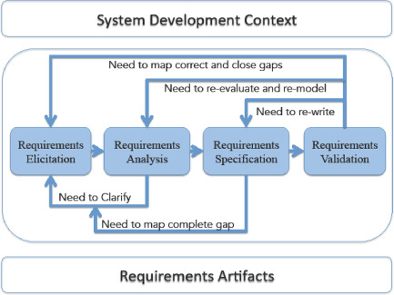

Requirements process
includes i. elicitation, ii. analysis, iii. specification, and iv. validation.
is initiated at the beginning of a project, and refined throughout the life cycle of the project
requirements are configuration items. They can be managed during the life cycle of the project
Incremental and iterative requirements engineering process.
Source: Jin, Zhi. Environment modeling-based requirements engineering for software intensive systems. Morgan Kaufmann, 2018. Chapter 1 - Requirements and Requirements Engineering
Software projects are critically vulnerable when the requirements related activities are poorly performed.

Slide 19
Requirements process – actors
users
will operate the software. Heterogenous goup involving people with different roles
customers
those who commissioned the software or who represent the target market
market analyst
for mass-market software, marketing people act as proxy customers
regulators
impose requirements of the regulatory authorities (ex, banking, public transport, utilitie)
software engineers
legitimate interest in optimizing the actual development time and costs
tradeoffs need to be negotiated
see for example https://www.bbau.ac.in/dept/dit/TM/Requirement%20Validation.pdf

Slide 20
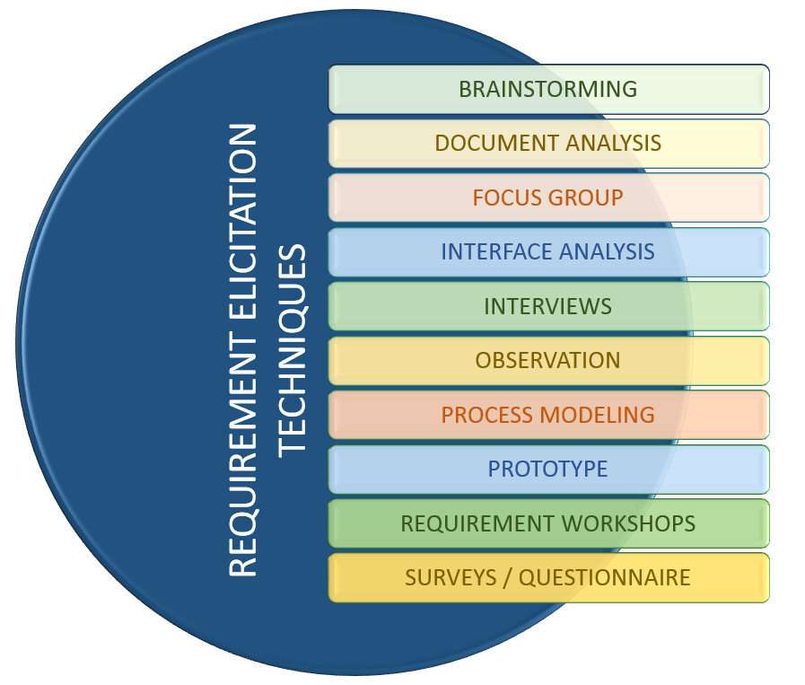
Requirements process – i. elicitation
Sources
goals of the software
domain knowledge
stakeholders
business rules
operational environment
organizational environment
Elicitation techniques
interviews
scenarios
prototypes
facilitated meetings
observation
user stories https://en.wikipedia.org/wiki/User_story
…
“As a <role>, I want <goal/desire> so that <benefit>.”

Slide 21
Requirements process – ii. analysis
Classify the requirements
functional/nonfunctional
source (e.g., user, regulation)
on the product or the process
priority (mandatory, highly desirable, desirable, optional)
scope (global, narrow)
Volatility/stability

Slide 22
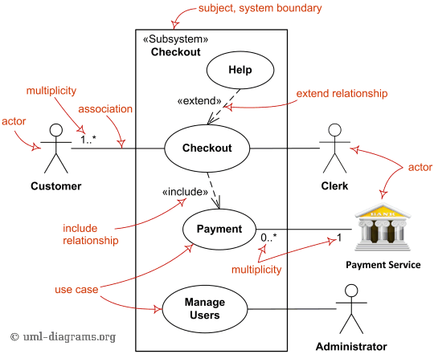
Requirements process – ii. analysis
Conceptual models
For example with the Unified Modeling Language (UML)
use case diagrams
communication diagrams
state machine diagrams
…
exemple: UML Use case diagrams
source: https://www.uml-diagrams.org/use-case-diagrams.html

Slide 23
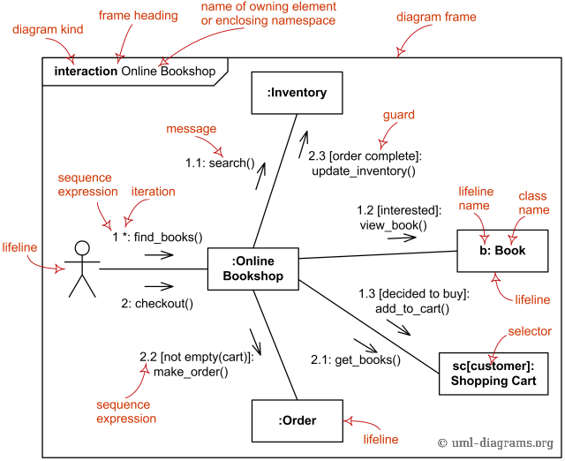
Requirements process – ii. analysis
Conceptual models
For example with the Unified Modeling Language (UML)
use case diagrams
communication diagrams
state machine diagrams
…
exemple: UML Communication diagrams
source: https://www.uml-diagrams.org/communication-diagrams.html

Slide 24
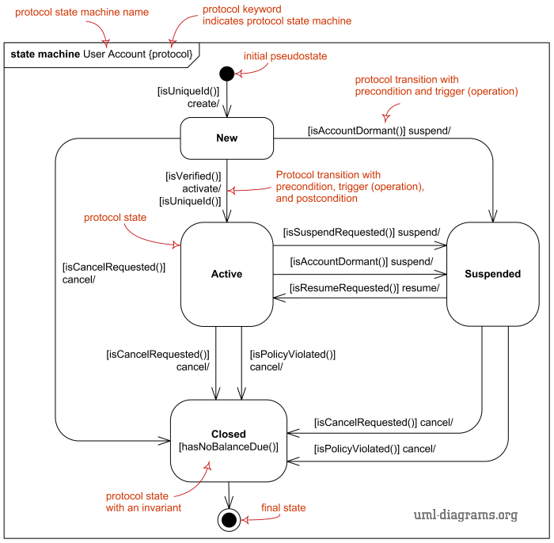
Requirements process – ii. analysis
Conceptual models
For example with the Unified Modeling Language (UML)
use case diagrams
communication diagrams
state machine diagrams
…
exemple: UML state machine diagrams
source: https://www.uml-diagrams.org/protocol-state-machine-diagrams.html

Slide 25
Requirements process – ii. analysis
Architectural Design
“point when the requirement process overlaps with the software/system design”
Requirement allocation
Requirements need to be allocated to the architecture/design component that will be responsible for satisfying the requirement
Demonstrates that the requirement process is not only an upfront analysis task !

Slide 26
Requirements process – ii. analysis
Conflicts may arise …
stakeholders require incompatible features
incompatibilities between requirements and resources
incompatibilities between functional and nonfunctional requirements
…
Negotiation is important
consult with the stakeholders instead of making unilateral decisions
refine priorization
estimate wisely cost and time
keep traces the decisions
see for example https://www.bbau.ac.in/dept/dit/TM/Requirement%20Validation.pdf

Slide 27
Requirements process – ii. analysis
formal analysis
“application of mathematically rigorous techniques for the specification, development, and verification of software and hardware systems”
costly
important for safety-critical or security-critical software/systems
permits static validation (for example, absence of deadlocks)
Methods
logic calculi, formal languages, automata theory, discrete event dynamic system, program semantics, type systems, algebraic datatypes
– What is formal method - https://shemesh.larc.nasa.gov/fm/fm-what.html
see for example https://en.wikipedia.org/wiki/Formal_methods

Slide 28
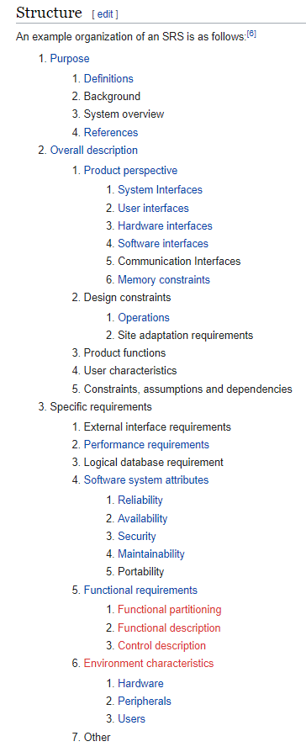
Requirements process – iii. specification
specification (in software engineering)
“production of a document that can be systematically reviewed, evaluated, and approved”
software requirements specification (SRS)
“structured collection of the essential requirements [functions, performance, design constraints and attributes] of the software and its external interfaces”
— ISO/IEC TR 19759:2015 Software Engineering Body of Knowledge (SWEBOK)
— IEEE 1012-2016 - IEEE Standard for System, Software, and Hardware Verification and Validation
example organization of a SRS document
source: https://en.wikipedia.org/wiki/Software_requirements_specification
see also https://en.wikipedia.org/wiki/Software_requirements_specification

Slide 29
Requirements process – iv. validation
requirement validation
“confirmation by examination that requirements (individually and as a set) define the right system as intended by the stakeholders”
Techniques for requirement validation
reviews
inspections
prototyping
user manual development
model validation
requirements testing
– ISO/IEC/IEEE 29148:2011 Systems and software engineering — Life cycle processes — Requirements engineering
see for example https://en.wikipedia.org/wiki/Formal_methods

Slide 30
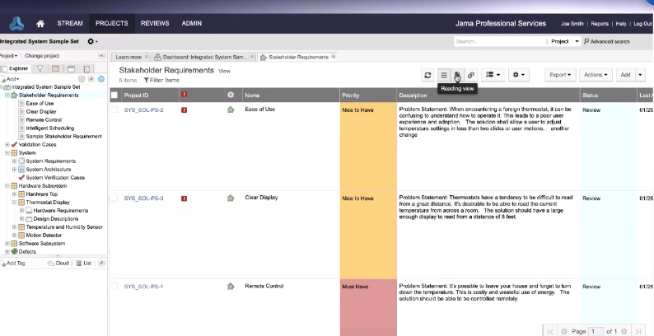
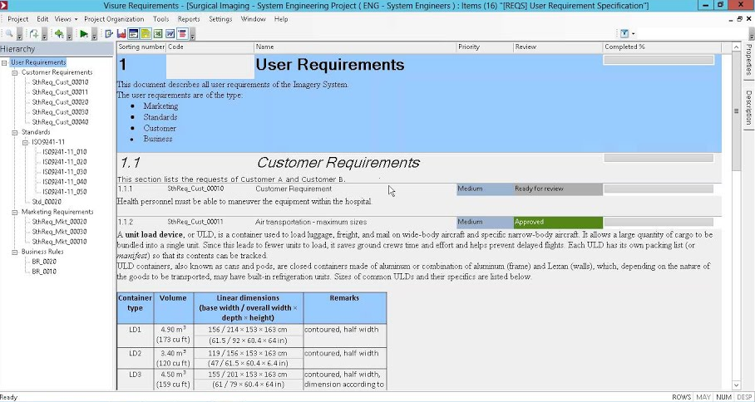
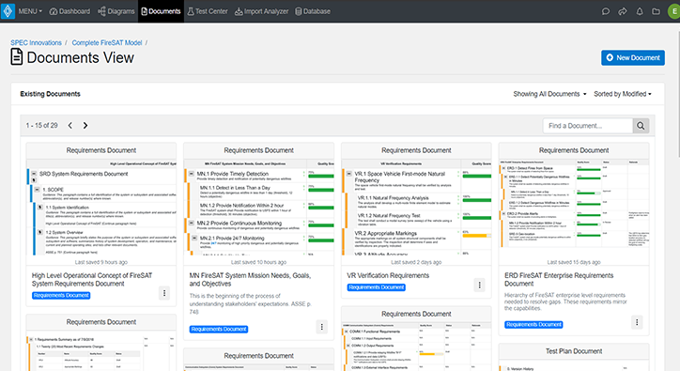
Software requirements tools
almost exclusively commercial tools
https://www.jamasoftware.com/solutions/software-development/
https://visuresolutions.com/
Detailed list here (see column « RM »)
https://en.wikipedia.org/wiki/List_of_requirements_engineering_tools
https://www.innoslate.com/requirements-management/

Slide 31
Breakdown of Topics for the Software Requirements KA. Source: SWEBOK V3

Slide 32
Software Engineering
Part 3 – The ISO/IEC 25010 System and software quality models
ICM – Computer Science Major – Software Engineering - Part 1: Introduction
M1 Cyber Physical and Social Systems – CPS2 engineering and development - Part 3: Software Engineering
Maxime Lefrançois https://maxime.lefrancois.info
Course unit URL: https://ci.mines-stetienne.fr/cps2/course/softeng/

Slide 33
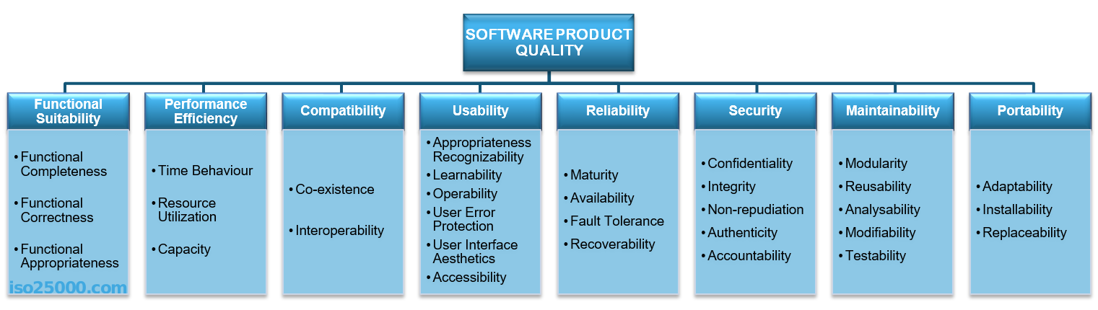
Software quality model (ISO/IEC 25010:2011)
https://iso25000.com/index.php/en/iso-25000-standards/iso-25010
software quality
degree to which a software product satisfies stated and implied needs when used under specified conditions
— ISO/IEC 25010:2011 System and software quality models

Slide 34
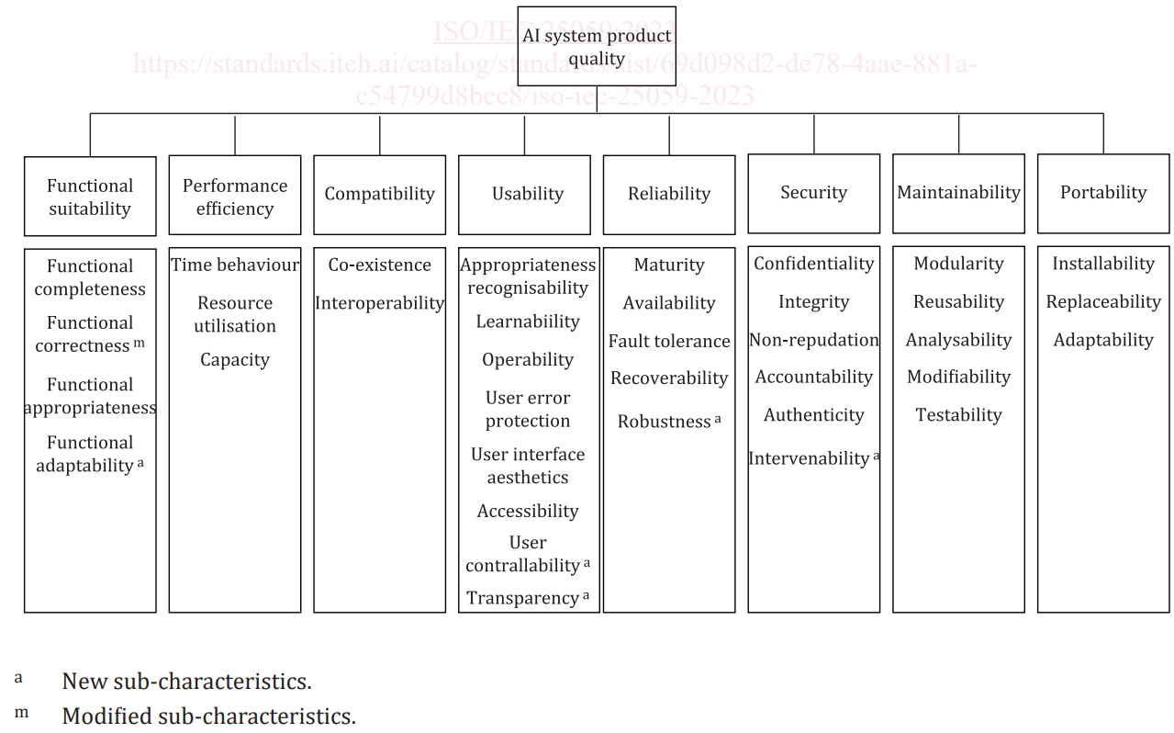
Quality model for AI systems (ISO/IEC 25059:2024)
https://iso25000.com/index.php/en/iso-25000-standards/iso-25059

Slide 35
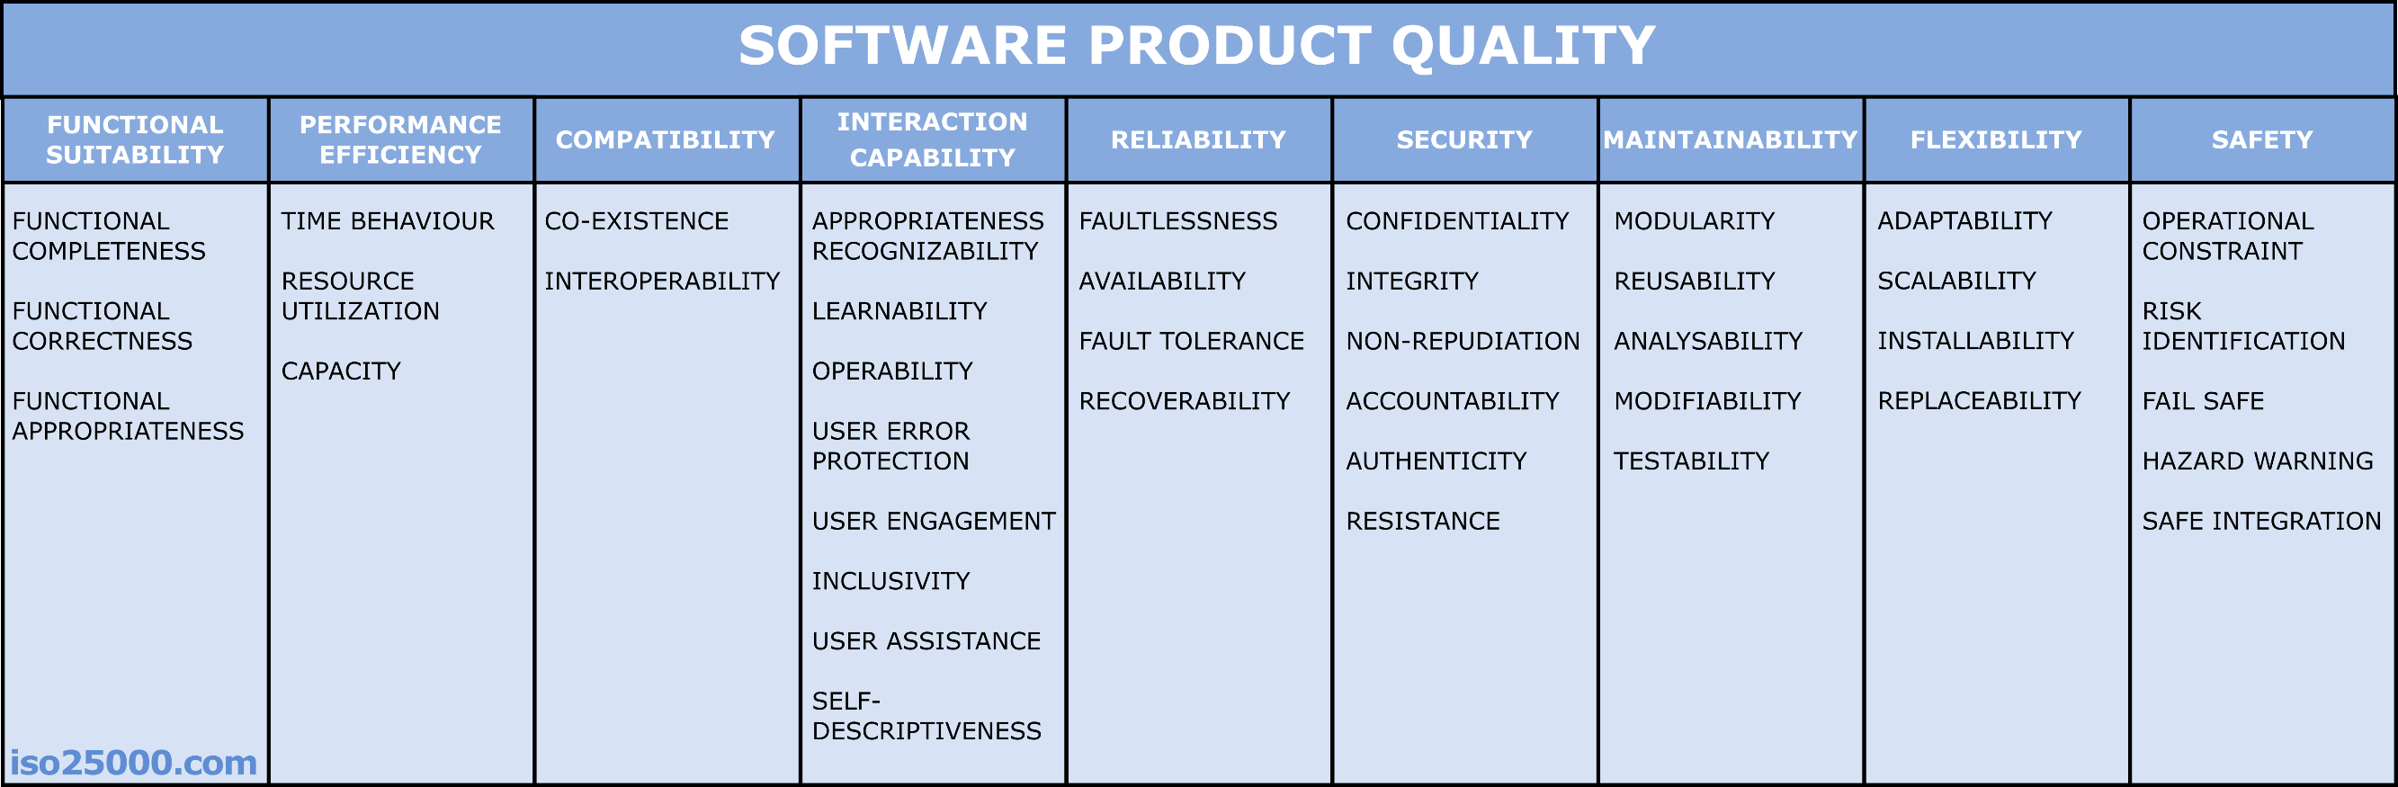
Software quality model (ISO/IEC 25010:2023)
https://iso25000.com/index.php/en/iso-25000-standards/iso-25010
software quality
degree to which the system satisfies the stated and implied needs of its various stakeholders, and thus provides value.
— ISO/IEC 25010:2011 System and software quality models
NEW!
NEW!
MODIFIED
NEW!

Slide 36
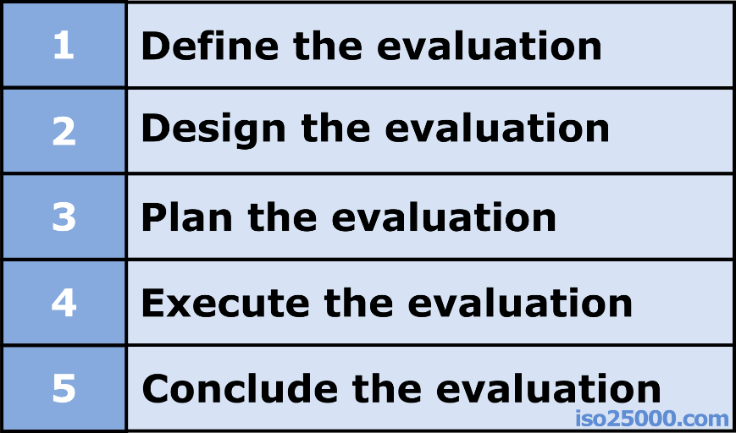
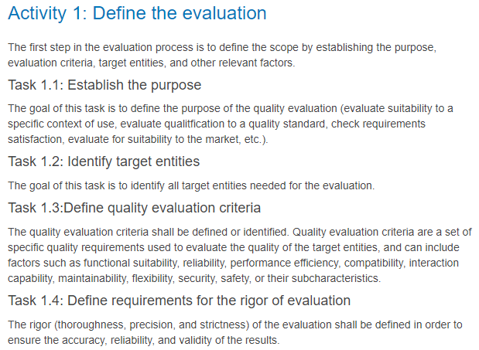
Evaluation process (ISO/IEC 25040:2011)
https://iso25000.com/index.php/en/iso-25000-standards/iso-25040
Five activities, each having different steps

