Slide 1
Software Engineering
Part 4 – Software Engineering Process
ICM – Computer Science Major – Software Engineering - Part 1: Introduction
M1 Cyber Physical and Social Systems – CPS2 engineering and development - Part 3: Software Engineering
Guillaume Muller
Course unit URL: https://ci.mines-stetienne.fr/cps2/course/softeng/

Slide 2
Software engineering methods – definition
software engineering method
organized and systematic approach to developing software for a target computer
— ISO/IEC TR 19759:2015 Software Engineering Body of Knowledge (SWEBOK)
objectives:
facilitate human understanding, communication, and coordination
aid management of software projects
measure and improve the quality of software products in an efficient manner
support process improvement
provide a basis for automated support of process execution

Slide 3
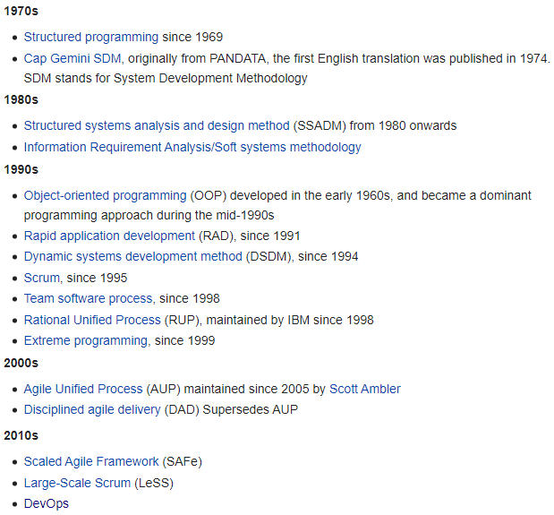
Software development life cycles (SDLC)
software development life cycle process
software processes used to specify and transform software requirements into a deliverable software product
history
— ISO/IEC TR 19759:2015 Software Engineering Body of Knowledge (SWEBOK)
source https://en.wikipedia.org/wiki/Software_development_process

Slide 4
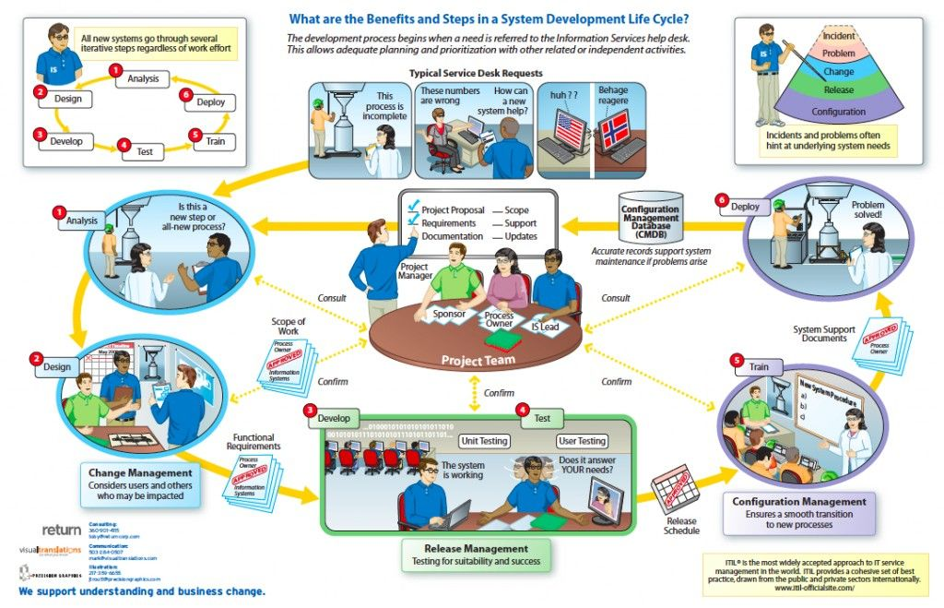
Example of a software development life cycle

Slide 5
Analysis vs. Design What vs. How
During Analysis
To know about the application domain and the requirements
Development of a coarse-grained model to show where responsibilities are, and how objects interact
Models show a message being passed, but no worry too much about the contents of each message
During Design
To know how the software should work
Development of fine-grained models to show exactly what will happen when the system runs

Slide 6
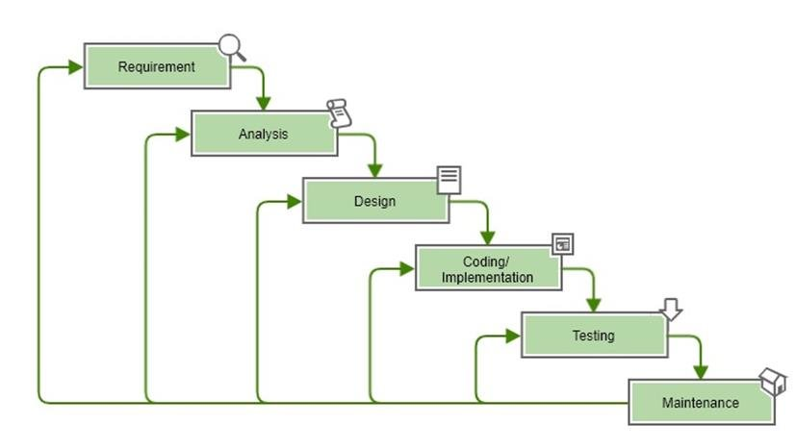
The waterfall development life cycle model
W.W. Royce, 1970
→ product requirements document
→ models, schemas, business rules
→ software architecture
→ development, unit tests, software integration
→ systematic discovery and debugging of defects
→ installation, migration, support, maintenance
Many variants of this model
☺ Well-documented and well structured
☺ Easy to maintain
☹ No prototype, late feedback to customer
Major project risks, e.g. Implementation technology, are faced at the end of the project

Slide 7
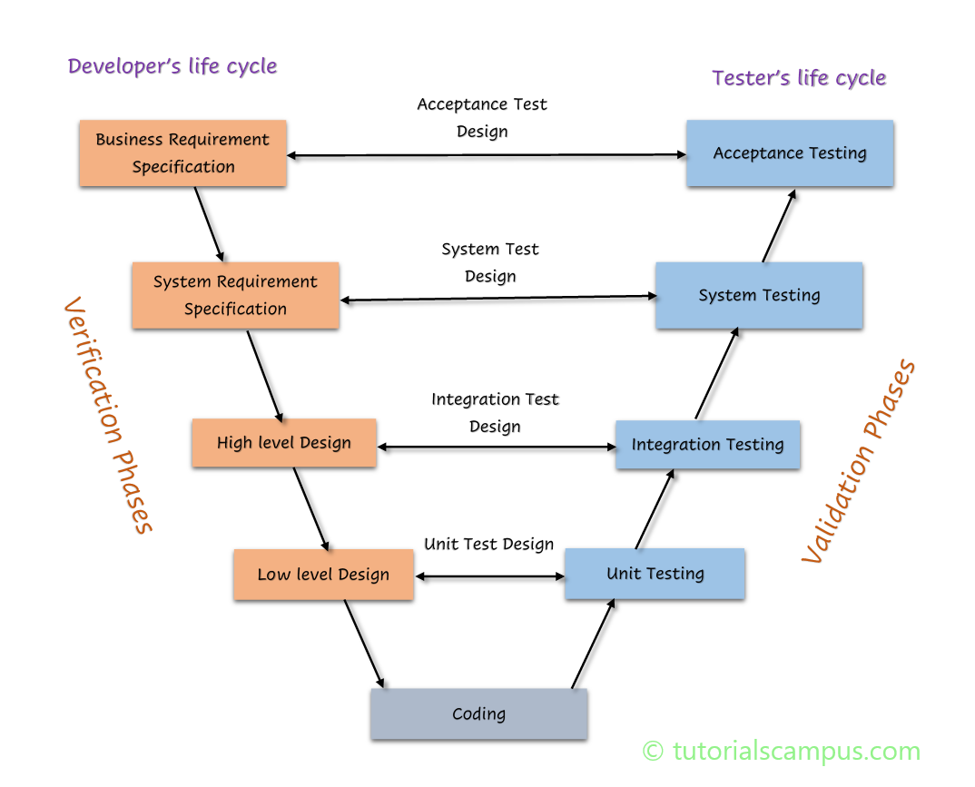
The V-model life cycle model
1980s
source: https://www.tutorialscampus.com/sdlc/v-model.htm

Slide 8
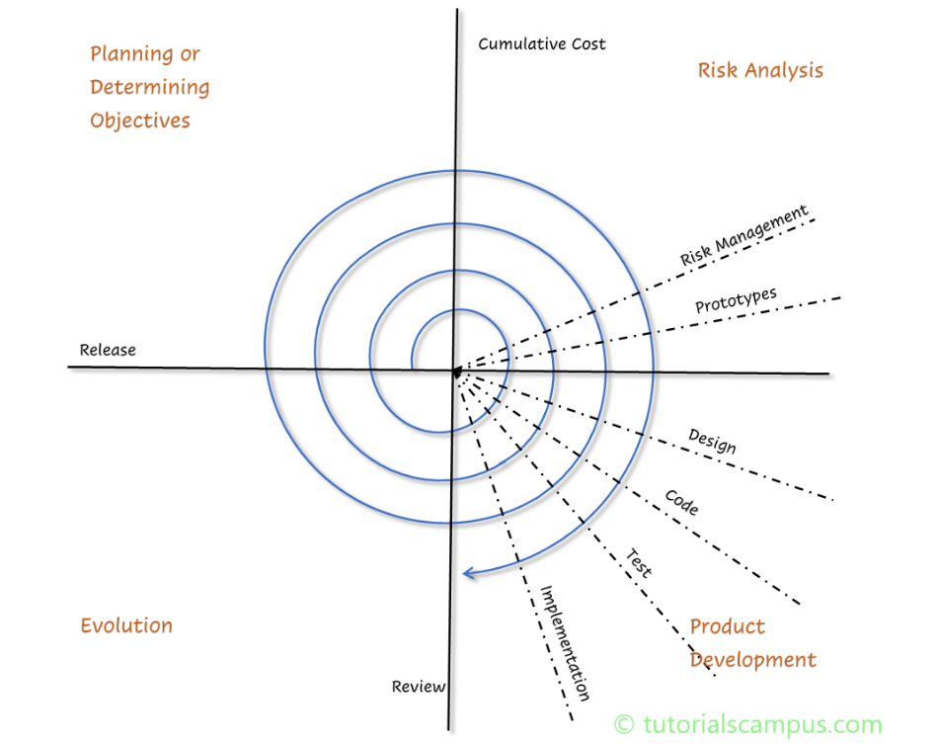
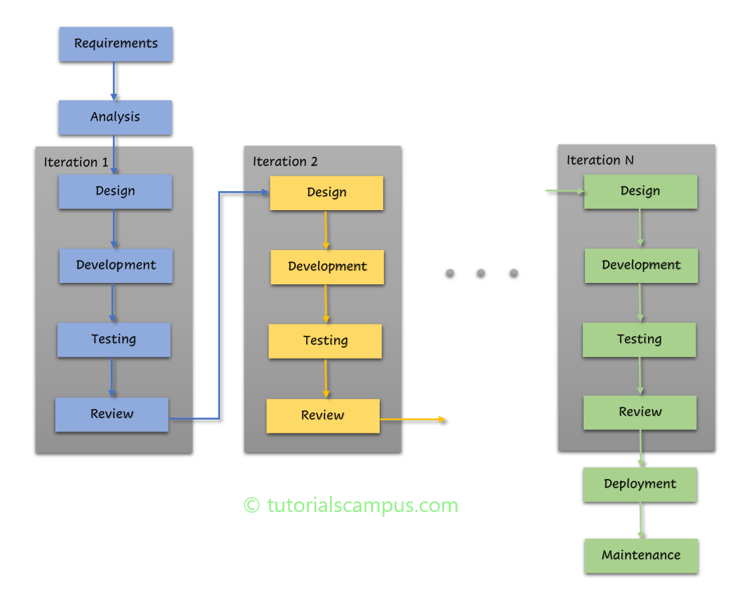
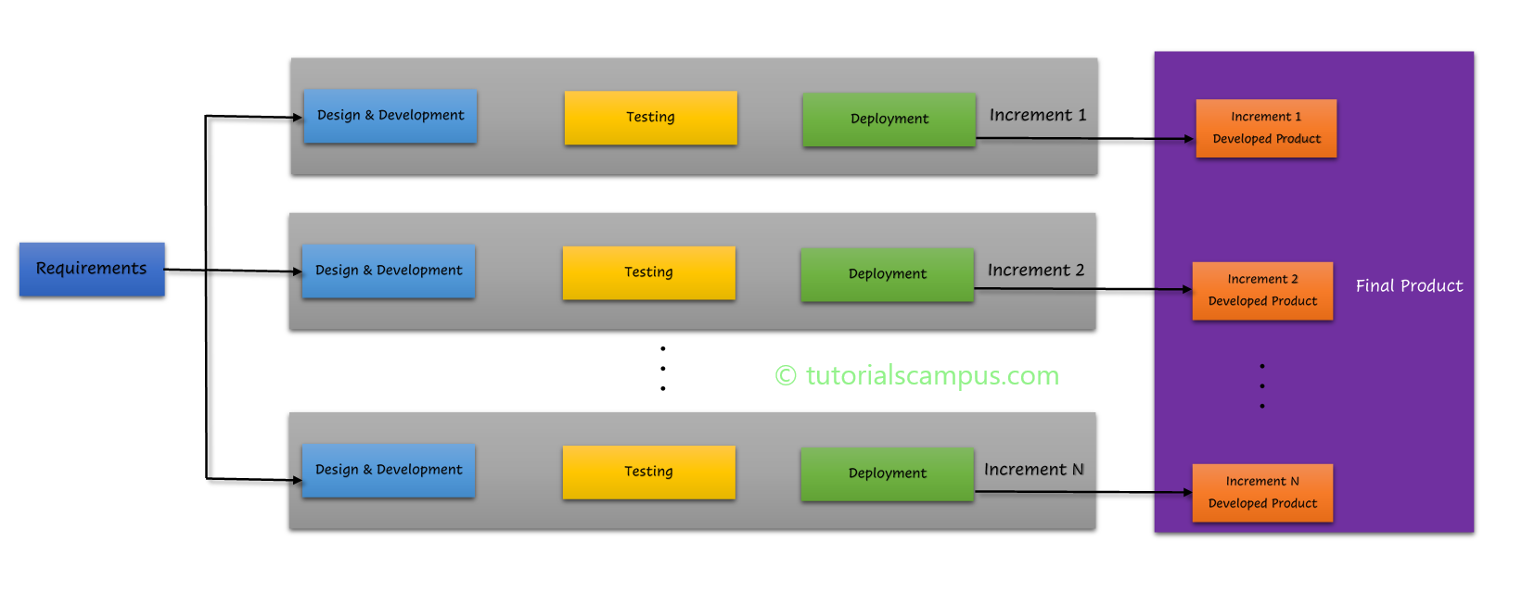
Many more SDLC models ...
spiral SDLC model
iterative SDLC model
incremental SDLC model
source: https://www.tutorialscampus.com/sdlc/

Slide 9

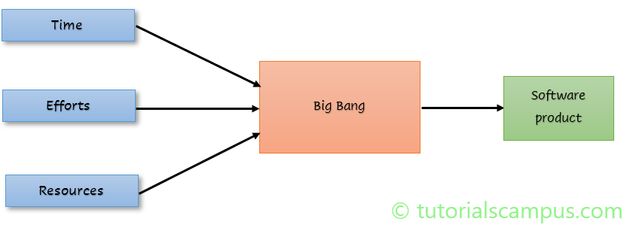
Simplest SDLC models ...
One main rule:
always resolve the most important issue first
Big Bang methodology
Chaos model
source: https://www.tutorialscampus.com/sdlc/

Slide 10
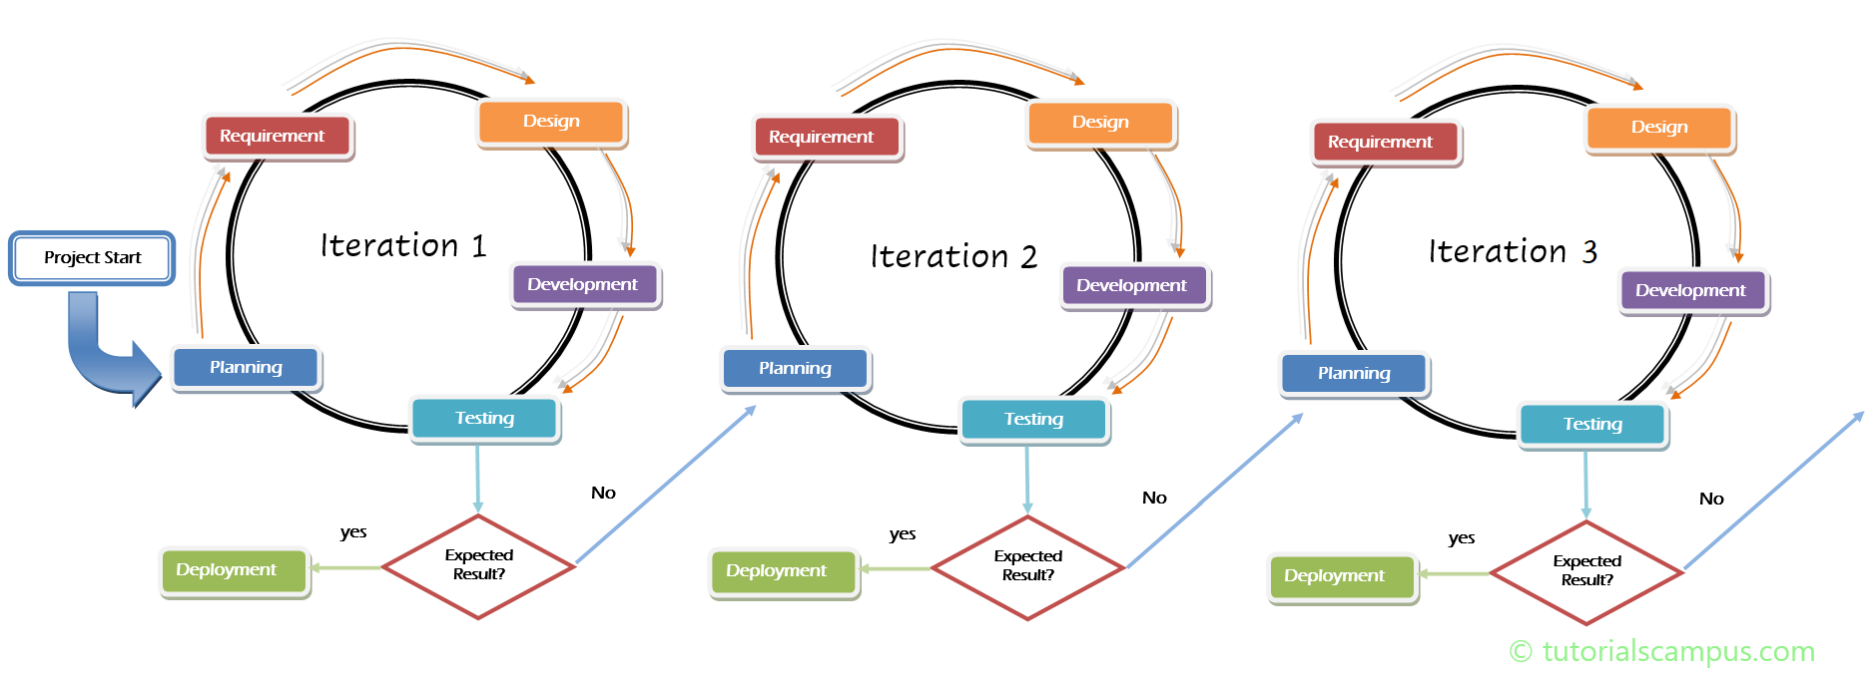
Agile methods (not a SDLC model!)
1990s
Many Agile SDLC models
Lightweight methods; short, iterative development cycles; self-organizing teams; simpler designs; code refactoring; test-driven development; frequent customer involvement; create demonstrable working product with each development cycle
source: https://www.tutorialscampus.com/sdlc/agile-model.htm

Slide 11
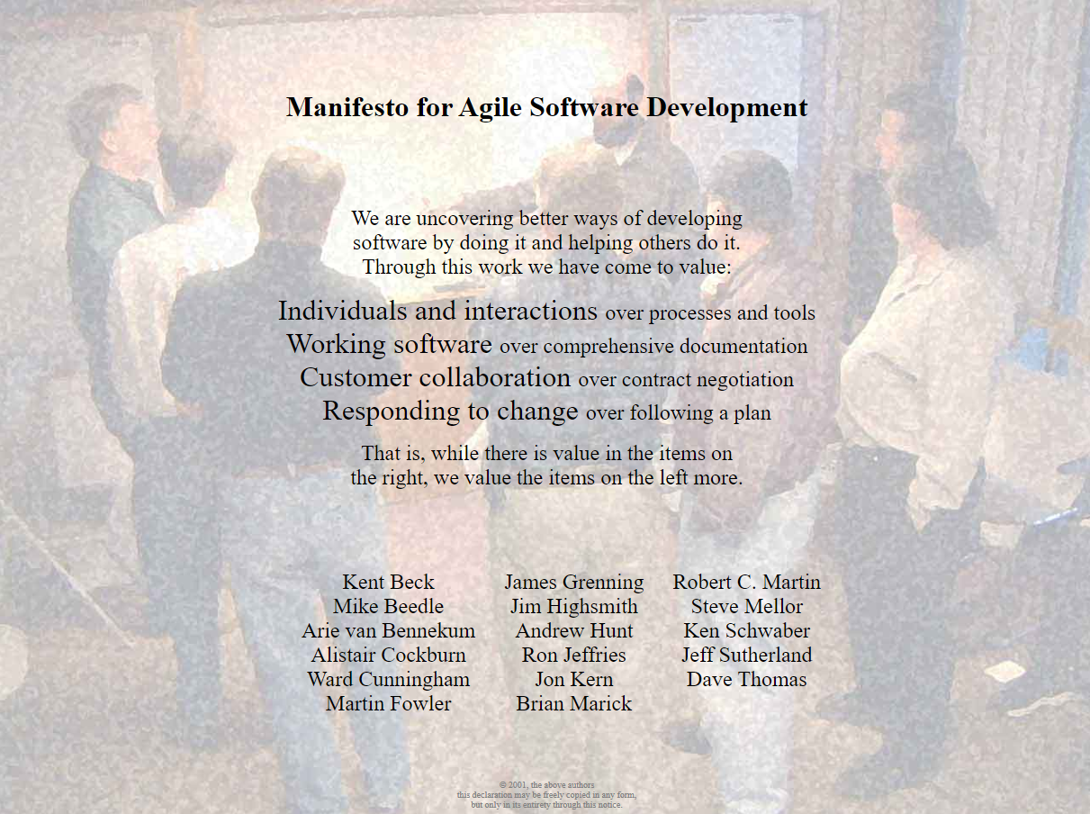
2001
4 values
source: https://agilemanifesto.org/

Slide 12

2001
4 values
and
12 principles
We follow these 12 principles:
Our highest priority is to satisfy the customer through early and continuous delivery of valuable software.
Welcome changing requirements, even late in development. Agile processes harness change for the customer's competitive advantage.
Deliver working software frequently, from a couple of weeks to a couple of months, with a preference to the shorter timescale.
Business people and developers must work together daily throughout the project.
Build projects around motivated individuals. Give them the environment and support they need, and trust them to get the job done.
The most efficient and effective method of conveying information to and within a development team is face-to-face conversation.
Working software is the primary measure of progress.
Agile processes promote sustainable development. The sponsors, developers, and users should be able to maintain a constant pace indefinitely.
Continuous attention to technical excellence and good design enhances agility.
Simplicity--the art of maximizing the amount of work not done--is essential.
The best architectures, requirements, and designs emerge from self-organizing teams.
At regular intervals, the team reflects on how to become more effective, then tunes and adjusts its behavior accordingly.
source: https://agilemanifesto.org/

Slide 13
Agile vs « traditional » methods

Slide 14
Agile development methods
Dynamic System Development Methodology and RAD (www.dsdm.org, 1995)
Scrum (Sutherland and Schwaber, 1995)
XP - eXtreme Programming (Beck, 1999)
Feature Driven Development (DeLuca, 1999)
Adaptive Sw Development (Highsmith, 2000)
Lean Development (Poppendieck, 2003)
Crystal Clear (Cockburn, 2004)
Agile Unified Process (Ambler, 2005)
DevOps (

Slide 15
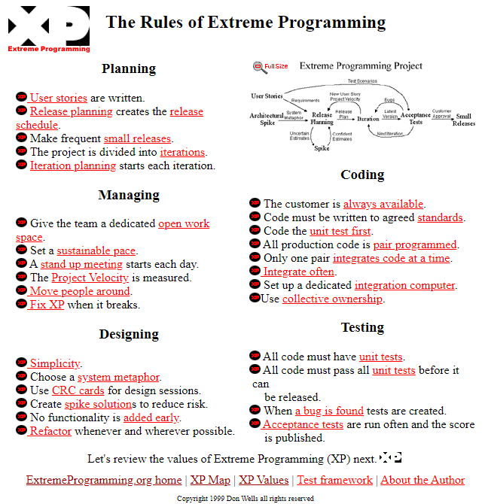
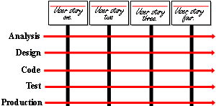
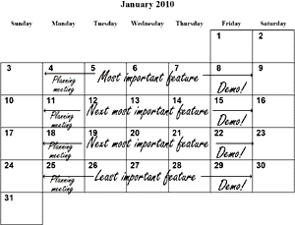
Extreme Programming (XP)
Manage Goals Instead of Activities
The values of XP
simplicity
communication
feedback
respect
courage
source: http://www.extremeprogramming.org

Slide 16
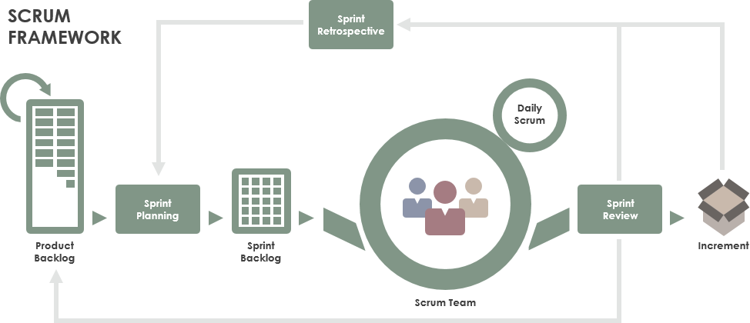
Scrum - Framework
A Scrum Master fosters an environment where
A Product Owner orders the work for a complex problem into a Product Backlog.
The Scrum Team turns a selection of the work into an Increment of value during a Sprint.
The Scrum Team and its stakeholders inspect the results and adjust for the next Sprint.
Repeat
https://www.scrum.org/ (with videos, guide)
https://www.scrumguides.org/index.html

Slide 17
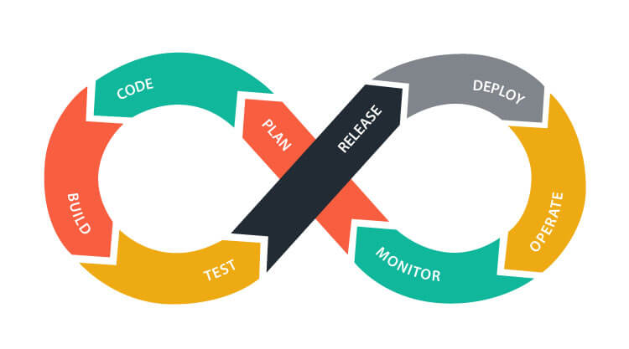

DevOps
DevOps is a set of practices that combines software development (Dev) and IT operations (Ops). It aims to shorten the systems development life cycle and provide continuous delivery with high software quality. DevOps is complementary with Agile software development; several DevOps aspects came from the Agile methodology.
— Contributors, Wikipedia https://en.wikipedia.org/wiki/DevOps
There are many variants

Slide 18
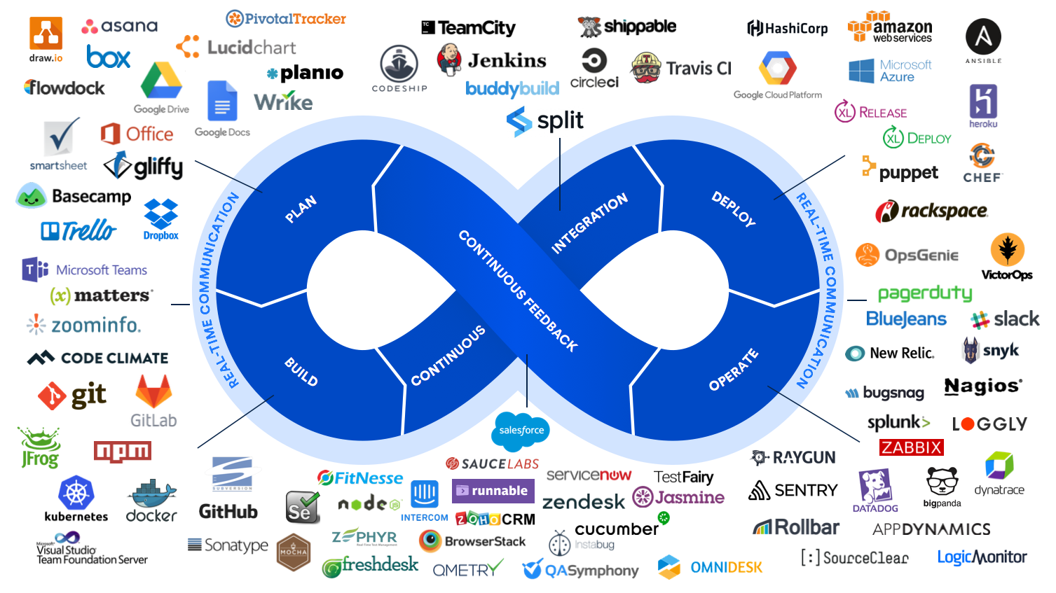
https://s32860.pcdn.co/wp-content/uploads/2019/11/devops-hero-1-87966cfbc9c5713ae047551c7b22985c.png

Slide 19
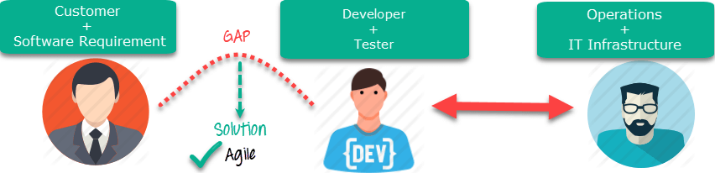
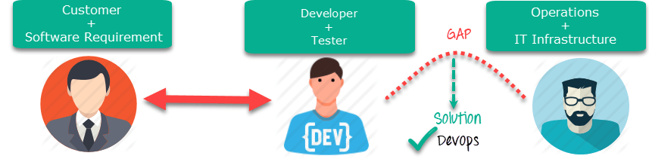
Agile vs DevOps
DevOps is a practice of bringing development and operations teams together whereas Agile is an iterative approach that focuses on collaboration, customer feedback and small rapid releases.
DevOps focuses on constant testing and delivery while the Agile process focuses on constant changes.
DevOps requires relatively a large team while Agile requires a small team.
DevOps leverages both shifts left and right principles, on the other hand, Agile leverage shift-left principle.
The target area of Agile is Software development whereas the Target area of DevOps is to give end-to-end business solutions and fast delivery.
DevOps focuses more on operational and business readiness whereas Agile focuses on functional and non-function readiness.
Source: https://www.guru99.com/agile-vs-devops.html

Slide 20
Software Engineering
Part 5 – Focus on the Scrum methodology
ICM – Computer Science Major – Software Engineering - Part 1: Introduction
M1 Cyber Physical and Social Systems – CPS2 engineering and development - Part 3: Software Engineering
Guillaume Muller
Course unit URL: https://ci.mines-stetienne.fr/cps2/course/softeng/

Slide 21

Scrum - roles
The Scrum Team consists of one Scrum Master, one Product Owner, and Developers
Developers are the people in the Scrum Team that are committed to creating any aspect of a usable Increment each Sprint.
Create a plan for the Sprint, the Sprint Backlog;
Instill quality by adhering to a Definition of Done;
Adapt their plan each day toward the Sprint Goal; and,
Hold each other accountable as professionals.
https://www.scrum.org/ (with videos, guide)
https://www.scrumguides.org/index.html

Slide 22

Scrum - roles
The Scrum Team consists of one Scrum Master, one Product Owner, and Developers
Product Owner is accountable for maximizing the value of the product resulting from the work of the Scrum Team. How this is done may vary widely across organizations, Scrum Teams, and individuals.
Develop and explicitly communicate the Product Goal;
Create and clearly communicate Product Backlog items;
Order Product Backlog items; and,
Ensure that the Product Backlog is transparent, visible and understood.
https://www.scrum.org/ (with videos, guide)
https://www.scrumguides.org/index.html

Slide 23

Scrum - roles
The Scrum Team consists of one Scrum Master, one Product Owner, and Developers
Scrum Master is accountable for establishing Scrum as defined in the Scrum Guide. They do this by helping everyone understand Scrum theory and practice, both within the Scrum Team and the organization.
The Scrum Master is accountable for the Scrum Team’s effectiveness. They do this by enabling the Scrum Team to improve its practices, within the Scrum framework.
Scrum Masters are true leaders who serve the Scrum Team and the larger organization.
Serves the Scrum Team:
Coaching the team members in self-management and cross-functionality;
Helping the Scrum Team focus on creating high-value Increments that meet the Definition of Done;
Causing the removal of impediments to the Scrum Team’s progress; and,
Ensuring that all Scrum events take place and are positive, productive, and kept within the timebox.
https://www.scrum.org/ (with videos, guide)
https://www.scrumguides.org/index.html

Slide 24
Scrum - roles
The Scrum Team consists of one Scrum Master, one Product Owner, and Developers
Scrum Master is accountable for establishing Scrum as defined in the Scrum Guide. They do this by helping everyone understand Scrum theory and practice, both within the Scrum Team and the organization.
The Scrum Master is accountable for the Scrum Team’s effectiveness. They do this by enabling the Scrum Team to improve its practices, within the Scrum framework.
Scrum Masters are true leaders who serve the Scrum Team and the larger organization.
Serves the Product Owner:
Helping find techniques for effective Product Goal definition and Product Backlog management;
Helping the Scrum Team understand the need for clear and concise Product Backlog items;
Helping establish empirical product planning for a complex environment; and,
Facilitating stakeholder collaboration as requested or needed.
https://www.scrum.org/ (with videos, guide)
https://www.scrumguides.org/index.html

Slide 25

Scrum - roles
The Scrum Team consists of one Scrum Master, one Product Owner, and Developers
Scrum Master is accountable for establishing Scrum as defined in the Scrum Guide. They do this by helping everyone understand Scrum theory and practice, both within the Scrum Team and the organization.
The Scrum Master is accountable for the Scrum Team’s effectiveness. They do this by enabling the Scrum Team to improve its practices, within the Scrum framework.
Scrum Masters are true leaders who serve the Scrum Team and the larger organization.
Serves the Organization:
Leading, training, and coaching the organization in its Scrum adoption;
Planning and advising Scrum implementations within the organization;
Helping employees and stakeholders understand and enact an empirical approach for complex work; and,
Removing barriers between stakeholders and Scrum Teams
https://www.scrum.org/ (with videos, guide)
https://www.scrumguides.org/index.html

Slide 26
Scrum - Framework
A Scrum Master fosters an environment where
A Product Owner orders the work for a complex problem into a Product Backlog.
The Scrum Team turns a selection of the work into an Increment of value during a Sprint.
The Scrum Team and its stakeholders inspect the results and adjust for the next Sprint.
Repeat
https://www.scrum.org/ (with videos, guide)
https://www.scrumguides.org/index.html

Slide 27

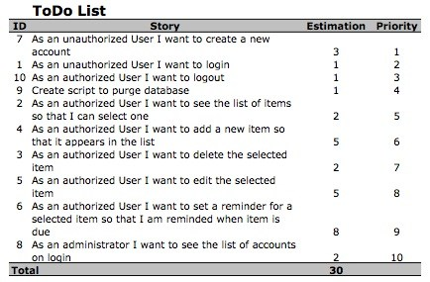
Scrum – product backlog
The Product Backlog is an emergent, ordered list of what is needed to improve the product. It is the single source of work undertaken by the Scrum Team.
https://www.scrum.org/ (with videos, guide)
https://www.scrumguides.org/index.html
Example Product Backlog
Source: https://www.scrum-institute.org/The_Scrum_Product_Backlog.php

Slide 28
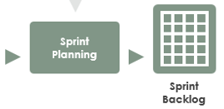
Scrum – sprint planning
Sprint Planning initiates the Sprint by laying out the work to be performed for the Sprint. This resulting plan is created by the collaborative work of the entire Scrum Team.
Topic One: Why is this Sprint valuable?
Product Owner proposes how to increase the value and utility of the product
Scrum Team collaborates to define Sprint Goal
Topic Two: What can be Done this Sprint?
Developers discuss with Product Owner and select items from the Product Backlog to include in the current Sprint
Refine items, estimate how much can be done in the Sprint timebox
Topic Three: How will the chosen work get done?
Developers plan the work. Decompose Product Backlog into smaller work items
Output: Sprint Backlog: Sprint Goal, Product Backlog selected for the Sprint, Plan for delivering them
https://www.scrum.org/ (with videos, guide)
https://www.scrumguides.org/index.html

Slide 29
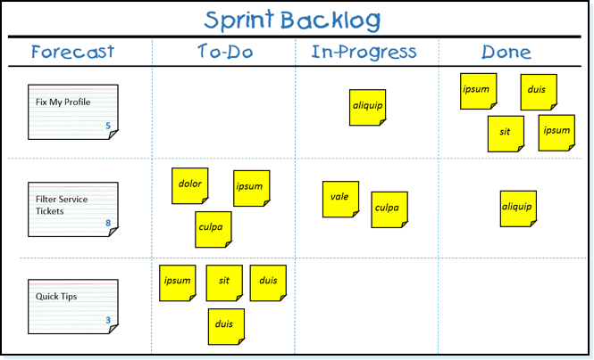
Scrum – sprint backlog
The Sprint Backlog is composed of the Sprint Goal (why), the set of Product Backlog items selected for the Sprint (what), as well as an actionable plan for delivering the Increment (how)
https://www.scrum.org/ (with videos, guide)
https://www.scrumguides.org/index.html
Example Sprint Backlog
Source: https://www.scrum.org/resources/what-is-a-sprint-backlog

Slide 30
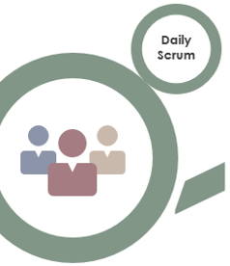
Scrum – daily scrum
For developers only - The purpose of the Daily Scrum is to inspect progress toward the Sprint Goal and adapt the Sprint Backlog as necessary, adjusting the upcoming planned work.
https://www.scrum.org/ (with videos, guide)
https://www.scrumguides.org/index.html
Example Sprint Backlog
Source: https://www.scrum.org/resources/what-is-a-sprint-backlog

Slide 31

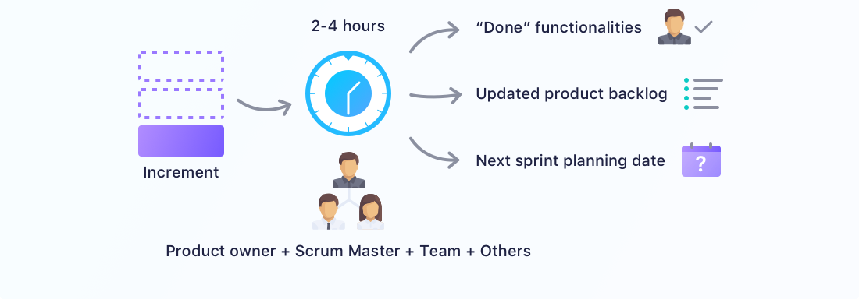
Scrum – sprint review
inspect the outcome of the Sprint and determine future adaptations. The Scrum Team presents the results of their work to key stakeholders and progress toward the Product Goal is discussed.
During the event, the Scrum Team and stakeholders review what was accomplished in the Sprint and what has changed in their environment. Based on this information, attendees collaborate on what to do next. The Product Backlog may also be adjusted to meet new opportunities. The Sprint Review is a working session and the Scrum Team should avoid limiting it to a presentation.
https://www.scrum.org/ (with videos, guide)
https://www.scrumguides.org/index.html
https://startinfinity.com/product-management-framework/scrum-sprint/sprint-review-vs-sprint-retrospective

Slide 32

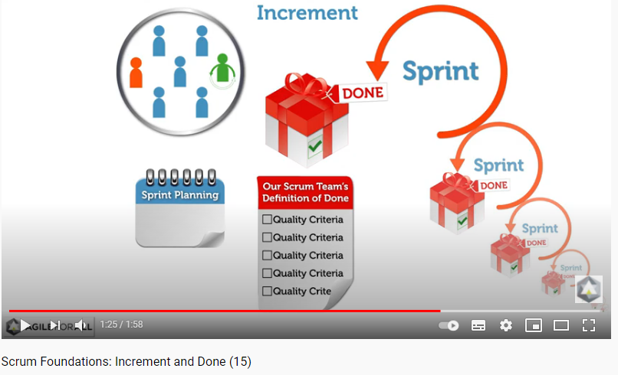
Scrum – Increment and Done
An Increment is a concrete stepping stone toward the Product Goal. Each Increment is additive to all prior Increments and thoroughly verified, ensuring that all Increments work together. In order to provide value, the Increment must be usable.
The Definition of Done is a formal description of the state of the Increment when it meets the quality measures required for the product
https://www.scrum.org/ (with videos, guide)
https://www.scrumguides.org/index.html
source: https://youtu.be/0MTWysPmaoU

Slide 33

Scrum – Sprint retrospective
The purpose of the Sprint Retrospective is to plan ways to increase quality and effectiveness.
The Scrum Team inspects how the last Sprint went with regards to individuals, interactions, processes, tools, and their Definition of Done.
The Scrum Team identifies the most helpful changes to improve its effectiveness.
https://www.scrum.org/ (with videos, guide)
https://www.scrumguides.org/index.html

Slide 34
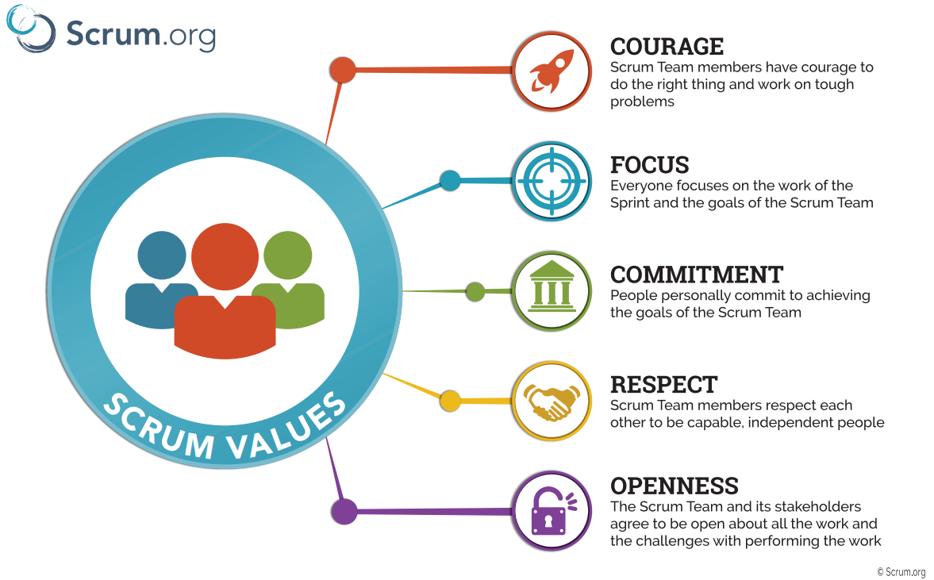
Scrum - values
https://www.scrum.org/ (with videos, guide)
https://www.scrumguides.org/index.html

