Slide 1
Software Engineering
Part 6 – The Unified Modeling Language
ICM – Computer Science Major – Software Engineering - Part 1: Introduction
M1 Cyber Physical and Social Systems – CPS2 engineering and development - Part 3: Software Engineering
Guillaume Muller
Course unit URL: https://ci.mines-stetienne.fr/cps2/course/softeng/

Slide 2
Software Engineering
Part 6 – The Unified Modeling Language
6.1 Introduction
ICM – Computer Science Major – Software Engineering - Part 1: Introduction
M1 Cyber Physical and Social Systems – CPS2 engineering and development - Part 3: Software Engineering
Guillaume Muller
Course unit URL: https://ci.mines-stetienne.fr/cps2/course/softeng/

Slide 3
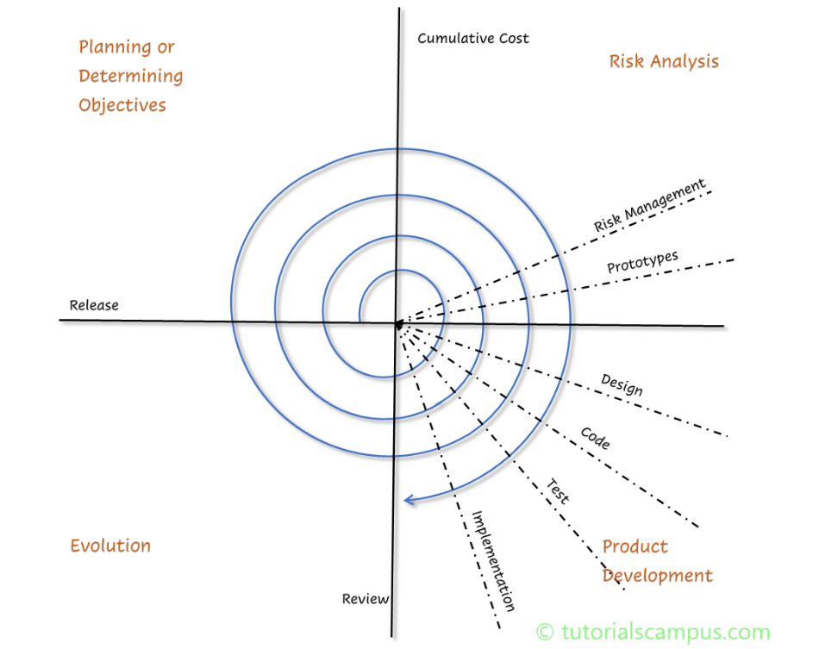
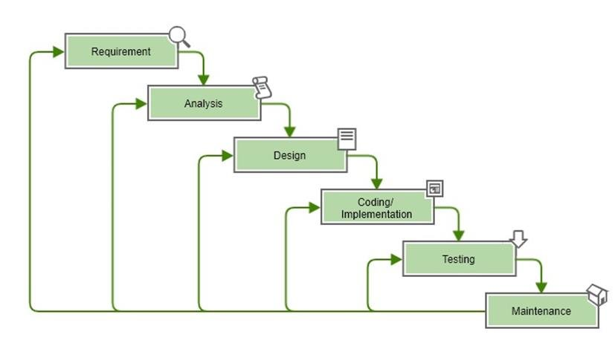
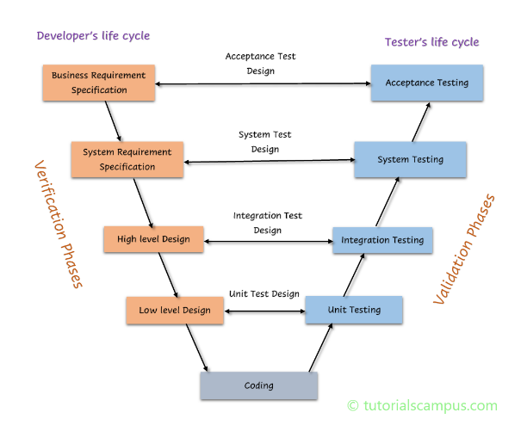
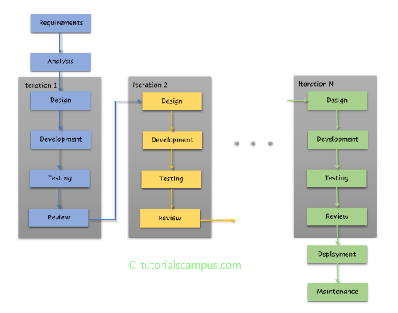
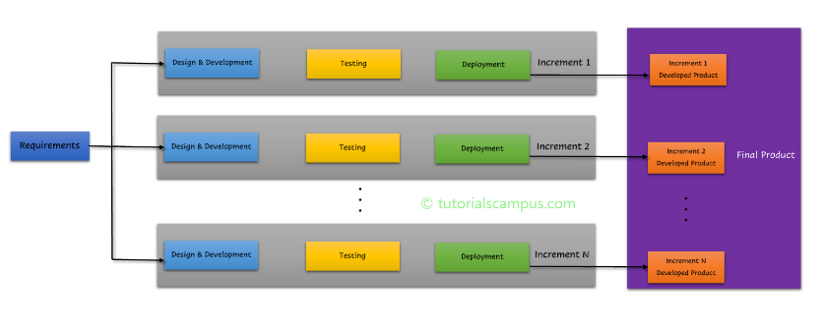
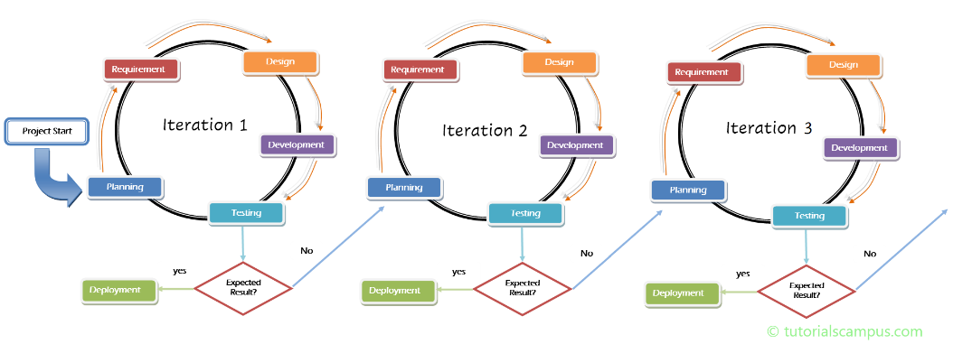
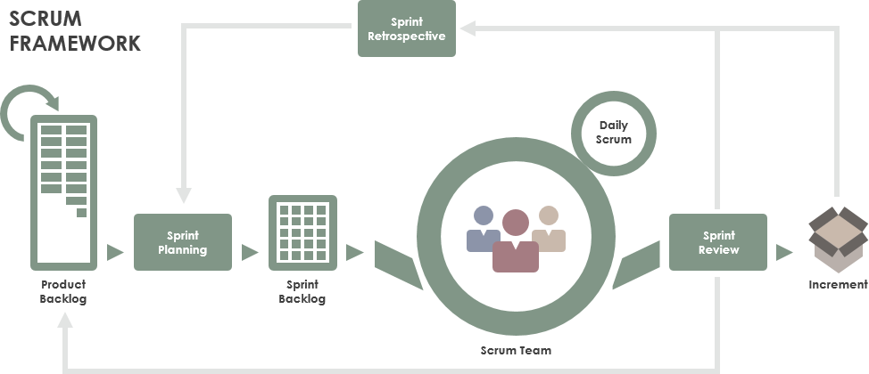
Software Development Methods

Slide 4
Software Development Methods
processes that distinguish development stages in the software life cycle. Should:
be modular, reduce complexity, reuseable, at the right level of abstraction
Using a representation formalism that facilitates communication, organization and verification
Production of a set of artifacts that facilitate design feedback and application evolution
documents, models, prototypes

Slide 5
Existing software Development Methods
Hierarchical functional methods
Data-Flow/SADT/SA-SD, Structure-Chart, ...
Data oriented methods
Entité-Relation, MERISE, ...
Behaviour oriented methods
SA-RT, Petri Net, ...
Object oriented methods
OMT, OOA, Classe-Relation, OOD, ...
Notes:
sadt software engineering methodology
SA/SD In software engineering, structured analysis (SA) and structured design (SD) are methods for analyzing business requirements and developing specifications for converting practices into computer programs, hardware configurations, and related manual procedures. https://en.wikipedia.org/wiki/Structured_analysis

Slide 6
Object-oriented SD methods
Statement:
at the beginning of the 90’s, there are about 50 object oriented methods,
linked only by a consensus around common ideas (object, class, subsystems, ...)
BUT each with its own notation,
WITHOUT being able to fulfill all the needs and to correctly model the various fields of application.
Definition of a single common language
usable by any object method,
in all phases of the life cycle,
compatible with current production techniques.
→ UML
Definition a common unified development process
→ Unified Process (obsolete, use Scrum or other more recent processes)

Slide 7

UML (Unified Modeling Language)
Based on:
OMT notations (J. Rumbaugh) for the analysis and design of data-based information systems
G. Booch’s method notations for the design and implementation phases
OOSE notations (I. Jacobson) for requirement analysis through "use cases".
Proposes:
Standardized development artifacts (models, notation, diagrams) WITHOUT standardizing the development process,
Important role played by RATIONAL and OMG (http://www.omg.org/)

Slide 8
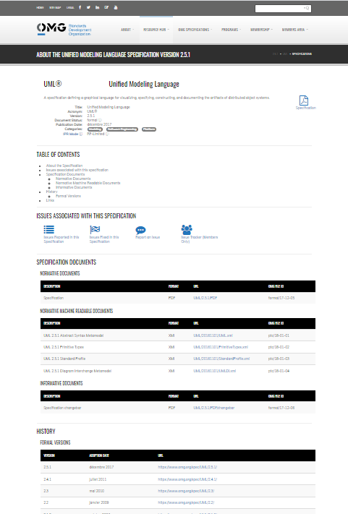

UML : Evolution
UML 2.5.1
Latest version
Revision Task Force, Jul 2005
UML 2.0
Approval OMG, Nov 1997
UML 1.1
1st submission à OMG, Jan 1997
UML partners
UML 1.0
Web - June 1996
UML 0.9
OOPSLA 1995
Unified Method 0.8
Other methods
Booch method
OMT (Rumbaugh)
OOSE (Jacobson)

Slide 9

Contributions to UML 1.X
Harel
Meyer
Gamma, et al
Statecharts
Before and after
conditions
Frameworks and patterns
HP Fusion
Booch
Operation descriptions and
message numbering
Booch method
Rumbaugh
Embley
OMT
Singleton classes and
high-level view
Jacobson
Wirfs-Brock
OOSE
Responsibilities
Shlaer - Mellor
Odell
Object lifecycles
Classification

Slide 10
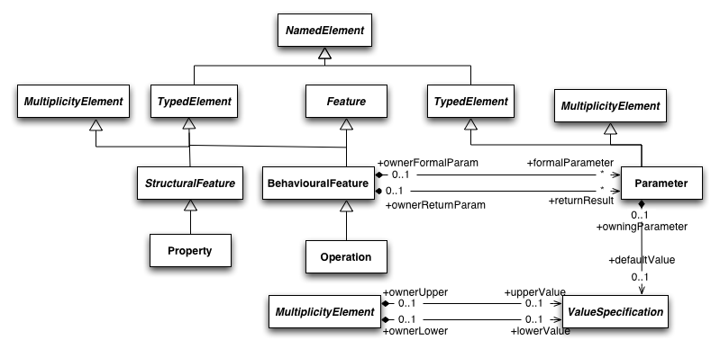
UML Meta-Model
Based on Martin Fowler UML Distilled and Viviane Jonckers OOSD-UML course

Slide 11
UML Vocabulary
Basic components
Relations
Annot.
Dependences
Associations
Generalisation
note
Struct.
Group.
Diagrams
Use cases
Classes
Active classes
Interface
Component
Collaboration
Node
Package
Model
Sub-system
Framework
Comp.
Interaction
State machine
+ extention mechanisms

Slide 12
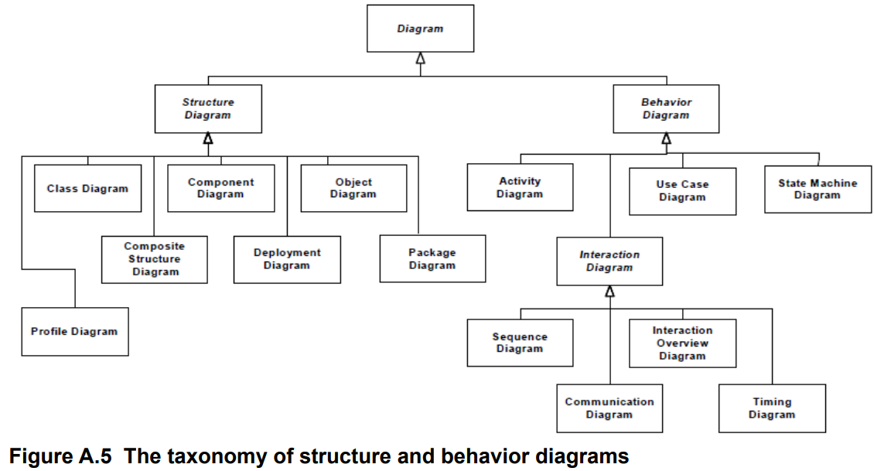
UML Diagrams
UML Specification, v2.5.1, p727 https://www.omg.org/spec/UML/2.5.1/PDF
Possibility of representing the same diagram at different levels of detail

Slide 13
Views on the Software
Design view
Implementation view
Designers
Programmers
Software
management
Use
cases
Problem domain
Process view
Deployment view
System integrators
System engineer
Performance
Scalability
System topology
Installation
Communication
Conceptuel
Physique

Slide 14
Diagrams within Views on the Software
Classes, Objects, Composite Structure
Communication, Sequences
Components, Composite Structure
Interaction, Statechart
Design view
Implementation view
Designers
Programmers
Software
management
Problem domain
Use case view
Interaction, Activity
Use Cases
Interaction
Component, Deployment
Interaction
Process view
Deployment view
System engineer
System integrators
System topology
Installation
Communication
Performance
Scalability
Conceptual
Physical

Slide 15
Rules of thumb
Nearly everything in UML is optional
UML provides a language to capture information that varies greatly depending on the domain of the problem.
Parts of UML either don't apply to your particular problem or may not lend anything to the particular view you are trying to convey.
You don't need to use every part of UML in every model you create.
You don't need to use every allowable symbol for a diagram type in every diagram you create.
Show only what helps clarify the message you are trying to

Slide 16
Pointers
The UML Specification https://www.omg.org/spec/UML/About-UML/
https://www.uml-diagrams.org/

Slide 17
Software Engineering
Part 6 – The Unified Modeling Language
6.2 – diagrams we’ll use for the analysis phase
6.2.1 – Use case diagrams
ICM – Computer Science Major – Software Engineering - Part 1: Introduction
M1 Cyber Physical and Social Systems – CPS2 engineering and development - Part 3: Software Engineering
Guillaume Muller
Course unit URL: https://ci.mines-stetienne.fr/cps2/course/softeng/

Slide 18
Use case diagrams
Describes a set of actions (use cases) that some system or systems (subject) should or can perform in collaboration with one or more external users of the system (actors) to provide some observable and valuable results to the actors or other stakeholders of the system(s).
terminology: use case, actor, subject, extend, include, association.
see also: https://www.uml-diagrams.org/use-case-reference.html

Slide 19
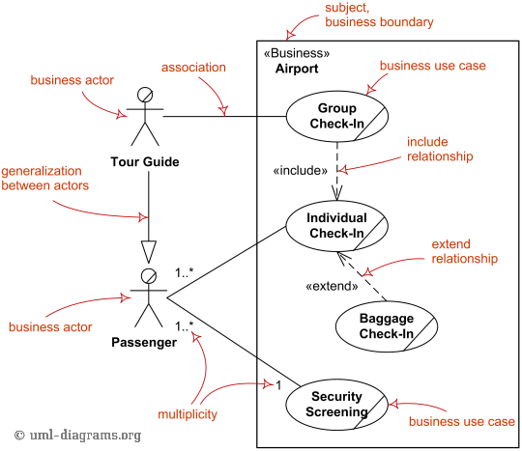
Business Use Case Diagrams
see also: https://www.uml-diagrams.org/use-case-reference.html

Slide 20
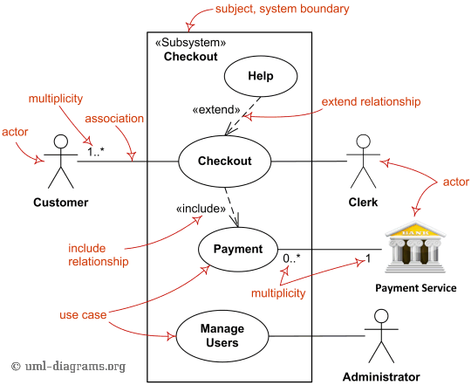
System Use Case Diagrams
see also: https://www.uml-diagrams.org/use-case-reference.html

Slide 21
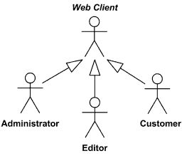



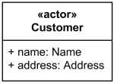
Actors and use cases
Actor
An actor is behaviored classifier which specifies a role played by an external entity that interacts with the subject (e.g., by exchanging signals and data), a human user of the designed system, some other system or hardware using services of the subject.
Use case
A use case is a kind of behaviored classifier that specifies a [complete] unit of [useful] functionality performed by [one or more] subjects to which the use case applies in collaboration with one or more actors, and which [for complete use cases] yields an observable result that is of some value to those actors [or other stakeholders] of each subject.
Generalization between actors
see also: https://www.uml-diagrams.org/use-case-reference.html

Slide 22
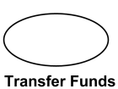
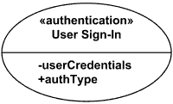
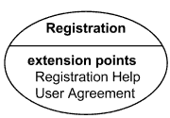
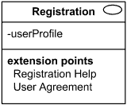

Actors and use cases
Actor
An actor is behaviored classifier which specifies a role played by an external entity that interacts with the subject (e.g., by exchanging signals and data), a human user of the designed system, some other system or hardware using services of the subject.
Use case
A use case is a kind of behaviored classifier that specifies a [complete] unit of [useful] functionality performed by [one or more] subjects to which the use case applies in collaboration with one or more actors, and which [for complete use cases] yields an observable result that is of some value to those actors [or other stakeholders] of each subject.
see also: https://www.uml-diagrams.org/use-case-reference.html

Slide 23
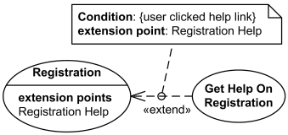

Includes and Extends
Extends
Extend is a directed relationship that specifies how and when the behavior defined in usually supplementary (optional) extending use case can be inserted into the behavior defined in the extended use case.
Includes
A use case is a kind of behaviored classifier that specifies a [complete] unit of [useful] functionality performed by [one or more] subjects to which the use case applies in collaboration with one or more actors, and which [for complete use cases] yields an observable result that is of some value to those actors [or other stakeholders] of each subject.
see also: https://www.uml-diagrams.org/use-case-reference.html

Slide 24
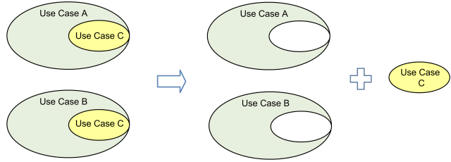
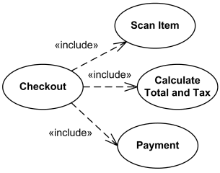
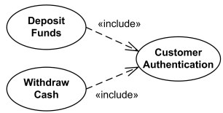
Includes and Extends
Includes
Use case include is a directed relationship between two use cases which is used to show that behavior of the included use case (the addition) is inserted into the behavior of the including (the base) use case.
The include relationship could be used:
to simplify large use case by splitting it into several use cases,
to extract common parts of the behaviors of two or more use cases.
see also: https://www.uml-diagrams.org/use-case-reference.html

Slide 25



Use Case Relationships Compared
Generalization | Extend | Include
Base use case could be abstract use case (incomplete) or concrete (complete). | Base use case is complete (concrete) by itself, defined independently. | Base use case is incomplete (abstract use case).
Specialized use case is required, not optional, if base use case is abstract. | Extending use case is optional, supplementary. | Included use case required, not optional.
No explicit location to use specialization. | Has at least one explicit extension location. | No explicit inclusion location but is included at some location.
No explicit condition to use specialization. | Could have optional extension condition. | No explicit inclusion condition.
see also: https://www.uml-diagrams.org/use-case-reference.html

Slide 26
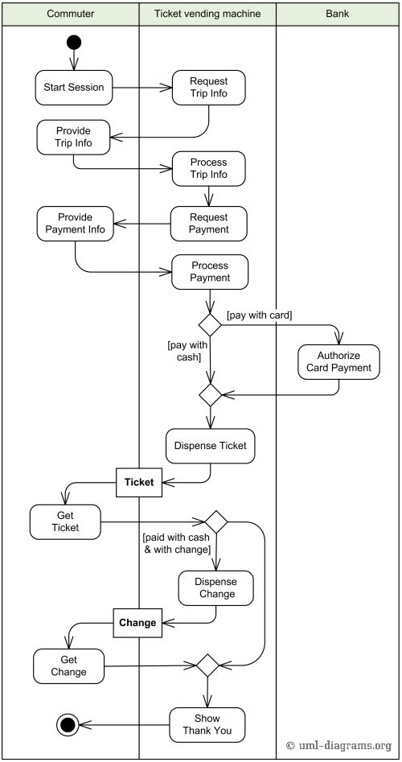
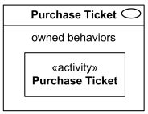
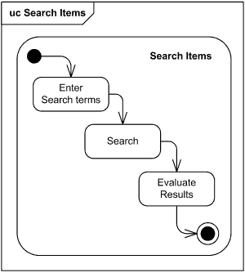
Describe Use Case Behaviors
Use case behaviors may be described in a natural language text (opaque behavior), which is current common practice, or by using UML behavior diagrams for specific behaviors such as
activity,
state machine,
interaction.
link between a use case and an activity
description using a state machine diagram
see also: https://www.uml-diagrams.org/use-case-reference.html
Activity diagram: description of the Purchase Ticket activity

Slide 27
Use Case diagrams examples
See https://www.uml-diagrams.org/use-case-diagrams-examples.html

Slide 28
Software Engineering
Part 6 – The Unified Modeling Language
6.2 – diagrams we’ll use for the analysis phase
6.2.2 – Activity diagrams
ICM – Computer Science Major – Software Engineering - Part 1: Introduction
M1 Cyber Physical and Social Systems – CPS2 engineering and development - Part 3: Software Engineering
Guillaume Muller
Course unit URL: https://ci.mines-stetienne.fr/cps2/course/softeng/

Slide 29
Activity diagrams
Activity diagram is UML behavior diagram which shows flow of control or object flow with emphasis on the sequence and conditions of the flow. The actions coordinated by activity models can be initiated because other actions finish executing, because objects and data become available, or because some events external to the flow occur.
terminology: activity, partition, action, object, control, activity edge.
see also: https://www.uml-diagrams.org/activity-diagrams-reference.html

Slide 30
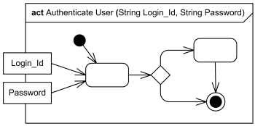
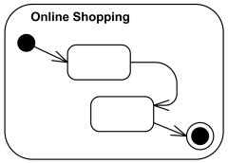
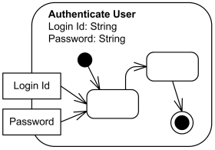
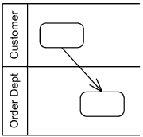
Activity diagrams
Rendered with the frame notation for diagrams: keyword act
With parameters
With swimlanes
terminology: activity, partition, action, object, control, activity edge.
see also: https://www.uml-diagrams.org/activity-diagrams-reference.html

Slide 31
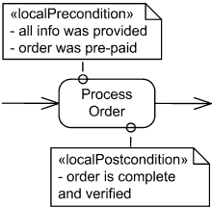






Actions
Types of actions
Action is a named element which represents a single atomic step within activity, i.e. that is not further decomposed within the activity. Activity represents a behavior that is composed of individual elements that are actions.
Object actions include different actions on objects, e.g. create and destroy object, test object identity, specify value, etc.
Variable actions include variable read, write, add, remove and clear actions.
Invocation actions include several call actions, signal send and broadcast actions and send object action.
Send signal action
Accept signal action
Wait time action
...
terminology: activity, partition, action, object, control, activity edge.
see also: https://www.uml-diagrams.org/activity-diagrams-actions.html

Slide 32
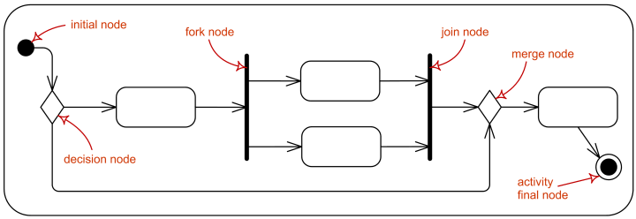
Controls
Types of controls
Control node is an activity node used to coordinate the flows between other nodes. It includes:
initial node
flow final node
activity final node
decision node
merge node
fork node
join node
terminology: activity, partition, action, object, control, activity edge.
see also: https://www.uml-diagrams.org/activity-diagrams-reference.html

Slide 33
Controls
Types of controls
Control node is an activity node used to coordinate the flows between other nodes. It includes:
initial node
flow final node
activity final node
decision node
merge node
fork node
join node
terminology: activity, partition, action, object, control, activity edge.
see also: https://www.uml-diagrams.org/activity-diagrams-objects.html

Slide 34
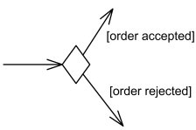
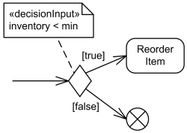
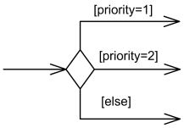
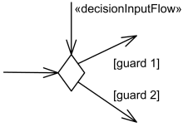
Controls
Types of controls
Control node is an activity node:
initial node
flow final node
activity final node
decision node
merge node
fork node
join node
Decision node with outgoing edges with guards
Decision node with decision input behavior.
Decision node with decision input flow.
terminology: activity, partition, action, object, control, activity edge.
see also: https://www.uml-diagrams.org/activity-diagrams-controls.html

Slide 35

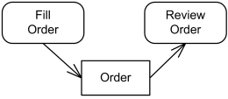


Objects
Objects flow in an activity
input and output pins
A data store is a central buffer node for non-transient information.
terminology: activity, partition, action, object, control, activity edge.
see also: https://www.uml-diagrams.org/activity-diagrams-controls.html

Slide 36
Activity diagrams examples
See https://www.uml-diagrams.org/activity-diagrams-examples.html

Slide 37
Software Engineering
Part 6 – The Unified Modeling Language
6.2 – diagrams we’ll use for the analysis phase
6.2.3 – State machine diagrams
ICM – Computer Science Major – Software Engineering - Part 1: Introduction
M1 Cyber Physical and Social Systems – CPS2 engineering and development - Part 3: Software Engineering
Guillaume Muller
Course unit URL: https://ci.mines-stetienne.fr/cps2/course/softeng/

Slide 38
State machine diagrams
Used for modeling discrete behavior through finite state transitions. In addition to expressing the behavior of a part of the system, state machines can also be used to express the usage protocol of part of a system. These two kinds of state machines are referred to as behavioral state machines and protocol state machines.
terminology: behavioral state, behavioral transition, protocol state, protocol transition, different pseudostates.
see also: https://www.uml-diagrams.org/activity-diagrams-reference.html

Slide 39
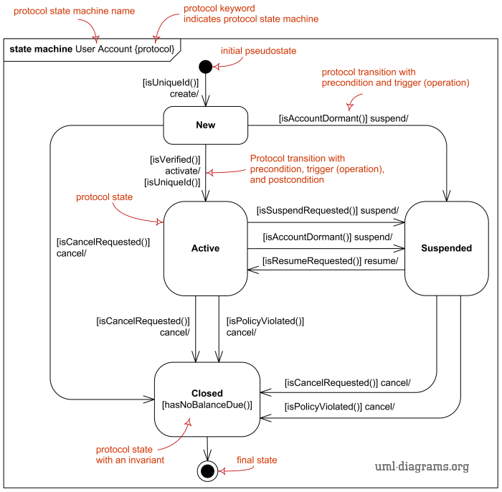
State machine diagrams

Slide 40

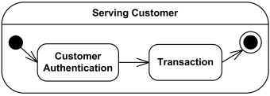
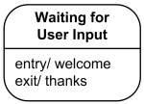

States
Simple state
Composite state
List of internal activities
Composite state with hidden decomposition

Slide 41
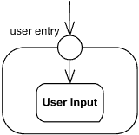
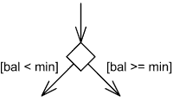
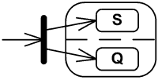


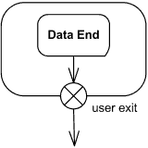
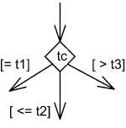


Pseudostates
initial/terminate(destroy)/final
entry/exit
choice
fork/join

Slide 42
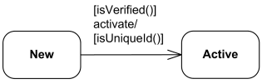
Protocol transition
A protocol transition is specialization of (behavioral) transition used for the protocol state machines which specifies a legal transition for an operation. Protocol transition has the following features: a pre-condition (guard), trigger, and a post-condition.
protocol-transition ::= [ pre-condition ] trigger '/' [ post-condition ] pre-condition ::= '[' constraint ']' post-condition ::= '[' constraint ']'

Slide 43
State Machine diagram examples
See https://www.uml-diagrams.org/state-machine-diagrams-examples.html

Slide 44
Software Engineering
Part 6 – The Unified Modeling Language
6.2 – diagrams we’ll use for the analysis phase
6.2.3 – Communication diagrams
ICM – Computer Science Major – Software Engineering - Part 1: Introduction
M1 Cyber Physical and Social Systems – CPS2 engineering and development - Part 3: Software Engineering
Guillaume Muller
Course unit URL: https://ci.mines-stetienne.fr/cps2/course/softeng/

Slide 45
Communication diagrams
Communication diagram (called collaboration diagram in UML 1.x) is a kind of UML interaction diagram which shows interactions between objects and/or parts (represented as lifelines) using sequenced messages in a free-form arrangement.
terminology: frame, lifeline, message
see also: https://www.uml-diagrams.org/communication-diagrams-reference.html

Slide 46
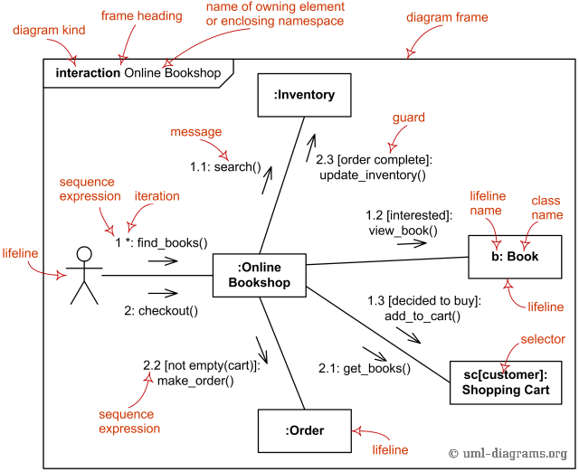
Communication diagrams
see also: https://www.uml-diagrams.org/communication-diagrams-reference.html

Slide 47
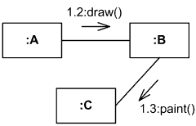
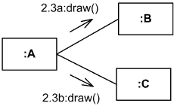



Communication diagrams
in sequence
in parallel
guards
n times, in sequence
n times in parallel
see also: https://www.uml-diagrams.org/communication-diagrams-reference.html

Slide 48
Communication diagram examples
See https://www.uml-diagrams.org/communication-diagrams-examples.html

Slide 49
Software Engineering
Part 6 – The Unified Modeling Language
6.3 – diagrams we’ll use for the design phase
6.3.1 – Class diagrams
ICM – Computer Science Major – Software Engineering - Part 1: Introduction
M1 Cyber Physical and Social Systems – CPS2 engineering and development - Part 3: Software Engineering
Guillaume Muller
Course unit URL: https://ci.mines-stetienne.fr/cps2/course/softeng/

Slide 50
Class diagrams
Class diagram is UML structure diagram which shows structure of the designed system at the level of classes and interfaces, shows their features, constraints and relationships - associations, generalizations, dependencies, etc.
types of class diagrams are:
domain model diagram,
diagram of implementation classes.
see also: https://www.uml-diagrams.org/class-reference.html

Slide 51
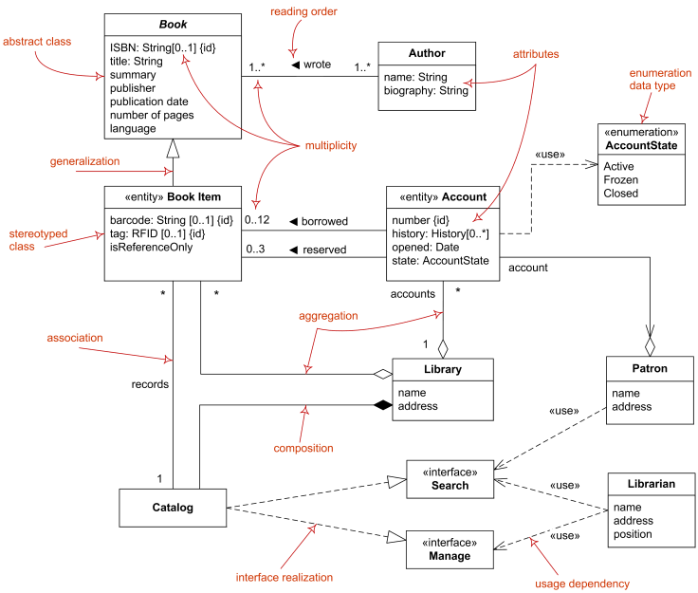
Domain model diagrams
see also: https://www.uml-diagrams.org/class-reference.html

Slide 52
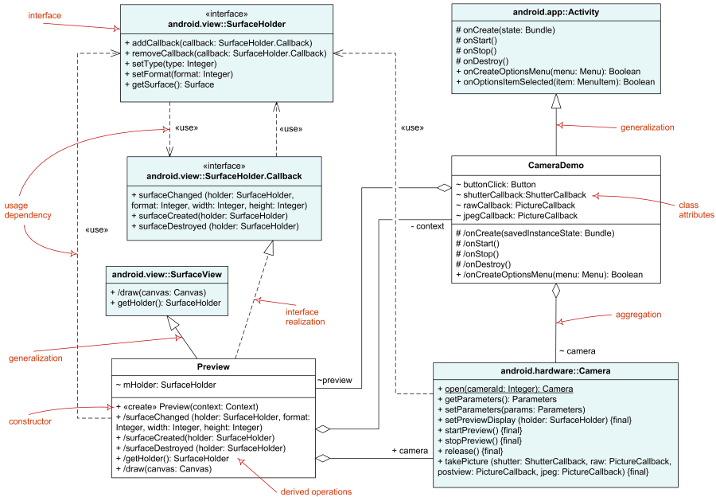
Diagram of Implementation Classes
see also: https://www.uml-diagrams.org/class-reference.html

Slide 53




Class
Class
A class is a classifier which describes a set of objects that share the same:
features,
constraints,
semantics (meaning).
Class SearchService - implementation level details. The createEngine is static operation
Class SearchService - analysis level details
Class SearchService - attributes and operations grouped by visibility
see also: https://www.uml-diagrams.org/class-reference.html

Slide 54







Abstract, Nested, Template, Interface
Abstract, Nested, Template, Interface
An interface
Various kinds of constraints or protocol specifications (ordering restrictions)
Interface realization
Abstract class (italics)
Class LinkedList is nesting the Element interface. The Element is in scope of the LinkedList namespace.
Template class Array and bound class Customers. The Customers class is an Array of 24 objects of Customer class.
Interface usage
see also: https://www.uml-diagrams.org/class-reference.html

Slide 55





Objects
Anonymous instance of the Customer class
Instance newPatient of the unnamed or unknown class
Instance front-facing-cam of the Camera class from android.hardware package.
Instance orderPaid of the Date class
has value July 31, 2011 3:00 pm.
Instance newPatient of the Patient class
has slots with values specified.
see also: https://www.uml-diagrams.org/class-reference.html

Slide 56





Data Type, primitive type, enumeration type
DateTime data type
Primitive data type. Standard UML primitive types include:
- Boolean,
- Integer,
- UnlimitedNatural,
- String.
values are enumerated in the model as user-defined enumeration literals
Structured data type
Attributes of the Patient class are of data types Name, Gender, DateTime, Address and Visit.
see also: https://www.uml-diagrams.org/class-reference.html

Slide 57



Operations
Operations with different visibilities
executeQuery is public, isPoolable is protected, getQueryTimeout has package visibility,
clearWarnings is private.
static operations are underlined
operations have a signature, with parameters, and a return type. File has two static operations - create and slashify. Create has two parameters and returns File. Slashify is private operation. Operation listFiles returns array of files. Operations getName and listFiles either have no parameters or parameters were suppressed.
Operation setDaemon has one input parameter, while single parameter of changeName is both input and output parameter. Static enumerate returns integer result while also having output parameter - array of threads. Operation isDaemon is shown with return type parameter. It is presentation option equivalent to returning operation result as: +isDaemon(): Boolean.
see also: https://www.uml-diagrams.org/class-reference.html

Slide 58



Write constraints
Bank account attribute constraints - non empty owner and positive balance.
Account owner is either Person or Corporation, {xor} is predefined UML constraint.
Bank account constraints - non empty owner and positive balance
see also: https://www.uml-diagrams.org/class-reference.html

Slide 59



Members and multiplicity
Multiplicity of players for SoccerTeam class
Utility: class that has only class scoped static attributes and operations.
see also: https://www.uml-diagrams.org/class-reference.html

Slide 60









Associations
Association
Order of the ends and reading: Car - was designed in - Year
Ternary association Design relating three classifiers.
Aggregation/composition
Ownership
Navigability
Aggregation
Association end qb is an attribute of SearchService class and is owned by the class.
A2 has unspecified navigability while B2 is navigable from A2.
Association qualifier
Composite Aggregation (= composition)
If folder is deleted, all files are deleted as well
A3 is not navigable from B3 while B3 has unspecified navigability.
Given a company and a social security number (SSN) at most one employee could be found.
see also: https://www.uml-diagrams.org/class-reference.html

Slide 61


Generalization
=
Checking, Savings, and Credit Accounts are generalized by Account.
see also: https://www.uml-diagrams.org/class-reference.html

Slide 62


Interfaces
Interface SiteSearch is used (required) by Search Controller.
Interface SiteSearch is realized (implemented) by SearchService.
see also: https://www.uml-diagrams.org/class-reference.html

Slide 63



Dependency
Data Access depends on Connection Pool
Search Controller uses Search Engine.
Data Source creates Connection
see also: https://www.uml-diagrams.org/class-reference.html

Slide 64
Class diagram examples
See https://www.uml-diagrams.org/class-diagrams-examples.html

Slide 65
Pointers
The UML Specification https://www.omg.org/spec/UML/About-UML/
https://www.uml-diagrams.org/

Slide 66
Software Engineering
Part 6 – The Unified Modeling Language
6.3 – diagrams we’ll use for the design phase
6.3.2 – Package diagrams
ICM – Computer Science Major – Software Engineering - Part 1: Introduction
M1 Cyber Physical and Social Systems – CPS2 engineering and development - Part 3: Software Engineering
Guillaume Muller
Course unit URL: https://ci.mines-stetienne.fr/cps2/course/softeng/

Slide 67
Package diagrams
Package diagram is UML structure diagram which shows structure of the designed system at the level of packages.
Elements:
package,
packageable element,
dependency,
element import,
package import,
package merge.
see also: https://www.uml-diagrams.org/class-reference.html

Slide 68

Package diagrams
see also: https://www.uml-diagrams.org/package-diagrams-reference.html

Slide 69




Package
Package
A package is a namespace used to group together elements that are semantically related and might change together. It is a general purpose mechanism to organize elements into groups to provide better structure for system model.
Package org.hibernate
Package org.hibernate contains SessionFactory and Session.
Package org.hibernate contains interfaces SessionFactory and Session.
All elements of Library Domain package are public except for Account.
see also: https://www.uml-diagrams.org/package-diagrams-reference.html

Slide 70





Import
Element Import
Package Import
Public import of PageInfo element into Search namespace from Domain package.
Imported element are added to the namespace and made visible outside the namespace
.
Public import:
All elements are added to the namespace and made visible outside the namespace
Private import of SortInfo element into Search namespace from Domain package.
Imported element are added to the namespace but not visible outside the namespace
.
Private import:
All elements are added to the namespace but not visible outside the namespace
see also: https://www.uml-diagrams.org/package-diagrams-reference.html

Slide 71

Package merge
Kernel package merges Constructs package which imports Primitive Types.
The contents of Constructs is combined with the one of Kernel

Slide 72

Model diagram
see also: https://www.uml-diagrams.org/package-diagrams-reference.html

Slide 73



Model
Different notations for Models
see also: https://www.uml-diagrams.org/package-diagrams-reference.html

Slide 74
Package diagram examples
See https://www.uml-diagrams.org/package-diagrams-examples.html

Slide 75
Pointers
The UML Specification https://www.omg.org/spec/UML/About-UML/
https://www.uml-diagrams.org/

Slide 76
Software Engineering
Part 6 – The Unified Modeling Language
6.3 – diagrams we’ll use for the design phase
6.3.3 – Composite Structure diagrams
ICM – Computer Science Major – Software Engineering - Part 1: Introduction
M1 Cyber Physical and Social Systems – CPS2 engineering and development - Part 3: Software Engineering
Guillaume Muller
Course unit URL: https://ci.mines-stetienne.fr/cps2/course/softeng/

Slide 77
Composite Structure diagrams
Composite Structure Diagram could be used to show: internal structure of a classifier - internal structure diagram, classifier interactions with environment through ports, a behavior of a collaboration - collaboration use diagram.
Elements:
class,
part,
port,
connector,
usage
see also: https://www.uml-diagrams.org/composite-structure-diagrams-reference.html

Slide 78

Composite Structure diagrams
see also: https://www.uml-diagrams.org/composite-structure-diagrams-reference.html

Slide 79


Structured classifier
Structured classifier
Structured classifier is classifier having internal structure and whose behavior can be fully or partially described by the collaboration of owned or referenced instances.
Different notations for structured classifiers
Simple ports joined directly by connector, mandatory UML notation.
Customers component part provides Account interface to Orders part.
see also: https://www.uml-diagrams.org/composite-structure-diagrams-reference.html

Slide 80

Encapsulated Classifier
Encapsulated classifier is structured classifier extended with the ability to own ports.
Library Services is classifier encapsulated through Search Port
Simple ports joined directly by connector, mandatory UML notation.
Customers component part provides Account interface to Orders part.
see also: https://www.uml-diagrams.org/composite-structure-diagrams-reference.html

Slide 81


Part
represents a set of instances that are owned by a containing instance of a classifyer.
all parts are destroyed when the containing classifier instance is destroyed (composition)
Search Controller has 1 to 3 engines - Search Engine part
Two Data Sources is sources property - but not part - of Search Controller
see also: https://www.uml-diagrams.org/composite-structure-diagrams-reference.html

Slide 82





Port
feature which specifies a link that enables communication between two or more instances playing some roles within a structured classifier.
see also: https://www.uml-diagrams.org/composite-structure-diagrams-reference.html

Slide 83



Connectors
feature which specifies a link that enables communication between two or more instances playing some roles within a structured classifier.
Assembly connector between ports of Authentication and Customers components.
Assembly connector that assembles three parts.
Assembly connector between simple ports of Authentication and Customers components.
see also: https://www.uml-diagrams.org/composite-structure-diagrams-reference.html

Slide 84
Composite structure diagram examples
See https://www.uml-diagrams.org/composite-structure-examples.html

Slide 85
Software Engineering
Part 6 – The Unified Modeling Language
6.3 – diagrams we’ll use for the design phase
6.3.4 – Component diagrams
ICM – Computer Science Major – Software Engineering - Part 1: Introduction
M1 Cyber Physical and Social Systems – CPS2 engineering and development - Part 3: Software Engineering
Guillaume Muller
Course unit URL: https://ci.mines-stetienne.fr/cps2/course/softeng/

Slide 86
Component diagrams
Component diagram shows components, provided and required interfaces, ports, and relationships between them. This type of diagrams is used in Component-Based Development (CBD) to describe systems with Service-Oriented Architecture (SOA).
Elements:
component,
provided interface,
required interface,
port,
connectors.
see also: https://www.uml-diagrams.org/component-diagrams-reference.html

Slide 87

Component diagrams
see also: https://www.uml-diagrams.org/component-diagrams-reference.html

Slide 88




Components
Component
A component is a class representing a modular part of a system with encapsulated content and whose manifestation is replaceable within its environment.
A component has its behavior defined in terms of provided interfaces and required interfaces (potentially exposed via ports)
Different notations for components
Old notation. For backward compatibility only
see also: https://www.uml-diagrams.org/package-diagrams-reference.html

Slide 89


Interfaces
User Services component requires IOrderServices interface.
Weather Services component provides (implements) Weather Forecast interface.

Slide 90



Realization
Different notations for:
Component UserService realized by UserServlet and UserDAO..

Slide 91



Delegation
Delegation connector from the delegating port to the UserServlet part.
Delegation connector from the simple port of Authentication component to the delegating port.
Delegation handled by a single port

Slide 92
Assembly
Assembly connector between ports of Authentication and Customers components.
Assembly connector that assembles three parts.
Assembly connector between simple ports of Authentication and Customers components.

Slide 93
Component diagram examples
See https://www.uml-diagrams.org/component-diagrams-examples.html

Slide 94
Software Engineering
Part 6 – The Unified Modeling Language
6.3 – diagrams we’ll use for the design phase
6.3.5 – Deployment diagrams
ICM – Computer Science Major – Software Engineering - Part 1: Introduction
M1 Cyber Physical and Social Systems – CPS2 engineering and development - Part 3: Software Engineering
Guillaume Muller
Course unit URL: https://ci.mines-stetienne.fr/cps2/course/softeng/

Slide 95
Deployment diagrams
Deployment Deployment diagram is a structure diagram which shows architecture of the system as deployment (distribution) of software artifacts to deployment targets.
Some common types of deployment diagrams are:
Implementation (manifestation) of components by artifacts,
Specification level deployment diagram,
Instance level deployment diagram,
Network architecture of the system.
see also: https://www.uml-diagrams.org/deployment-diagrams-reference.html

Slide 96

Manifestation of Components by Artifacts
see also: https://www.uml-diagrams.org/component-diagrams-reference.html

Slide 97

Specification Level Deployment Diagram
see also: https://www.uml-diagrams.org/component-diagrams-reference.html

Slide 98

Instance Level Deployment Diagram
see also: https://www.uml-diagrams.org/component-diagrams-reference.html

Slide 99

Network Architecture Diagrams
see also: https://www.uml-diagrams.org/component-diagrams-reference.html

Slide 100
Deployment diagram examples
See https://www.uml-diagrams.org/deployment-diagrams-examples.html

Slide 101
Software Engineering
Part 6 – The Unified Modeling Language
6.3 – diagrams we’ll use for the design phase
6.3.6 – Sequence diagrams
ICM – Computer Science Major – Software Engineering - Part 1: Introduction
M1 Cyber Physical and Social Systems – CPS2 engineering and development - Part 3: Software Engineering
Guillaume Muller
Course unit URL: https://ci.mines-stetienne.fr/cps2/course/softeng/

Slide 102
Sequence diagrams
Sequence diagram is the most common kind of interaction diagram, which focuses on the message interchange between a number of lifelines.
Types of nodes
lifeline,
execution specification,
message,
combined fragment,
interaction use,
state invariant,
continuation,
destruction occurrence.
see also: https://www.uml-diagrams.org/sequence-diagrams-reference.html

Slide 103

Sequence diagrams
see also: https://www.uml-diagrams.org/sequence-diagrams-reference.html

Slide 104



Lifeline
see also: https://www.uml-diagrams.org/sequence-diagrams-reference.html

Slide 105




Execution

Slide 106


Calls
Synchronous
Web Client searches Online Bookshop and waits for results.
Asynchronous
Service starts Task and proceeds in parallel without waiting.

Slide 107





Messages
Create
Delete
Reply
Lost
Found

Slide 108










Combined fragment with interaction operator
Interaction operator could be one of:
alt - alternatives
opt - option
loop - iteration
break - break
par - parallel
strict - strict sequencing
seq - weak sequencing
critical - critical region
ignore - ignore
consider - consider
assert - assertion
neg - negative

Slide 109
Sequence diagram examples
See https://www.uml-diagrams.org/sequence-diagrams-examples.html

