Slide 1
Software Engineering
Syllabus and Course Organization
ICM – Computer Science Major – Course unit on Software Engineering
M1 Cyber Physical and Social Systems – Course unit on System Modeling
Maxime Lefrançois https://maxime.lefrancois.info
Course unit URL: https://ci.mines-stetienne.fr/cps2/course/softeng

Slide 2
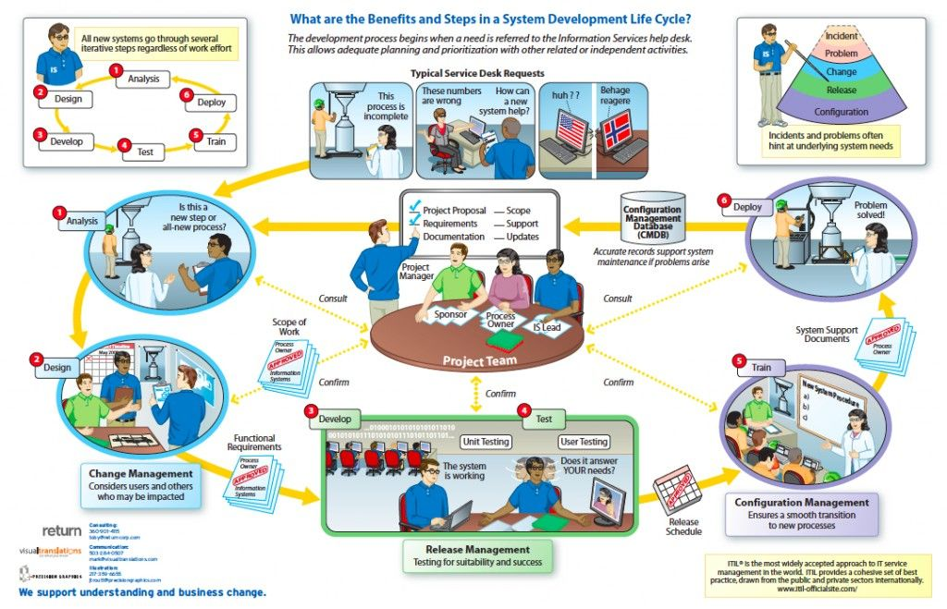

Slide 3
Course objectives
The objective is to know some core concepts, processes, and models, that are useful to comprehend common issues and problems in the engineering of IT systems that result from the integration of existing systems (systems of systems), operate in distributed environments Web, IoT, Cloud, ...
Topics:
Software Engineering Introduction
  Motivations and Definitions
Software Requirements
  Definitions
  Elicitation, analysis, specification, validation
Software Quality
  The ISO/IEC 25010:2011 System and software quality models
Software Engineering process
  Software development life cycles
  Agile methodologies
  The Scrum methodology
  DevOps methodologies
Software Engineering Models
  The Unified Modeling Language

Slide 4
Positioning wrt Teaching Module
M1 CPS2 students
ICM students
Teaching Module on CPS2 engineering and development
Everything from the command line (ECL: weight 18)
Technological foundations of software development (TFSD: weight 20)
Software Engineering (Softeng: weight 12)
Teaching Module on CPS2 software engineering
Introduction to Software Engineering
Software development best practices
Software architectures
Course organization
See https://ci.mines-stetienne.fr/cps2/course/softeng

Slide 5
Grading policy for this part
Behavior (B, -2 to +2)
Written Exam (WE, 0 to 20)
Grade = WE + B

