Slide 1
Technological foundations of software development
Master your working environment
ICM – Computer Science Major – Course unit on Technological foundations of computer science
M1 Cyber Physical and Social Systems – Course unit on CPS2 engineering and development, Part 2: Technological foundations of software development
Maxime Lefrançois https://maxime-lefrancois.info
online: https://ci.mines-stetienne.fr/cps2/course/tfsd/

Slide 2
Objectives of the session
Ensure that you are familiar with your computer, your operating system, and the shell-like command-line programming environment

Slide 3
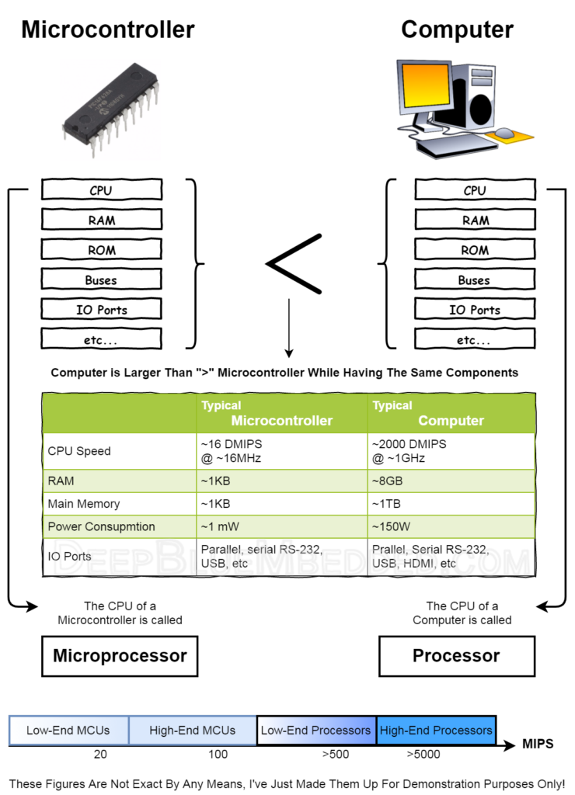
Reminders – computer ?
Programmable information processing system
Typically contains:
CPU,
RAM,
ROM,
Peripherals,
IO Ports
https://deepbluembedded.com/what-is-the-difference-between-microprocessor-and-microcontroller/

Slide 4
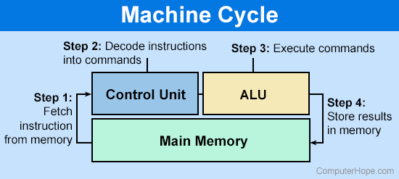
CPU
The central processing unit (CPU) or processor, is the unit which performs most of the processing inside a computer. It processes all instructions received by software running on the PC and by other hardware components, and acts as a powerful calculator.
https://www.techopedia.com/definition/2851/central-processing-unit-cpu
https://www.computerhope.com/jargon/a/alu.htm
A control unit (CU) handles all processor control signals. It directs all input and output flow, fetches code for instructions from microprograms and directs other units and models by providing control and timing signals. A CU component is considered the processor brain because it issues orders to just about everything and ensures correct instruction execution.
An arithmetic logic unit (ALU) is a major component of the central processing unit of a computer system. It does all processes related to arithmetic and logic operations that need to be done on instruction words.
https://www.techopedia.com/definition/2849/arithmetic-logic-unit-alu
https://www.techopedia.com/definition/2855/control-unit-cu

Slide 5
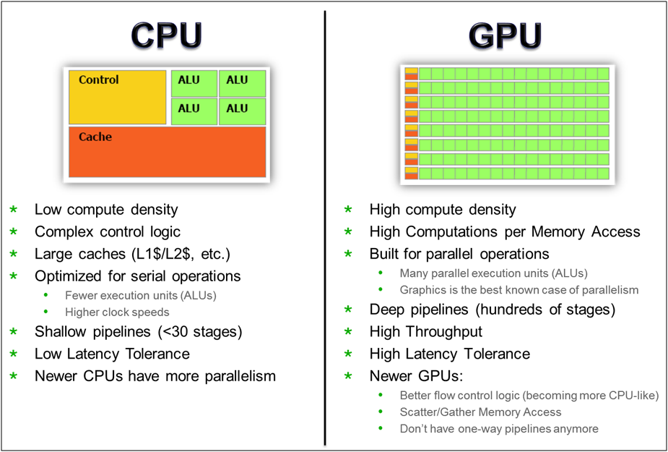
https://www.electronicspecifier.com/products/communications/vivante-es-design-magazine-gpus-the-next-must-have

Slide 6
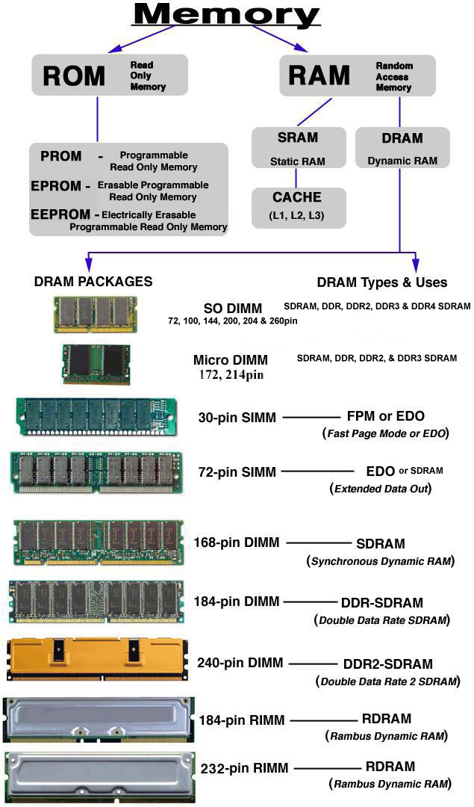
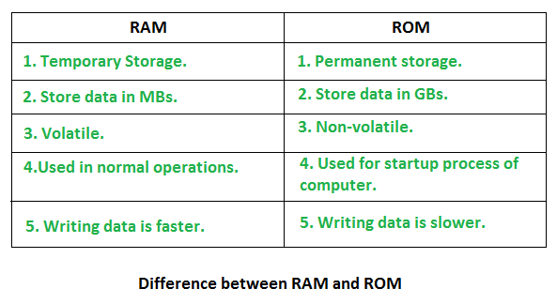
RAM vs ROM
https://www.geeksforgeeks.org/random-access-memory-ram-and-read-only-memory-rom/
https://www.escotal.com/memory.html

Slide 7
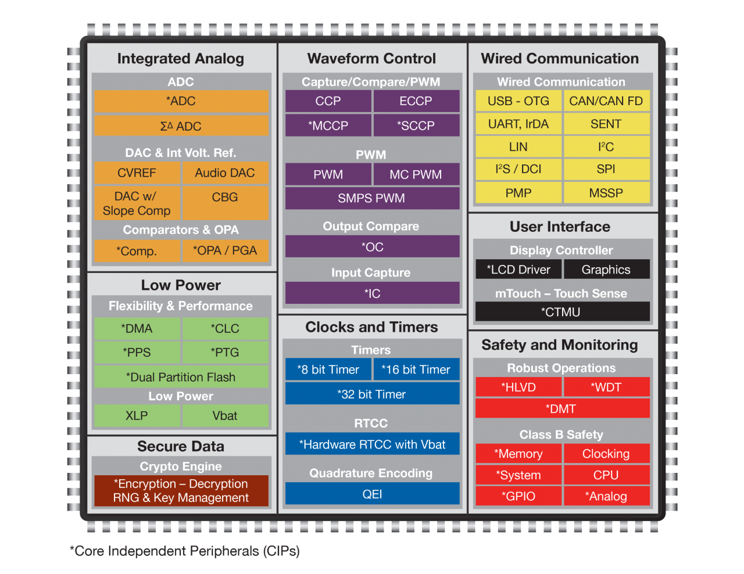
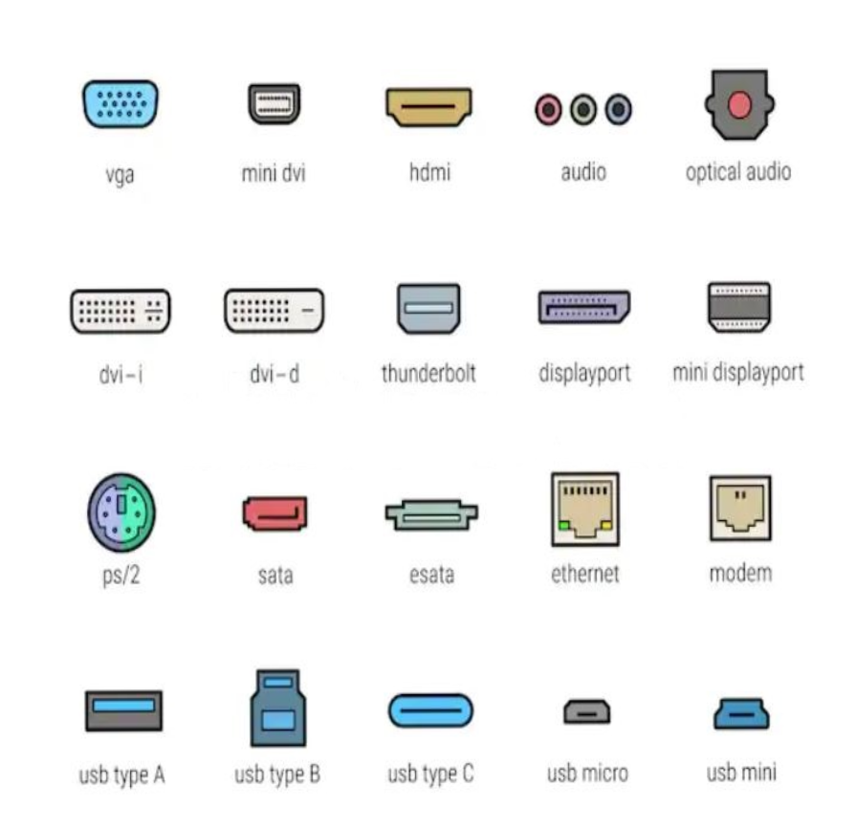
Peripherals and I/O ports
Embedded peripherals
External peripherals
Input, Output, Storage, Processing
I/O ports
Example: Peripheral embedded in a PIC24 microcontroller
https://www.microchip.com/en-us/products/microcontrollers-and-microprocessors/16-bit-mcus/peripherals#

Slide 8
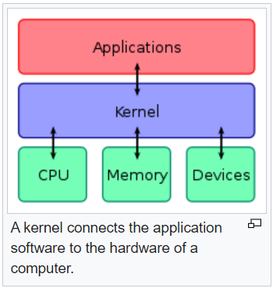
Operating system - definition
A set of programs that directs the use
of a computer's resources
by application software.
https://en.wikipedia.org/wiki/Operating_system
Brian L. Stuart, Principles of Operating Systems: Design & Applications, Cengage Learning EMEA, 2008 (ISBN 978-1418837693)

Slide 9
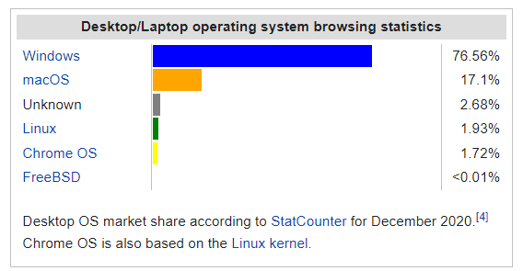
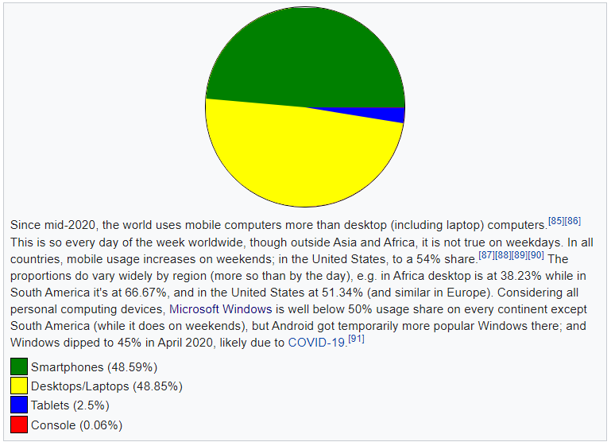
Operating system – usage share
https://en.wikipedia.org/wiki/Usage_share_of_operating_systems

Slide 10
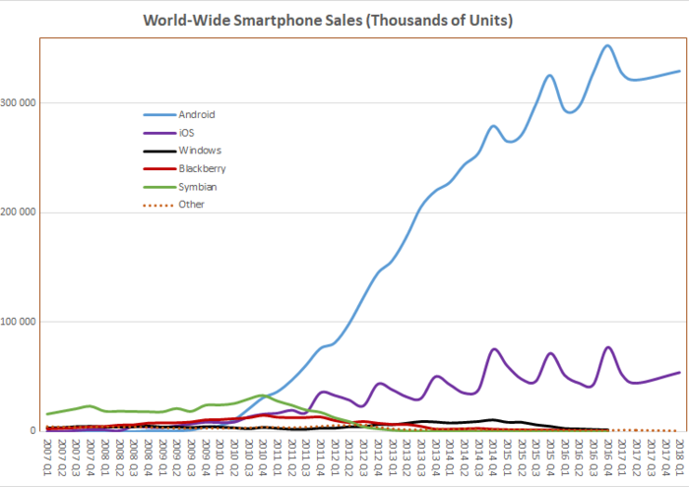
Operating system – smartphones
https://en.wikipedia.org/wiki/Usage_share_of_operating_systems

Slide 11
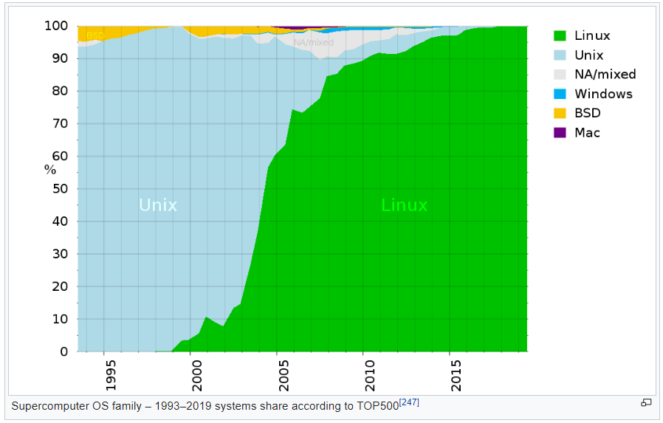
Operating system – supercomputers

Slide 12
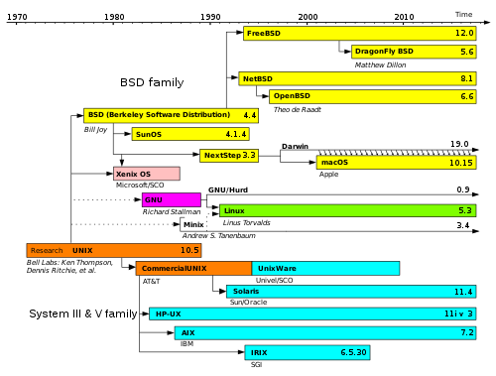
Your Operating System – Unix-like OS
Simplified history of Unix-like operating systems. Linux shares similar architecture and concepts
(as part of the POSIX standard) but does not share non-free source code with the original Unix or MINIX.
https://en.wikipedia.org/wiki/Linux

Slide 13
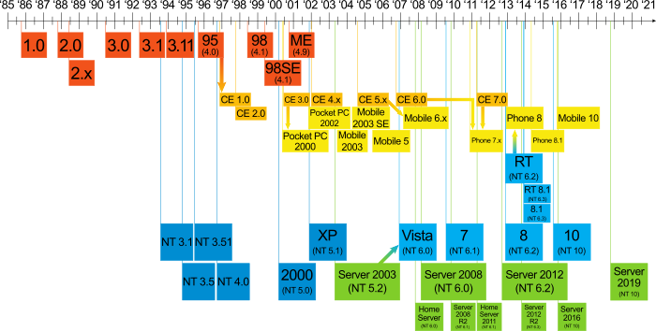
Your Operating System – Windows

Slide 14
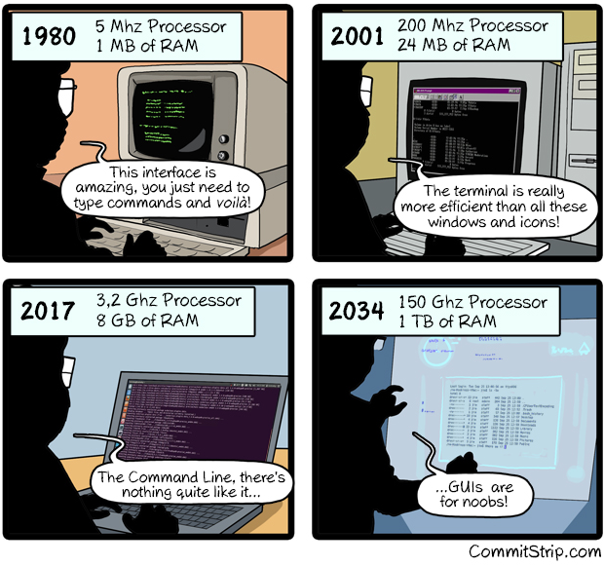
Shell – Console – Terminal
https://www.commitstrip.com/en/2016/12/22/terminal-forever/?

Slide 15
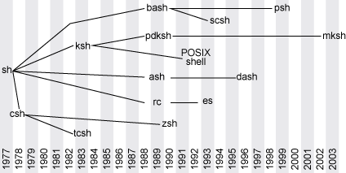
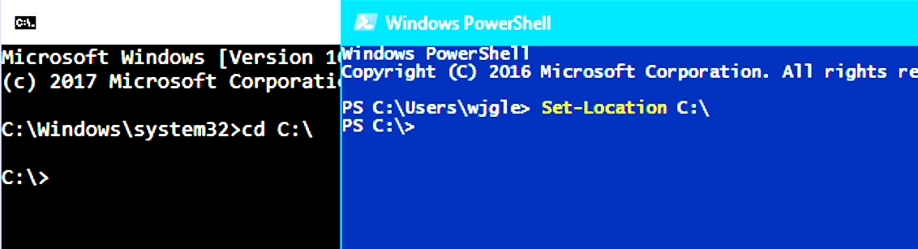
Shell – Console – Terminal
terminal = text input/output environment
console = physical terminal
shell = command line interpreter - software layer that provides the user interface of an operating system
Unix / Linux
Windows
1987
2006

Slide 16
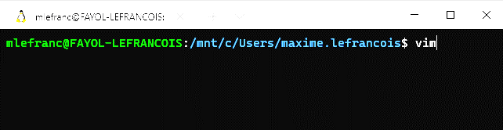
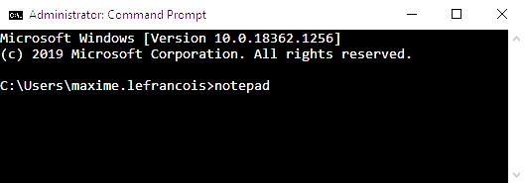
Run a program in the console

Slide 17
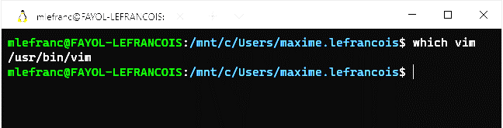
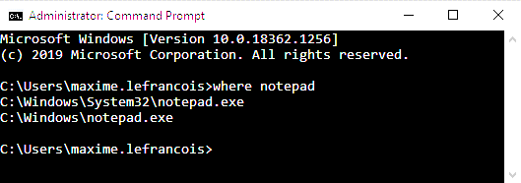
Run a program in the console
Where were these programs found ?

Slide 18
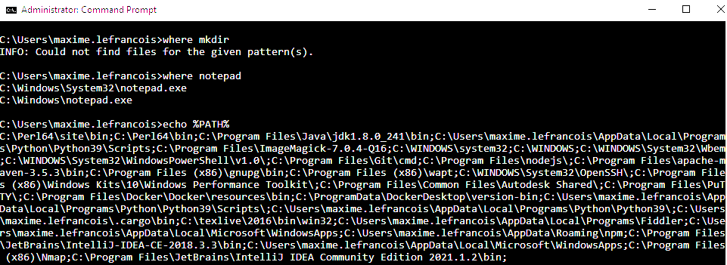
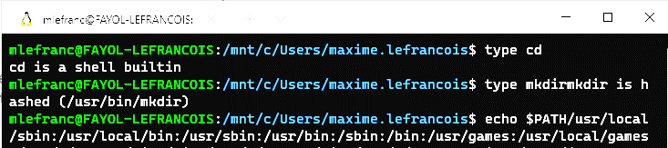
Programs location
Some programs are integrated in the Shell, the others are searched in the file system by scanning the PATH environment variable

Slide 19
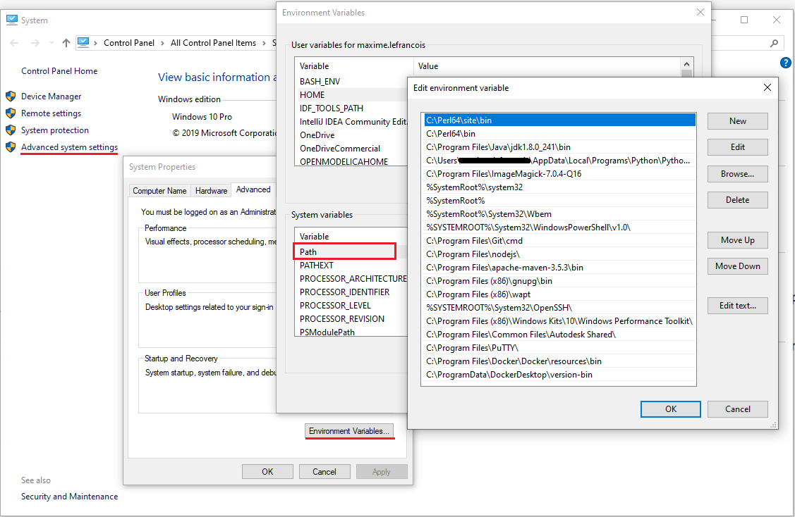
Windows – Environment variable %PATH%
%PATH% contains a list of files. When a command is executed in the CMD prompt:
Windows first looks for an executable file in the current directory.
If this fails, it scans %PATH% to find it.

Slide 20
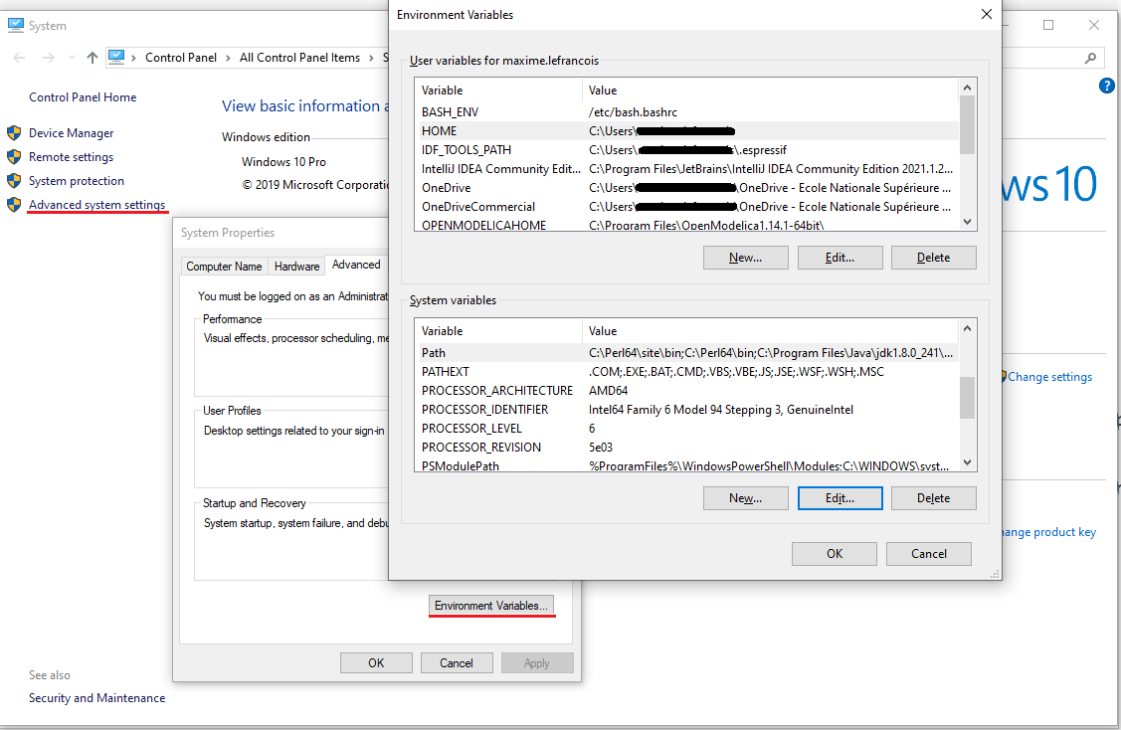
Windows – Other environment variable
In cmd.exe:
Display a variable:
> echo %HOME%
Display all variables:
> set
Change a variable
(for the current session)
> set HOME=hello world

Slide 21

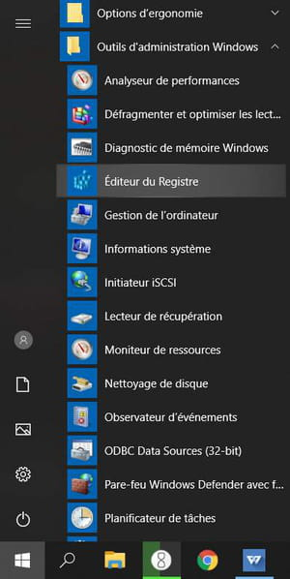
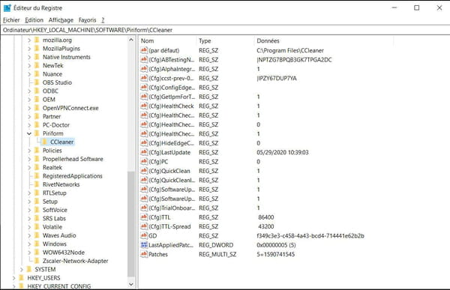
Windows – Registry
The registry is a database used by the Windows operating system. It contains the configuration data of the operating system and other installed software that want to use it.
Environment variables are stored in the registry.
More information with ex. https://learn.microsoft.com/en-us/troubleshoot/windows-server/performance/windows-registry-advanced-users

Slide 22
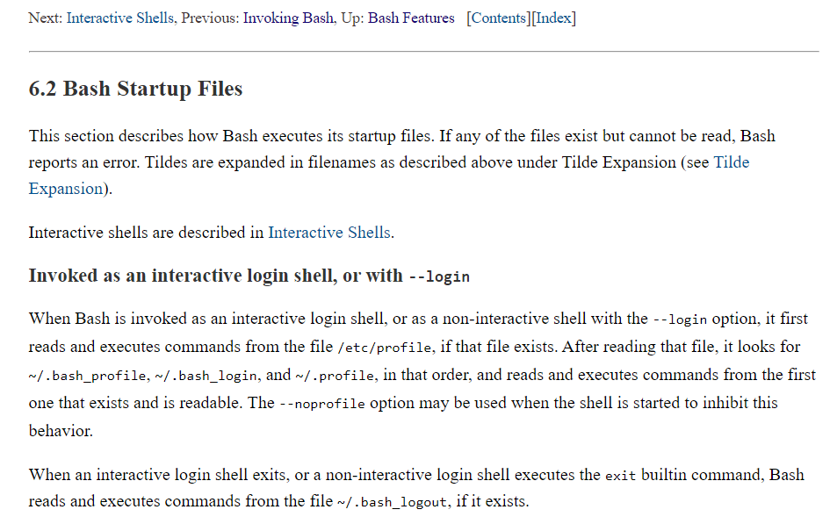
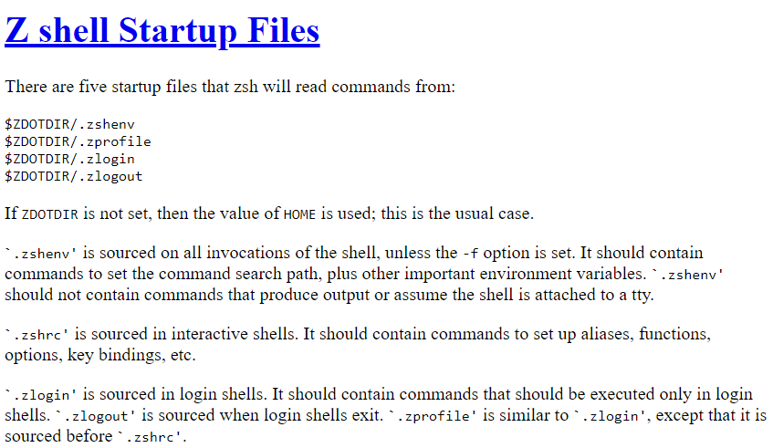
Linux – Different configurations depending on the Shell
We will only see bash (Bourne shell, default in Ubuntu) and zsh (Z shell, default in iOS from Catalina)
https://www.gnu.org/software/bash/manual/html_node/Bash-Startup-Files.html
https://zsh.sourceforge.io/Intro/intro_3.html (modified slightly)

Slide 23
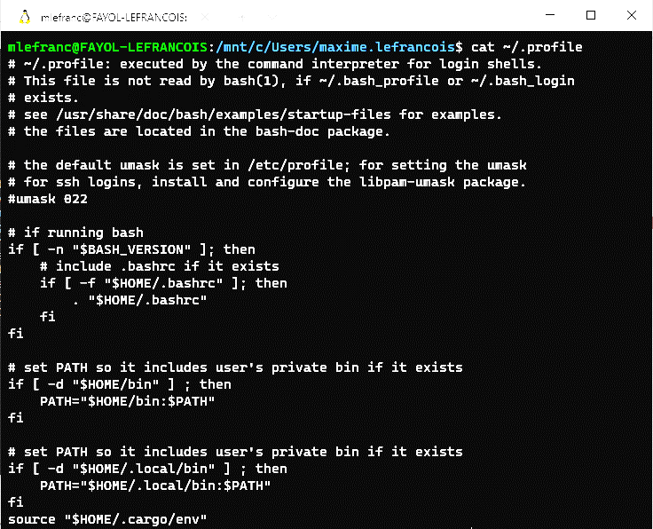
Linux – Different configurations depending on the Shell
We will only see bash (Bourne shell, default in Ubuntu) and zsh (Z shell, default in iOS from Catalina)
https://www.gnu.org/software/bash/manual/html_node/Bash-Startup-Files.html

Slide 24
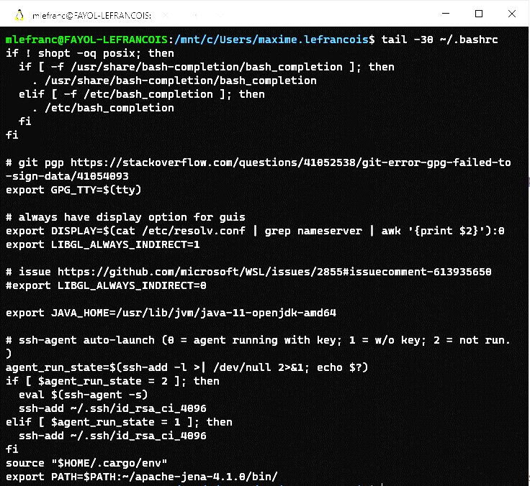
Linux – Different configurations depending on the Shell
We will only see bash (Bourne shell, default in Ubuntu) and zsh (Z shell, default in iOS from Catalina)
https://www.gnu.org/software/bash/manual/html_node/Bash-Startup-Files.html

Slide 25
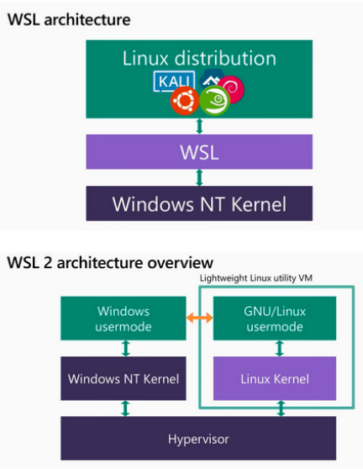
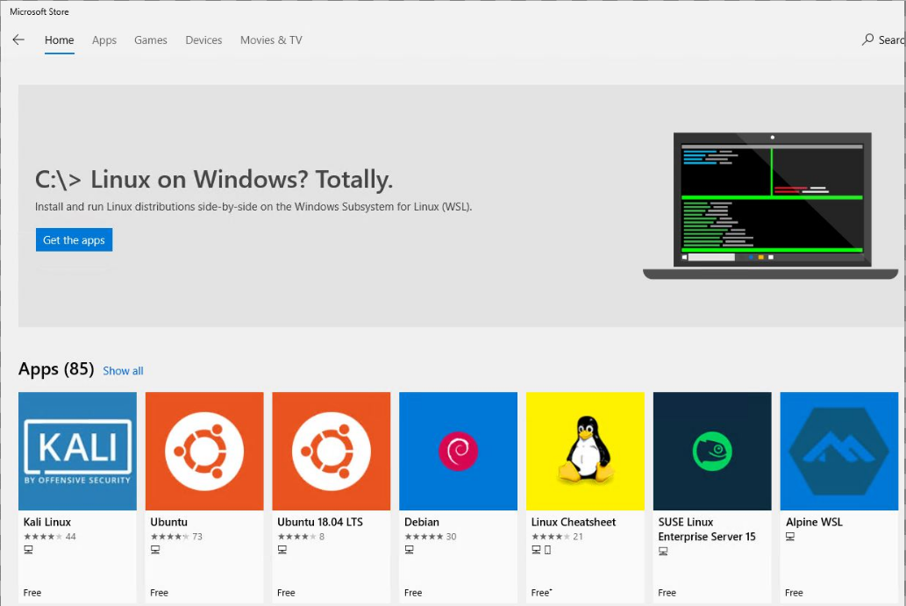
Windows Subsystem for Linux (WSL / WSL2)
Will allow you to use a UNIX/Linux kernel and a Shell, regardless of your OS
https://lecrabeinfo.net/installer-wsl-windows-subsystem-for-linux-sur-windows-10.html

Slide 26
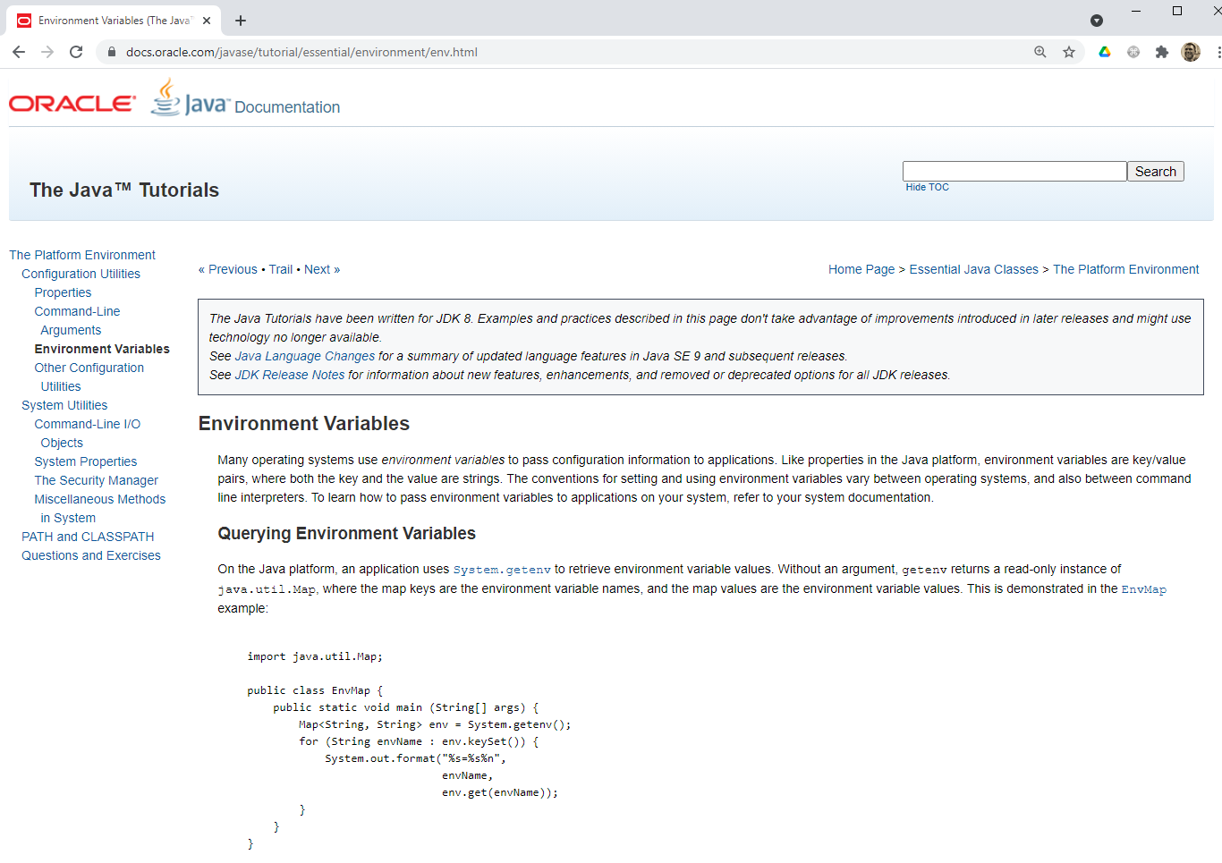
Access to environment variables
(e.g. with Java)
https://docs.oracle.com/javase/tutorial/essential/environment/env.html

Slide 27
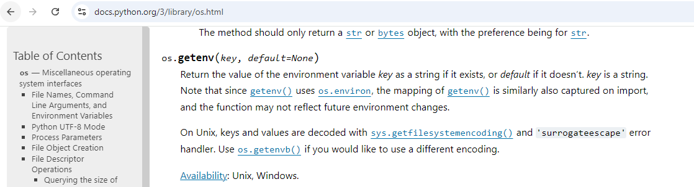
Access to environment variables
(e.g. with Python)
There are tutorials for other languages
example for C: https://www.gnu.org/software/libc/manual/html_node/Environment-Access.html
example for node.js: https://nodejs.org/en/learn/command-line/how-to-read-environment-variables-from-nodejs

Slide 28
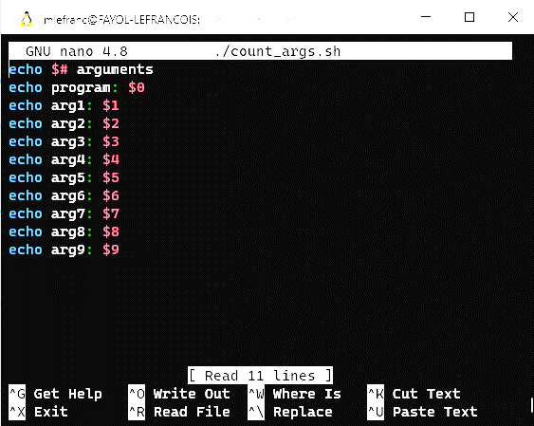
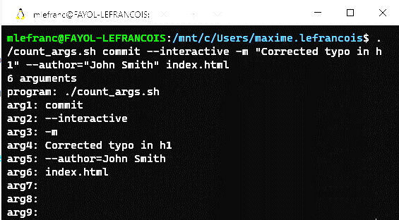
Run a program in the console
Name of the program, then list of arguments separated by spaces
example: small program count_args.sh
Run with a list of arguments

Slide 29
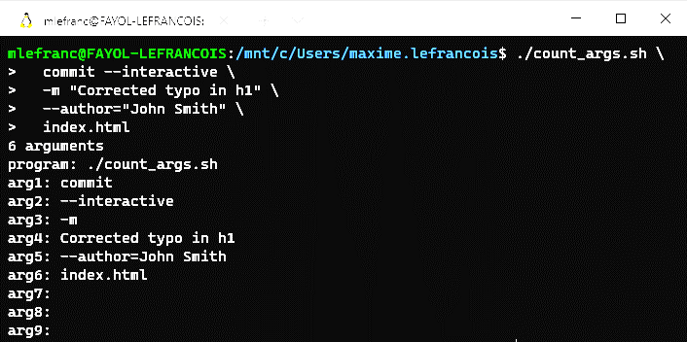
Run a program in the console
Name of the program, then list of arguments separated by spaces
example: small program count_args.sh
Use of the '\' line continuation symbol for clarity

Slide 30
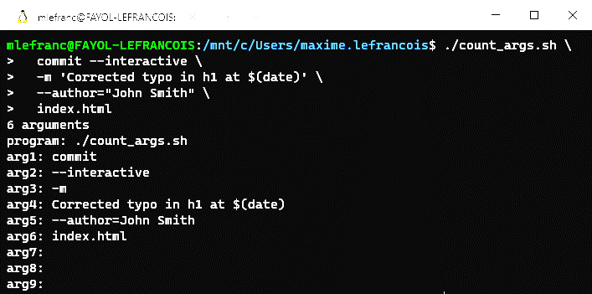
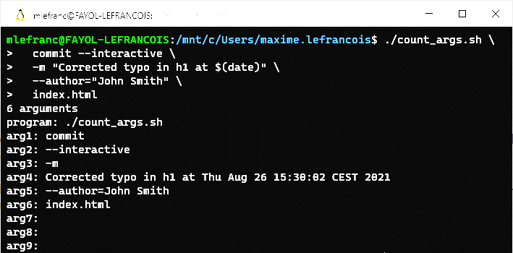
Run a program in the console
Name of the program, then list of arguments separated by spaces
Single quote vs. double quote: compare

Slide 31
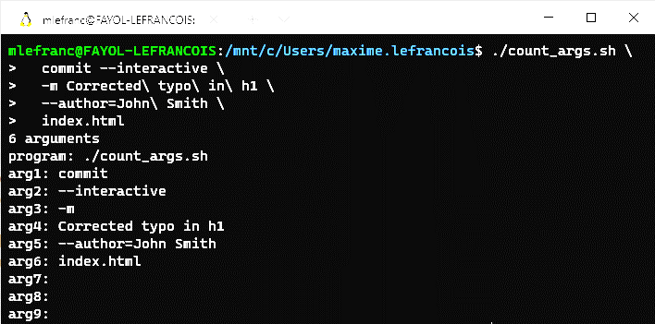
Run a program in the console
Name of the program, then list of arguments separated by spaces
example: small program count_args.sh
Escape the space to avoid using quotation marks

Slide 32
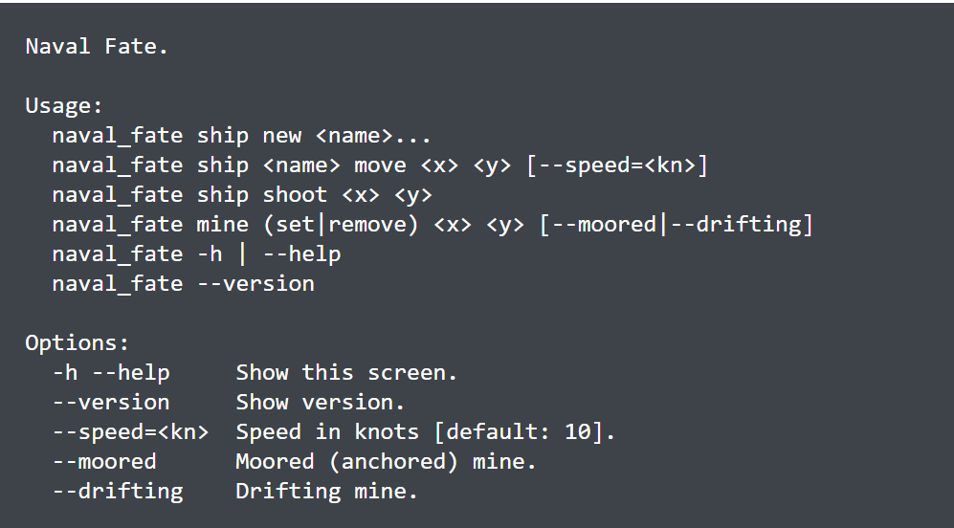
Program CLI (command line interface)
With nearly 40 years of CLI design, some good conventions have been established
Read for example: Command Line Interface Guidelines https://clig.dev/
example of CLI documentation. Source, http://docopt.org/

Slide 33
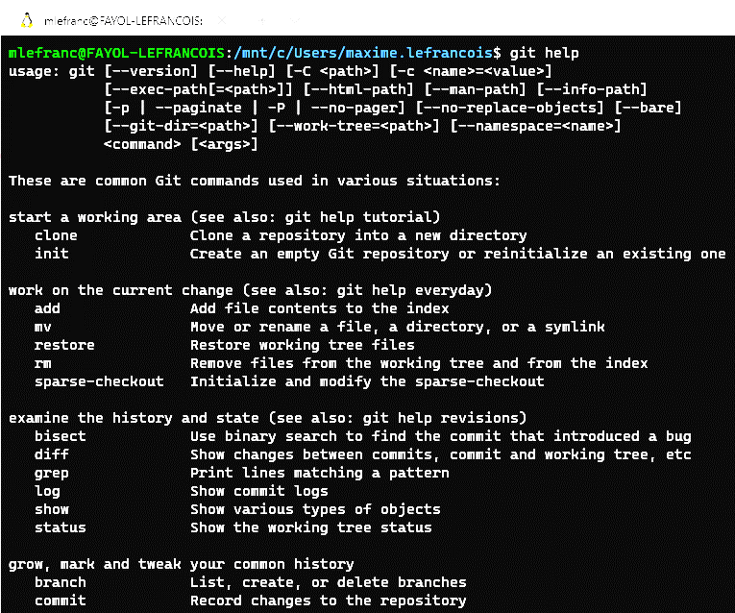
Program CLI (command line interface)
By convention, each program (e.g. git)
has a documentation, which can be obtained
with the argument help, -h , or --help
The man command can also be used:
$ man git
to exit the documentation, press q

Slide 34
Fundamental Linux principles
Everything is a file. ( Including hardware )
Small, single-purpose programs.
Ability to chain programs together to perform complex tasks.
Avoid captive user interfaces.
Configuration data stored in text.
Example justification: https://linuxtutorials4u.wordpress.com/2011/09/03/linux-principles/

Slide 35
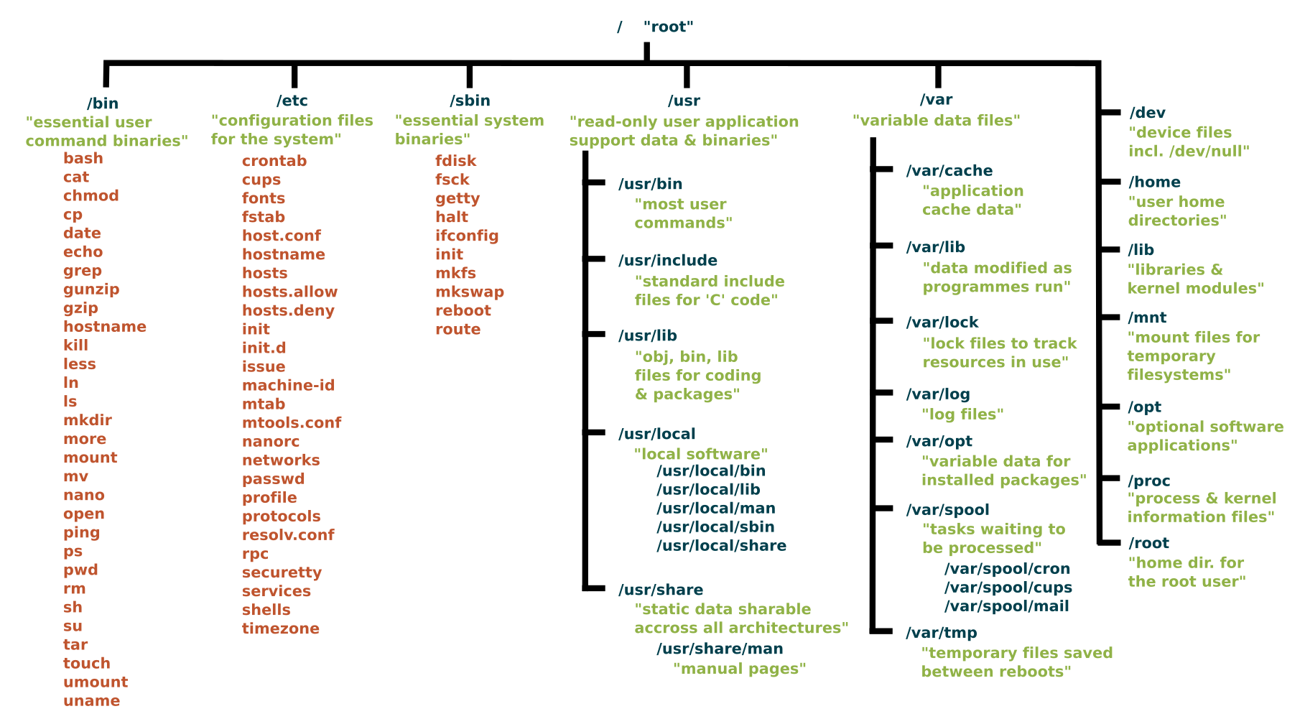
Standard linux file system hierarchy

Slide 36
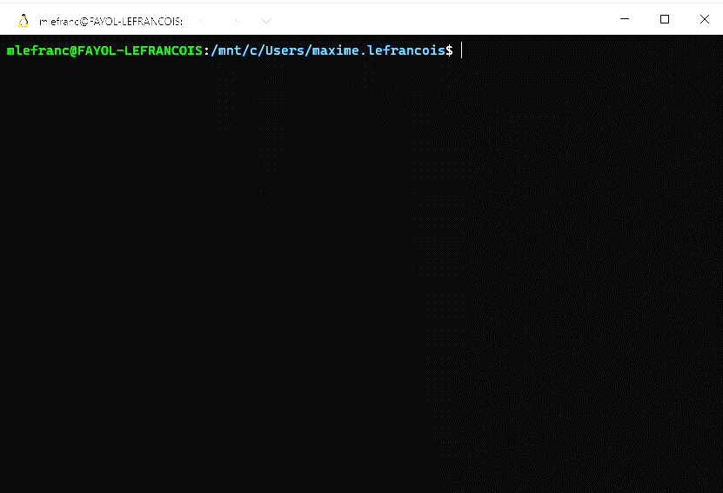
The command prompt
user
machine
current directory
command prompt

Slide 37
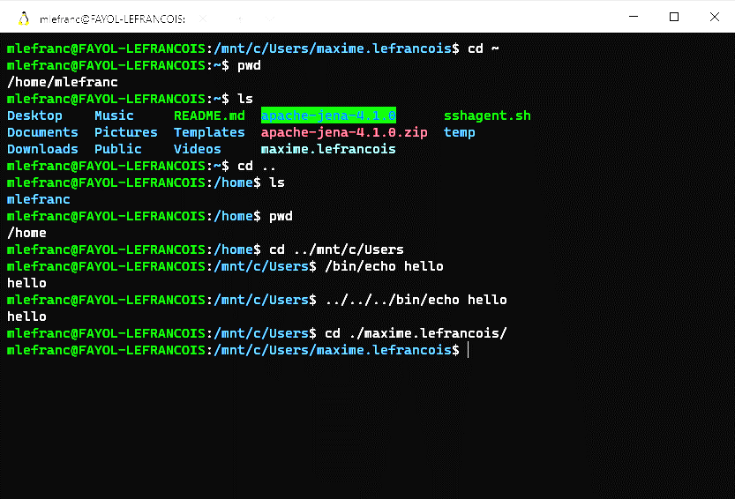
Navigating the file system

Slide 38
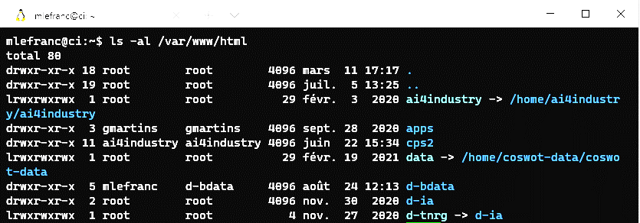
The permissions system
permissions
owner
user
owner
group
last
modif.
name -> link target
size (bytes)
deuxième colonne: https://bertvv.github.io/notes-to-self/2015/10/18/the-number-of-hard-links-in-ls--l/

Slide 39
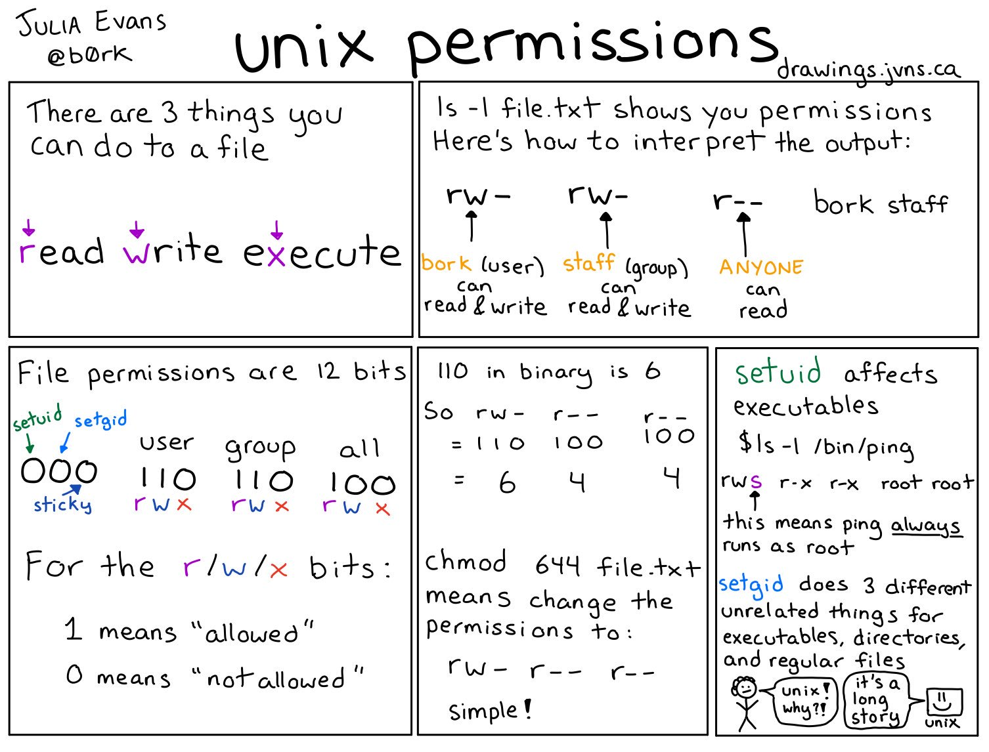
https://twitter.com/b0rk/status/982641594305273856
more about setuid and setgid: https://en.wikipedia.org/wiki/Setuid

Slide 40
Assign a variable
fruit=banana # assigns the value banana to the variable fruit
echo $fruit # outputs « banana »
echo "$fruit" # outputs « banana »
echo '$fruit' # outputs « $fruit »
Parameter Expansion
see section " Parameter expansions ".
https://devhints.io/bash#parameter-expansions
name="John"
echo ${name}
echo ${name/J/j} #=> "john" (substitution)
echo ${name:0:2} #=> "Jo" (slicing)
echo ${name::2} #=> "Jo" (slicing)
echo ${name::-1} #=> "Joh" (slicing)
echo ${name%hne} #=> "Jo" (remove suffix)
echo ${name^^} #=> "JOHN" (all uppercase)
echo ${food:-Cake} #=> $food or "Cake" if food doesn’t exist

Slide 41
Command return values
Linux commands return a numerical value.
0 : ok. command true always returns 0
≠0 : not ok. commande false always returns 1
$? : contains the return value of the previous command
<command1> && <command2> # <command2> executed only in case of success
<command1> || <command2> # <command2> executed only in case of failure
<command1> ; <command2> # <command2> always executed

Slide 42
Standard input and output of controls
Linux commands have by default 3 different file descriptors.
Standard input (STDIN): file descriptor &0,
Commands expect information from STDIN.
By default, triggers a keyboard input request. Otherwise, can read from a file
$ mail toto
>Hi
>How are you?
>^d (equivalent to CTRL+d)
$
$ mail < file
$ mail 0< file
# executes mail with the file contents as standard input
# idem explicit file descriptor number
https://quennec.fr/trucs-astuces/syst%C3%A8mes/gnulinux/programmation-shell-sous-gnulinux/les-m%C3%A9canismes-du-shell/redirections

Slide 43
Standard input and output of controls
Linux commands have by default 3 different file descriptors.
Standard output (STDOUT): file descriptor &1,
By default, displayed on the screen. Can be redirected to a file
$ ls > temp
$ ls 1> temp
$ ls >> temp
$ ls 1>> temp
# redirects the result of ls to the temp file
# idem
# concatenates the result of ls to the temp file
# idem
https://quennec.fr/trucs-astuces/syst%C3%A8mes/gnulinux/programmation-shell-sous-gnulinux/les-m%C3%A9canismes-du-shell/redirections

Slide 44
Standard input and output of controls
Linux commands have by default 3 different file descriptors.
Standard error output (STDERR): file descriptor &2,
By default, displayed on the screen. Can be redirected to a file
$ command 2> temp
$ command 2>> temp
# redirects errors from command to the temp file
# concatenates errors from command to the temp file
https://quennec.fr/trucs-astuces/syst%C3%A8mes/gnulinux/programmation-shell-sous-gnulinux/les-m%C3%A9canismes-du-shell/redirections

Slide 45
Standard input and output of controls
Linux commands have by default 3 different file descriptors.
You can combine the redirections
$ find /etc -name smb.conf 1> result 2> error
$ cat result
/etc/samba/smb.conf
$ cat error
find: "/etc/lvm/cache": Permission denied
find: "/etc/lvm/backup": Permission denied
find: "/etc/lvm/archive": Permission denied
One can redirect to /dev/null
$ find /etc -name smb.conf 1> result 2> /dev/null
$ cat result
/etc/samba/smb.conf
$ cat /dev/null
$
https://quennec.fr/trucs-astuces/syst%C3%A8mes/gnulinux/programmation-shell-sous-gnulinux/les-m%C3%A9canismes-du-shell/redirections

Slide 46
Communication pipes
The communication pipe (character ‘|’) forwards the standard output of the left command to the standard input of the right command
$ ls | wc -l
29
$ ls | wc -l | mail toto
$ cat /etc/passwd | grep root | cut -d':' -f1,7
root:/bin/bash
# Display the number of files in a directory
# Send by mail the number of files in a directory
# Display only certain elements of a file

Slide 47
Globbing
Character '*' allows to replace any sequence of characters
$ ls
file1 file2.a myfile herfile.b
$ ls *.a
file2.a
$ ls f*
file1 file2.a
The '?' character represents any character
$ ls *.?
file2.a herfile.b
$ ls ?????
file1
The '[]' characters allow you to indicate a list of characters you are looking for
$ ls [fh]*.[a-z]
File2.a herfile.b
$ ls ?[A-Z0-9e]*
cOucou f1chier F2chier Hello
$ ls [!a-z]*
1coucou Coucou F2chier Fichier Hello
https://quennec.fr/trucs-astuces/syst%C3%A8mes/gnulinux/programmation-shell-sous-gnulinux/les-m%C3%A9canismes-du-shell/remplacement-de-noms-de-fichiers/expressions-simples

Slide 48
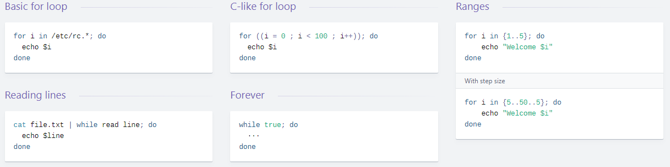
Control structures
see « Loops » section
https://devhints.io/bash#loops

Slide 49
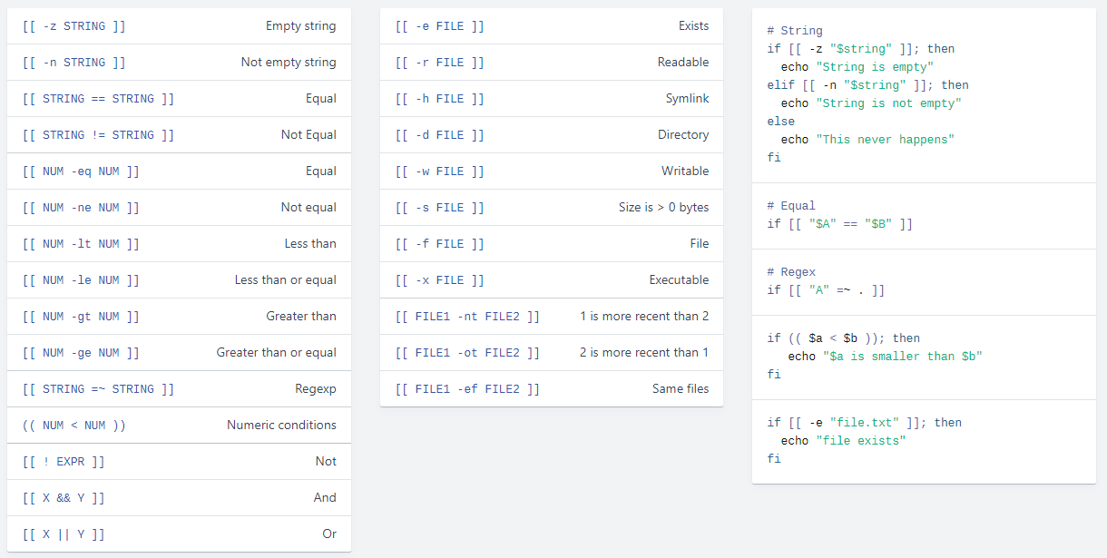
Conditions
See « Conditionals » section
https://devhints.io/bash#conditionals
TODO read: http://mywiki.wooledge.org/BashFAQ/031

Slide 50
Invoke a script
You can call a script
example executable file (see permissions) ./reverse
for ((i=$# ; i>0 ; i--)); do
echo ${!i};
done
$ reverse a b c
c
b
a
You can add a "shebang" line at the beginning of the file to specify the interpreter to use
example executable file (see permissions) ./reverse
#!/bin/bash
for ((i=$# ; i>0 ; i--)); do
echo ${!i};
done
$ reverse a b c
c
b
a
So you can use other interpreters, python, perl, etc.
example executable file (see permissions) ./reverse
#!/usr/bin/python3
import sys
for arg in reversed(sys.argv[1:]):
print(arg)
#!/usr/bin/env python3
import sys
for arg in reversed(sys.argv[1:]):
print(arg)
$ ./reverse a b c
c
b
a

Slide 51
Top 50 unix commands (for this course)
Users and permissions
sudo Command to escalate privileges in Linux
useradd and usermod - Add new user or change existing users data
passwd Create or update passwords for existing users
chmod Command to change file permissions
chown Command for granting ownership of files or folders
System, terminal, processes
whoami Print effective userid
apt, pacman, yum, rpm - Package managers depending on the distro
date Print or set the system date and time
clear Clear the terminal display
exit Cause normal process termination
man Access manual pages for all Linux commands
df Report file system disk space usage
du Estimate file space usage
ps Report a snapshot of the current processes
File system
ls Command in Linux to list files
pwd Print working directory command in Linux
cd Linux command to navigate through directories
mkdir Command used to create directories in Linux
mv Move or rename files in Linux
cp Similar usage as mv but for copying files in Linux
rm Delete files or directories
touch Create blank/empty files
ln Create symbolic links (shortcuts) to other files
comm Combines the functionality of diff and cmp
find Search for files in a directory hierarchy
Reading and writing
read Read a file descriptor in variables
echo Print any text that follows the command
printf Command identical to the C language one

Slide 52
Top 50 unix commands (for this course)
Environment and position variables
env Display environment variables
unset Unset an environment variable
set set/unset values of shell options and positional parameters
shift Shift arguments to the left ($2 becomes $1)
export Export environment variables in Linux
Filter commands – data visualisation
cat Display file contents on the terminal
head Return the specified number of lines from the top
grep Search for a string within an output
sed Stream editor for filtering and transforming text
tail Return the specified number of lines from the bottom
tee Read from STDIN and write to standard output and files
nl Print file with line numbers
Filter commands – data processing
cut Remove sections from each line of files
wc Print newline, word, and byte counts for each file
sort Sort lines of text files
paste Merge lines of files
split Split a file into pieces
tr Translate or delete characters
uniq Report or omit repeated lines
Compression, archiving, conversion
tar Command to extract and compress files in Linux
zip Zip files in Linux
unzip Unzip files in Linux
dd Majorly used for creating bootable USB sticks
Web
wget Direct download files from the internet
curl Transfer a URL

Slide 53
... some references to deepen the subject
@fr: parcourez les notes de Ronan Quennec:
https://quennec.fr/trucs-astuces/syst%C3%A8mes/gnulinux/programmation-shell-sous-gnulinux
Cheatsheet at devhints: https://devhints.io/bash
For the record, almost everything you see about Bash applies to zsh : https://devhints.io/zsh
Simplified man pages https://tldr.ostera.io/

Slide 54
... your turn
Complete the TODO section:
https://ci.mines-stetienne.fr/cps2/course/tfsd/course-1.html#_todos

