Slide 1
Technological foundations of software development
Master your development environment and software dependencies
ICM – Computer Science Major – Course unit on Technological foundations of computer science
M1 Cyber Physical and Social Systems – Course unit on CPS2 engineering and development, Part 2: Technological foundations of software development
Maxime Lefrançois https://maxime-lefrancois.info
online: https://ci.mines-stetienne.fr/cps2/course/tfsd/

Slide 2
Objectives of the session
Ensure that you are familiar with integrated development environments, as well as the use of dependencies on external versioned libraries.

Slide 3
Technological foundations of software development
Master your development environment and software dependencies
Part 1: Integrated Development Environments (IDEs)
ICM – Computer Science Major – Course unit on Technological foundations of computer scienceopment
M1 Cyber Physical and Social Systems – Course unit on CPS2 engineering and development, Part 2: Technological foundations of software development
Maxime Lefrançois https://maxime-lefrancois.info
online: https://ci.mines-stetienne.fr/cps2/course/tfsd/

Slide 4

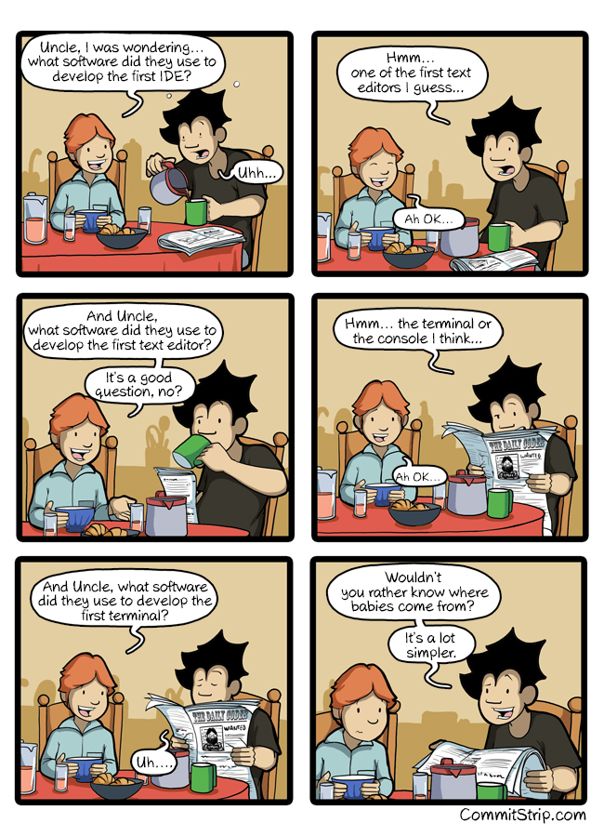
https://www.commitstrip.com/en/2016/05/11/the-code-ide-paradox/?

Slide 5

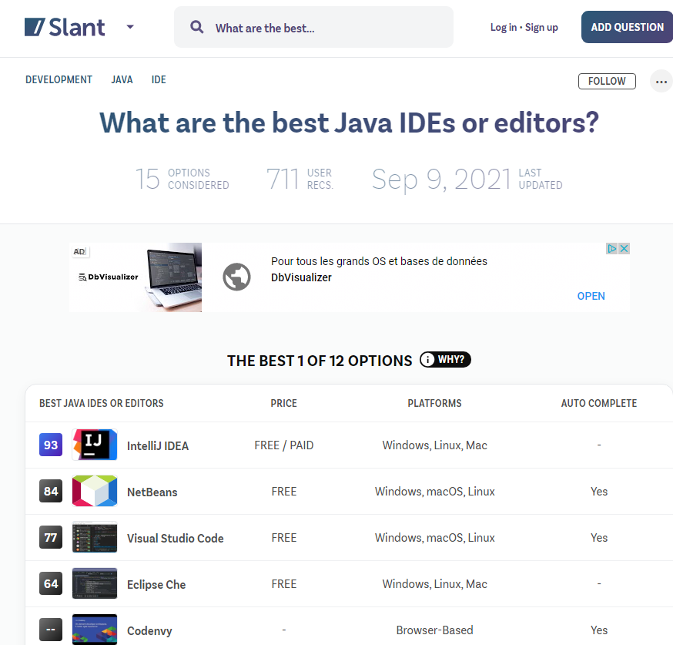




IntelliJ IDEA
JetBrains, 2001,
one of the best Java IDEs starting 2010
written in Java and Kotlin
Community ed. Apache License 2.0 - Open source
Paid version - Trialware
NetBeans
Student (1996), then Sun Microsystems (1999), then Oracle Corporation (2010), then Apache Software Foundation (2016)
written in Java
Apache License 2.0 - Open source
Visual Studio Code
Microsoft (2015)
written in TypeScript, JavaScript, HTML, CSS
MIT License - Open source
Eclipse
IBM (2001),
then Eclipse Foundation (2004)
written in Java, C
Eclipse Public License - Open source
Eclipse Che and Codenvy
Eclipse Foundation (2016),
Cloud-based IDE
written in Java, Google Web Toolkit, Docker
Eclipse Public License - Open source
https://www.slant.co/topics/607/~best-java-ides-or-editors

Slide 6
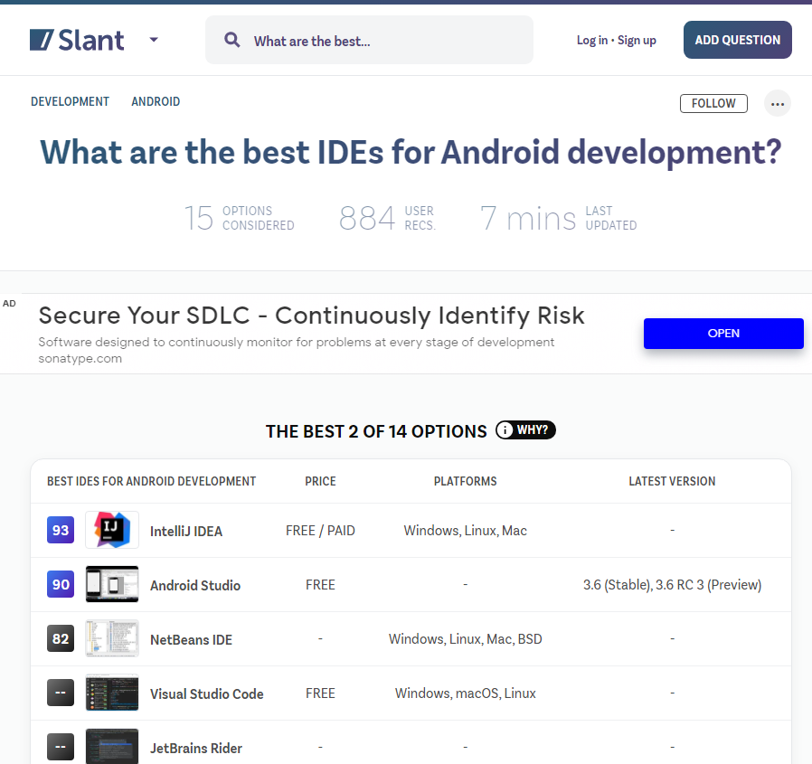

IntelliJ IDEA
JetBrains, 2001,
one of the best Java IDEs starting 2010
written in Java and Kotlin
Community ed. Apache License 2.0 - Open source
Paid version - Trialware
NetBeans
Student (1996), then Sun Microsystems (1999), then Oracle Corporation (2010), then Apache Software Foundation (2016)
written in Java
Apache License 2.0 - Open source
Visual Studio Code
Microsoft (2015)
written in TypeScript, JavaScript, HTML, CSS
MIT License - Open source
Android Studio
Google, JetBrains, 2013
Based on IntelliJ IDEA
freeware
https://www.slant.co/topics/1321/~best-ides-for-android-development

Slide 7
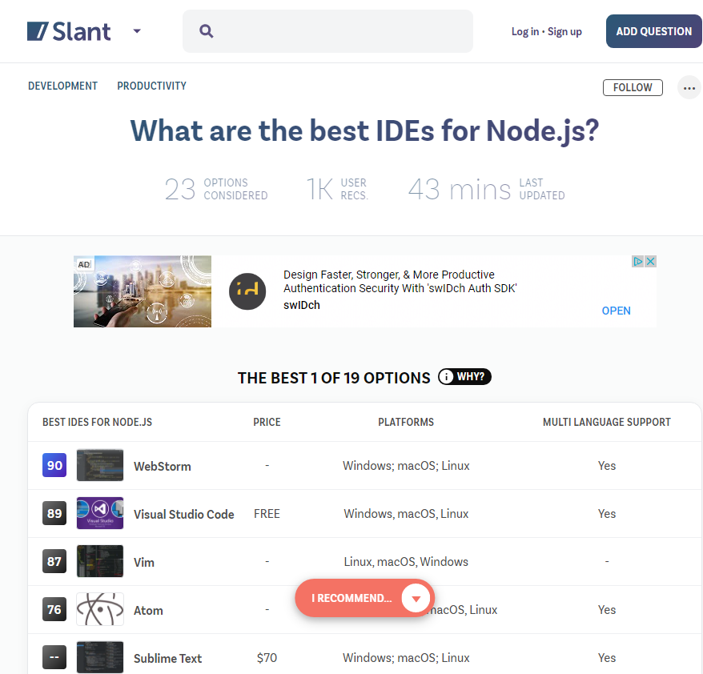




WebStorm
JetBrains, 2001,
written in Java and Kotlin
Community ed. Apache License 2.0 - Open source
Paid version – Trialware
WebStorm – For web, JavaScript and TypeScript development. Many of JetBrains's other IDEs include the feature set of WebStorm via plugins.
Vim
Bram Moolenaar (1991)
written in C
Vim License - Open source
https://blog.talanlabs.com/vim-cest-bien-mais-vscode/
Visual Studio Code
Microsoft (2015)
written in TypeScript, JavaScript, HTML, CSS
MIT License - Open source
Atom
GitHub (2014)
written in CoffeeScript, JavaScript, Less, HTML
MIT License - Open source
Sublime Text
Jon Skinner (2008)
written in C++, Python
Proprietary License
https://www.slant.co/topics/46/~best-ides-for-node-js

Slide 8
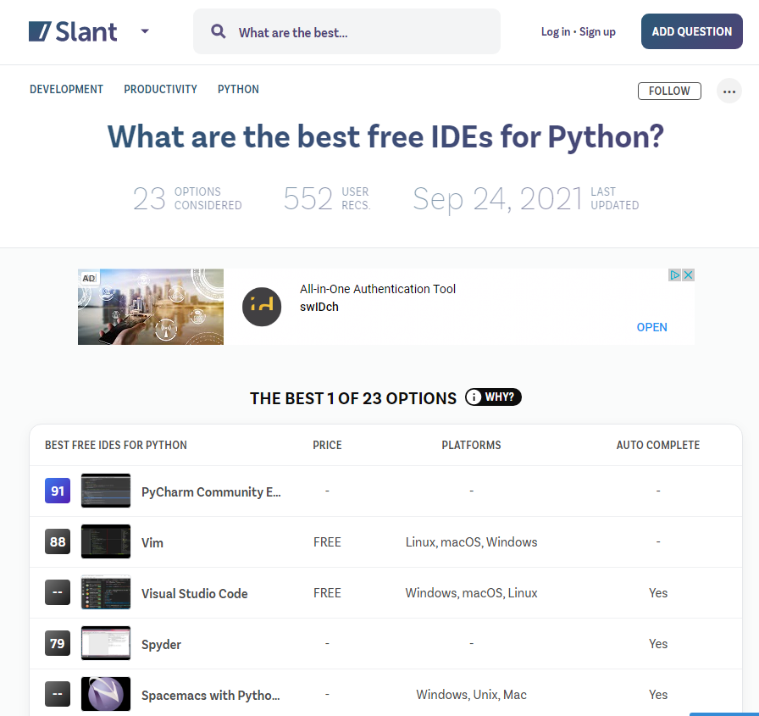


PyCharm
JetBrains, 2001,
written in Java and Python
Community ed. Apache License 2.0 - Open source
Paid version – Trialware
WebStorm – For web, JavaScript and TypeScript development. Many of JetBrains's other IDEs include the feature set of WebStorm via plugins.
Vim
Bram Moolenaar (1991)
written in C
Vim License - Open source
https://blog.talanlabs.com/vim-cest-bien-mais-vscode/
Visual Studio Code
Microsoft (2015)
written in TypeScript, JavaScript, HTML, CSS
MIT License - Open source
Spyder
Puierre Raybaut (2009)
written in Python
MIT License - Open source
Sublime Text
Jon Skinner (2008)
written in C++, Python
Proprietary License
https://www.slant.co/topics/1332/~best-free-ides-for-python

Slide 9
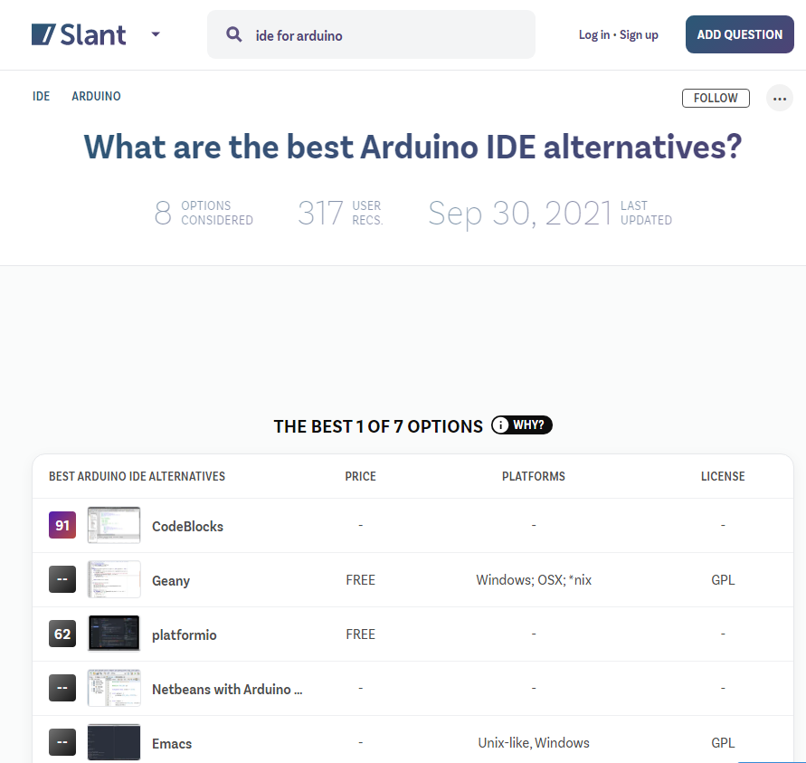


Arduino IDE
Arduino Software, 2005,
Written in C and C++
GNU General Public License 2 - Open source
PlatformIO
Ivan Kravets, 2014
Not an IDE – just a CLI + extensions
Written in Python
Useable as a plugin for:
VSCode
Eclipse
Netbeans
Atom
Sublime Text
...
https://www.slant.co/topics/9848/~arduino-ide-alternatives

Slide 10
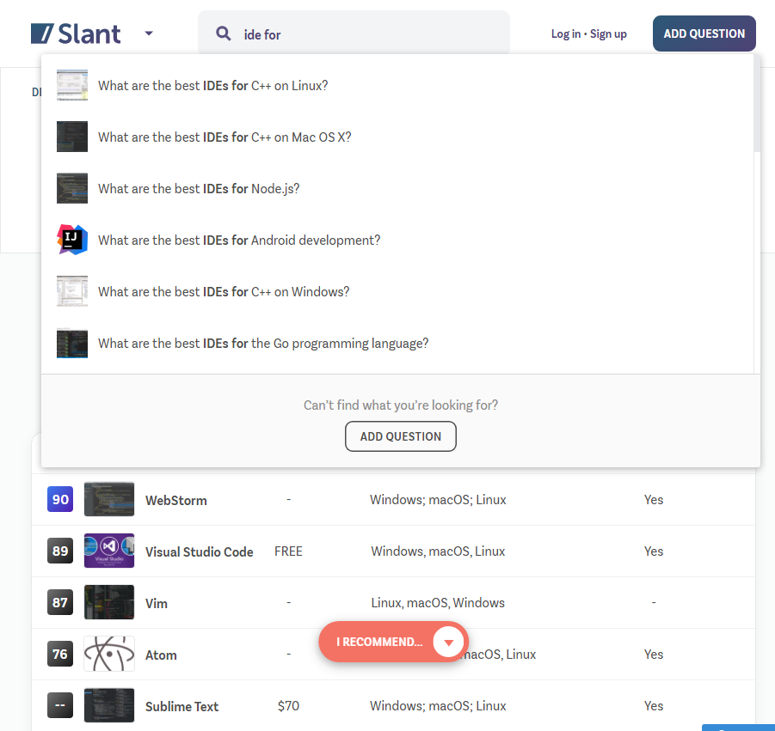
A large number of programming languages,
A large number of IDEs
Text editor
?
IDE
https://www.slant.co/topics/9848/~arduino-ide-alternatives

Slide 11
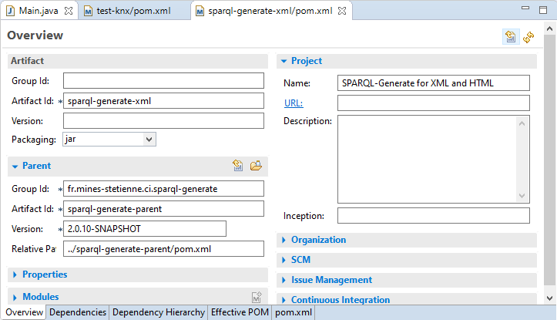
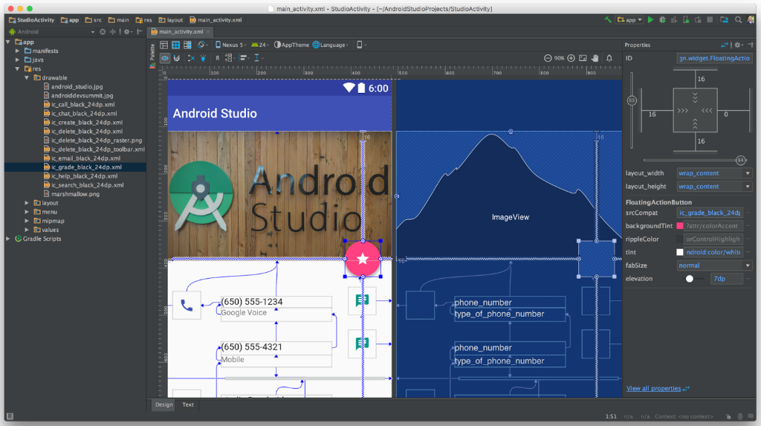
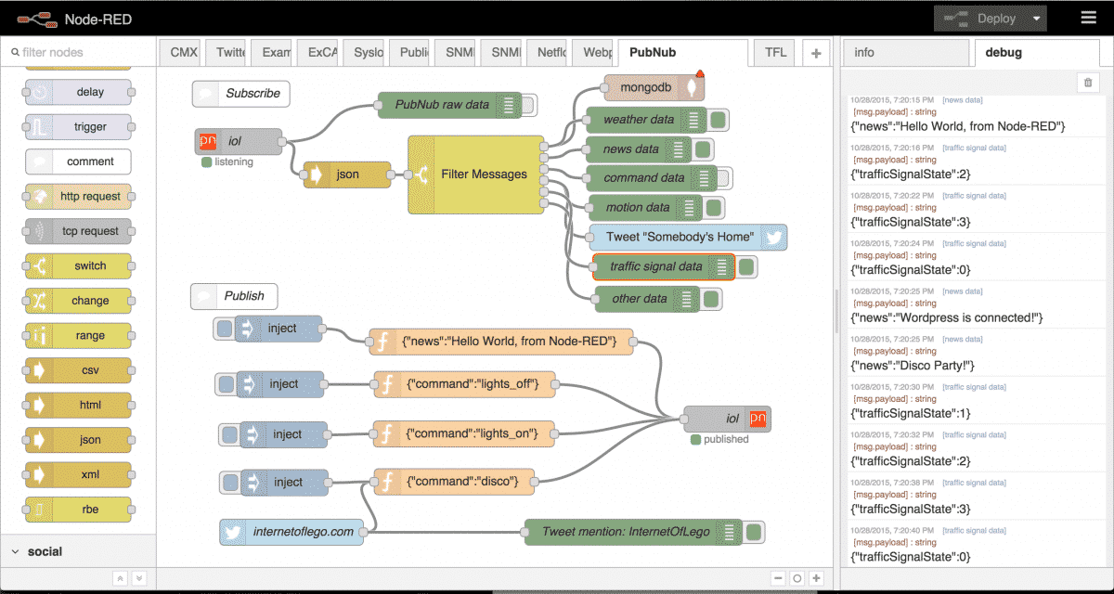
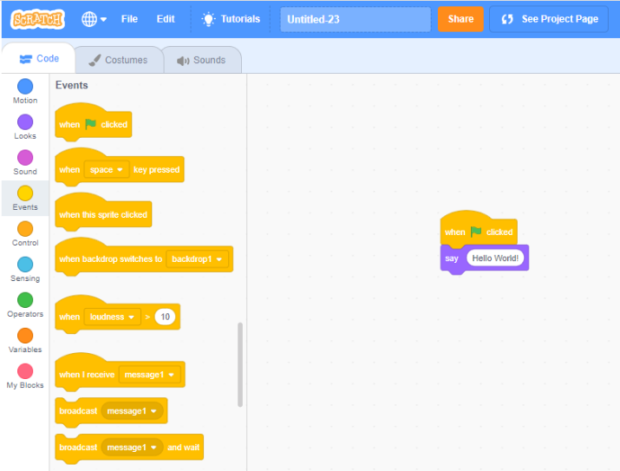
Visual programming
Types of IDEs
Formulaire to edit an XML document in Eclipse
Interface programing with Android Studio
Visual programming with Node-RED
Visual programming for learning to program with Scratch

Slide 12
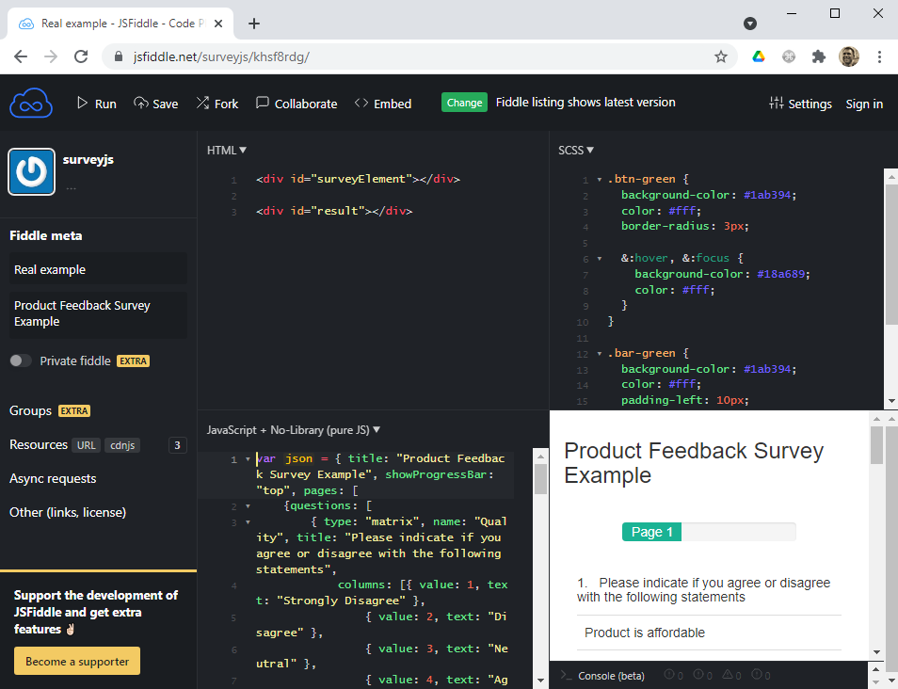
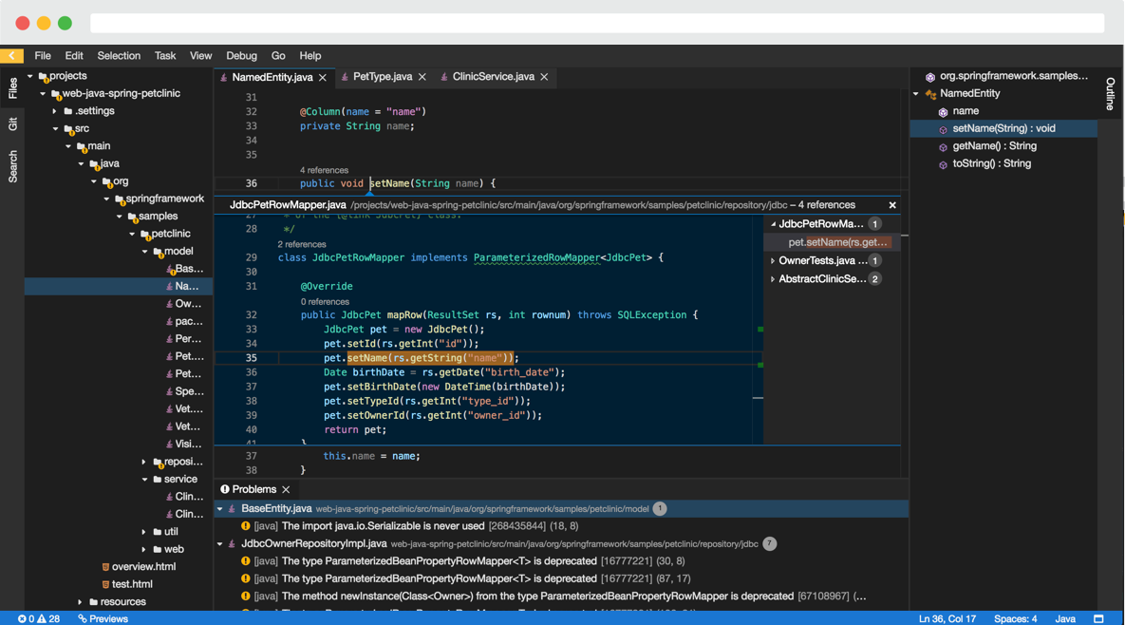
Web IDE
Types of IDEs
Actually to produce code
Eclipse Che
CodeAnywhere
Replit
Cloud9 IDE
Playgrounds and snippet sharing
codesandbox.io
codechef.com
jsfiddle.com
ideone.com
Eclipse Che
jsfiddle

Slide 13
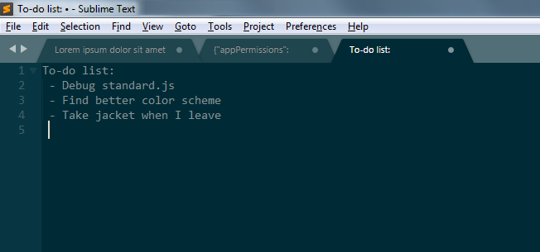
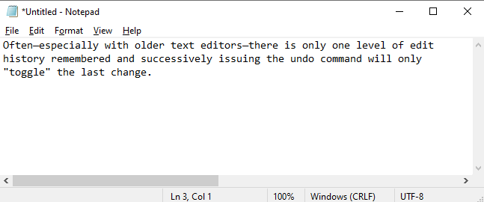
Undo - redo
Text editors features
Stack of edits
Unsaved changes
Stupid Undo – Redo with Notepad
Unsaved files are available when you reopen Sublime Text

Slide 14
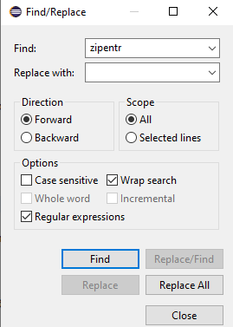
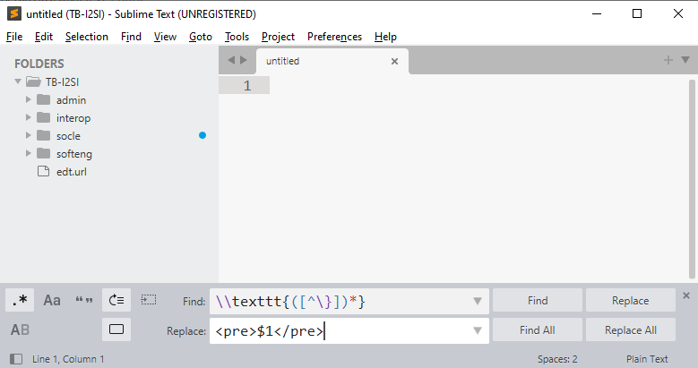
Find - Replace
Text editors features
In file or set of files
With REGEX - Regular expressions
Find – Replace with Eclipse
Find – Replace with Sublime Text
Find – Replace with IntelliJ IDEA

Slide 15
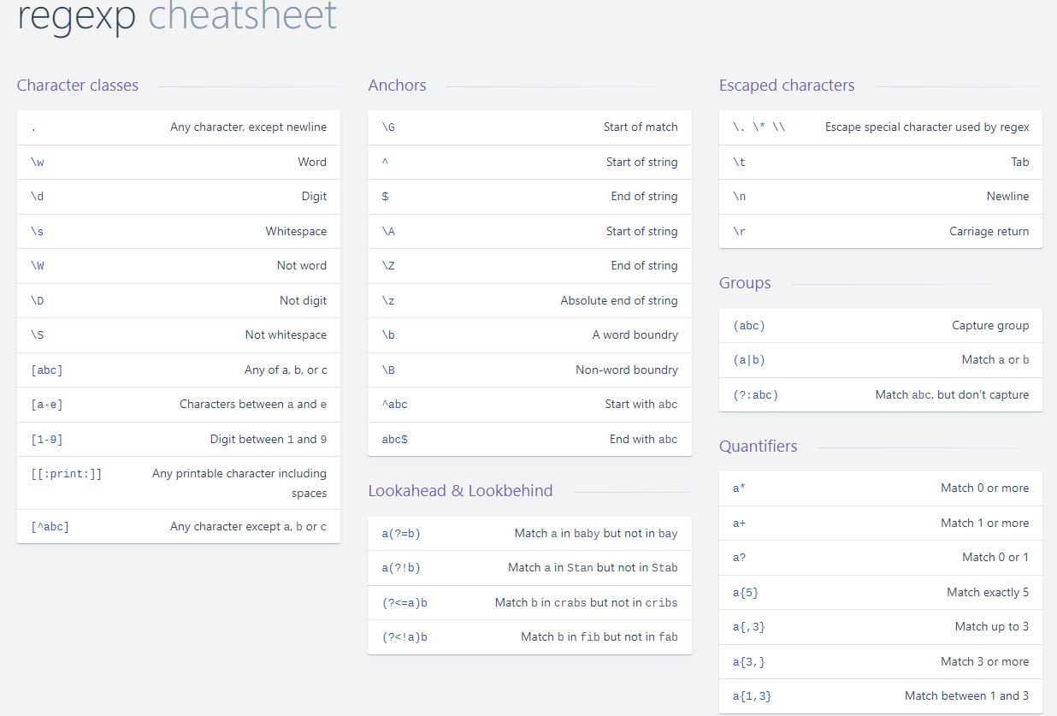
Chercher – Remplacer
Fonctionnalités des Editeurs de Texte
https://devhints.io/regexp

Slide 16
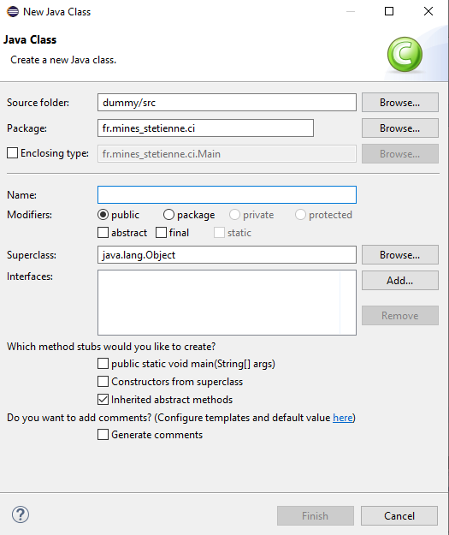
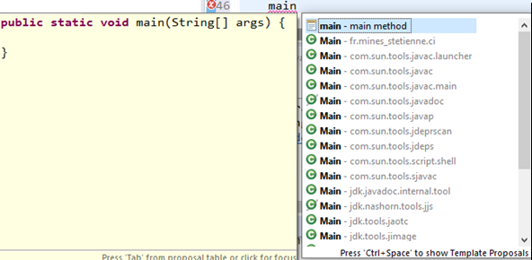
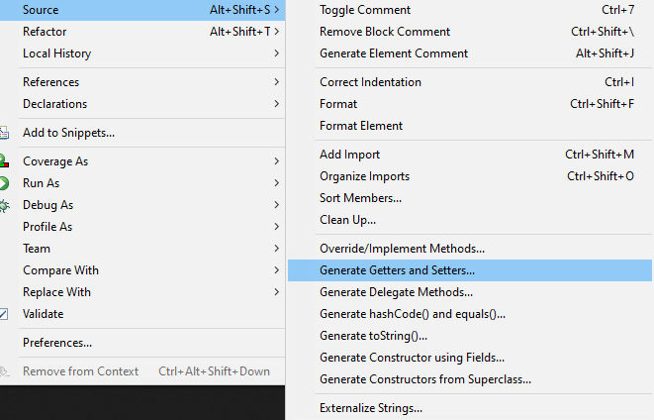
Source code generation snippets
Text editors features
Adding the main method with autocompletion
File creation form
Generation of frequent methods getters, setters, hashCode, equals, etc.

Slide 17
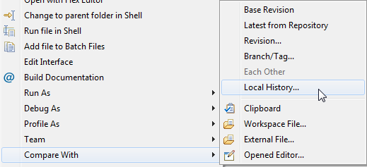
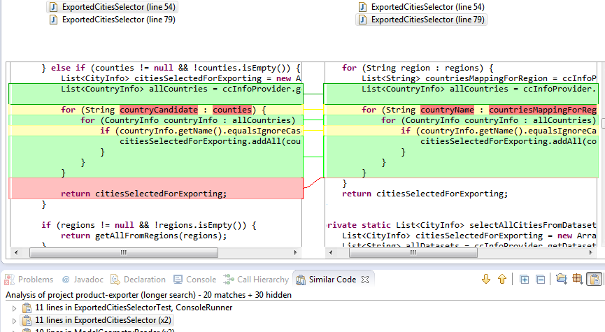
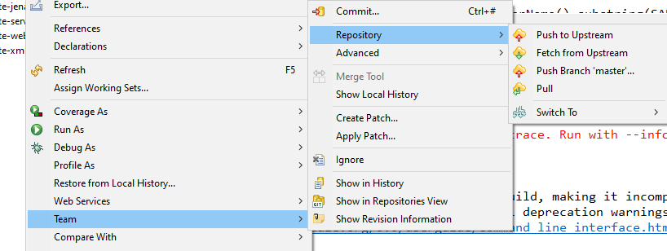
Version control and file comparison
IDE features
Local history,
Version Control System (VCS) integration
File comparison utilities
Historique local avec Eclipse
Integration of git in Eclipse
Comparing files in Eclipse

Slide 18
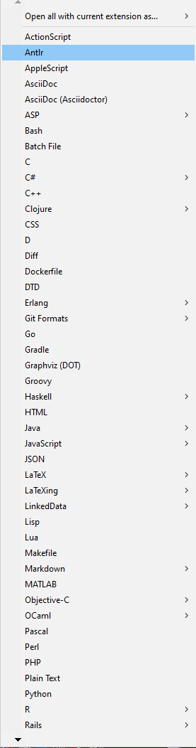
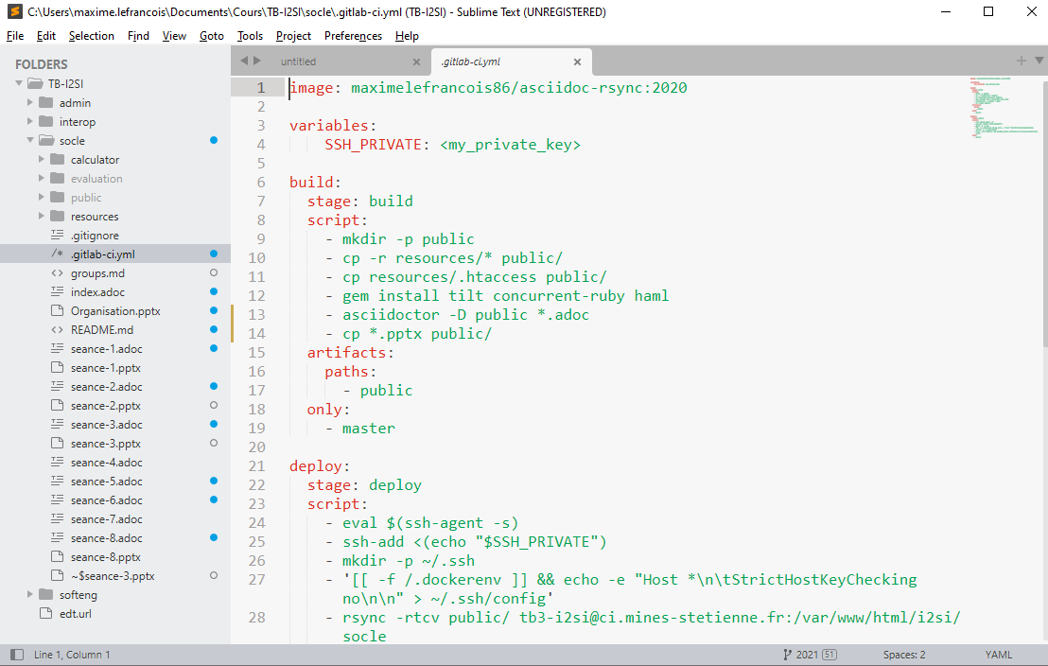
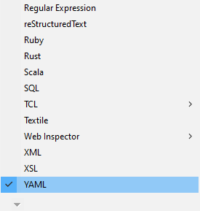

Syntax highlighting and validation
IDE features
Warnings and errors
Linter
Quick fixes
syntax highlighting with Sublime Text
Syntax validation with Eclipse
list of available grammars

Slide 19
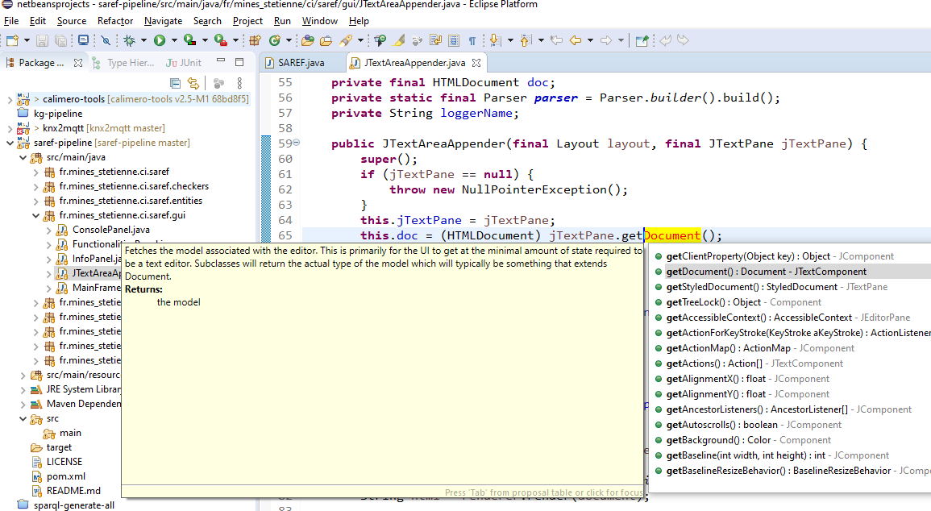
Code completion
IDE features
More or less intelligent
Based on current project or external libraries
CTRL+SPACE: Auto-completion with Eclipse

Slide 20
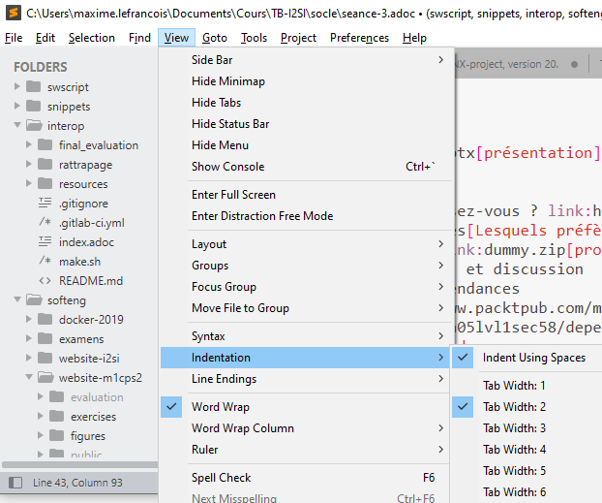
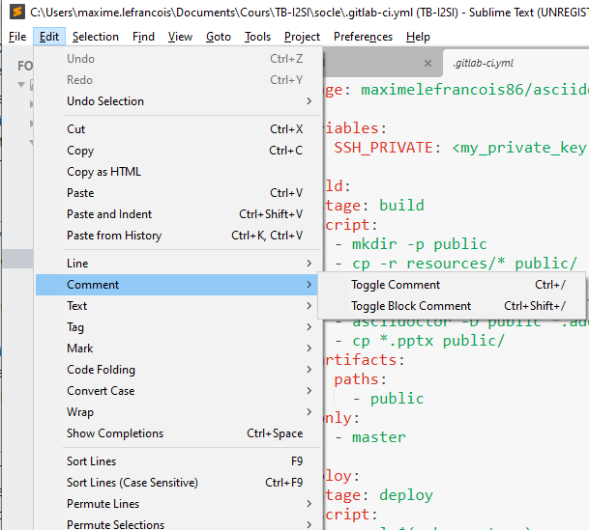
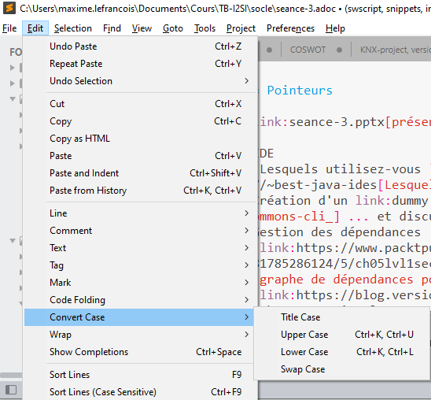
Text formatting
IDE features
Automatic line feed
Auto-indentation tab/space
Comment/uncomment
Tab vs space indentation
Comment/uncomment with Sublime Text
Case conversion

Slide 21
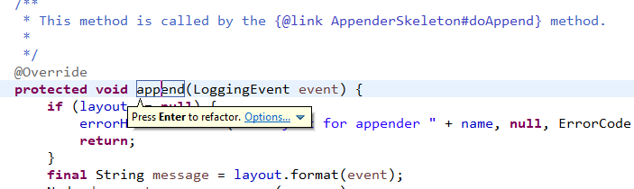
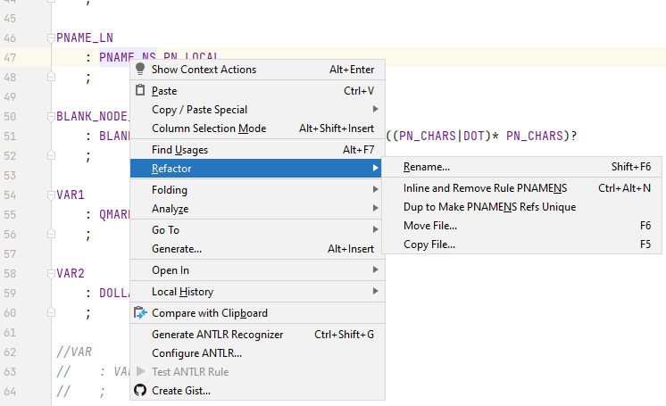
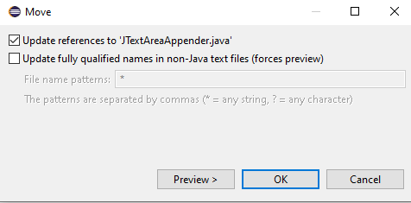
Refactoring
IDE features
Replacement of an identifier in the whole project
identifier of variable, method, class, ...
Change package of a java class, ...
in line refactoring with Eclipse: ALT+SHIFT+R
Refactoring with IntelliJ: SHIFT+F6
moving a Java class with Eclipse

Slide 22
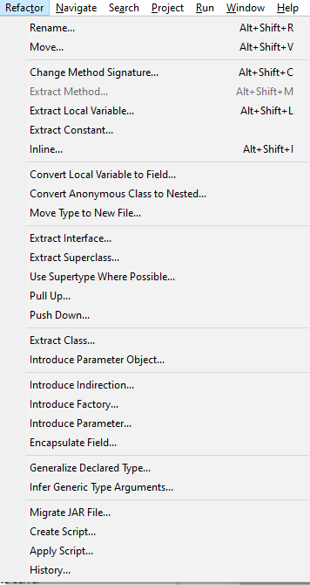
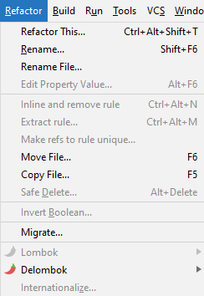
Refactoring
IDE features
Replacement of an identifier in the whole project
identifier of variable, method, class, ...
Change package of a java class, ...
Refactor menu in IntelliJ
Refactor menu in Eclipse

Slide 23
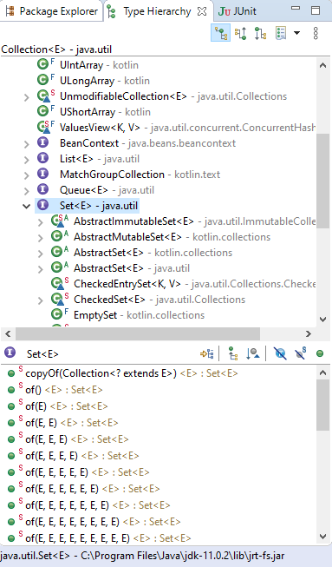
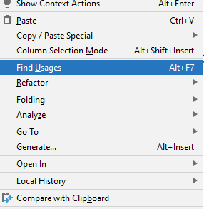
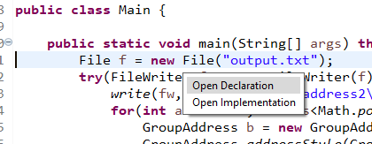
Analysis and Navigation
IDE features
CTRL+click to navigate to the declaration
Viewing the hierarchy, viewing the members
IntelliJ – Find usages – ALT+F7
CTRL to display the navigation options
Eclipse Type Hierarchy and navigator pane - open for a class with F4

Slide 24
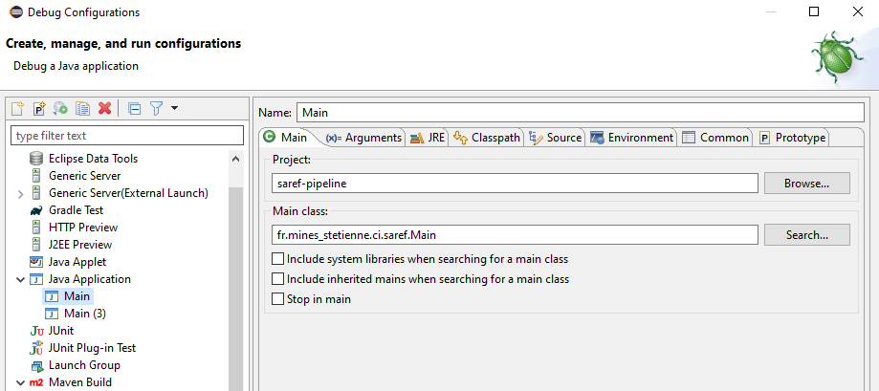
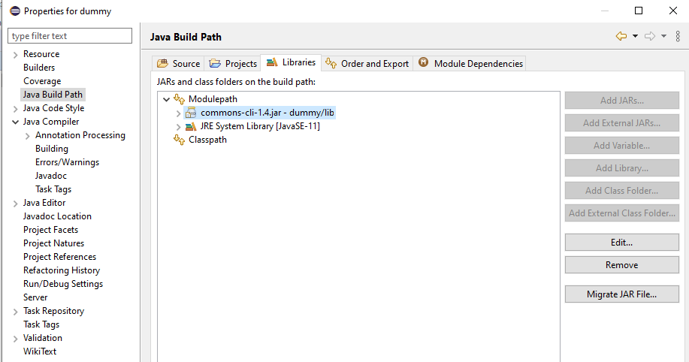
Project configuration
IDE features
Execution configuration with Eclipse
Add an external library to a java project in Eclipse

Slide 25
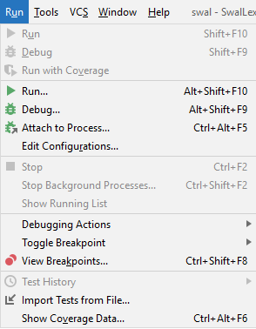
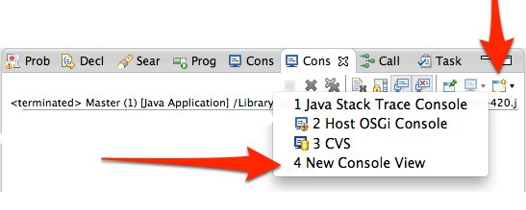
Run
IDE features
Execution configuration with Eclipse
IntelliJ Run menu
Eclipse console

Slide 26
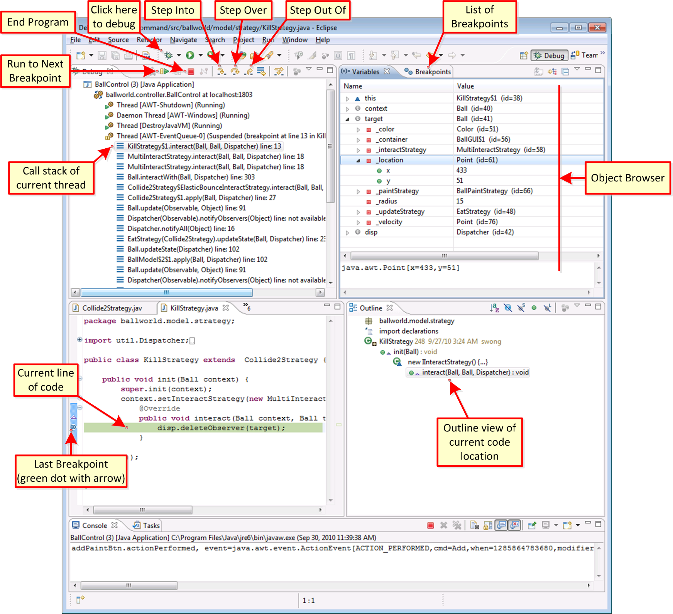
Debug
IDE features
Controlled execution of the program
Monitoring and/or modification of the content of variables during execution
Allows to trace bugs

Slide 27
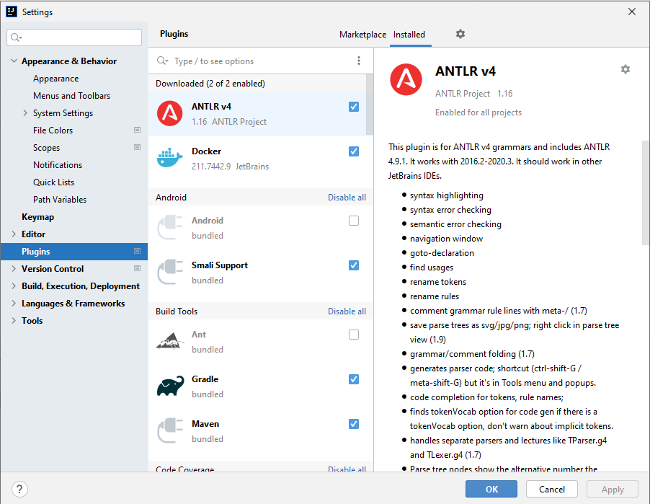
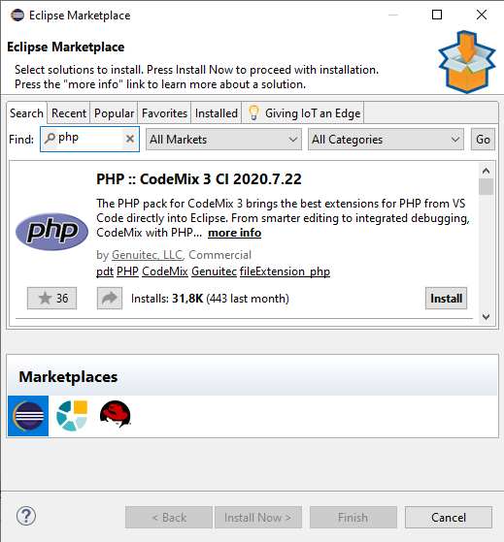
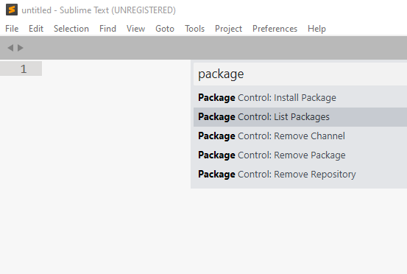
Extensibility
IDE features
Extension system, plugins, packages, ...
IntelliJ IDEA plugins
Eclipse Marketplace
Packages control in Sublime Text -> tool -> command palette

Slide 28
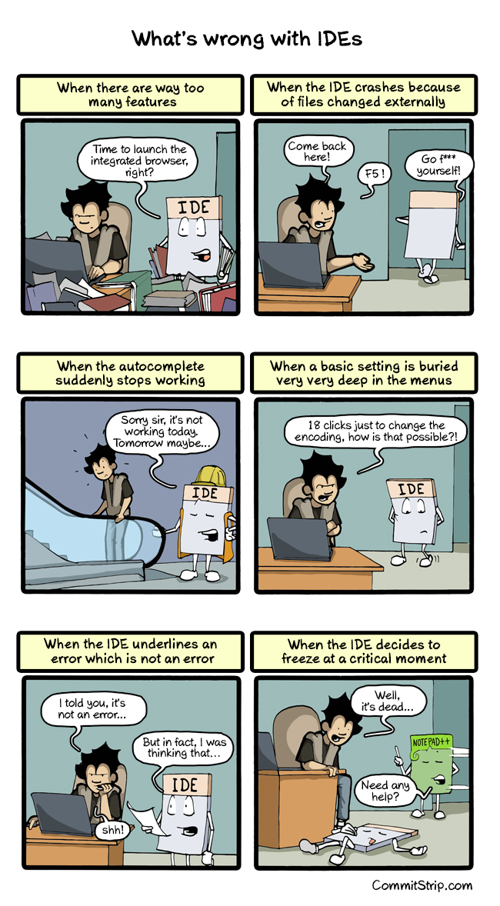
https://www.commitstrip.com/en/2015/04/22/whats-wrong-with-ides/?

Slide 29
Technological foundations of software development
Master your development environment and software dependencies
Part 2: Versioned external libraries
ICM – Computer Science Major – Course unit on Technological foundations of computer scienceopment
M1 Cyber Physical and Social Systems – Course unit on CPS2 engineering and development, Part 2: Technological foundations of software development
Maxime Lefrançois https://maxime-lefrancois.info
online: https://ci.mines-stetienne.fr/cps2/course/tfsd/

Slide 30
External libraries
Set of resources that can be reused
sources
compiled code
documentation
https://en.wikipedia.org/wiki/Library_(computing)

Slide 31
External libraries
Set of resources that can be reused
sources
compiled code
documentation
Used in different phases of the software life cycle
For compilation (static library, *.lib, *.a)
For testing
For execution (dynamic library, *.dll, *.so)
At runtime (OSGi example)
https://en.wikipedia.org/wiki/Library_(computing)

Slide 32
Linking
Resolution phase of references to external libraries
Static linking
copy the *.lib or *.a library during the creation of the executable
pro: more portable, no version conflicts
con: copy the whole library -> not optimized
Dynamic linking
resolution and loading of the library at runtime
pro: save disk and memory space,
pro: in case of bug, just replace the *.dll or *.so
con: DLL hell: evolution and backward compatibility problems
https://en.wikipedia.org/wiki/Library_(computing)

Slide 33
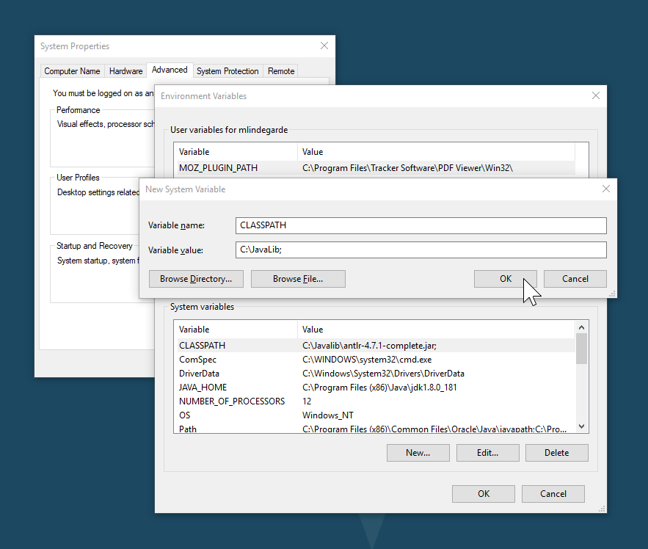
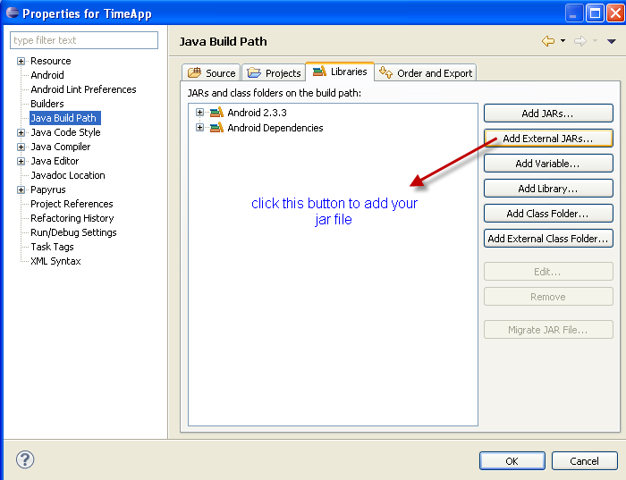
With Java – class libraries
The Class Loader resolves references with the Classpath
Compiled classes *.class, or archives *.jar
CLASSPATH environment variable
jvm option --classpath
Classpath environment variable
Set the classpath of java projects in Eclipse
https://docs.oracle.com/javase/specs/jvms/se17/html/jvms-5.html

Slide 34

With Python
Python module path resolves references to modules
Environnement variable PYTHONPATH
Set the pythonpath of python projects in PyCharm
https://docs.python.org/3/using/cmdline.html#envvar-PYTHONPATH

Slide 35
Library repository
Place where libraries and their metadata are stored
example for Linux: https://wiki.debian.org/DebianRepository/ https://help.ubuntu.com/community/Repositories/Ubuntu
https://en.wikipedia.org/wiki/Software_repository

Slide 36



Library repository
Place where libraries and their metadata are stored
Java: Maven Central
.NET: NuGet
Node.js: npm
Python: PyPI
...
PyPI central repository
https://pypi.org/
Maven distributed repositories
https://mvnrepository.com/ - https://search.maven.org/ - ...
npm central repository
https://npmjs.com/
https://en.wikipedia.org/wiki/Software_repository

Slide 37
Library manager
Software that allows to download or update libraries and their dependencies (transitive)
Package Manager | Description
npm | A package manager for Node.js^{[21]}
pip | A package installer for Python^{[22]}
apt | For managing Debian Packages^{[23]}
Homebrew | A package installer for MacOS that allows you to install packages Apple didn't^{[24]}
vcpkg | A package manager for C and C++^{[25][26]}
yum and dnf | Package manager for Fedora and Red Hat Enterprise Linux^{[27]}
pacman | Package manager for Arch Linux^{[28]}
https://en.wikipedia.org/wiki/Software_repository

Slide 38
Typical library artifacts
Binaries, sources, documentation
Metadata
Name, description
Publisher, developer
version number
Links to sources, issue tracker
Checksum
Necessary dependencies
Example for Java: com.google.code.gson:gson:2.8.8 https://mvnrepository.com/artifact/com.google.code.gson/gson/2.8.8 --> link « view all »
Example for Ubuntu: asciidoc:8.6.10-2 https://packages.ubuntu.com/source/bionic/asciidoc --> download dsc
https://en.wikipedia.org/wiki/Software_repository

Slide 39


Java maven central: G-A-V coordinates
G-A-V = Group, Artefact, Version
https://repo1.maven.org/maven2/com/google/code/gson/gson/2.8.8/gson-2.8.8.pom
https://repo1.maven.org/maven2/com/google/code/gson/gson/

Slide 40
Packaging flow for python
Configuration file pyproject.toml
Build $ python3 -m build .
source distribution, (or sdists) ex., pip-23.3.1.tar.gz
Sources + PKG-INFO file with metadata
binary distribution(s), (or wheels) ex., pip-23.3.1-py3-none-any.whl
extension modules, written in compiled languages like C, C++ and Rust, need to be compiled into platform-dependent machine code. Wheels contain compiled, executable code (.so/.dll files)
Upload to PyPI (or other) $ twine upload --repository testpypi dist/*
Download and install $ python3 -m pip install package-name
https://packaging.python.org/en/latest/flow/
https://packaging.python.org/en/latest/discussions/package-formats/

Slide 41
Software versions
Version name unique to a software state
internal names (build number or timestamp)
names for publication
A wide variety of naming choices
When should you change this or that part of the version name?
https://en.wikipedia.org/wiki/Software_versioning

Slide 42
Software versions
Version name unique to a software state
internal names (build number or timestamp)
names for publication
A wide variety of naming choices
When should you change this or that part of the version name?
Marketing and superstition sometimes get in the way
Photoshop 5 -> 5.5
Office 2007 (v12) ->Office 2010 (v14)
Sometimes specified by language
Python: PEP 440 – Version Identification and Dependency Specification
https://en.wikipedia.org/wiki/Software_versioning

Slide 43

https://www.commitstrip.com/en/2013/08/20/numeros-de-version/?
The convention is sometimes singular
TeX 3 ; 3.1 ; 3.14 ; 3.141 ; 3.1415 ; ...

Slide 44

Software versions
Calendar Versioning (CalVer)
Office 2007, 2010
Ubuntu 18.04 = April 2018
Wine 20040505 = 2004-05-05
Standardisation attempt: https://calver.org/
https://calver.org/

Slide 45

Software versions
Semantic Versionning (SemVer)
Standardisation attempt: https://semver.org
MAJOR: increment = change not retro-compatible
Minor: increment = feature added
Patch: increment = bug corrected
x.y.z-a1 = first alpha version
x.y.z-b3 = third beta version
x.y.z-rc1 = first release candidate
0.y.z = work in progress
https://semver.org

Slide 46

Versions de logiciels
Semantic Versionning (SemVer)
Tentative de standardisation: https://semver.org
MAJOR: increment = pas rétrocompatible
Minor: increment = ajout de fonctionnalité
Patch: increment = correction de bug
x.y.z-a1 = première version alpha
x.y.z-b3 = troisième version béta
x.y.z-rc1 = première candidate release
0.y.z = work in progress
https://www.commitstrip.com/en/2019/01/24/1-10-or-1-1/?

Slide 47
Technological foundations of software development
Master your development environment and software dependencies
ICM – Computer Science Major – Course unit on Technological foundations of computer scienceopment
M1 Cyber Physical and Social Systems – Course unit on CPS2 engineering and development, Part 2: Technological foundations of software development
Maxime Lefrançois https://maxime-lefrancois.info
online: https://ci.mines-stetienne.fr/cps2/course/tfsd/

Slide 48
... Your turn
Complete the TODO section:
https://ci.mines-stetienne.fr/cps2/course/tfsd/course-2.html#_todos

