Slide 1
Technological foundations of software development
Manage your source code
ICM – Computer Science Major – Course unit on Technological foundations of computer science
M1 Cyber Physical and Social Systems – Course unit on CPS2 engineering and development, Part 2: Technological foundations of software development
Maxime Lefrançois https://maxime-lefrancois.info
online: https://ci.mines-stetienne.fr/cps2/course/tfsd/

Slide 2
Objectives of the session
Ensure you are familiar with source code management methodologies and tools, in particular the git software, the gitlab platform used at school, and the github platform.

Slide 3
Technological foundations of software development
Manage your source code
Part 1: generalities
ICM – Computer Science Major – Course unit on Technological foundations of computer science
M1 Cyber Physical and Social Systems – Course unit on CPS2 engineering and development, Part 2: Technological foundations of software development
Maxime Lefrançois https://maxime-lefrancois.info
online: https://ci.mines-stetienne.fr/cps2/course/tfsd/

Slide 4
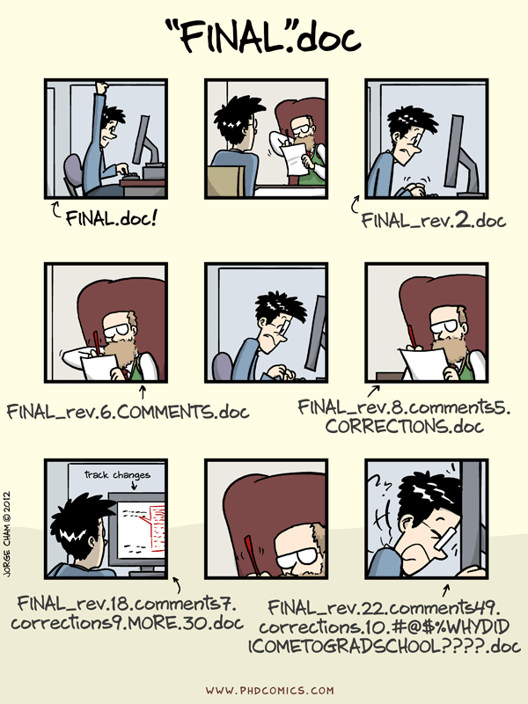
Why track versions ?
Example: many versions of the same file
http://phdcomics.com/comics/archive.php?comicid=1531

Slide 5
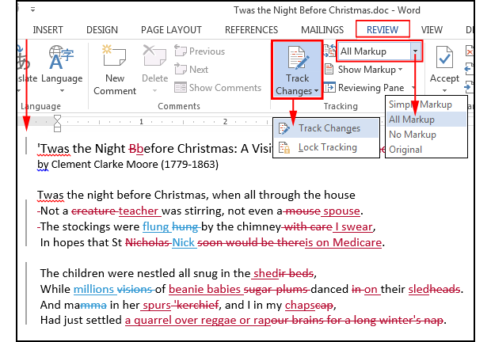
Track changes in a file
Example with Word

Slide 6
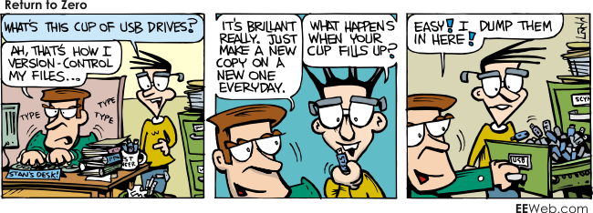
Why save versions ?
Example: to restore to a previous state
http://library.ucmerced.edu/node/66631

Slide 7
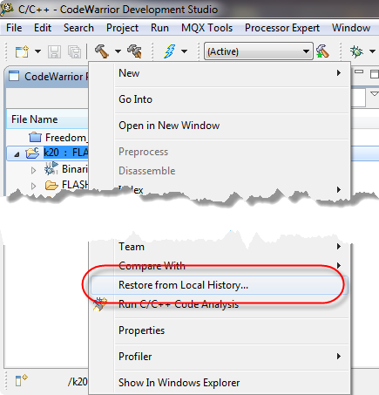
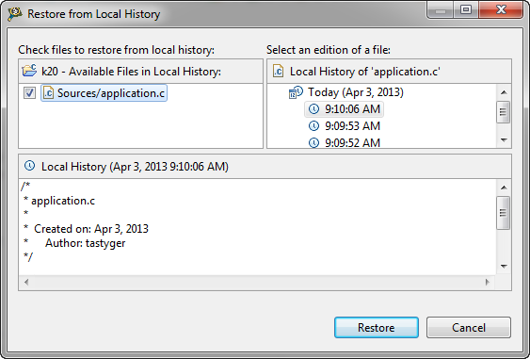
For code ?
Some IDEs have embedded solutions
For example with Eclipse
https://mcuoneclipse.com/2013/04/03/restore-deleted-files-in-eclipse-with-local-history/

Slide 8
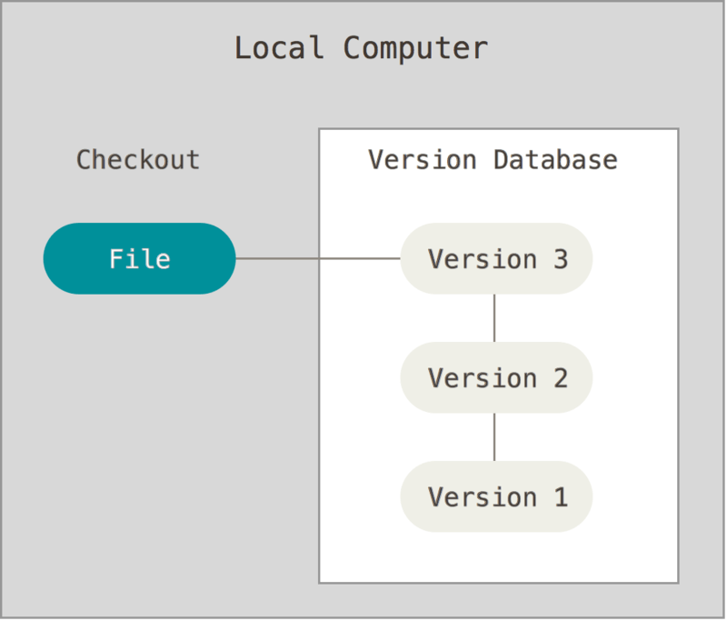
For code ?
Some IDEs have embedded solutions
For example with Eclipse
Local version management
https://mcuoneclipse.com/2013/04/03/restore-deleted-files-in-eclipse-with-local-history/
https://git-scm.com/book/en/v2/Getting-Started-About-Version-Control

Slide 9
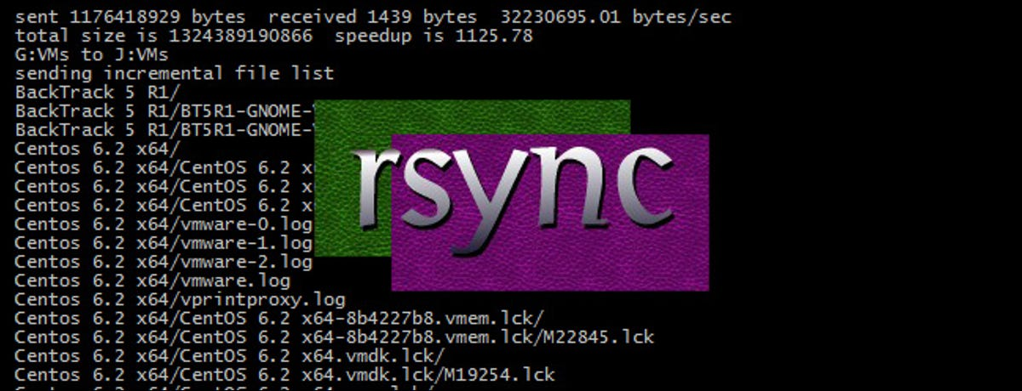
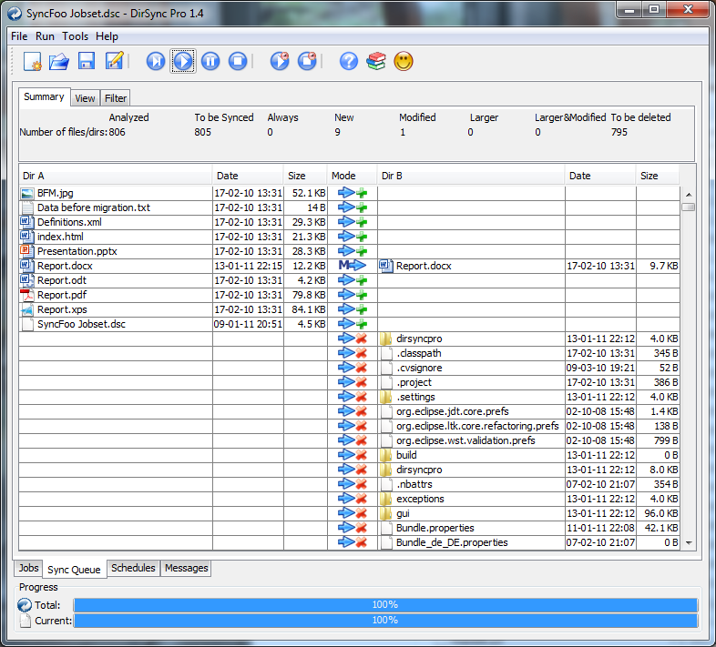
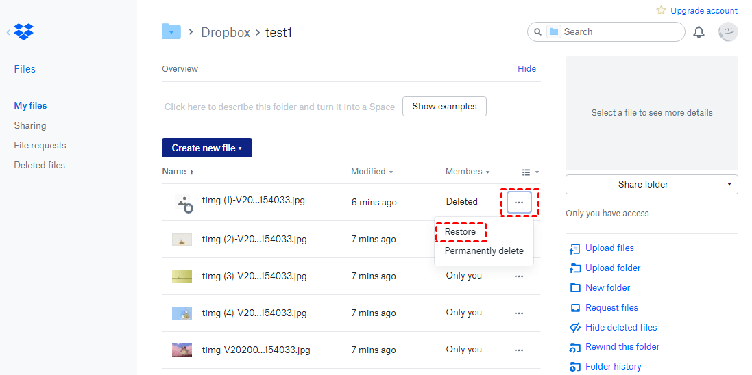
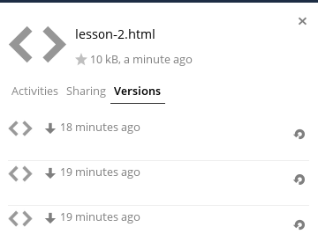
File synchronization software
Many solutions exist
https://en.wikipedia.org/wiki/Comparison_of_file_synchronization_software
commercial or open-source
local, or with server, or with cloud
personal or collaborative folders
rsync, 1996
ownCloud, 2010
dirsyncpro, 2004
dropbox, 2007

Slide 10
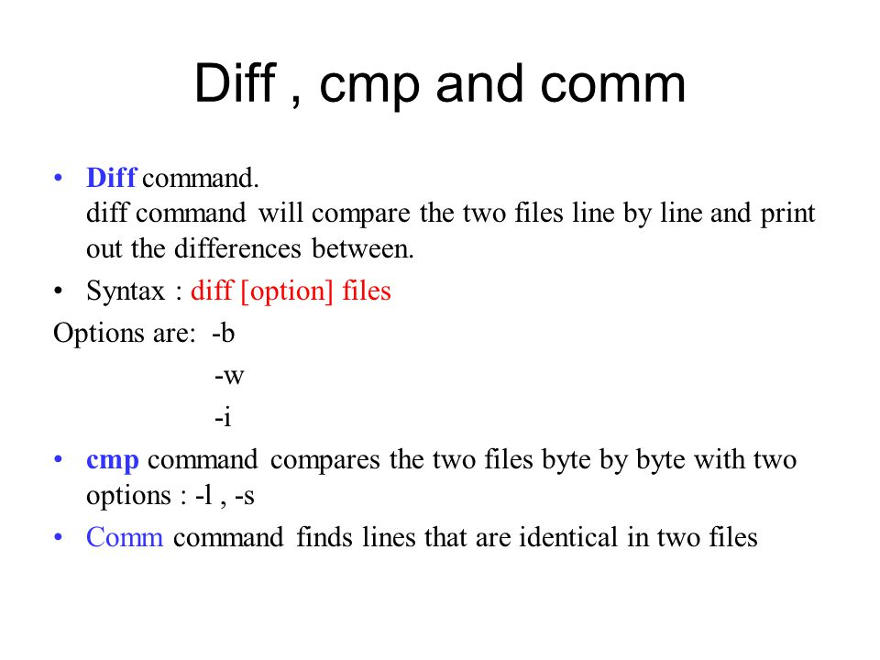
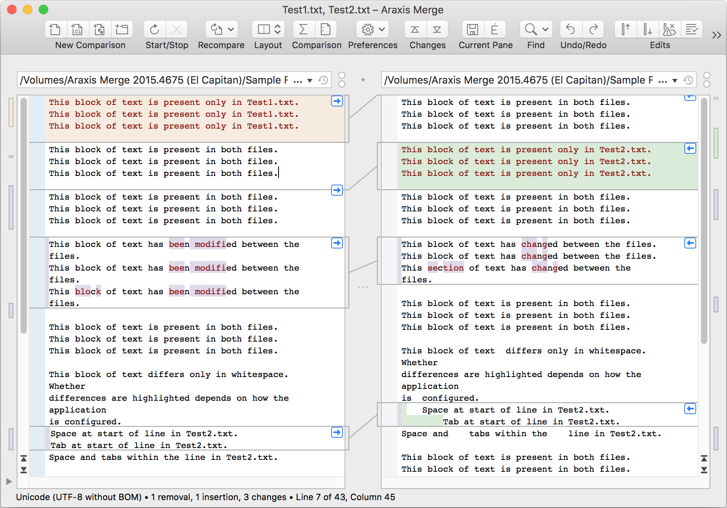
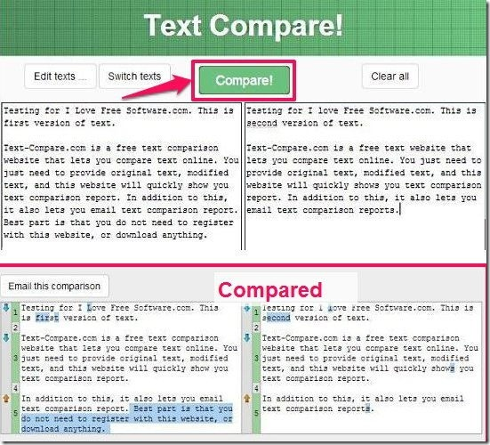
Diff utilities
https://en.wikipedia.org/wiki/Diff
linux diff, comp, comm, cli tools
Araxis merge, software
https://text-compare.com/ , online

Slide 11
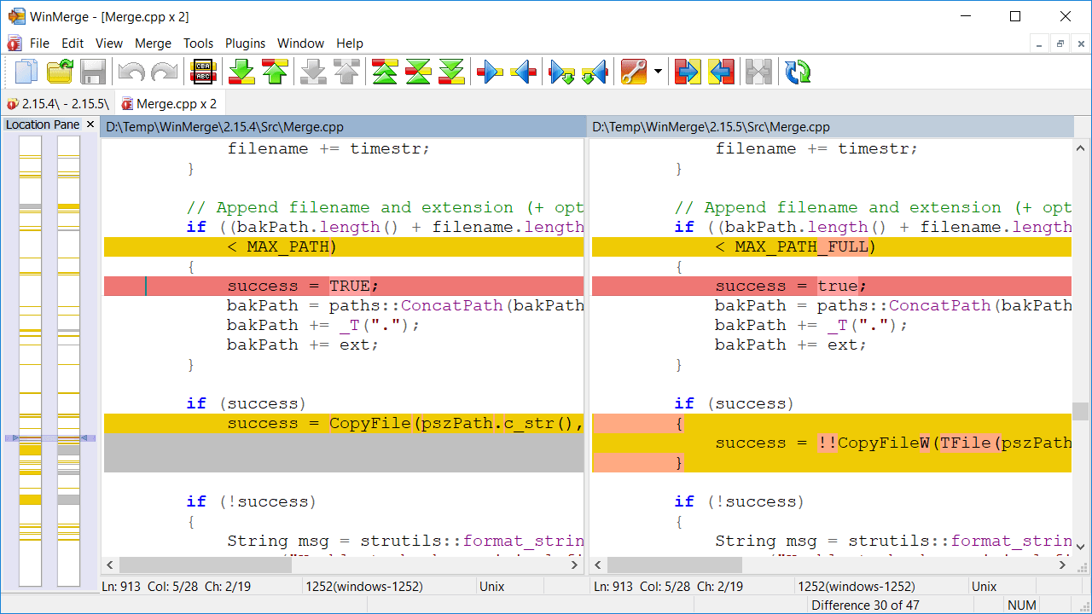
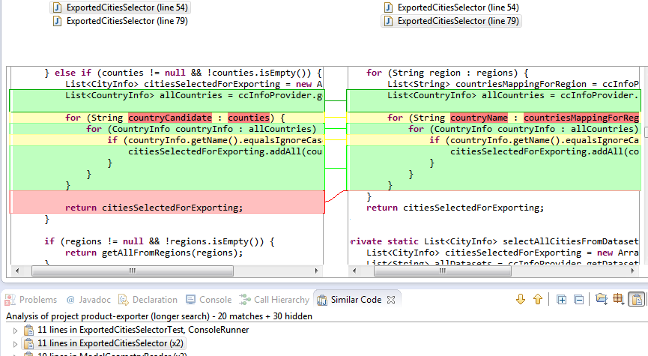
Diff utilities
https://en.wikipedia.org/wiki/Diff
syntax - semantics
WinMerge
In Eclipse

Slide 12
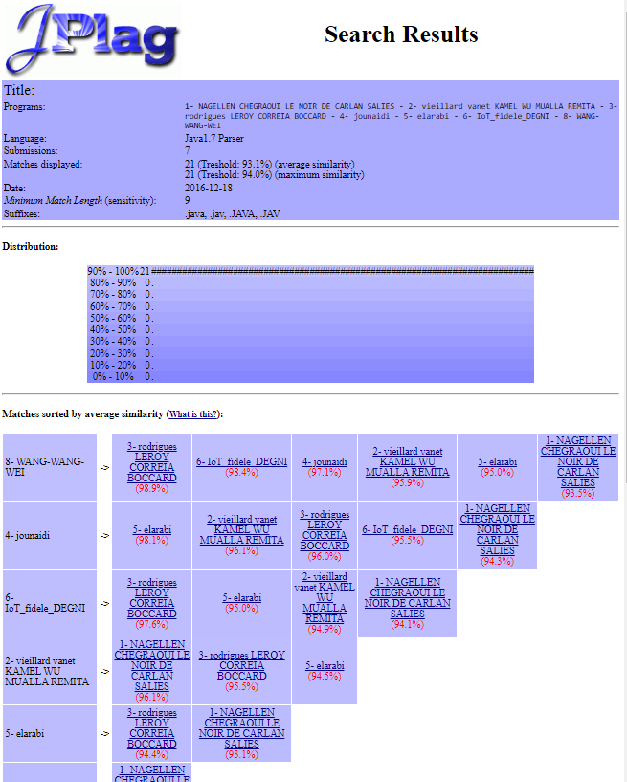
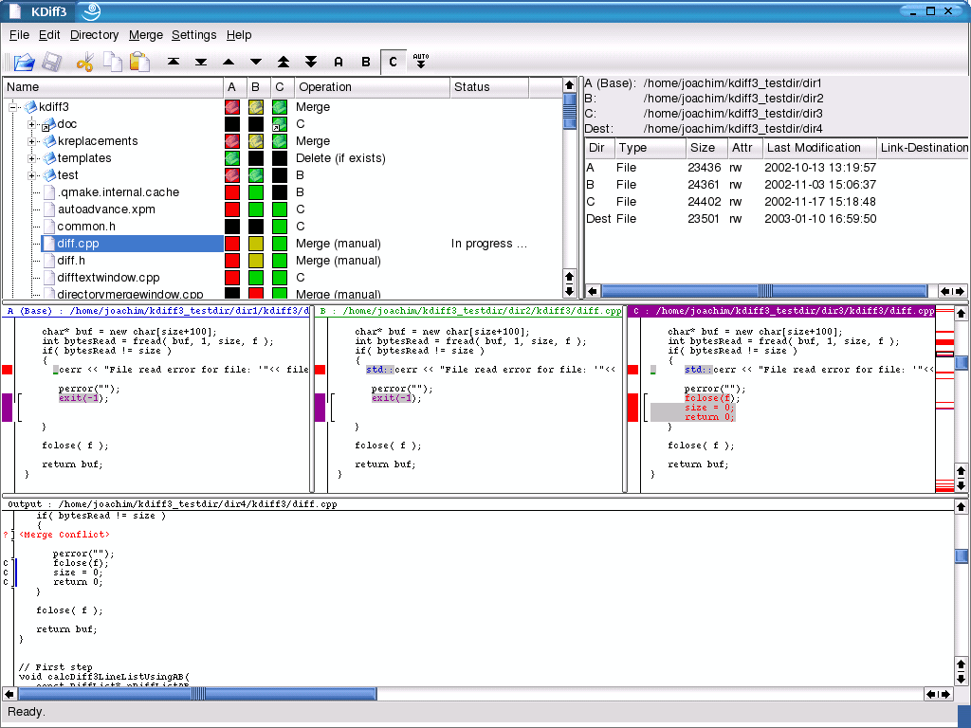
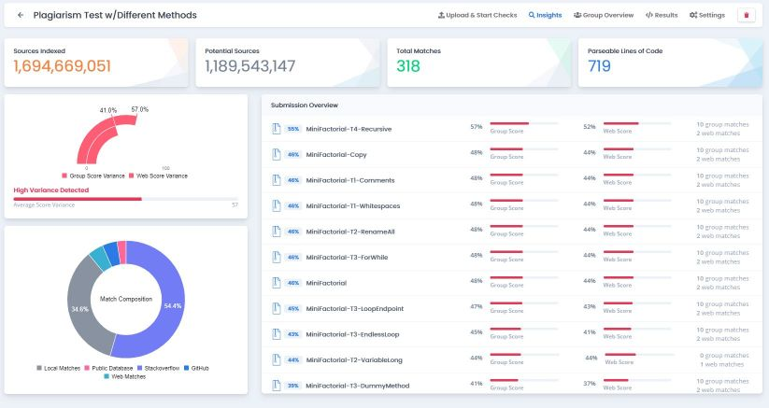
Content comparison utilities
https://en.wikipedia.org/wiki/Content_similarity_detection
Example: plagiarism detection
KDiff3, open-source
codequiry, shareware
Jplag, freeware

Slide 13
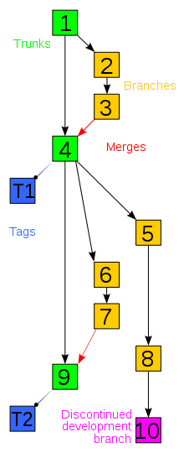
VCS - Version Control System
Definition
A tool that helps developers/programmers solve certain day-to-day problems, such as: tracking code changes, helping with code maintenance, and allowing them to work on the same source code files without affecting each other's workflow.
https://en.wikipedia.org/wiki/Version_control

Slide 14
VCS - Version Control System
Objectives
Generate backups
Test and experiment
Keep history and track changes
Collaborate and contribute remotely
https://en.wikipedia.org/wiki/Version_control

Slide 15
Concepts
make a local copy of a remote repository
make changes, commit changes ("submit")
divergent branches containing version sequences
merge branches, with resolution of possible conflicts
tag versions
propose revisions (PR, pull request)
https://en.wikipedia.org/wiki/Version_control

Slide 16
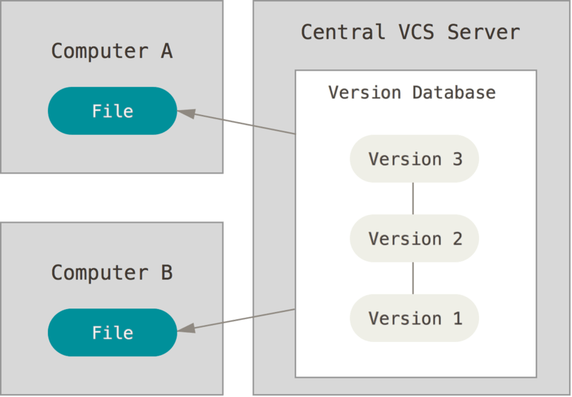



Centralized version management
Main limitation:
single point of failure
https://git-scm.com/book/en/v2/Getting-Started-About-Version-Control

Slide 17
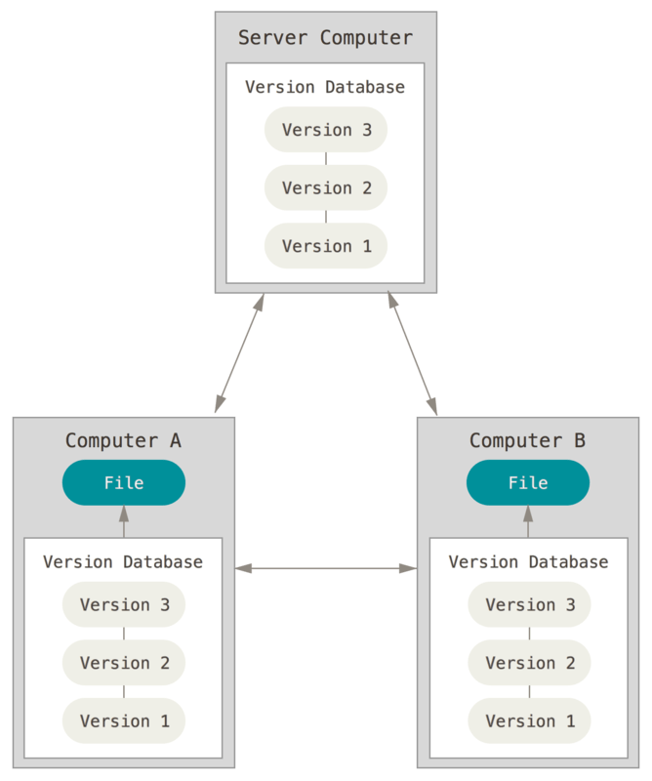




Distributed version management
(Bazaar)
https://git-scm.com/book/en/v2/Getting-Started-About-Version-Control

Slide 18
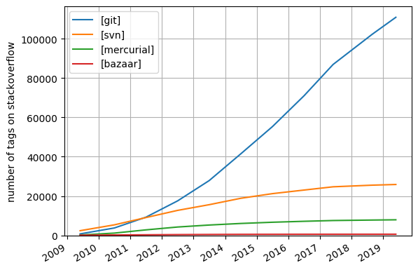
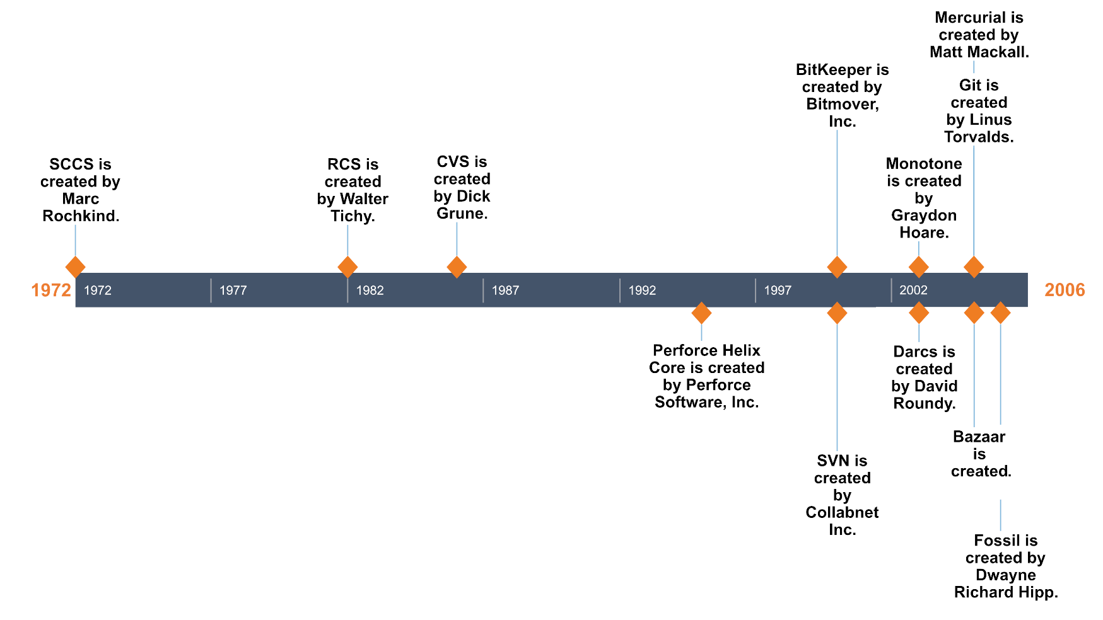
History
https://initialcommit.com/blog/Technical-Guide-VCS-Internals
https://askcodez.com/la-popularite-de-git-mercurial-bazar-vs-qui-a-recommander.html

Slide 19
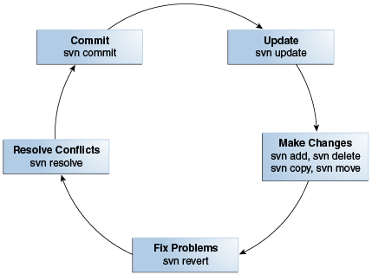
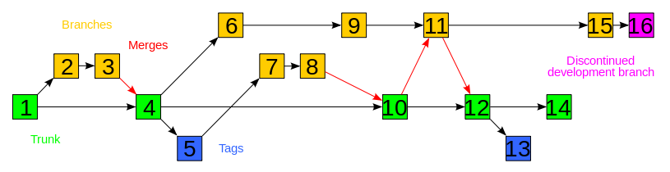
SVN – Apache Subversion
Homepage http://subversion.apache.org/
SVN Book http://svnbook.red-bean.com/
Limitations
centralized system
no time stamping
no history management, global version numbering
network almost always necessary
poorly managed "move" operation (delete + add)
no normalization of file names
https://docs.oracle.com/middleware/1221/core/MAVEN/config_svn.htm
https://en.wikipedia.org/wiki/Apache_Subversion

Slide 20
Git
(which means "unpleasant person" in British English slang). : "I'm an egotistical bastard, and I name all my projects after myself. First 'Linux', now 'git'." The man page describes Git as "the stupid content tracker".
developers initialy Linus Torvalds. Mainly Junio Hamano +1620
first version 2005
current version v2.41.0
license GPLv2 (free, open-source)
history
Linux kernel contributions before 2002: patches transmitted and integrated by hand
Linux kernel development 2002-2005: VCS distributed BitKeeper
2005: BitKeeper becomes payware, Linux Torvalds develops git with the following goals:
speed ;
simple design ;
support for non-linear development (thousands of parallel branches) ;
fully distributed ;
ability to efficiently manage large projects such as the Linux kernel (speed and data compactness)
to update: https://github.com/git/git/graphs/contributors
to update: https://github.com/git/git/releases
https://en.wikipedia.org/wiki/Git
https://git-scm.com/book/fr/v2/D%C3%A9marrage-rapide-Une-rapide-histoire-de-Git

Slide 21
Technological foundations of software development
Manage your source code
Part 2 – Git basics
ICM – Computer Science Major – Course unit on Technological foundations of computer science
M1 Cyber Physical and Social Systems – Course unit on CPS2 engineering and development, Part 2: Technological foundations of software development
Maxime Lefrançois https://maxime-lefrancois.info
online: https://ci.mines-stetienne.fr/cps2/course/tfsd/

Slide 22
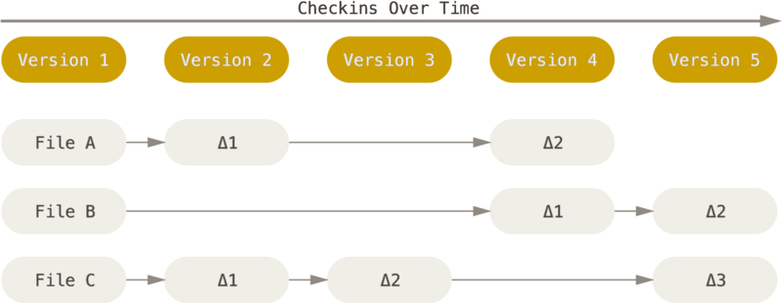
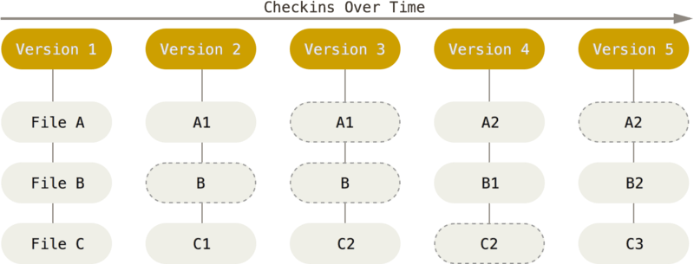
Philosophy
CVS, Subversion, Perforce, Bazaar, etc.
Save information as changes to files
How git works:
Stores data as snapshots of the project over time
(snapshot flow)
https://git-scm.com/book/en/v2/Getting-Started-What-is-Git%3F

Slide 23
Philosophy
Almost all operations are local
remote repository ≈ local directory
no need to constantly access the central server
Git manages integrity
id of a repo state = checksum(previous id, changes)
SHA-1 (40 hex characters, example 24b9da6552252987aa493b52f8696cd6d3b00373 )
git indexes the data by these checksum
Generally, Git only adds data
almost impossible to lose permanently a repo state
even undo actions are stored as a new change
gives freedom to experiment safely
https://git-scm.com/book/en/v2/Getting-Started-What-is-Git%3F

Slide 24
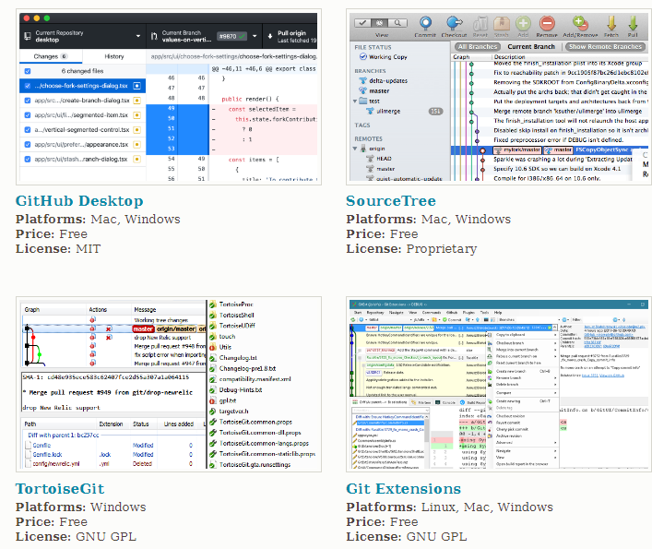
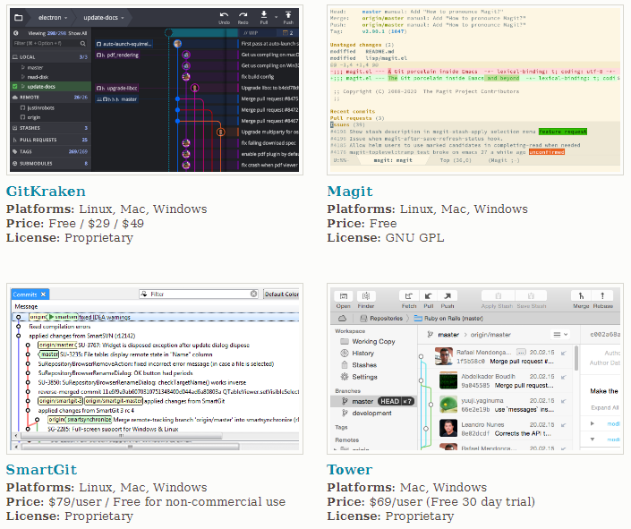
How to use git - softwares
…
https://git-scm.com/downloads/guis

Slide 25
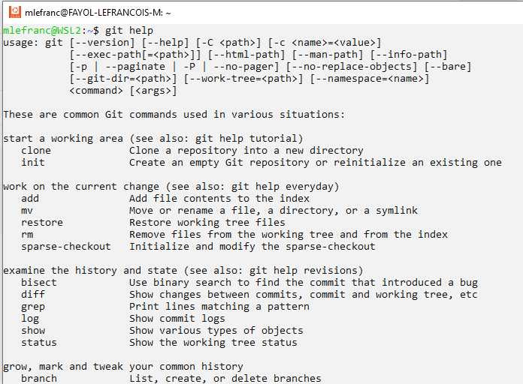
How to use git - CLI

Slide 26
How to use git - CLI
Obtain help
Obtain a concise version of the help
$ git help <commande>
$ git <commande> --help
$ man git-<commande>
$ git <commande> -h
https://git-scm.com/book/fr/v2/D%C3%A9marrage-rapide-Obtenir-de-l%E2%80%99aide

Slide 27
Initialize a Git repository in a directory
Option 1 to start a Git repository:
2
$ tree –a .
.
└── .git
├── HEAD
├── branches
├── config
├── description
├── hooks
│ ├── applypatch-msg.sample
│ ├── commit-msg.sample
│ ├── fsmonitor-watchman.sample
│ ├── post-update.sample
│ ├── pre-applypatch.sample
│ ├── pre-commit.sample
│ ├── pre-merge-commit.sample
│ ├── pre-push.sample
│ ├── pre-rebase.sample
│ ├── pre-receive.sample
│ ├── prepare-commit-msg.sample
│ └── update.sample
├── info
│ └── exclude
├── objects
│ ├── info
│ └── pack
└── refs
├── heads
└── tag
1
$ git init
Initialized empty Git repository in .
3
$ git add *.html
$ git add README.md
$ git commit –m 'first version'
https://git-scm.com/book/en/v2/Git-Basics-Getting-a-Git-Repository

Slide 28
Clone an existing Git repository
Option 2 to start a Git repository:
1
$ git clone https://github.com/FFmpeg/FFmpeg
Cloning into 'FFmpeg'...
remote: Enumerating objects: 633677, done.
remote: Total 633677 (delta 0), reused 0 (delta 0), pack-reused 633677
Receiving objects: 100% (633677/633677), 263.28 MiB | 11.00 MiB/s, done.
Resolving deltas: 100% (498066/498066), done.
Updating files: 100% (7479/7479), done.
2
$ cd FFmpeg/
$ git status
On branch master
Your branch is up to date with 'origin/master'.
nothing to commit, working tree clean
https://git-scm.com/book/en/v2/Git-Basics-Getting-a-Git-Repository

Slide 29
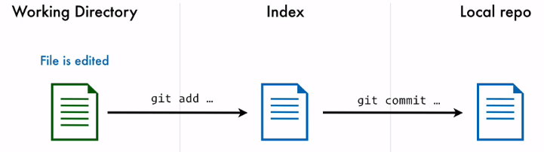
Three file states: modified, indexed, validated.
modified: file modified but not validated in the DB
indexed: file marked to be part of the next snapshot
validated: data safely stored in the local database
https://git-scm.com/book/en/v2/Getting-Started-What-is-Git%3F
https://screencasts.delicious-insights.com/courses/git-core-concepts/102205-default-section/305169-zones-and-file-lifecycle

Slide 30
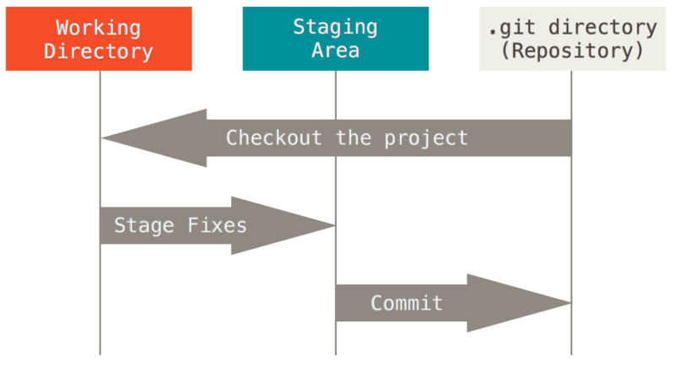
Three repo areas: working directory, index area, git directory
Where metadata, project database, compressed snapshots are stored
copied when cloning from a remote repository
a unique project extraction
simple file that stores what will be in the next snapshot
Working directory, index area and Git directory
https://git-scm.com/book/fr/v2/D%C3%A9marrage-rapide-Rudiments-de-Git

Slide 31
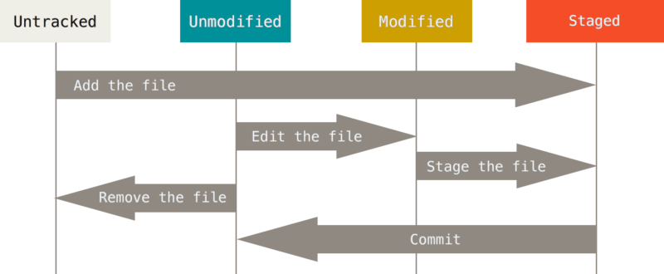
File states life cycle
Record changes to the repository
not tracked
tracked
Index the file
Record the indexed changes
https://git-scm.com/book/en/v2/Git-Basics-Recording-Changes-to-the-Repository

Slide 32
Check the files state
Record changes to the repository
$ git status
On branch master
Your branch is up to date with 'origin/master'.
nothing to commit, working tree clean
no tracked files have been modified
no untracked files
master branch
$ echo "My project" > README.md
$ git status
On branch master
No commits yet
Untracked files:
(use "git add <file>..." to include in what will be committed)
README.md
nothing added to commit but untracked files present (use "git add" to track)
new untracked file detected
https://git-scm.com/book/en/v2/Git-Basics-Recording-Changes-to-the-Repository

Slide 33
Index changed files
Record changes to the repository
$ nano index.html
editing an existing file
$ git status
On branch master
Changes to be committed:
(use "git restore --staged <file>..." to unstage)
new file: README.md
Changes not staged for commit:
(use "git add <file>..." to update what will be committed)
(use "git restore <file>..." to discard changes in working directory)
modified: index.html
README.md file tracked and indexed
index.html file modified
https://git-scm.com/book/en/v2/Git-Basics-Recording-Changes-to-the-Repository

Slide 34
Index changed files
Record changes to the repository
$ git add index.html
Index index.html
$ git status
On branch master
Changes to be committed:
(use "git restore --staged <file>..." to unstage)
new file: README.md
modified: index.html
README.md tracked and indexed
index.html file tracked and indexed
$ nano index.html
modified index.html
$ git status
On branch master
Changes to be committed:
(use "git restore --staged <file>..." to unstage)
new file: README.md
modified: index.html
Changes not staged for commit:
(use "git add <file>..." to update what will be committed)
(use "git restore <file>..." to discard changes in working directory)
modified: index.html
?
https://git-scm.com/book/en/v2/Git-Basics-Recording-Changes-to-the-Repository

Slide 35
Index changed files
Record changes to the repository
$ git add index.html
Index index.html
$ git status
On branch master
Changes to be committed:
(use "git restore --staged <file>..." to unstage)
new file: README.md
modified: index.html
README.md tracked and indexed
index.html file tracked and indexed
$ nano index.html
modified index.html
$ git status
On branch master
Changes to be committed:
(use "git restore --staged <file>..." to unstage)
new file: README.md
modified: index.html
Changes not staged for commit:
(use "git add <file>..." to update what will be committed)
(use "git restore <file>..." to discard changes in working directory)
modified: index.html
- index.html file indexed when running git add
- then modified
https://git-scm.com/book/en/v2/Git-Basics-Recording-Changes-to-the-Repository

Slide 36
Commit changes
Record changes to the repository
$ git commit –h
usage: git commit [<options>] [--] <pathspec>...
Commit message options
-F, --file <file> read message from file
--author <author> override author for commit
--date <date> override date for commit
-m, --message <message>
commit message
--status include status in commit message template
...
Commit contents options
-a, --all commit all changed files
-i, --include add specified files to index for commit
--dry-run show what would be committed
--short show status concisely
--branch show branch information
--amend amend previous commit
...
git commit -a skip the indexing step
https://git-scm.com/book/en/v2/Git-Basics-Recording-Changes-to-the-Repository

Slide 37
Technological foundations of software development
Manage your source code
Part 3 – Branching and merging with Git
ICM – Computer Science Major – Course unit on Technological foundations of computer science
M1 Cyber Physical and Social Systems – Course unit on CPS2 engineering and development, Part 2: Technological foundations of software development
Maxime Lefrançois https://maxime-lefrancois.info
online: https://ci.mines-stetienne.fr/cps2/course/tfsd/

Slide 38
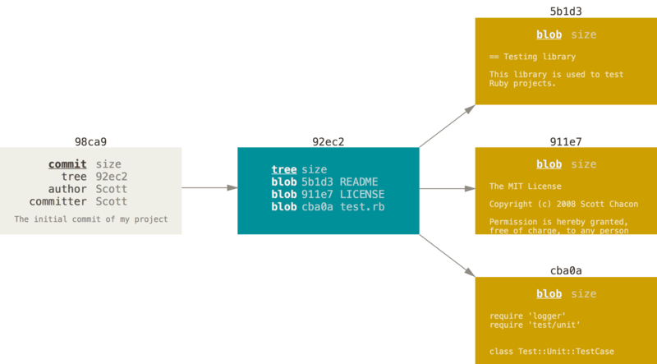
A commit and its tree
Branches in a nutshell
First commit of a repository with three files indexed, then validated
Calculated checksum: SHA-1
$ git init
$ git add README test.rb LICENSE
$ git commit -m 'initial commit of my project‘
$ git tree -a
https://git-scm.com/book/en/v2/Git-Branching-Branches-in-a-Nutshell

Slide 39
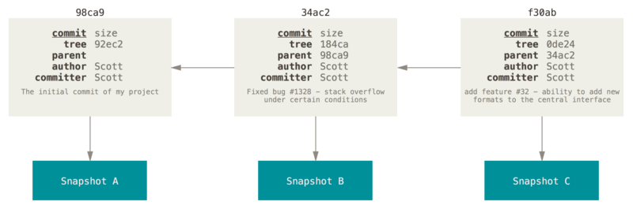
Commits and their parents
Branches in a nutshell
New changes: each commit stores a pointer to the previous commit(s)
Branch = pointer to the last commit of a sequence.
Automatically advances as new commits are made.
https://git-scm.com/book/en/v2/Git-Branching-Branches-in-a-Nutshell

Slide 40
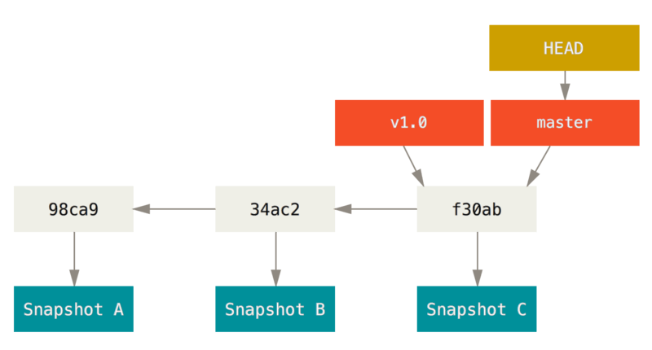
A branch and its commits history
Branches in a nutshell
A sequence of commits,
A label pointer
A branch pointer
The HEAD pointer indicates on which object we are currently located (in which state our directory is)
https://git-scm.com/book/en/v2/Git-Branching-Branches-in-a-Nutshell

Slide 41
Create a new branch
Branches in a nutshell
Two branches now point to the same set of commits
$ git branch testing
testing
https://git-scm.com/book/en/v2/Git-Branching-Branches-in-a-Nutshell

Slide 42
Switching between branches
Branches in a nutshell
HEAD now points to the testing branch
$ git checkout testing
testing
HEAD
https://git-scm.com/book/en/v2/Git-Branching-Branches-in-a-Nutshell

Slide 43
Moving the HEAD
Branches in a nutshell
The testing pointer advances with each commit
$ vim test.rb
$ git commit -a -m 'made a change'
HEAD
testing
87ab2
https://git-scm.com/book/en/v2/Git-Branching-Branches-in-a-Nutshell

Slide 44
Divergent history
Branches in a nutshell
The two branches have diverged
$ git checkout master
$ vim test.rb
$ git commit -a -m 'made other change'
HEAD
master
c2b9e
87ab2
testing
https://git-scm.com/book/en/v2/Git-Branching-Branches-in-a-Nutshell

Slide 45
Divergent history
Branches in a nutshell
$ git log --oneline --decorate --graph --all
* c2b9e (HEAD, master) made other changes
| * 87ab2 (test) made a change
|/
* f30ab add feature #32 - ability to add new formats to the
* 34ac2 fixed bug #ch1328 - stack overflow under certain conditions
* 98ca9 initial commit of my project
HEAD
master
c2b9e
87ab2
testing
https://git-scm.com/book/en/v2/Git-Branching-Branches-in-a-Nutshell

Slide 46


Technological foundations of software development
Manage your source code
Part 4 – Source code management platforms
https://gitlab.emse.fr/
https://gitlab.com/
https://github.com
ICM – Computer Science Major – Course unit on Technological foundations of computer science
M1 Cyber Physical and Social Systems – Course unit on CPS2 engineering and development, Part 2: Technological foundations of software development
Maxime Lefrançois https://maxime-lefrancois.info
online: https://ci.mines-stetienne.fr/cps2/course/tfsd/

Slide 47
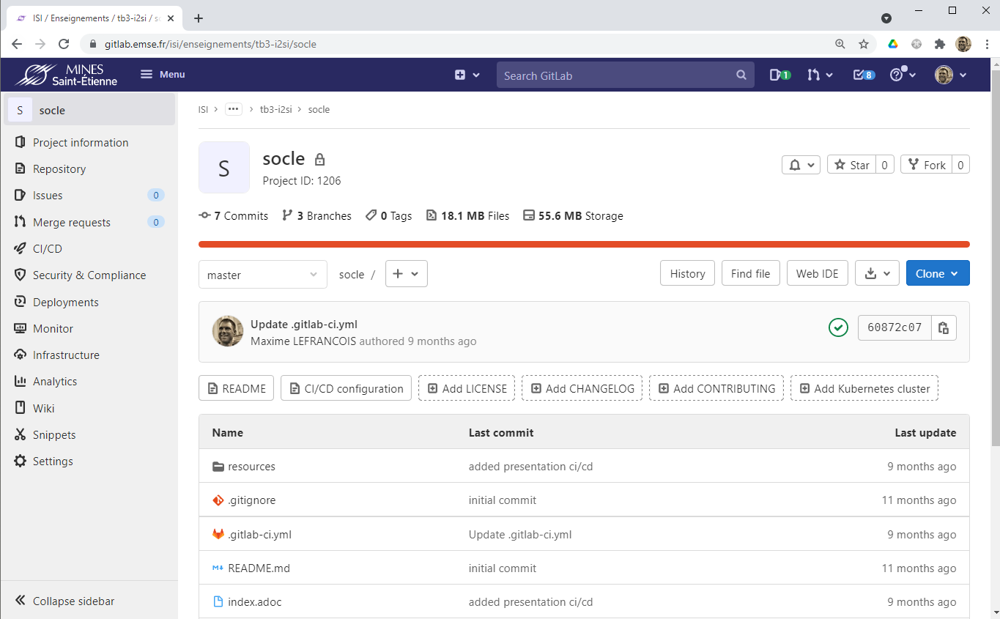
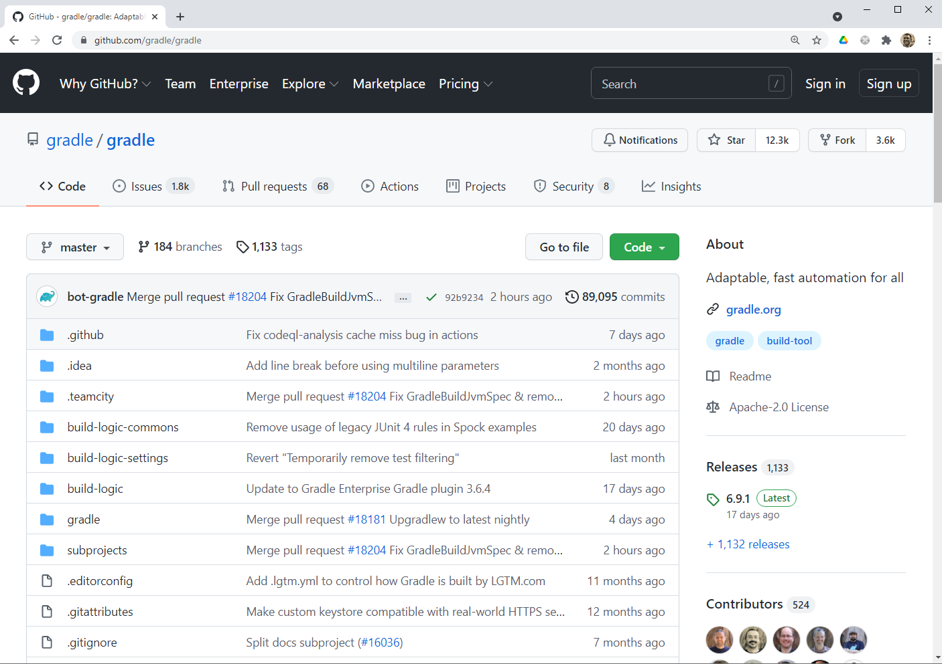
In addition to Git...
Rights management
Ticket management, Kanban
Merge Requests / Pull Requests
Integration and continuous deployment (e.g. github pages)
Wiki
Analytics
Integration with other applications,
Social network for developers, and opensource resume
https://git-scm.com/book/fr/v2/Les-branches-avec-Git-Branches-et-fusions%C2%A0%3A-les-bases

Slide 48
... References to deepen this course
Pro Git (2e edition), Scott Chacon and Ben Straub, Apress, 2014, 978-1-4842-0076-6
https://git-scm.com/book/en/v2
Git reference documentation https://git-scm.com/docs
Interactive Git cheat sheet http://ndpsoftware.com/git-cheatsheet.html
Gitlab basics: https://docs.gitlab.com/ee/gitlab-basics/
Gitlab docs: https://docs.gitlab.com/ sections Agile with GitLab et Collaboration
Github guides: https://guides.github.com/introduction/flow/
https://guides.github.com/activities/forking/
https://guides.github.com/activities/socialize/

Slide 49
... your turn
Complete the TODO section:
https://ci.mines-stetienne.fr/cps2/course/tfsd/course-2.html#_todos

Slide 50
Technological foundations of software development
Manage your source code
Part 2 – Git basics – complementary slides
ICM – Computer Science Major – Course unit on Technological foundations of computer science
M1 Cyber Physical and Social Systems – Course unit on CPS2 engineering and development, Part 2: Technological foundations of software development
Maxime Lefrançois https://maxime-lefrancois.info
online: https://ci.mines-stetienne.fr/cps2/course/tfsd/

Slide 51
Ignore files
Record changes to the repository
Ignore log files, automatically generated files, ...
$ cat .gitignore
*.log
*~
target/*
# pas de fichier .a
*.a
# mais suivre lib.a malgré la règle précédente
!lib.a
# ignorer uniquement le fichier TODO à la racine du projet
/TODO
# ignorer tous les fichiers dans le répertoire build
build/
# ignorer doc/notes.txt, mais pas doc/server/arch.txt
doc/*.txt
# ignorer tous les fichiers .txt sous le répertoire doc/
doc/**/*.txt
standard shell file patterns ( *, [abc], ?, [0-9], ** )
applied recursively in the working tree ;
starts with '/': not recursive ;
ends with a slash ('/'): directory ;
starts with '!': include file despite other rules.
https://git-scm.com/book/en/v2/Git-Basics-Recording-Changes-to-the-Repository

Slide 52
Inspect indexed and non-indexed changes
Record changes to the repository
$ git diff
diff --git a/CONTRIBUTING.md b/CONTRIBUTING.md
index 8ebb991..643e24f 100644
--- a/CONTRIBUTING.md
+++ b/CONTRIBUTING.md
@@ -65,7 +65,8 @@ branch directly, things can get messy.
Please include a nice description of your changes when you submit your PR;
if we have to read the whole diff to figure out why you're contributing
in the first place, you're less likely to get feedback and have your change
-merged in.
+merged in. Also, split your changes into comprehensive chunks if you patch is
+longer than a dozen lines.
If you are starting to work on a particular area, feel free to submit a PR
that highlights your work in progress (and note in the PR title that it's
git diff
git diff --cached
git difftool --tool-help
https://git-scm.com/book/en/v2/Git-Basics-Recording-Changes-to-the-Repository

Slide 53
Delete files
Record changes to the repository
$ rm index.html
$ git status
On branch master
Changes not staged for commit:
(use "git add/rm <file>..." to update what will be committed)
(use "git restore <file>..." to discard changes in working directory)
deleted: index.html
no changes added to commit (use "git add" and/or "git commit -a")
deletes the file in the directory only
need git add index.html
( or git rm index.html )
$ git rm index.html
$ git status
On branch master
Changes to be committed:
(use "git restore --staged <file>..." to unstage)
deleted: index.html
deletes the file in the directory and in the index
$ git rm --cached big_file_should_be_in_gitignore.log
rm 'big_file_should_be_in_gitignore.log'
$ git status
On branch master
Untracked files:
(use "git add <file>..." to include in what will be committed)
big_file_should_be_in_gitignore.log
nothing added to commit but untracked files present (use "git add" to track)
deletes a file in the index only
https://git-scm.com/book/en/v2/Git-Basics-Recording-Changes-to-the-Repository

Slide 54
View the history of validations
$ git log
commit ca82a6dff817ec66f44342007202690a93763949
Author: Scott Chacon <schacon@gee-mail.com>
Date: Mon Mar 17 21:52:11 2008 -0700
changed the version number
commit 085bb3bcb608e1e8451d4b2432f8ecbe6306e7e7
Author: Scott Chacon <schacon@gee-mail.com>
Date: Sat Mar 15 16:40:33 2008 -0700
removed unnecessary test
commit a11bef06a3f659402fe7563abf99ad00de2209e6
Author: Scott Chacon <schacon@gee-mail.com>
Date: Sat Mar 15 10:31:28 2008 -0700
first commit
https://git-scm.com/book/en/v2/Git-Basics-Viewing-the-Commit-History

Slide 55
View the history of validations
$ git log
commit ca82a6dff817ec66f44342007202690a93763949
Author: Scott Chacon <schacon@gee-mail.com>
Date: Mon Mar 17 21:52:11 2008 -0700
changed the version number
commit 085bb3bcb608e1e8451d4b2432f8ecbe6306e7e7
Author: Scott Chacon <schacon@gee-mail.com>
Date: Sat Mar 15 16:40:33 2008 -0700
removed unnecessary test
commit a11bef06a3f659402fe7563abf99ad00de2209e6
Author: Scott Chacon <schacon@gee-mail.com>
Date: Sat Mar 15 10:31:28 2008 -0700
first commit
$ git log –p -2
commit ca82a6dff817ec66f44342007202690a93763949
Author: Scott Chacon <schacon@gee-mail.com>
Date: Mon Mar 17 21:52:11 2008 -0700
changed the version number
diff --git a/Rakefile b/Rakefile
index a874b73..8f94139 100644
--- a/Rakefile
+++ b/Rakefile
@@ -5,7 +5,7 @@ require 'rake/gempackagetask'
spec = Gem::Specification.new do |s|
s.platform = Gem::Platform::RUBY
s.name = "simplegit"
- s.version = "0.1.0"
+ s.version = "0.1.1"
s.author = "Scott Chacon"
s.email = "schacon@gee-mail.com"
s.summary = "A simple gem for using Git in Ruby code."
commit 085bb3bcb608e1e8451d4b2432f8ecbe6306e7e7
Author: Scott Chacon <schacon@gee-mail.com>
Date: Sat Mar 15 16:40:33 2008 -0700
removed unnecessary test
diff --git a/lib/simplegit.rb b/lib/simplegit.rb
index a0a60ae..47c6340 100644
--- a/lib/simplegit.rb
+++ b/lib/simplegit.rb
@@ -18,8 +18,3 @@ class SimpleGit
end
end
-
-if $0 == __FILE__
- git = SimpleGit.new
- puts git.show
-end
\ No newline at end of file
$ git log --stat
commit ca82a6dff817ec66f44342007202690a93763949
Author: Scott Chacon <schacon@gee-mail.com>
Date: Mon Mar 17 21:52:11 2008 -0700
changed the version number
Rakefile | 2 +-
1 file changed, 1 insertion(+), 1 deletion(-)
commit 085bb3bcb608e1e8451d4b2432f8ecbe6306e7e7
Author: Scott Chacon <schacon@gee-mail.com>
Date: Sat Mar 15 16:40:33 2008 -0700
removed unnecessary test
lib/simplegit.rb | 5 -----
1 file changed, 5 deletions(-)
commit a11bef06a3f659402fe7563abf99ad00de2209e6
Author: Scott Chacon <schacon@gee-mail.com>
Date: Sat Mar 15 10:31:28 2008 -0700
first commit
README | 6 ++++++
Rakefile | 23 +++++++++++++++++++++++
lib/simplegit.rb | 25 +++++++++++++++++++++++++
3 files changed, 54 insertions(+)
$ git log --pretty=oneline
ca82a6dff817ec66f44342007202690a93763949 changed the version number
085bb3bcb608e1e8451d4b2432f8ecbe6306e7e7 removed unnecessary test
a11bef06a3f659402fe7563abf99ad00de2209e6 first commit
$ git log --pretty=format:"%h - %an, %ar : %s"
ca82a6d - Scott Chacon, 6 years ago : changed the version number
085bb3b - Scott Chacon, 6 years ago : removed unnecessary test
a11bef0 - Scott Chacon, 6 years ago : first commit
$ git log --pretty=format:"%h %s" --graph
* 2d3acf9 ignore errors from SIGCHLD on trap
* 5e3ee11 Merge branch 'master' of git://github.com/dustin/grit
|\
| * 420eac9 Added a method for getting the current branch.
* | 30e367c timeout code and tests
* | 5a09431 add timeout protection to grit
* | e1193f8 support for heads with slashes in them
|/
* d6016bc require time for xmlschema
* 11d191e Merge branch 'defunkt' into local
https://git-scm.com/book/en/v2/Git-Basics-Viewing-the-Commit-History

Slide 56
View the history of validations
Table 1. Useful options for git log --pretty=format
Table 2. Common git log options
Table 3. Options for limiting git log output
Option Description of formatting
%H Commit checksum
%h Abbreviated commit checksum
%T Tree checksum
%t Tree abbreviated checksum
%P Parent checksums
%p Abbreviated parent checksums
%an Author's name
%ae Author's e-mail
%ad Author's date (format of -date= <option>)
%ar Author's relative date
%cn Validator name
%ce Validator's e-mail
%cd Validator date
%cr Validator relative date
%s Subject
Option Description
-p Displays the patch applied by each commit--stat Displays the statistics of each file for each commit
--shortstat Displays only modified/inserted/deleted lines from the -stat option
--name-only Displays the list of files modified after the commit information
--name-status Displays list of affected files with add/change/delete information
--abbrev-commit Displays only the first few characters of the SHA-1 checksum
--relative-date Displays the date in relative format (e.g. "2 weeks ago") instead of the full date format
--graph Displays in ASCII characters the graph of branches and merges opposite the history
--pretty Displays commits in an alternative format. Formats include oneline, short, full, fuller, and format (where you can specify your own format)
--oneline Convenience option corresponding to --pretty=oneline --abbrev-commit
Option Description
-(n) Displays only the last n commits
--since, --after Limit the display to commits made after the specified date
--until, --before Limit the display to commits made before the specified date
--author Show only commits whose author field matches the string passed as argument
--committer Show only commits whose validator field matches the string passed as argument
--grep Show only commits whose validation message contains the string
-S Show only commits whose add or remove contains the string
https://git-scm.com/book/en/v2/Git-Basics-Viewing-the-Commit-History

Slide 57
Cancel actions
$ git commit --amend
allows to replace the last commit with a new one.
$ git commit -m 'validation initiale'
$ git add fichier_oublie
$ git commit --amend
$ git add index.html
$ git status
On branch master
Changes to be committed:
(use "git restore --staged <file>..." to unstage)
modified: index.html
$ git restore --staged index.html
git explains how to de-index an already indexed file
$ nano index.html
$ git status | grep discard
On branch master
Changes not staged for commit:
(use "git add <file>..." to update what will be committed)
(use "git restore <file>..." to discard changes in working directory)
modified: index.html
no changes added to commit (use "git add" and/or "git commit -a")
$ git restore index.html
git explains how to undo changes in the working directory
https://git-scm.com/book/en/v2/Git-Basics-Undoing-Things

Slide 58
Working with remote repositories
$ git clone https://github.com/schacon/ticgit > /dev/null
$ cd ticgit && git remote
origin
$ git remote –v
origin https://github.com/schacon/ticgit (fetch)
origin https://github.com/schacon/ticgit (push)
when cloning a repository, it is named origin by default
we can then pull/push the contributions from this repository
https://git-scm.com/book/en/v2/Git-Basics-Working-with-Remotes

Slide 59
Working with remote repositories
$ git clone https://github.com/schacon/ticgit > /dev/null
$ cd ticgit && git remote
origin
$ git remote –v
origin https://github.com/schacon/ticgit (fetch)
origin https://github.com/schacon/ticgit (push)
when cloning a repository, it is named origin by default
we can then pull/push the contributions from this repository
$ git remote -h
usage: git remote [-v | --verbose]
or: git remote add [-t <branch>] [-m <master>] [-f] [--tags | --no-tags] [--mirror=<fetch|push>] <name> <url>
or: git remote rename <old> <new>
or: git remote remove <name>
or: git remote set-head <name> (-a | --auto | -d | --delete | <branch>)
or: git remote [-v | --verbose] show [-n] <name>
or: git remote prune [-n | --dry-run] <name>
or: git remote [-v | --verbose] update [-p | --prune] [(<group> | <remote>)...]
or: git remote set-branches [--add] <name> <branch>...
or: git remote get-url [--push] [--all] <name>
or: git remote set-url [--push] <name> <newurl> [<oldurl>]
or: git remote set-url --add <name> <newurl>
or: git remote set-url --delete <name> <url>
with git remote one can manage remote repositories:
list remote repositories
their names, their fetch/push urls,
the tracked branches
the default branch of the remote
...
https://git-scm.com/book/en/v2/Git-Basics-Working-with-Remotes

Slide 60
Working with remote repositories
git fetch:
Retrieve all information from a remote repository
the master branch from pb is now pb/master
No automatic merge, no local modification!
$ git remote add pb https://github.com/paulboone/ticgit
$ git fetch pb
remote: Counting objects: 43, done.
remote: Compressing objects: 100% (36/36), done.
remote: Total 43 (delta 10), reused 31 (delta 5)
Unpacking objects: 100% (43/43), fait.
From https://github.com/paulboone/ticgit
* [new branch] master -> pb/master
* [new branch] ticgit -> pb/ticgit
git push:
Push to the remote repository
ex 1: push the ticgit branch to pb
ex 2: push branch1 to the branch2 branch of origin
ex 3: with default values, equivalent to: git push origin master
⚠ There may be conflicts during the merge ! ⚠
$ git push pb ticgit
$ # man: git push <remote> <branch>
$ git push origin branch1:branch2
$ # man: git push <remote> <local-ref>:<remote-ref>
$ git push
https://git-scm.com/book/en/v2/Git-Basics-Working-with-Remotes

Slide 61
Tagging
git allows you to tag states in the history
list tags
$ git tag
v0.1
v1.3
tag the current commit, with a tagging message
$ git tag –a v1.4 –m "Version 1.4"
$ git tag
v0.1
v1.3
v1.4
tag a specific commit
$ git tag -a v1.2 9fceb02
push a tag
is not done by default during git push, except with the --tags option $ git push origin --tags
$ git push origin v1.2
$ git tag –d v1.4
$ git push origin –delete v1.4
deleting a tag
and deletion on the remote server
https://git-scm.com/book/en/v2/Git-Basics-Tagging

Slide 62
Tagging
$ git checkout v2.29.2
Note : basculement sur 'v2.29.2'.
You are in the "HEAD detached" state. You can visit, make experimental modifications and and validate them. You just need to make another switch to
abandon the commits you make in this state without impacting the other branches
If you want to create a new branch to keep the commits you create,
you just use the -c option of the switch command like this:
git switch -c <name-of-new-branch>
Or undo this operation with :
git switch -
Disable this advice by setting the advice.detachedHead configuration variable to false
HEAD is now on 898f80736c Git 2.29.2
$ git checkout v2.29.1
HEAD's previous position was on 898f80736c Git 2.29.2
HEAD is now on b927c80531 Git 2.29.1
in the "detached HEAD" state,
a new commit would not belong to any branch
it would be reachable only with its exact footprint
it is better to create a branch
for example:
$ git checkout -b v2.29.X
Basculement sur la nouvelle branche 'v2.29.X'
https://git-scm.com/book/en/v2/Git-Basics-Tagging

Slide 63
Technological foundations of software development
Manage your source code
Part 3 – Branching and merging with Git – complementary slides
ICM – Computer Science Major – Course unit on Technological foundations of computer science
M1 Cyber Physical and Social Systems – Course unit on CPS2 engineering and development, Part 2: Technological foundations of software development
Maxime Lefrançois https://maxime-lefrancois.info
online: https://ci.mines-stetienne.fr/cps2/course/tfsd/

Slide 64
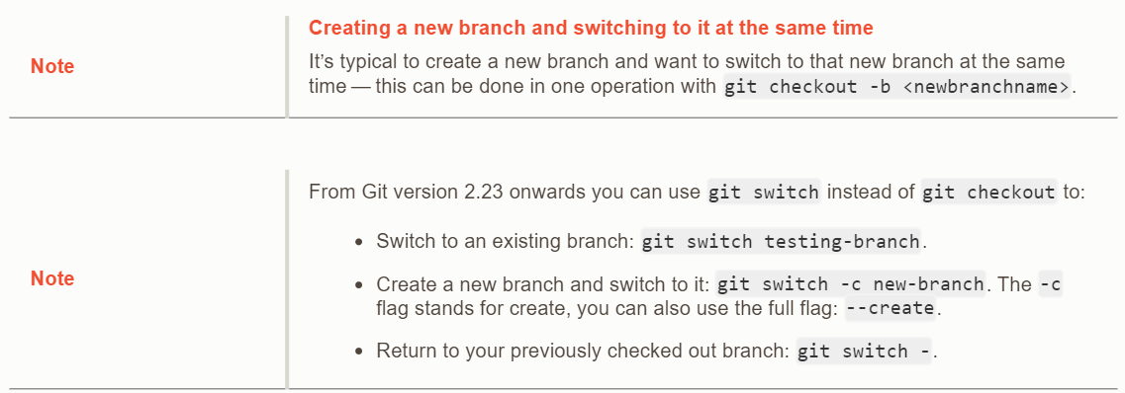
Notes
Branches in a nutshell
https://git-scm.com/book/en/v2/Git-Branching-Branches-in-a-Nutshell

Slide 65

Scenario
Branching and merging
you are working on a web site;
you create a branch for a new article in progress;
you start working on this branch.
At this point, you get a call that a critical problem has been discovered and needs to be addressed as soon as possible.
So you do the following:
you switch to the production branch;
you create a branch to add the patch;
after testing it, you merge the patch branch and push the result to production;
you switch back to the initial branch and continue your work
https://git-scm.com/book/en/v2/Git-Branching-Basic-Branching-and-Merging

Slide 66
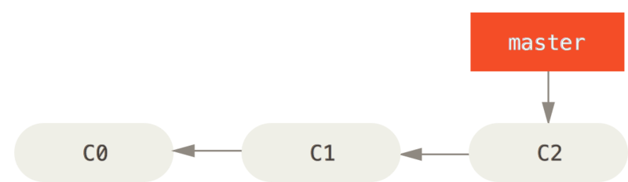
Scenario
Branching and merging
you are working on a web site;
HEAD
https://git-scm.com/book/en/v2/Git-Branching-Basic-Branching-and-Merging

Slide 67
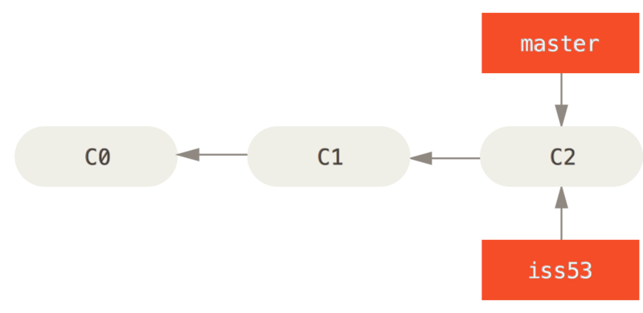
Scenario
Branching and merging
you are working on a web site;
you create a branch for a new article in progress;
Creation of a new branch iss53 to work on issue #53
$ git checkout -b iss53
Switched to a new branch "iss53"
$ git branch iss53
$ git checkout iss53
HEAD
https://git-scm.com/book/en/v2/Git-Branching-Basic-Branching-and-Merging

Slide 68
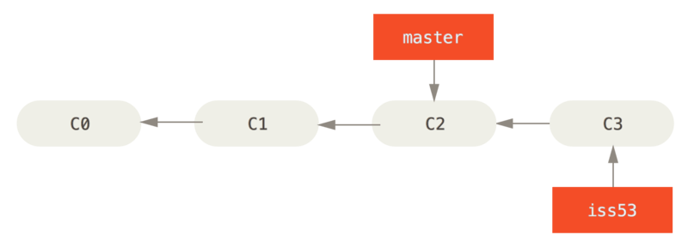
Scenario
Branching and merging
you are working on a web site;
you create a branch for a new article in progress;
you start working on this branch.
Example of a new commit on branch iss53
$ vim index.html
$ git commit -a -m "add footer [issue 53]"
HEAD
https://git-scm.com/book/en/v2/Git-Branching-Basic-Branching-and-Merging

Slide 69
Scenario
Branching and merging
At this point, you get a call that a critical problem has been discovered and needs to be addressed as soon as possible.
HEAD
https://git-scm.com/book/en/v2/Git-Branching-Basic-Branching-and-Merging

Slide 70
Scenario
Branching and merging
you switch to the production branch;
$ git checkout master
Switched to branch 'master'
HEAD
https://git-scm.com/book/en/v2/Git-Branching-Basic-Branching-and-Merging

Slide 71
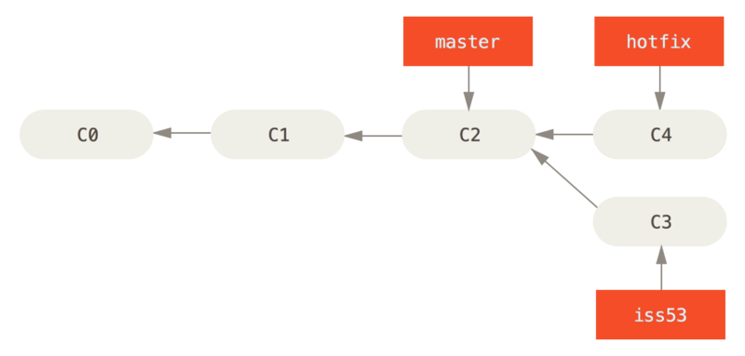
Scenario
Branching and merging
2. you create a branch to add the patch;
HEAD
$ git checkout -b patch
Switched to a new branch patch'
$ vim index.html
$ git commit -a -m "incorrect email address"
[correctif 1fb7853] "incorrect email address"
1 file changed, 2 insertions(+)
https://git-scm.com/book/en/v2/Git-Branching-Basic-Branching-and-Merging

Slide 72
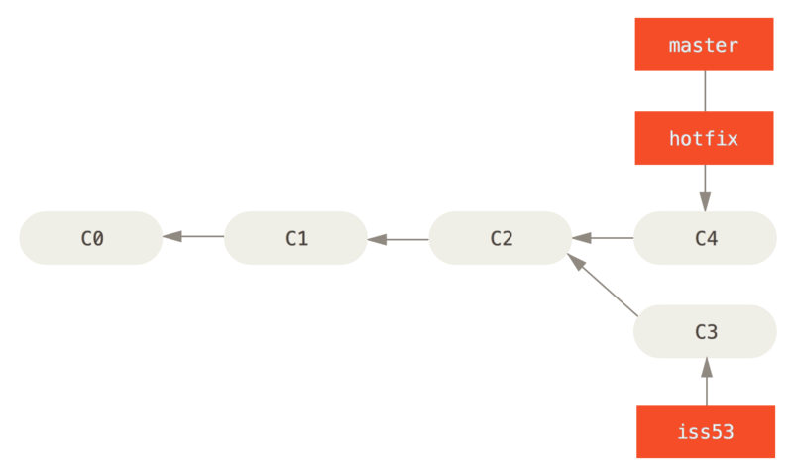
Scenario
Branching and merging
3. after testing it, you merge the patch branch and push the result to production;
HEAD
$ git checkout master
$ git merge patch
Updating f42c576..3a0874c
Fast-forward
index.html | 2 ++
1 file changed, 2 insertions(+)
Fast-forward: simple déplacement du pointeur vers l’avant
https://git-scm.com/book/en/v2/Git-Branching-Basic-Branching-and-Merging

Slide 73
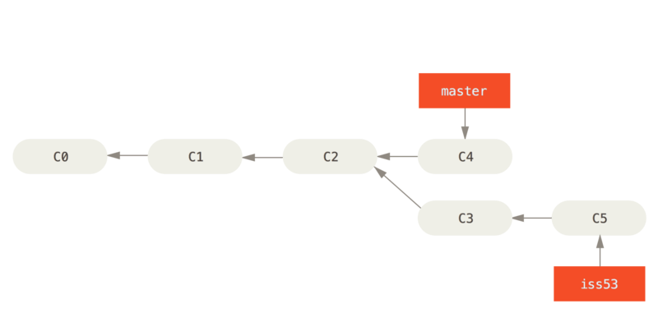
Scenario
Branching and merging
4. you switch back to the initial branch and continue your work
$ git branch -d patch
Deleted branch patch (3a0874c).
Delete branch hotfix
$ git checkout iss53
Switched to branch "iss53"
$ vim index.html
$ git commit -a -m ‘New footer finished [issue 53]'
[iss53 ad82d7a] New footer finished [issue 53]
1 file changed, 1 insertion(+)
HEAD
Switch to branch iss53 and create new commits
https://git-scm.com/book/en/v2/Git-Branching-Basic-Branching-and-Merging

Slide 74
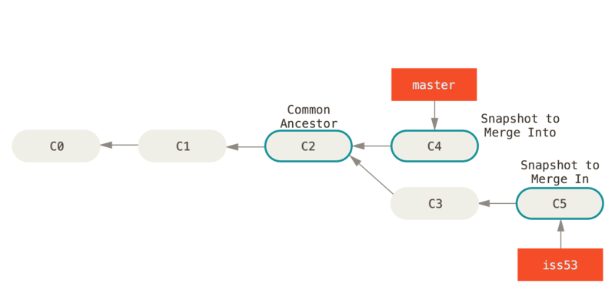
Merging
Branching and merging
HEAD
$ git checkout master
Switched to branch 'master'
$ git merge iss53
Merge made by the 'recursive' strategy.
README | 1 +
1 file changed, 1 insertion(+)
‘recusive’ strategy: Simple 3-sources fusion
https://git-scm.com/book/en/v2/Git-Branching-Basic-Branching-and-Merging

Slide 75
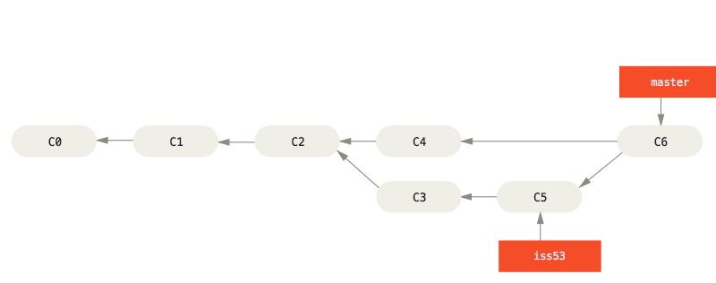
Merging
Branching and merging
HEAD
$ git checkout master
Switched to branch 'master'
$ git merge iss53
Merge made by the 'recursive' strategy.
README | 1 +
1 file changed, 1 insertion(+)
‘recusive’ strategy: Simple 3-sources fusion
https://git-scm.com/book/en/v2/Git-Branching-Basic-Branching-and-Merging

Slide 76
Merge conflicts
Branching and merging
$ git merge iss53
Auto-merging index.html
CONFLICT (content): Merge conflict in index.html
Automatic merge failed; fix conflicts and then commit the result.
<<<<<<< HEAD:index.html
<div id="footer">contact : email.support@github.com</div>
======
<div id="footer">
please contact us at support@github.com
</div>
>>>>>>> iss53:index.html
$ git status
On branch master
You have unmerged paths.
(fix conflicts and run "git commit")
Unmerged paths:
(use "git add <file>..." to mark resolution)
both modified: index.html
no changes added to commit (use "git add" and/or "git commit -a")
Contents of the index.html file
with conflict markers
Example of a merger conflict to be resolved
https://git-scm.com/book/en/v2/Git-Branching-Basic-Branching-and-Merging

Slide 77
Merge conflicts
Branching and merging
<<<<<<< HEAD:index.html
<div id="footer">contact : email.support@github.com</div>
======
<div id="footer">
please contact us at support@github.com
</div>
>>>>>>> iss53:index.html
<div id="footer">
please contact us at email.support@github.com
</div>
Example of manual resolution
$ git add index.html
We mark this conflict "resolved".
$ git status
On branch master
All conflicts fixed but you are still merging.
(use "git commit" to conclude merge)
Changes to be committed:
modified: index.html
$ git commit
We finalize the commit
https://git-scm.com/book/en/v2/Git-Branching-Basic-Branching-and-Merging

Slide 78
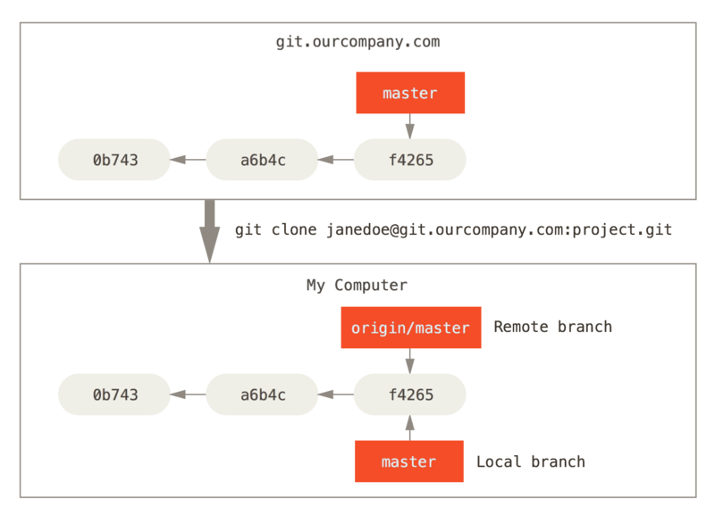
Remote branches
The <remote>/<branch> branch is unmodifiable. It is a bookmark to indicate the state of the remote branch
https://git-scm.com/book/en/v2/Git-Branching-Basic-Branching-and-Merging

Slide 79
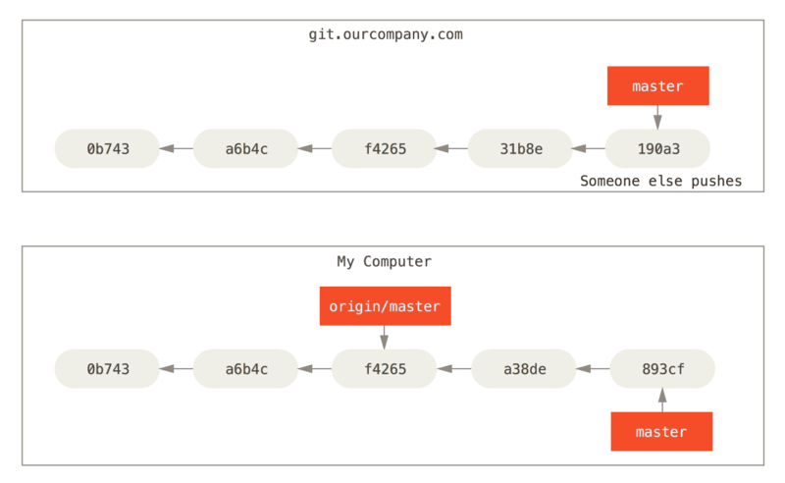
Remote branches
Local and remote work may differ
https://git-scm.com/book/en/v2/Git-Branching-Basic-Branching-and-Merging

Slide 80
Remote branches
$ git push origin issue-53
Counting objects: 24, done.
Delta compression using up to 8 threads.
Compressing objects: 100% (15/15), done.
Writing objects: 100% (24/24), 1.91 KiB | 0 bytes/s, done.
Total 24 (delta 2), reused 0 (delta 0)
To https://github.com/schacon/simplegit
* [new branch] issue-53 -> issue-53
$ git fetch origin
remote: Counting objects: 7, done.
remote: Compressing objects: 100% (2/2), done.
remote: Total 3 (delta 0), reused 3 (delta 0)
Unpacking objects: 100% (3/3), done.
From https://github.com/schacon/simplegit
* [new branch] issue-53 -> origin/issue-53
My colleague retrieves the changes
I push my changes on the remote server
$ git checkout -b issue-53 origin/issue-53
Branch issue-53 set up to track remote branch issue-53 from origin.
Switched to a new branch 'issue-53'
My colleague creates a modifiable local branch issue-53, based on the state of origin/issue-53
https://git-scm.com/book/en/v2/Git-Branching-Basic-Branching-and-Merging

Slide 81
Remote branches
$ git checkout -b issue-53 origin/issue-53
Branch issue-53 set up to track remote branch issue-53 from origin.
Switched to a new branch 'issue-53'
Create issue-53 that "follows" origin/issue-53
Allows you to push and pull from origin/issue-53 by default
$ git checkout --track origin/issue-53
Branch issue-53 set up to track remote branch issue-53 from origin.
Switched to a new branch 'issue-53'
Shortcut: automatic naming of the created branch
$ git checkout issue-53
Branch issue-53 set up to track remote branch issue-53 from origin.
Switched to a new branch 'issue-53'
Shortcut: if issue-53 does not exist, and exists on a single remote
https://git-scm.com/book/en/v2/Git-Branching-Basic-Branching-and-Merging

Slide 82
Remote branches
$ git branch -vv
iss53 7e424c3 [origin/iss53: ahead 2] forgot the brackets
master 1ae2a45 [origin/master] deploying index fix
* correctionserveur f8674d9 [equipe1/correction-serveur-ok: ahead 3, behind 1] this should do it
test 5ea463a trying something new
Visualize the branches and the branches they are configured to follow
$ git pull issue-53
Shortcut for git fetch then git merge
https://git-scm.com/book/en/v2/Git-Branching-Basic-Branching-and-Merging

