Slide 1
Technological foundations of software development²
Automate build production
ICM – Computer Science Major – Course unit on Technological foundations of computer science
M1 Cyber Physical and Social Systems – Course unit on CPS2 engineering and development, Part 2: Technological foundations of software development
Maxime Lefrançois https://maxime-lefrancois.info
online: https://ci.mines-stetienne.fr/cps2/course/tfsd/

Slide 2
Objectives of the session
This session aims to familiarize you with the methods and tools for automating code production: compilation, testing, packaging, deployment, etc. In particular, we will see:
make
Apache Maven

Slide 3
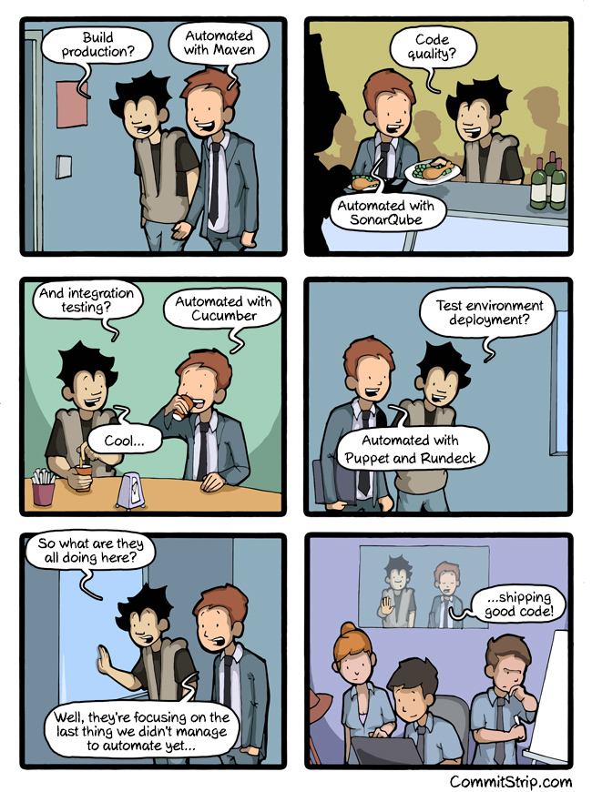
Technological foundations of software development
Automate build production
Part 1: « Automate »: What? Why? How?
ICM – Computer Science Major – Course unit on Technological foundations of computer science
M1 Cyber Physical and Social Systems – Course unit on CPS2 engineering and development, Part 2: Technological foundations of software development
Maxime Lefrançois https://maxime-lefrancois.info
online: https://ci.mines-stetienne.fr/cps2/course/tfsd/
https://www.commitstrip.com/en/2015/06/22/can-we-automate-everything/?

Slide 4
Technological foundations of software development
this session
Build Production
Automate build production
Part 1: « Automate »: What? Why? How?
ICM – Computer Science Major – Course unit on Technological foundations of computer science
M1 Cyber Physical and Social Systems – Course unit on CPS2 engineering and development, Part 2: Technological foundations of software development
Maxime Lefrançois https://maxime-lefrancois.info
online: https://ci.mines-stetienne.fr/cps2/course/tfsd/
https://www.commitstrip.com/en/2015/06/22/can-we-automate-everything/?

Slide 5
« Automate »: What ?
Check the licenses of the files, check that the remote repository has no new commit, ...
Potentially generate source code
Download or update dependencies
Manage additional resources
Compile sources, optimize code
Run unit tests
Generate documentation
Package executable code
Deploy in a test environment and execute integration tests
Verify the integrity of the archive, check the quality of the code, ...
Deploy in a production environment, publish the code version
Create and push a git tag
...
https://en.wikipedia.org/wiki/Build_automation

Slide 6
« Automate »: Why ?
Accelerate software production
Improve software quality
Avoid redundant tasks
Limit bad software versions
History: traceability, non-repudiation
Save time and money
As a building block for continuous integration and deployment
https://en.wikipedia.org/wiki/Build_automation

Slide 7
« Automate »: How ?
Build automation utilities
examples: make, rake, msbuild, ant, maven, gradle, webpack, ...
automate simple and repeatable tasks
order tasks to achieve goals
execute only the necessary tasks
Two paradigms:
task-oriented: breaks down goals into tasks
product-oriented: breaks down into sub-products to be generated
https://en.wikipedia.org/wiki/Build_automation

Slide 8
« Automate »: How ?
Build automation servers
run build automation utilities
Three paradigms:
On-demand automation: the user requests the execution of the production
Scheduled automation: execution is scheduled (e.g. nightly build)
Triggered automation: execution is triggered by an event (e.g., commit on master)
https://en.wikipedia.org/wiki/Build_automation

Slide 9
Technological foundations of software development
Automate build production
Part 2: Build automation utilities
ICM – Computer Science Major – Course unit on Technological foundations of computer science
M1 Cyber Physical and Social Systems – Course unit on CPS2 engineering and development, Part 2: Technological foundations of software development
Maxime Lefrançois https://maxime-lefrancois.info
online: https://ci.mines-stetienne.fr/cps2/course/tfsd/

Slide 10
Technological foundations of software development
Automate build production
Part 2: Build automation utilities
Part 2.1: Make-like
ICM – Computer Science Major – Course unit on Technological foundations of computer science
M1 Cyber Physical and Social Systems – Course unit on CPS2 engineering and development, Part 2: Technological foundations of software development
Maxime Lefrançois https://maxime-lefrancois.info
online: https://ci.mines-stetienne.fr/cps2/course/tfsd/

Slide 11
Make-like build automation utilities
macros, declarative programming
first implementation by Stuart Feldman (Bell Labs, released in 1976)
many variants of the tool
make, GNU gmake, Microsoft nmake (in Visual Studio), google Kati (for Android OS) ...
still widely used today
https://en.wikipedia.org/wiki/Make_(software)
https://makefiletutorial.com/#makefile-cookbook

Slide 12
file makefile (or Makefile, or GNUmakefile, ...)
srcfiles := $(shell echo src/{00..99}.txt)
destfiles := $(patsubst src/%.txt,dest/%.txt,$(srcfiles))
tutorial:
@echo "10 questions about Isaac's Makefile in the MCQ"
src/%.txt:
@[ -d src ] || mkdir src
echo $* > $@
dest/%.txt: src/%.txt
@[ -d dest ] || mkdir dest
cp $< $@
destination: $(destfiles)
.PHONY: tutorial destination
Macros: reusable pieces of text or values that can be substituted throughout the build
Declarative programming rules
target [target ...]: [component ...]
[Tab ↹] [command 1]
…
[Tab ↹] [command n]
"tutorial" and "destination" aren’t actual filename, soe we define them as .PHONY
$ make # calls rule “tutorial”
$ make dest/00.txt # calls third rule, which needs second.
$ make destination # updates all targets
call with target file names
https://en.wikipedia.org/wiki/Make_(software)
https://makefiletutorial.com/#makefile-cookbook

Slide 13
To read for MCQ test
“Isaac’s Makefile” https://gist.github.com/isaacs/62a2d1825d04437c6f08

Slide 14
Technological foundations of software development
Automate build production
Part 1: Build automation utilities
Part 2.2: for Java
ICM – Computer Science Major – Course unit on Technological foundations of computer science
M1 Cyber Physical and Social Systems – Course unit on CPS2 engineering and development, Part 2: Technological foundations of software development
Maxime Lefrançois https://maxime-lefrancois.info
online: https://ci.mines-stetienne.fr/cps2/course/tfsd/

Slide 15
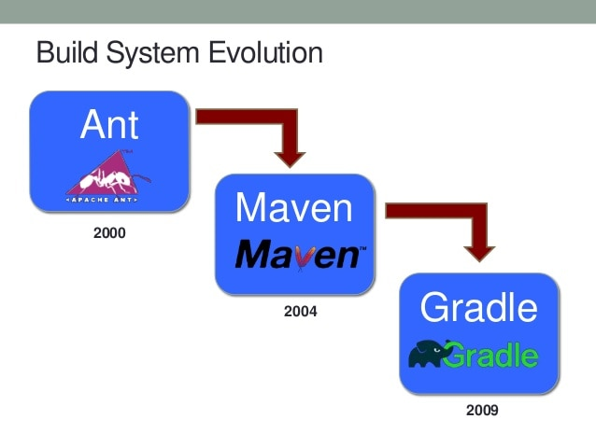
For Java

Slide 16

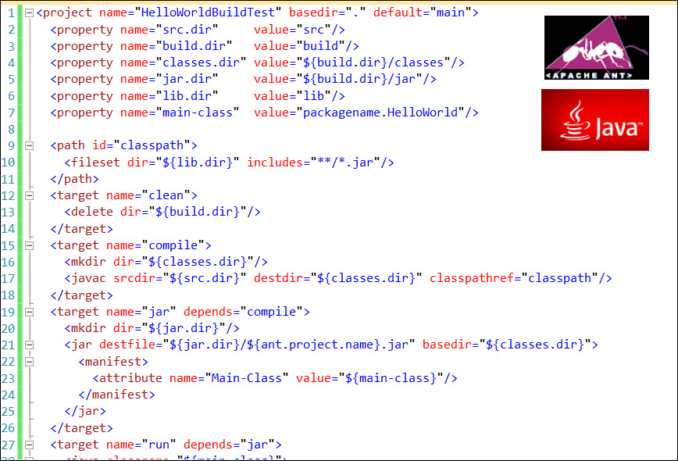
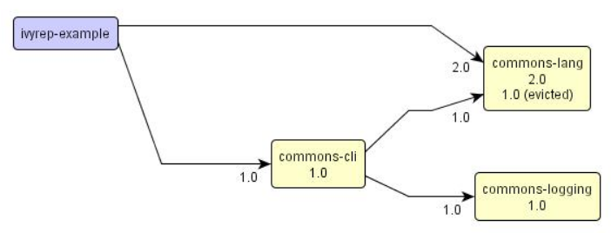
For Java
Apache Ant ("Another Neat Tool")
Apache Software Foundation, v1 2000 ;
written in Java
XML project files, complex, verbose
https://en.wikipedia.org/wiki/Apache_Ant
http://blog.travelmarx.com/2011/10/java-apache-ant-and-hello-world.html
+ Apache Ivy
Transitive dependency manager
example:
<dependency org="com.google.code.gson" name="gson" rev="2.8.8"/>
http://ant.apache.org/ivy/
http://www.jaya.free.fr/ivy/doc/print.html

Slide 17
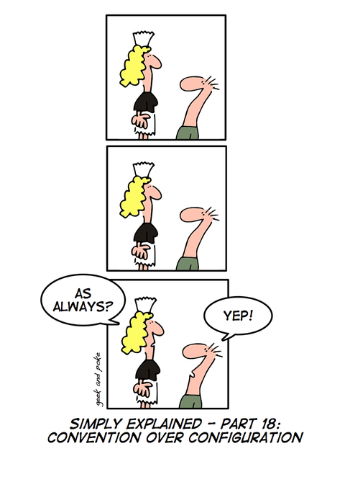

For Java
Apache Maven
Apache Software Foundation, v1 2004; v2 2005; v3 2013
written in Java
Convention over configuration
objective: limit the number of decisions a developer has to make.
https://en.wikipedia.org/wiki/Apache_Maven
https://devopedia.org/convention-over-configuration

Slide 18
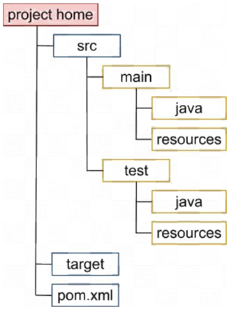
For Java
Apache Maven
Apache Software Foundation, v1 2004; v2 2005; v3 2013
written in Java
Convention over configuration
Conventions for the project structure
https://en.wikipedia.org/wiki/Apache_Maven

Slide 19
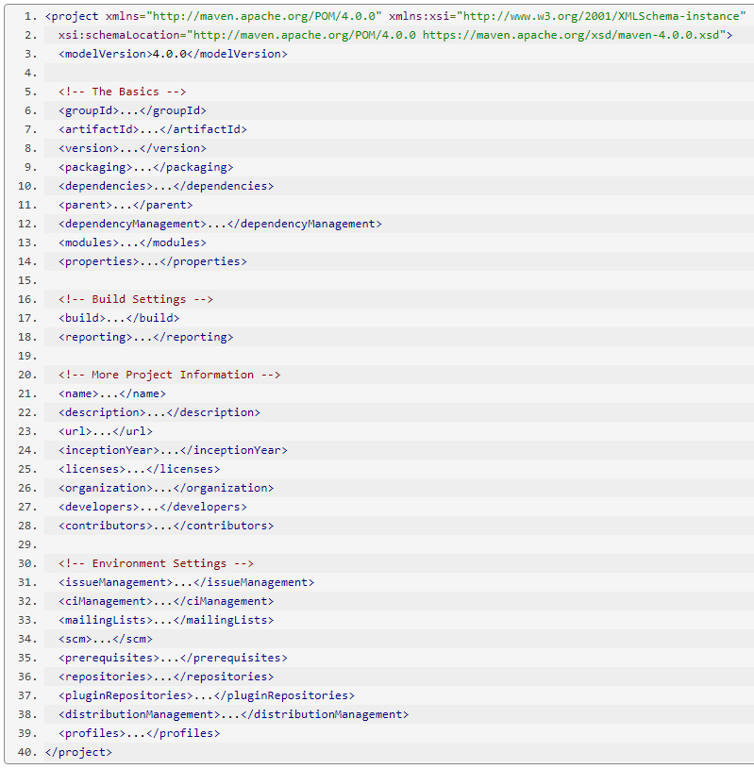
For Java
Apache Maven
Apache Software Foundation, v1 2004; v2 2005; v3 2013
written in Java
Convention over configuration
Conventions for the project structure
A project is described by an XML file: le POM (Project Object Model)
https://maven.apache.org/guides/introduction/introduction-to-the-pom.html
https://en.wikipedia.org/wiki/Apache_Maven

Slide 20
For Java
G-A-V
jar (default), war, pom, ...
Apache Maven
Apache Software Foundation, v1 2004; v2 2005; v3 2013
written in Java
dependencies
inheritance and multi-modules
configuration ${prop}
Convention over configuration
plugins used during the build
plugins for reporting
Conventions for the project structure
A project is described by an XML file: le POM (Project Object Model)
metadata about the projet
config. environnement
https://maven.apache.org/guides/introduction/introduction-to-the-pom.html
https://en.wikipedia.org/wiki/Apache_Maven

Slide 21
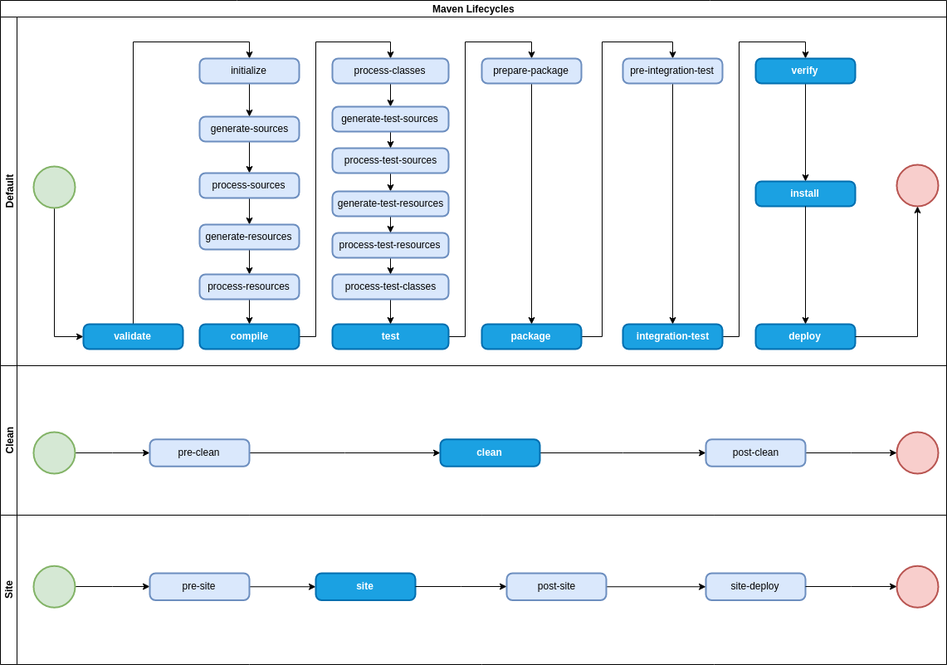
For Java
Apache Maven
Apache Software Foundation, v1 2004; v2 2005; v3 2013
written in Java
Convention over configuration
Conventions for the project structure
A project is described by an XML file: le POM (Project Object Model)
Standardized life cycle (phases)
https://medium.com/@yetanothersoftwareengineer/maven-lifecycle-phases-plugins-and-goals-25d8e33fa22
https://en.wikipedia.org/wiki/Apache_Maven

Slide 22
For Java
Apache Maven
Apache Software Foundation, v1 2004; v2 2005; v3 2013
written in Java
Convention over configuration
Conventions for the project structure
A project is described by an XML file: le POM (Project Object Model)
Standardized life cycle (phases)
https://medium.com/@yetanothersoftwareengineer/maven-lifecycle-phases-plugins-and-goals-25d8e33fa22
https://en.wikipedia.org/wiki/Apache_Maven

Slide 23
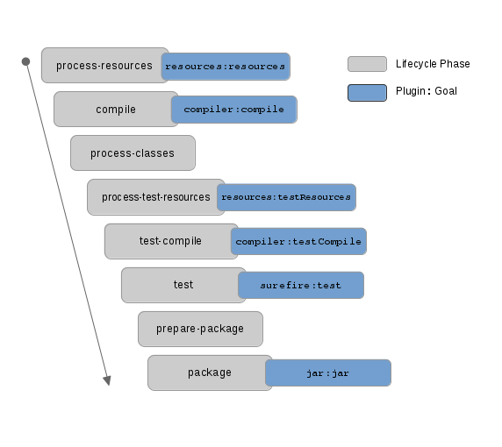
For Java
Apache Maven
Apache Software Foundation, v1 2004; v2 2005; v3 2013
written in Java
Convention over configuration
Conventions for the project structure
A project is described by an XML file: le POM (Project Object Model)
Standardized life cycle (phases)
Convention for plugin goals executed at each phase of the lifecycle
Example for <packaging>jar</packaging>
https://en.wikipedia.org/wiki/Apache_Maven
https://webdevdesigner.com/q/maven-lifecycle-vs-phase-vs-plugin-vs-goal-closed-34346/

Slide 24
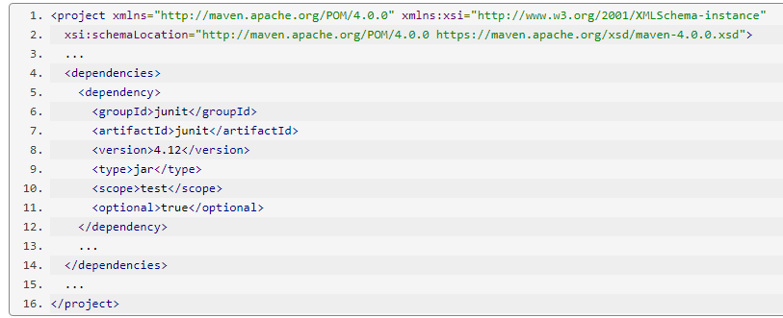
For Java
Apache Maven
Apache Software Foundation, v1 2004; v2 2005; v3 2013
written in Java
Dependency management
Use G-A-V coordinates
concepts:
repositories: where dependencies are downloaded to
scope: context of use of the dependency
transitivity: dependencies of dependencies
inheritance: inheritance of dependencies from parent project
https://maven.apache.org/pom.html#dependencies
https://en.wikipedia.org/wiki/Apache_Maven

Slide 25
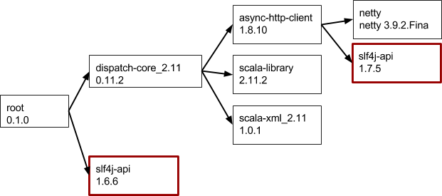
For Java
Apache Maven
Apache Software Foundation, v1 2004; v2 2005; v3 2013
written in Java
Dependency management
Use G-A-V coordinates
⚠ dependence on multiple versions of the same artifact?
https://en.wikipedia.org/wiki/Apache_Maven
https://www.baeldung.com/maven-version-collision

Slide 26
For Java
Apache Maven
Apache Software Foundation, v1 2004; v2 2005; v3 2013
written in Java
Dependency management
Use G-A-V coordinates
⚠ dependence on multiple versions of the same artifact?
Flexibility in version numbers :
[1.0,) : version 1.0 or greater
(,1.0] : version lower or equal to 1.0
[1.0,1.2] : between versions 1.0 and 1.2, inclusive
(,1.2),(1.2,) : all versions except 1.2
[1.0,2.0) : version greater or equal to 1.0 and lower than 2.0
Other solutions: https://www.baeldung.com/maven-version-collision
https://en.wikipedia.org/wiki/Apache_Maven

Slide 27
For Java
Apache Maven
Apache Software Foundation, v1 2004; v2 2005; v3 2013
written in Java
Everything is plugin
A plugin is a jar that contains a class annotated @Mojo
<G>:<A>:<V>:<goal>
example: org.apache.maven.plugins:maven-compiler-plugin:3.8.1:compile
Convention for plugin goals executed at each phase of the lifecycle
Configuration of other plugins, ...
Many plugins already published by Maven https://maven.apache.org/plugins/
Example: https://maven.apache.org/plugins/maven-deploy-plugin/examples/deploy-ftp.html
Convention for the phases to which a goal is attached
https://en.wikipedia.org/wiki/Apache_Maven

Slide 28
For Java
Apache Maven
Apache Software Foundation, v1 2004; v2 2005; v3 2013
written in Java
Execution of a life cycle goal
Executes all goals associated with all phases ≤ package
Execution of a specific goal of a specific plugin
Executes goal effective-pom from plugin help
Passing parameters (same as in POM <parameters>…</parameters>)
Executes goal describe from plugin help
$ mvn package
$ mvn help:effective-pom
$ mvn org.apache.maven.plugins:maven-help-plugin:3.2.0:effective-pom
$ mvn help:describe -Dplugin=help –Dminimal
https://en.wikipedia.org/wiki/Apache_Maven

Slide 29
For Java
Apache Maven
Apache Software Foundation, v1 2004; v2 2005; v3 2013
written in Java
pointers:
@fr http://www.jmdoudoux.fr/java/dej/indexavecframes.htm chapter 93. Maven (except: 93.2, 93.3.6, 93.3.7, 93.3.9
https://maven.apache.org/guides/getting-started/maven-in-five-minutes.html
https://maven.apache.org/guides/getting-started/index.html
https://en.wikipedia.org/wiki/Apache_Maven

Slide 30

For Java
Apache Gradle
Open Source, 2007
written in Java, Groovy, Kotlin
Convention over configuration
Domain specific language (DSL) rather than XML
DSL based on Groovy, or on Kotlin
More expressive, concise, flexible, than Ant and Maven
Acyclic oriented graph of tasks
execution of tasks in parallel or in sequence
dependencies between tasks
incremental production
https://en.wikipedia.org/wiki/Apache_Maven

Slide 31
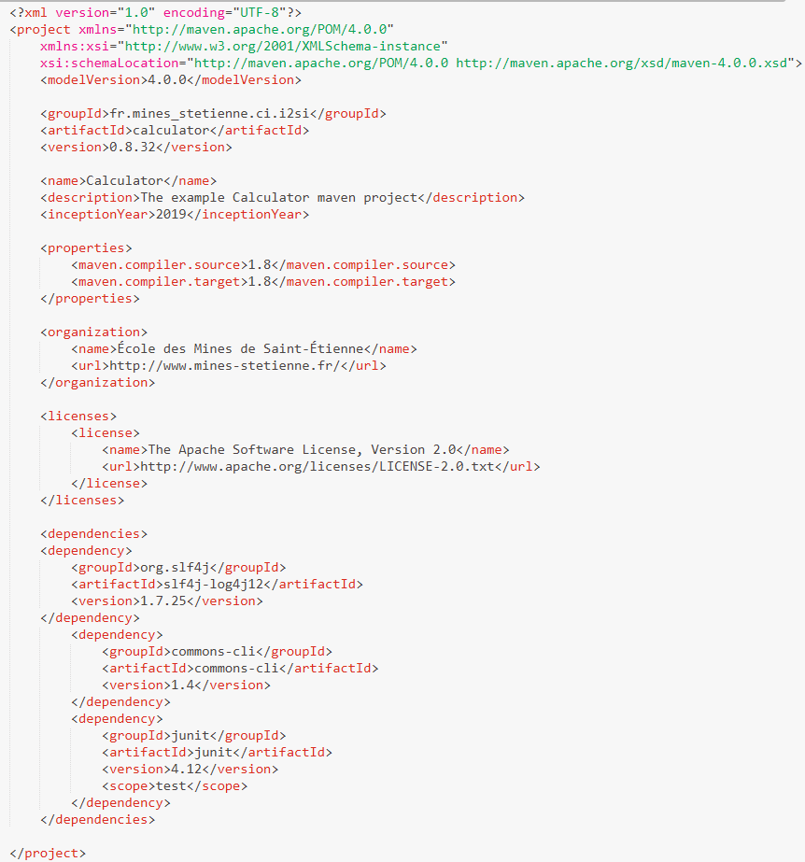
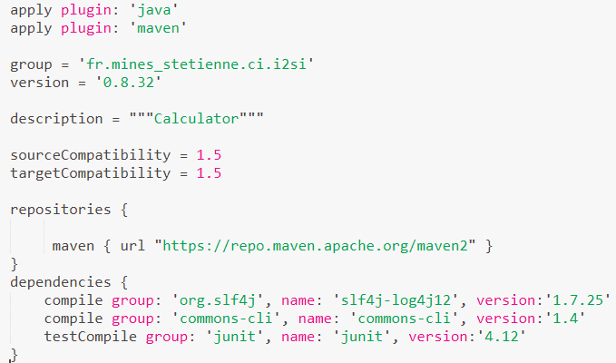


pom.xml
build.gradle
settings.gradle

Slide 32
For Java
Apache Gradle
Open Source, 2007
written in Java, Groovy, Kotlin
Viewed in details in the course “Web Programming”
pointers:
https://docs.gradle.org/current/userguide/what_is_gradle.html
https://spring.io/guides/gs/gradle/
https://dev-mind.fr/training/gradle/gradle_en.html
https://en.wikipedia.org/wiki/Apache_Maven

Slide 33
Technological foundations of software development
Automate build production
Part 1: Build automation utilities
Part 2.3: For node.js / front-end dev
ICM – Computer Science Major – Course unit on Technological foundations of computer science
M1 Cyber Physical and Social Systems – Course unit on CPS2 engineering and development, Part 2: Technological foundations of software development
Maxime Lefrançois https://maxime-lefrancois.info
online: https://ci.mines-stetienne.fr/cps2/course/tfsd/

Slide 34


For node.js / front-end dev
Dependency Managers
https://www.npmjs.com/
main central repository for js
package.json - example: https://github.com/angular/angular-cli/blob/master/package.json
https://yarnpkg.com/
npm + caching (limits downloads) + parallelization
https://www.developerdrive.com/best-build-tools-frontend-development/

Slide 35


For node.js / front-end dev
Tasks automation
grunt https://gruntjs.com/
task automation: minification, linting, testing, ...
gulp https://gulpjs.com/
grunt + faster (ram vs i/o) + big ecosystem (plugins)
https://www.developerdrive.com/best-build-tools-frontend-development/

Slide 36

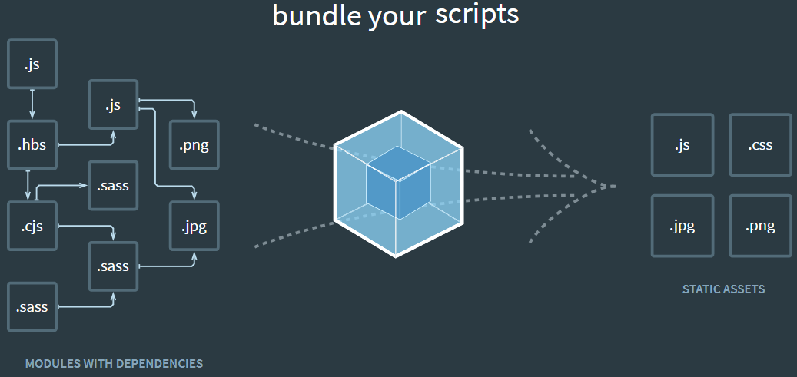

For node.js / front-end dev
bundling of code and dependencies so that the client downloads only one js file and one css file
browserify http://browserify.org/
package the code and the dependencies (require() fonction of Node.js)
only one js
webpack https://webpack.js.org/
The solution to recommend today
https://www.developerdrive.com/best-build-tools-frontend-development/

Slide 37
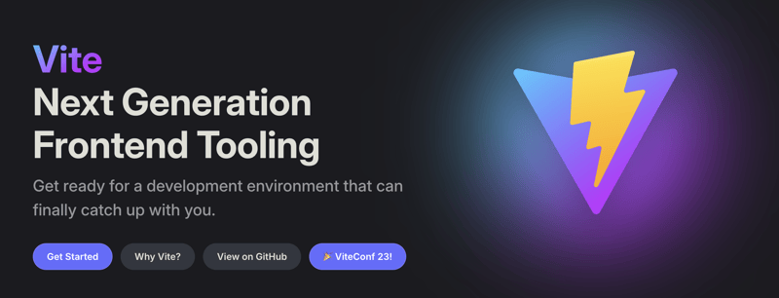
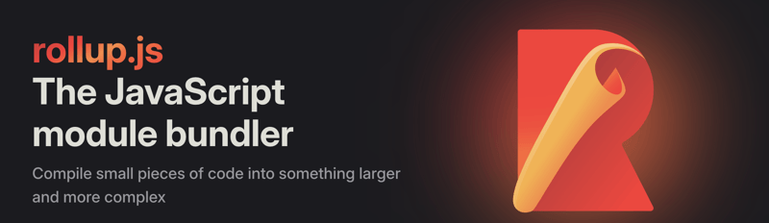
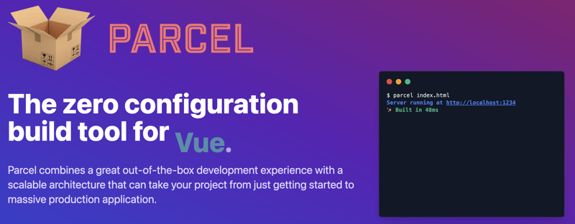
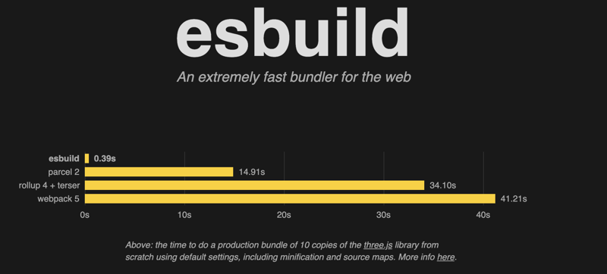
For node.js / front-end dev
webpack was recommended in 2022.
In 2024 there are these alternatives:
https://vitejs.dev/
https://rollupjs.org/
https://parceljs.org/
https://esbuild.github.io/
https://dev.to/strapi/top-5-alternatives-to-webpack-1dll

Slide 38
Technological foundations of software development
Automate build production
Part 1: Build automation utilities
Part 2.4: For python
ICM – Computer Science Major – Course unit on Technological foundations of computer science
M1 Cyber Physical and Social Systems – Course unit on CPS2 engineering and development, Part 2: Technological foundations of software development
Maxime Lefrançois https://maxime-lefrancois.info
online: https://ci.mines-stetienne.fr/cps2/course/tfsd/

Slide 39
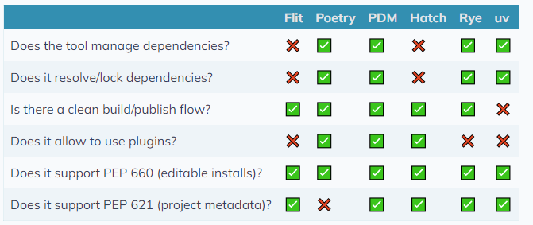
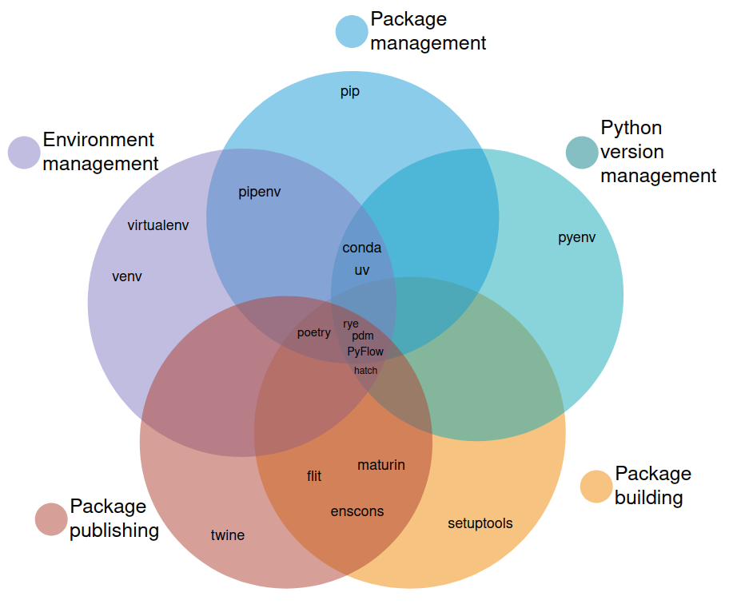
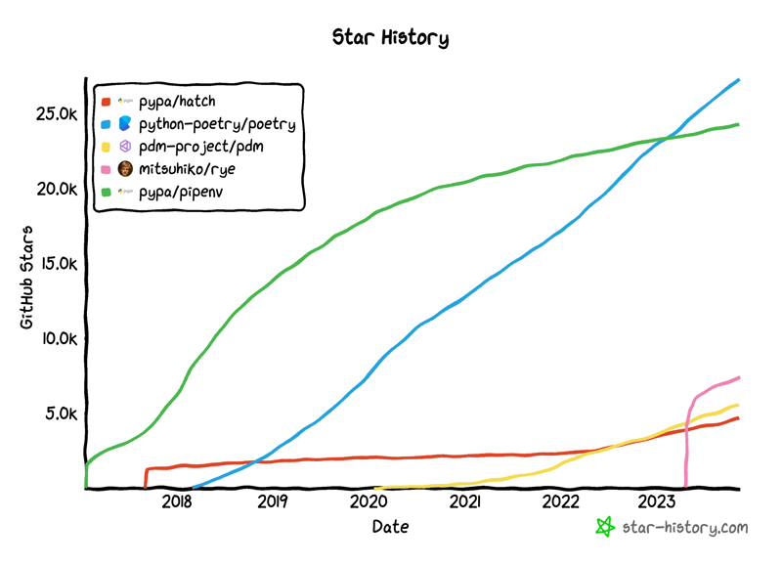
https://alpopkes.com/posts/python/packaging_tools/
https://dev.to/adamghill/python-package-manager-comparison-1g98 (2023)

Slide 40

Example: Poetry
Poetry
dependency management, linting, autoformatting, testing, and publishing in python
https://python-poetry.org/
MIT License - Open source: https://github.com/python-poetry/poetry
Managing different environments
Installing python packages
Environment reproducibility
Packaging and publishing python packages
$ poetry init / poetry install
$ poetry add "package==version"
$ poetry update
$ poetry run
$ poetry shell - exit
See https://medium.com/edge-analytics/python-best-practices-2934de825fd2

Slide 41

Example: Hatch
Hatch
dependency management, linting, autoformatting, testing, and publishing in python
https://hatch.pypa.io/latest/
MIT License - Open source: https://github.com/pypa/hatch
Standardized build system with reproducible builds by default
Robust environment management with support for custom scripts and UV
Configurable Python distribution management
Test execution with known best practices
Static analysis with sane defaults
Built-in Python script runner
Easy publishing to PyPI or other indices
Version management
Best practice project generation
Responsive CLI, ~2-3x faster than equivalent tools

Slide 42
To read for MCQ test
To read (necessary for questions in the MCQ)
The pyproject.toml guide https://packaging.python.org/en/latest/guides/writing-pyproject-toml/
“An unbiased evaluation of environment management and packaging tools” https://alpopkes.com/posts/python/packaging_tools/

Slide 43
Technological foundations of software development
Automate build production
ICM – Computer Science Major – Course unit on Technological foundations of computer science
M1 Cyber Physical and Social Systems – Course unit on CPS2 engineering and development, Part 2: Technological foundations of software development
Maxime Lefrançois https://maxime-lefrancois.info
online: https://ci.mines-stetienne.fr/cps2/course/tfsd/

Slide 44
... Your turn
Complete the TODO section:
https://ci.mines-stetienne.fr/cps2/course/tfsd/course-4.html#_todos

