Slide 1
Technological foundations of software development
Debug, log, test, profile, analyze your software
ICM – Computer Science Major – Course unit on Technological foundations of computer science
M1 Cyber Physical and Social Systems – Course unit on CPS2 engineering and development, Part 2: Technological foundations of software development
Maxime Lefrançois https://maxime-lefrancois.info
online: https://ci.mines-stetienne.fr/cps2/course/tfsd/

Slide 2
Objectives of the session
This session aims to familiarize you with the methods and tools for debugging, logging, testing, profiling, analyzing your software.
In particular, we will cover tools for Java, Python, JavaScript.

Slide 3
Technological foundations of software development
Debug, log, test, profile, analyze your software
Part 1: Big Bang development
ICM – Computer Science Major – Course unit on Technological foundations of computer science
M1 Cyber Physical and Social Systems – Course unit on CPS2 engineering and development, Part 2: Technological foundations of software development
Maxime Lefrançois https://maxime-lefrancois.info
online: https://ci.mines-stetienne.fr/cps2/course/tfsd/

Slide 4
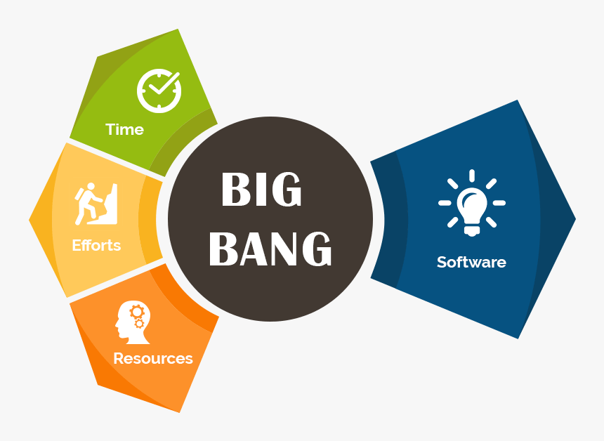
... write code the old-fashioned way

Slide 5
... possibly with some precautions
try-catch
try { ... } catch (Exception ex) { ... }
multicatch
try { ... } catch (NullPointerException |IOException ex) { ... }
finally
try { ... } catch (Exception ex) { ... } finally { ... }
try with resource:
try (InputStream fis = new FileInputStream(file) ) { ... }
catch (...) { ... }

Slide 6
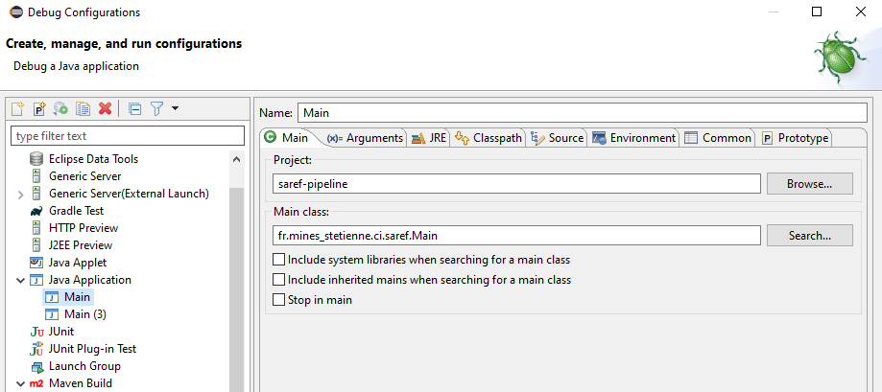
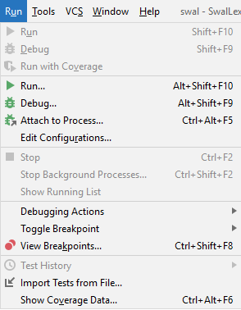
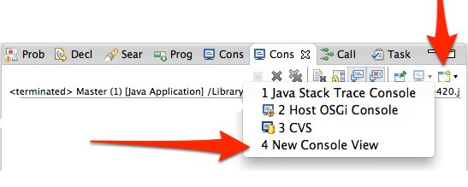
Run your code...
Run configuration in Eclipse
Run Menu in IntelliJ
Console in Eclipse

Slide 7

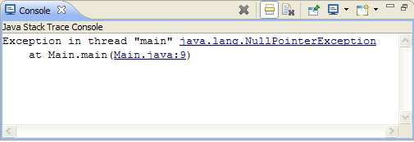
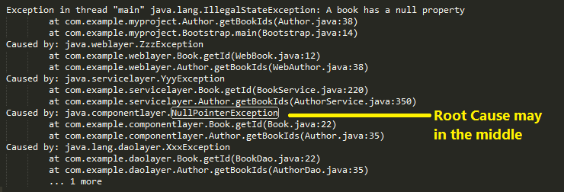
... and stumble upon an error
Stacktrace

Slide 8
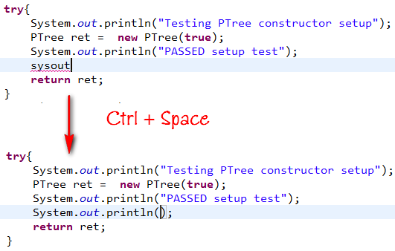
Print values ...
and we comment ... and we decomment ...
and we start again...

Slide 9
Technological foundations of software development
Debug, log, test, profile, analyze your software
Part 2: Troubleshoot a bug
ICM – Computer Science Major – Course unit on Technological foundations of computer science
M1 Cyber Physical and Social Systems – Course unit on CPS2 engineering and development, Part 2: Technological foundations of software development
Maxime Lefrançois https://maxime-lefrancois.info
online: https://ci.mines-stetienne.fr/cps2/course/tfsd/

Slide 10
... and stumble upon an error
Stacktrace

Slide 11
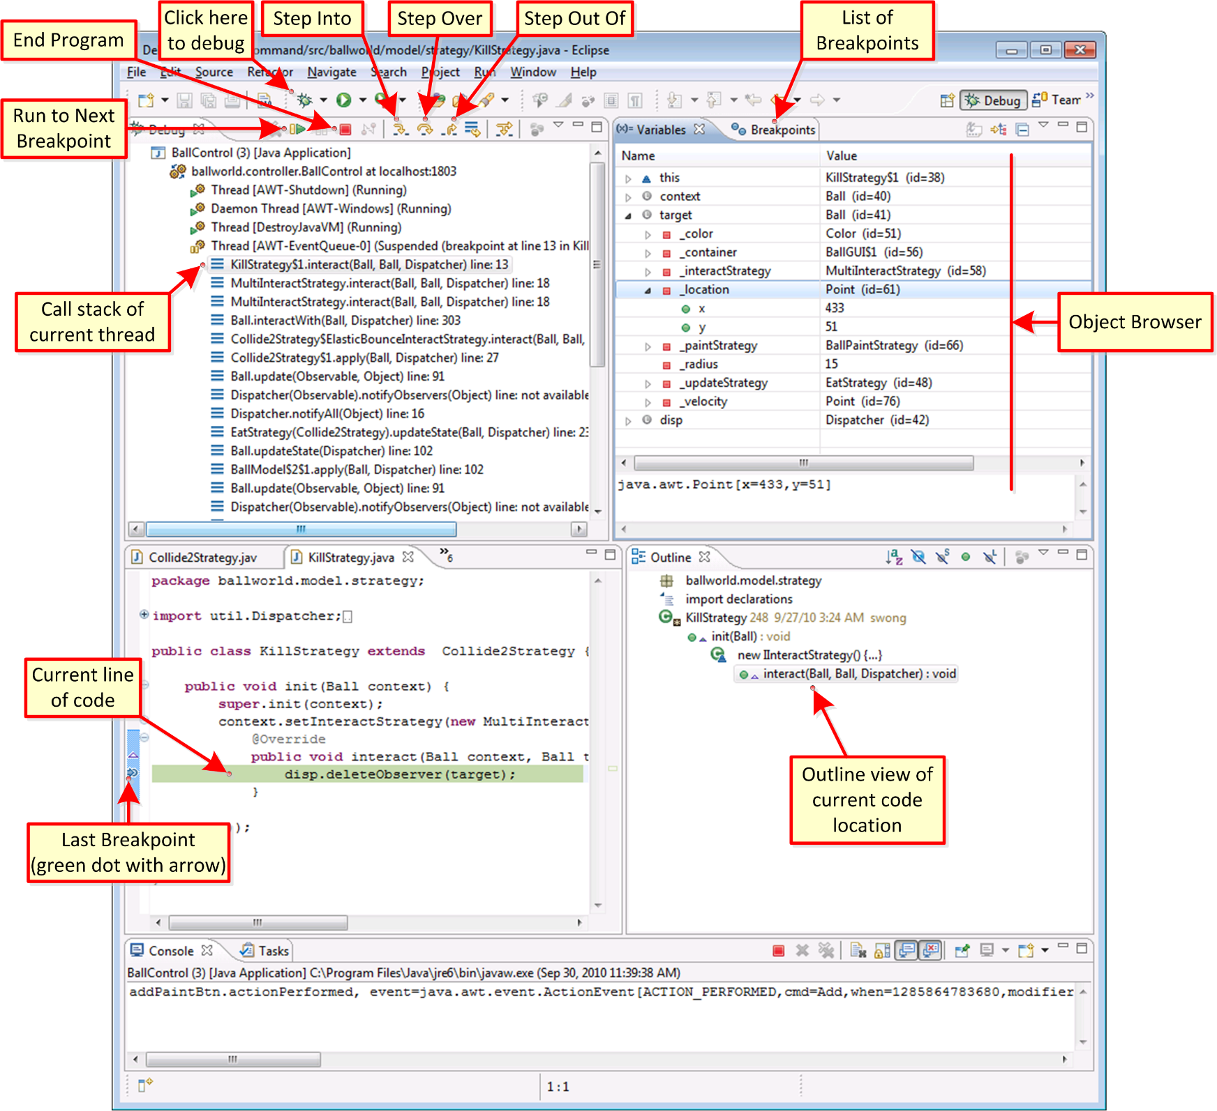
Debugging
Controlled execution of the program
Monitoring and/or modification of the content of variables during execution
Allows to trace bugs

Slide 12
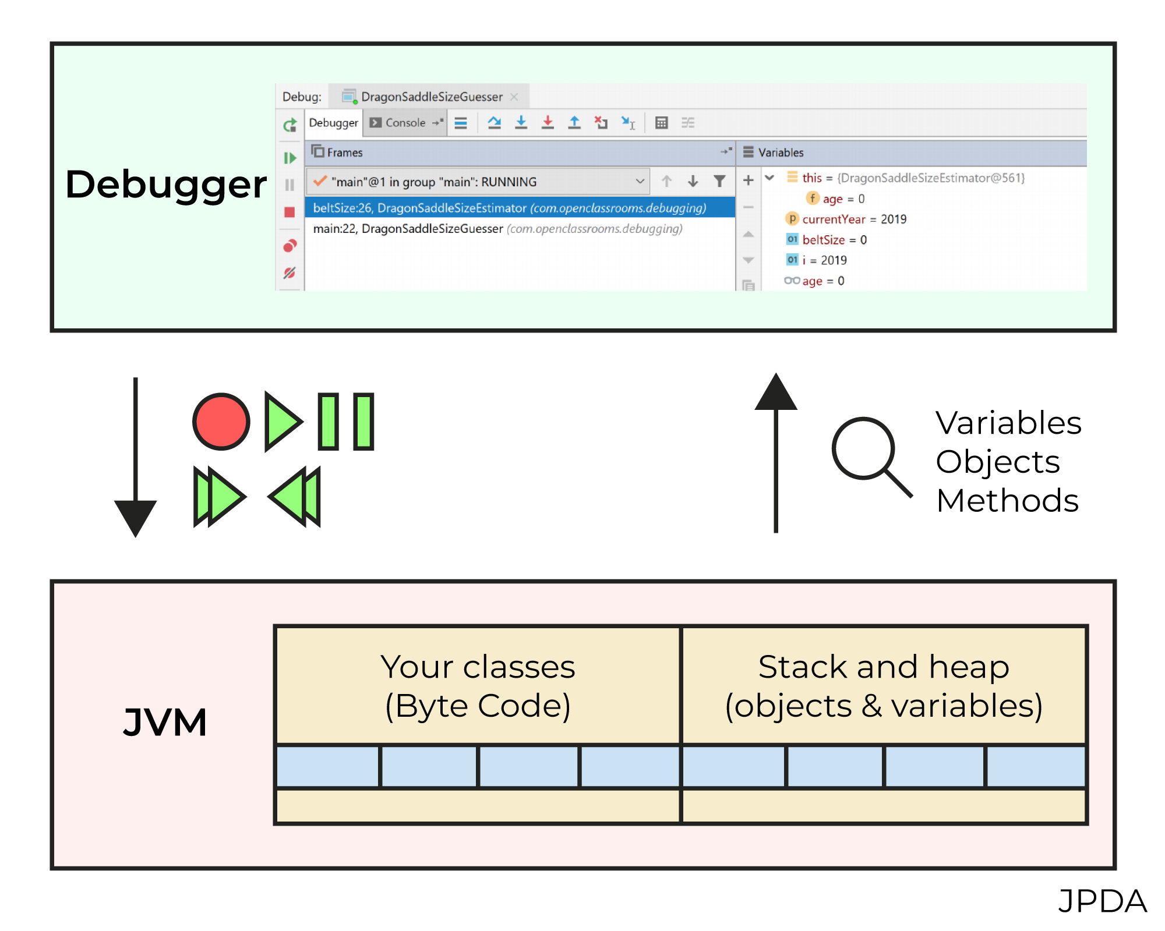
Debugging
Uses the Java Platform Debugger Architecture (JPDA) framework
All Java IDE debuggers will have approximately the same functionalities
https://docs.oracle.com/javase/8/docs/technotes/guides/jpda/

Slide 13
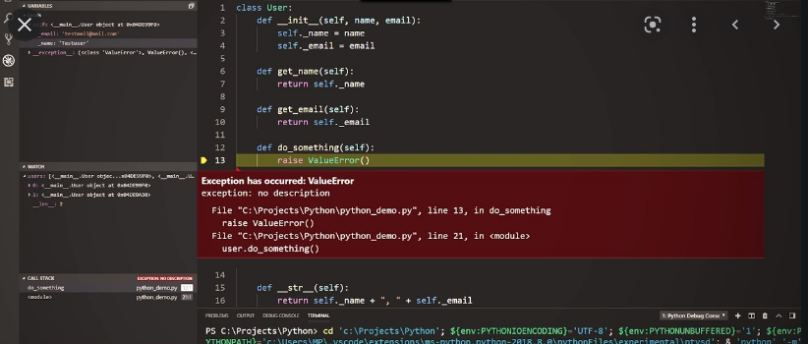
Debugging with Python
https://www.youtube.com/watch?v=w8QHoVam1-I&ab_channel=Jayanam

Slide 14
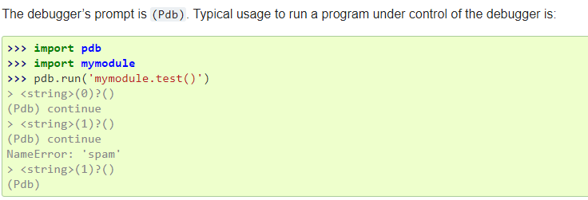
Debugging with Python
Python debuggers rely on the standard pdb module
https://docs.python.org/3/library/pdb.html

Slide 15
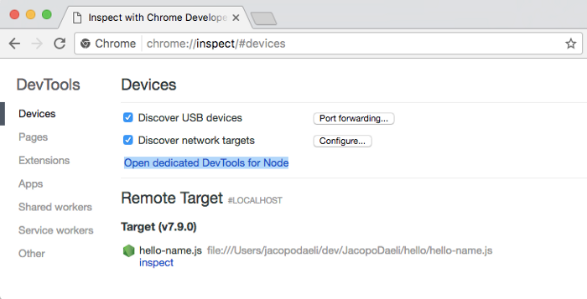
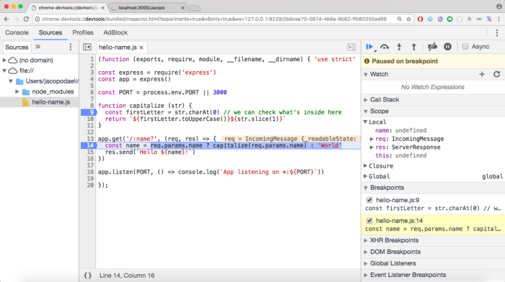
Debugging with node.js
https://medium.com/the-node-js-collection/debugging-node-js-with-google-chrome-4965b5f910f4

Slide 16
Technological foundations of software development
Debug, log, test, profile, analyze your software
Part 3: Smart Logging
ICM – Computer Science Major – Course unit on Technological foundations of computer science
M1 Cyber Physical and Social Systems – Course unit on CPS2 engineering and development, Part 2: Technological foundations of software development
Maxime Lefrançois https://maxime-lefrancois.info
online: https://ci.mines-stetienne.fr/cps2/course/tfsd/

Slide 17
Logging
Print messages with varying degrees of severity
fatal : messages concerning an unexpected stop of the application
error : error messages requiring analysis e.g. exceptions thrown
warn : warning message
info : information messages for example the start or stop of the application, the connection to a resource, ...
trace : messages to follow the execution flow
debug : debugging messages for example to get the value of variables, ...
only during development
http://www.jmdoudoux.fr/java/dej/chap-logging.htm#logging-1

Slide 18
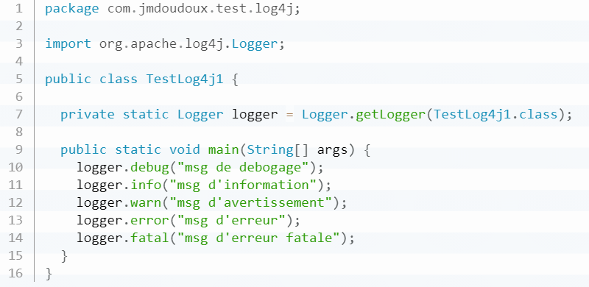
Logging
Example for Java: log4j framework
http://www.jmdoudoux.fr/java/dej/chap-logging.htm#logging-1

Slide 19
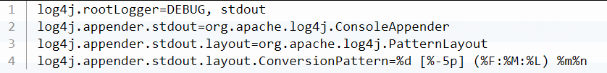
Logging
Exemple for Java: log4j framework (with Maven)
add log4j:log4j:jar:1.2.x in the list of dependencies in the pom.xml
configuration file src/main/resources/log4j.properties
different appenders (console, files, ...)
choice of the pattern https://logging.apache.org/log4j/1.2/apidocs/org/apache/log4j/PatternLayout.html
an example of a log4j.properties file
http://www.jmdoudoux.fr/java/dej/chap-logging.htm#logging-1

Slide 20
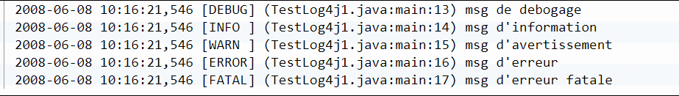
Logging
http://www.jmdoudoux.fr/java/dej/chap-logging.htm#logging-1

Slide 21



Logging
Limit the cost of logging
http://www.jmdoudoux.fr/java/dej/chap-logging.htm#logging-1

Slide 22
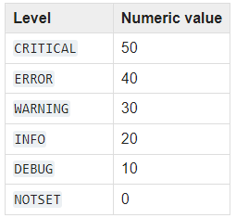
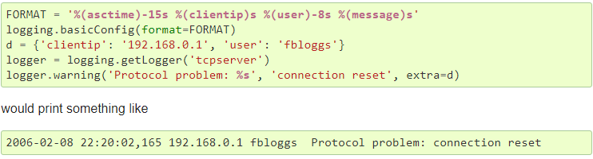
Logging
Same principles for Python
https://docs.python.org/3/library/logging.html

Slide 23
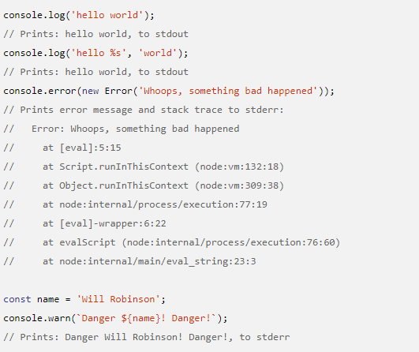
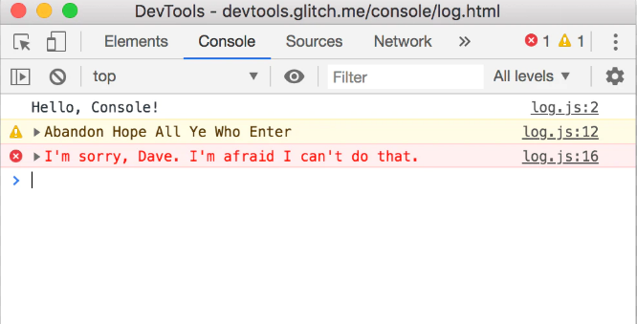
Logging
Same principles for JavaScript
https://developer.chrome.com/docs/devtools/console/log/
https://nodejs.org/api/console.html

Slide 24
To read for MCQ test
Python Basic Logging Tutorial https://docs.python.org/3/howto/logging.html#basic-logging-tutorial

Slide 25
Technological foundations of software development
Debug, log, test, profile, analyze your software
Part 4: Writing and running tests
ICM – Computer Science Major – Course unit on Technological foundations of computer science
M1 Cyber Physical and Social Systems – Course unit on CPS2 engineering and development, Part 2: Technological foundations of software development
Maxime Lefrançois https://maxime-lefrancois.info
online: https://ci.mines-stetienne.fr/cps2/course/tfsd/

Slide 26
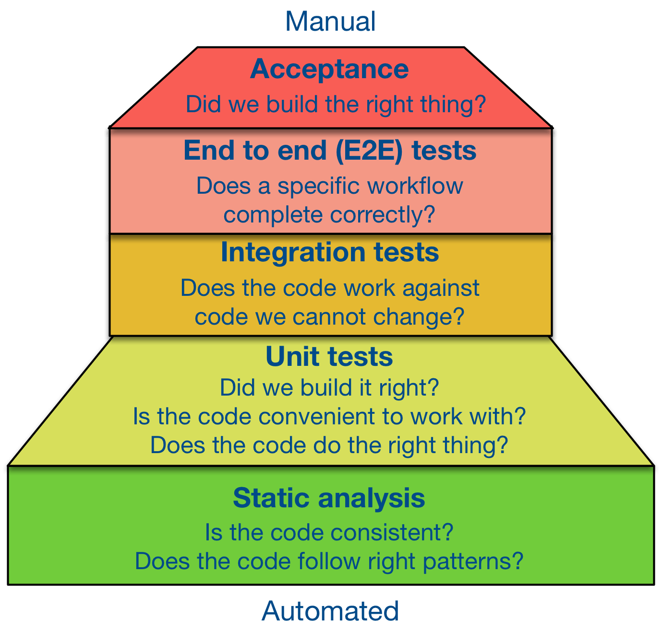
Different types of test
https://survivejs.com/books/maintenance/code-quality/testing/

Slide 27

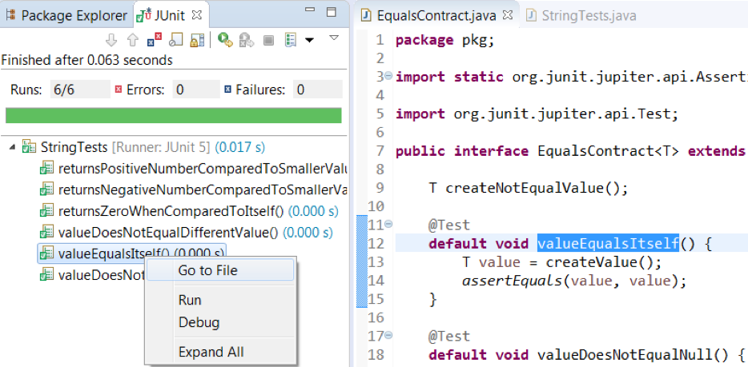
Unit tests - for Java
open source framework for the development and execution of automatable unit tests
http://www.jmdoudoux.fr/java/dej/chap-junit.htm

Slide 28
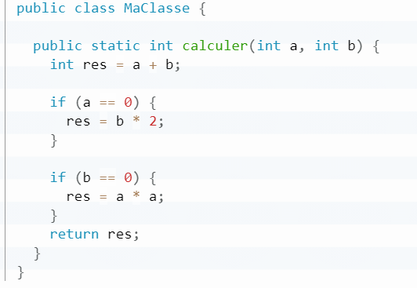
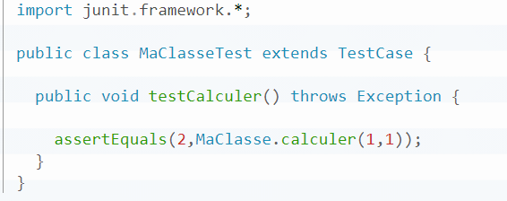
Unit tests - for Java
open source framework for the development and execution of automatable unit tests
http://www.jmdoudoux.fr/java/dej/chap-junit.htm

Slide 29
Unit tests – Multiple frameworks for Python
Unit Testing Tools
Mock Testing Tools
Fuzz Testing Tools
Web Testing Tools: Browser simulation, Browser automation
Acceptance/Business Logic Testing Tools
GUI Testing Tools
Source Code Checking Tools
Code Coverage Tools
Continuous Integration Tools
https://wiki.python.org/moin/PythonTestingToolsTaxonomy

Slide 30
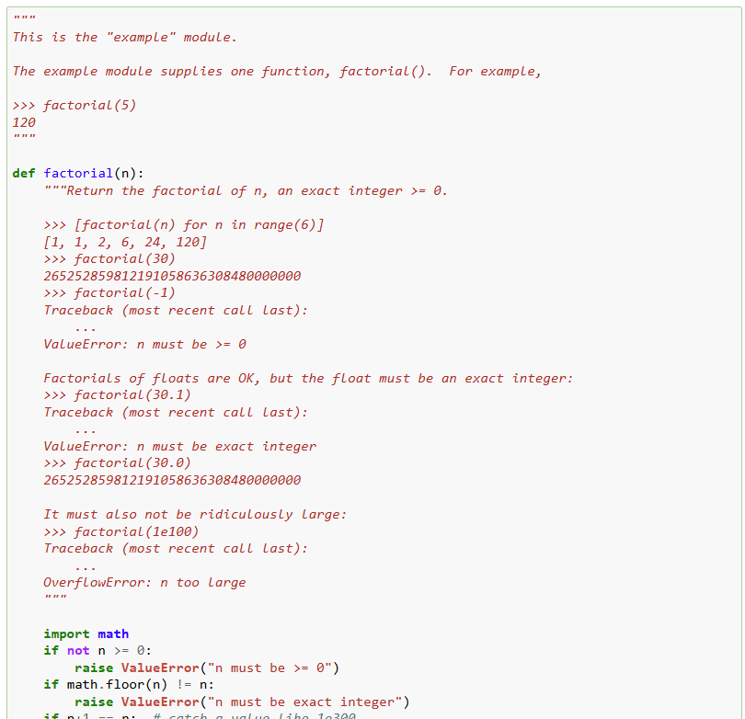
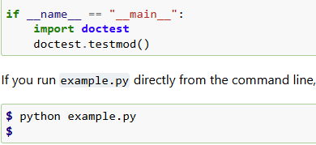
Unit tests – Multiple frameworks for Python
Standard doctest module searches for pieces of text that look like interactive Python sessions, and then executes those sessions to verify that they work exactly as shown.
you run example.py directly from the command line
https://docs.python.org/3/library/doctest.html

Slide 31
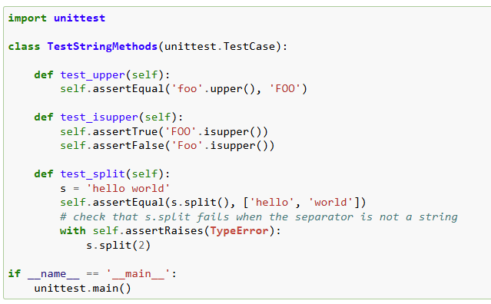
Unit tests – Multiple frameworks for Python
Standard unittest module,
inspired by Junit,
similar flavor as major unit testing frameworks in other languages.
Concepts: test fixture, test case, test suite, test runner
https://docs.python.org/3/library/unittest.html

Slide 32
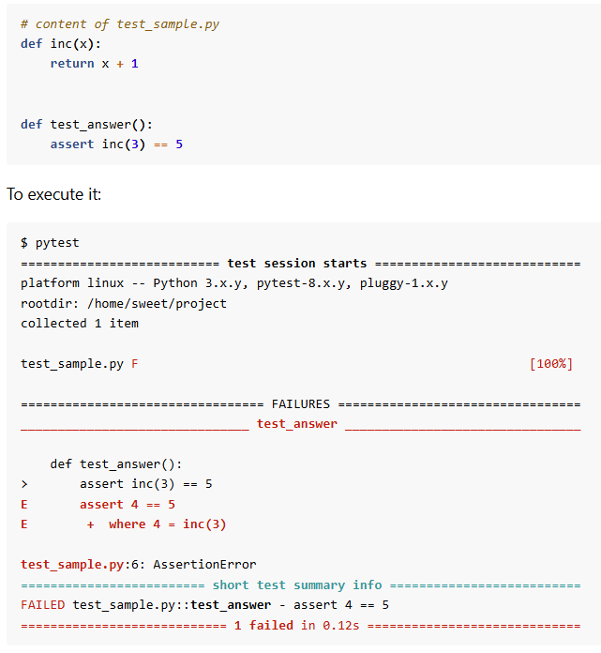
Unit tests – Multiple frameworks for Python
pytest module,
One of the most widely used Python testing frameworks
Use assert statements (simpler than unittest)
Auto-discovery of tests modules and functions
Modular fixtures for managing small or parametrized long-lived test resources
Can run unittest test suites out of the box
https://docs.pytest.org/en/stable/getting-started.html

Slide 33
To read for MCQ test
doctest documentation (beginning only) https://docs.python.org/3/library/doctest.html
pytest getting started guide https://docs.pytest.org/en/stable/getting-started.html

Slide 34
Technological foundations of software development
Debug, log, test, profile, analyze your software
Part 5: Profiling the execution of your software
ICM – Computer Science Major – Course unit on Technological foundations of computer science
M1 Cyber Physical and Social Systems – Course unit on CPS2 engineering and development, Part 2: Technological foundations of software development
Maxime Lefrançois https://maxime-lefrancois.info
online: https://ci.mines-stetienne.fr/cps2/course/tfsd/

Slide 35
Profiling the execution of your software: Why ?
detect memory leaks
detect application congestion points
identify possible improvements

Slide 36
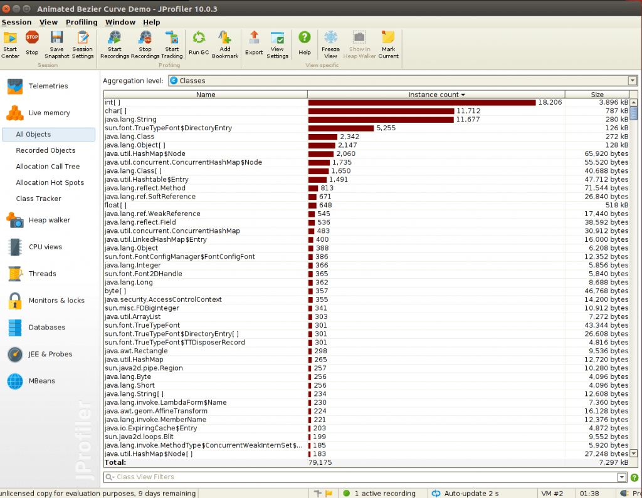
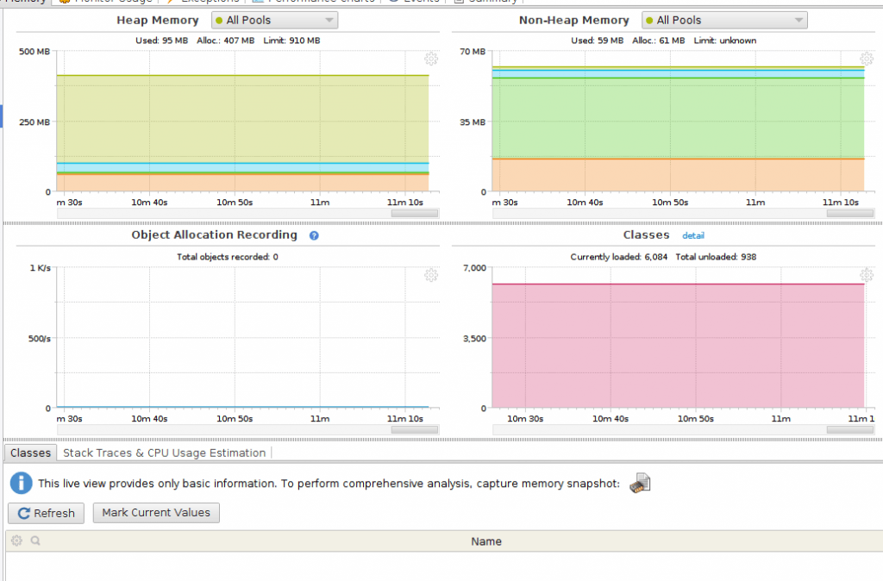
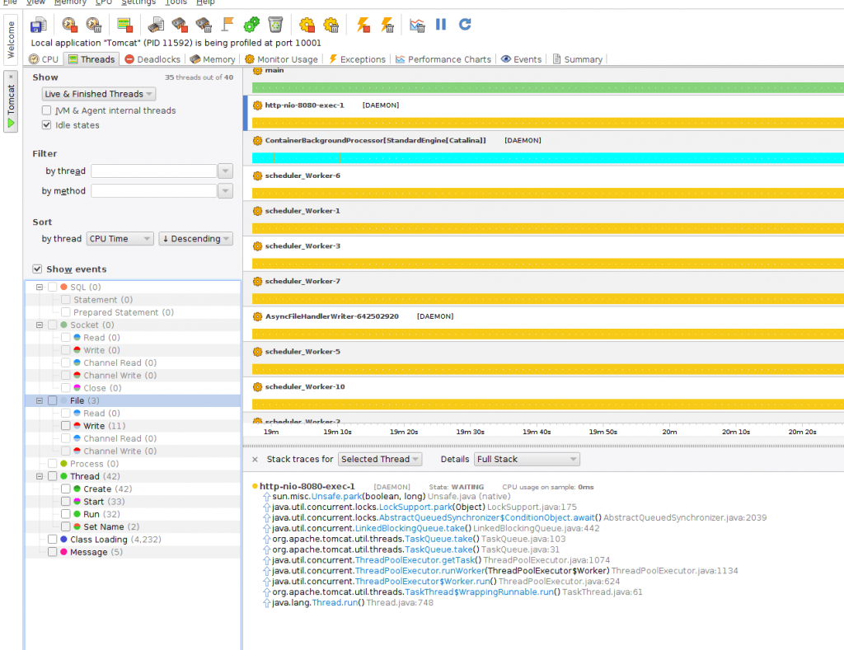
Java
threads, function calls
number of objects, garbage collector
connections to databases
https://www.baeldung.com/java-profilers

Slide 37
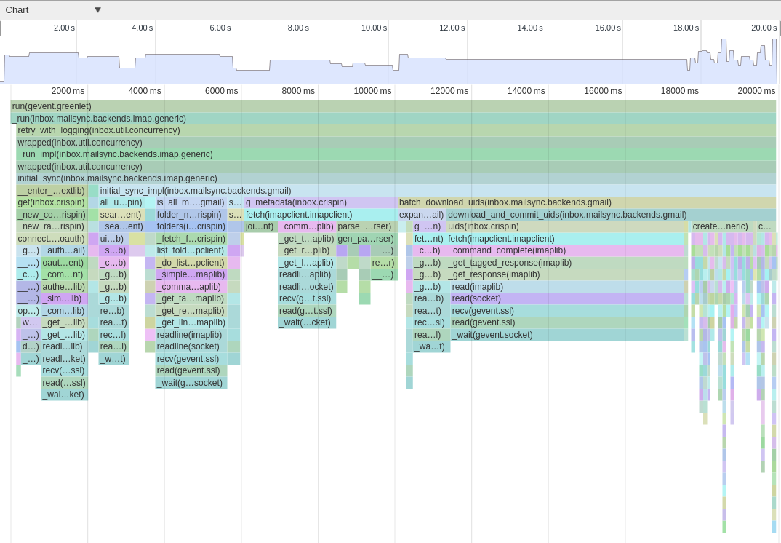
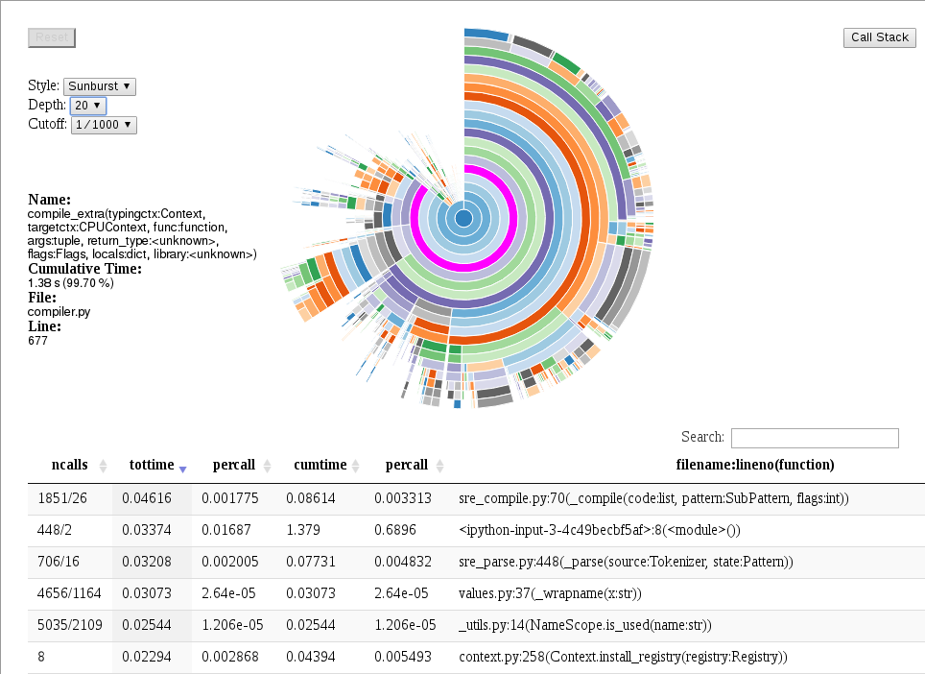
Python
https://www.nylas.com/blog/performance/
https://docs.anaconda.com/accelerate/profiling/

Slide 38
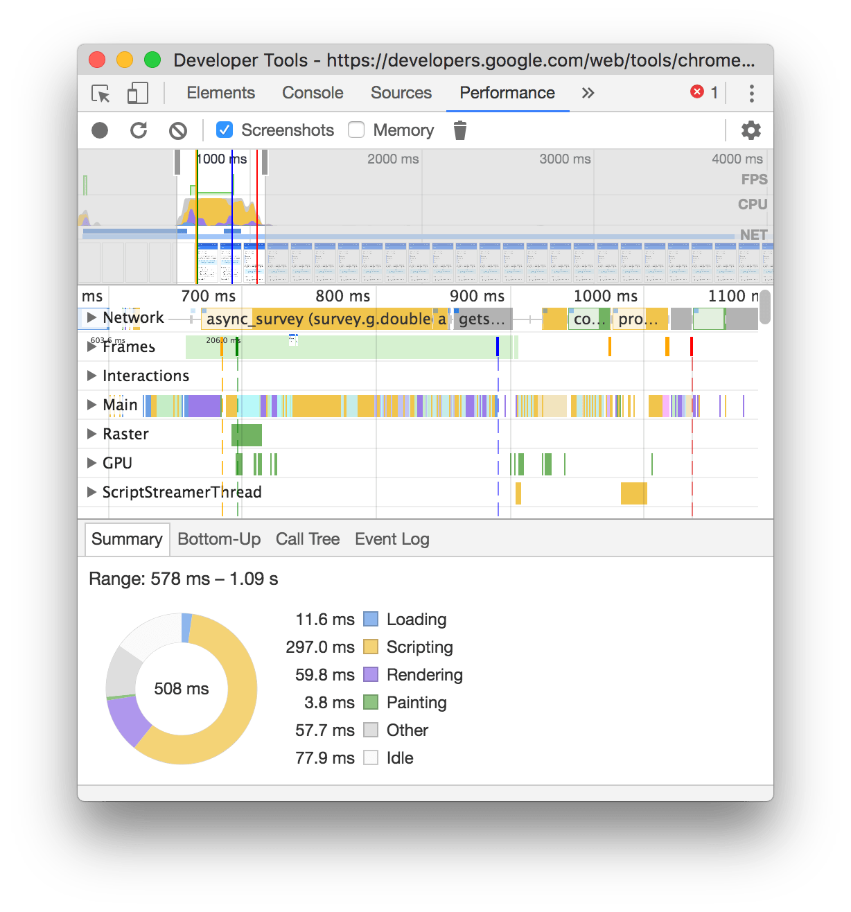
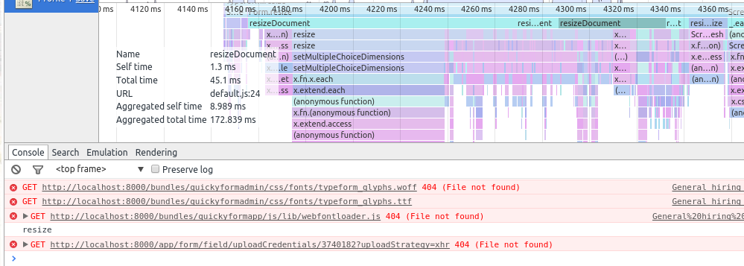
JavaScript
https://developer.chrome.com/docs/devtools/

Slide 39
Technological foundations of software development
Debug, log, test, profile, analyze your software
Part 6: Static code analysis
ICM – Computer Science Major – Course unit on Technological foundations of computer science
M1 Cyber Physical and Social Systems – Course unit on CPS2 engineering and development, Part 2: Technological foundations of software development
Maxime Lefrançois https://maxime-lefrancois.info
online: https://ci.mines-stetienne.fr/cps2/course/tfsd/

Slide 40
Dynamic vs. static analysis
Pros of dynamic analysis
is able to detect dependencies that cannot be detected in static analysis. Ex: dynamic dependencies by reflection, dependency injection, polymorphism.
can collect temporal information.
processes real input data. During static analysis it is difficult to impossible to know which files will be passed as input, which Web requests will come, which user will click, etc.
Cons of dynamic analysis
may have a negative impact on the performance of the application.
cannot guarantee complete coverage of the source code, as executed, is based on user interaction or automated testing.

Slide 41
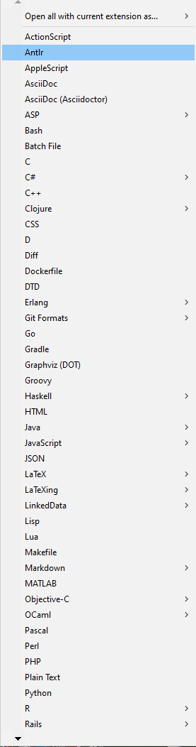
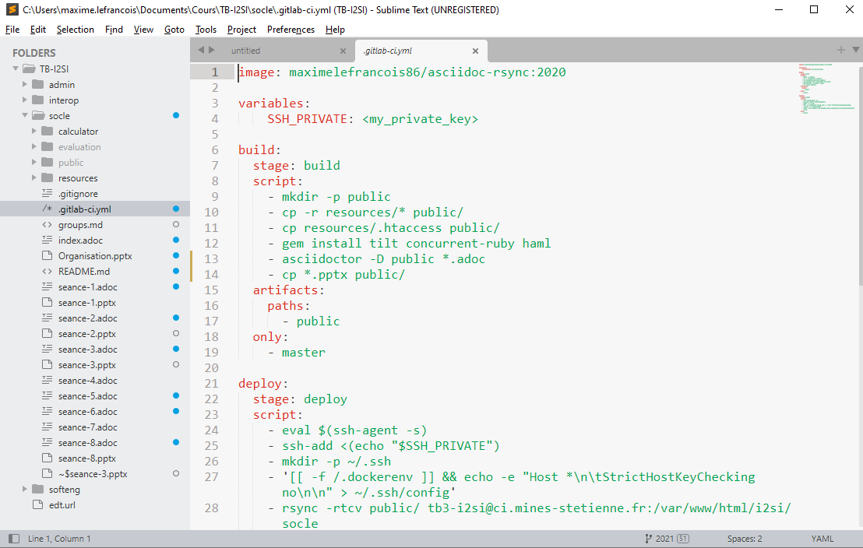
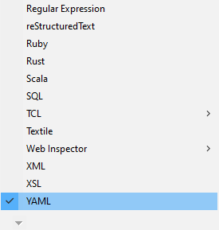

Static code analysis
Syntax checking
Semantic check
Linter
Quick fixes
Syntax highlighting with Sublime Text
Syntactic validation syntaxique with Eclipse
list of available grammars

Slide 42
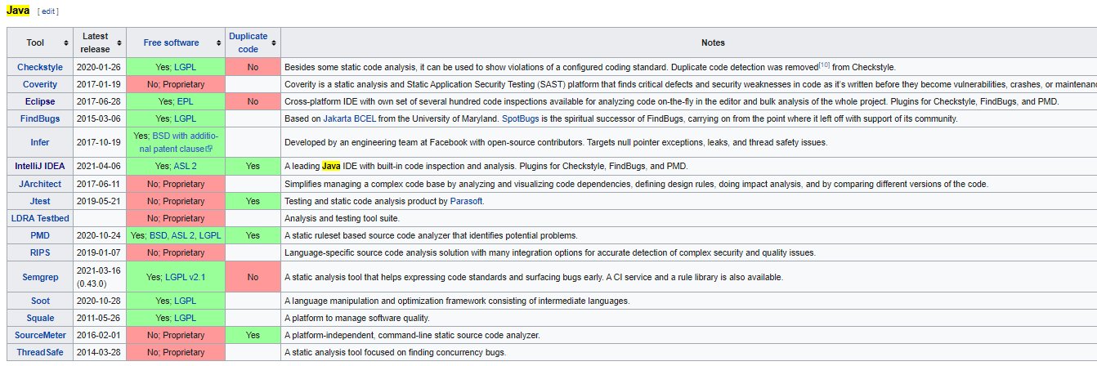
Static analysis tools
Example for Java
https://en.wikipedia.org/wiki/List_of_tools_for_static_code_analysis

Slide 43

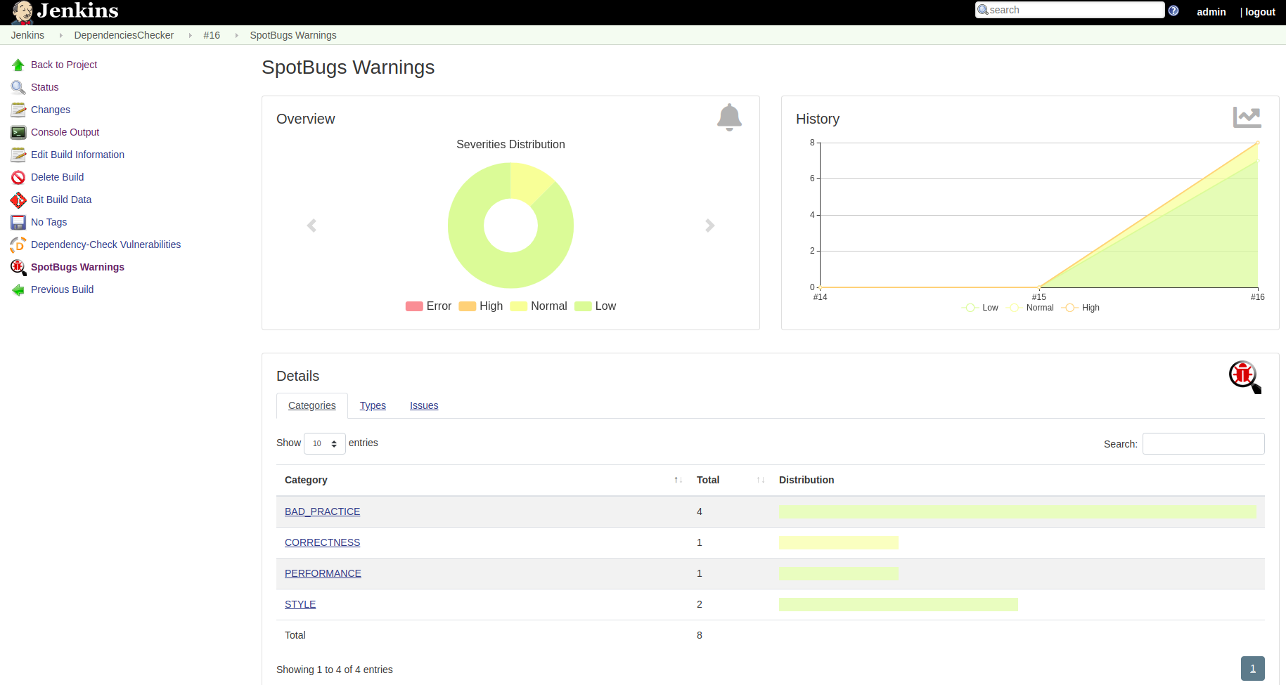
Static analysis tools - e.g.
https://mip-cloud.gitlab.io/post/2018/12/spotbugs/

Slide 44
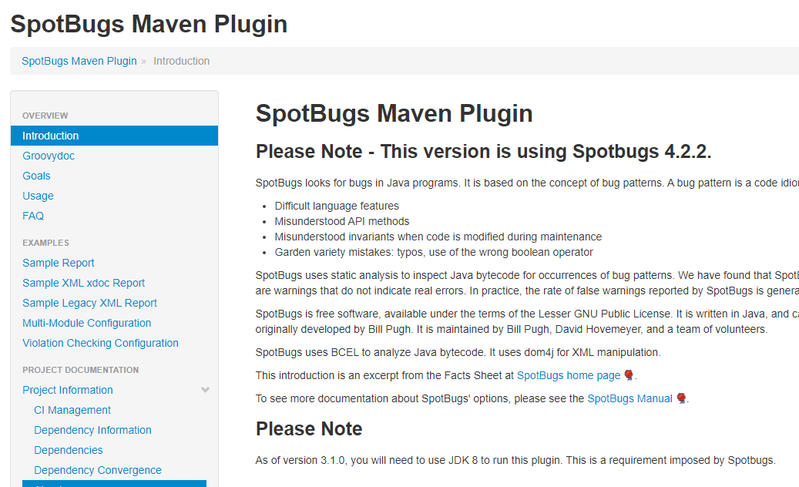
Static analysis tools - e.g.
https://spotbugs.github.io/spotbugs-maven-plugin/

Slide 45

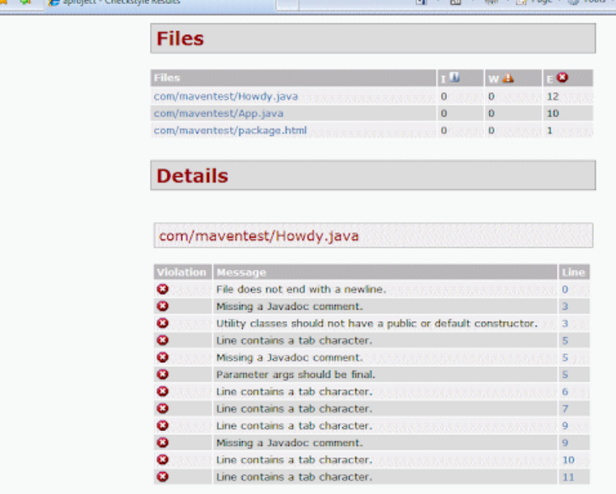
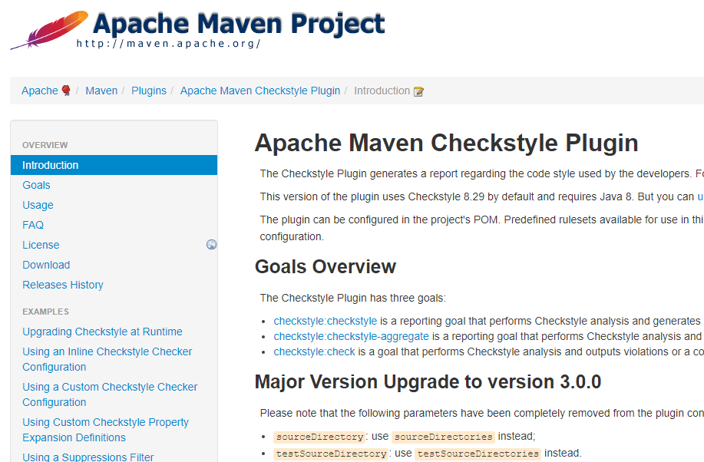
Static analysis tools - e.g.
https://checkstyle.sourceforge.io/

Slide 46
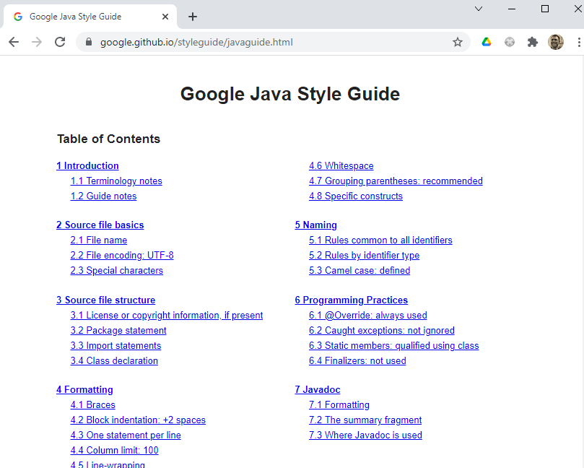
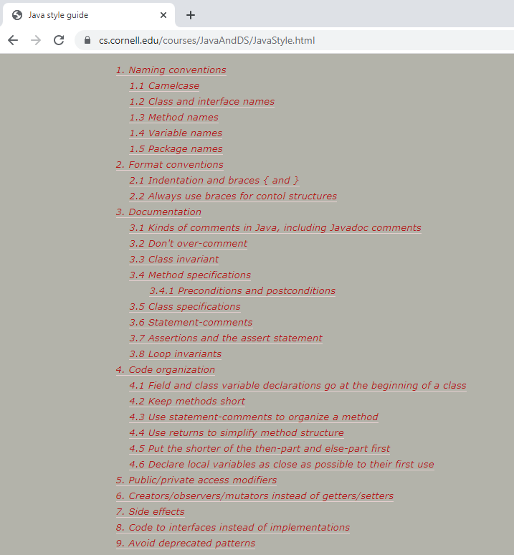
Develop with style !
"There are two ways of constructing a software design. One way is to make it so simple that there are obviously no deficiencies. The other way is to make it so complicated that there are no obvious deficiencies." - C.A.R. Hoare.

Slide 47
Technological foundations of software development
Debug, log, test, profile, analyze your software
Part 7: Integration in platforms
ICM – Computer Science Major – Course unit on Technological foundations of computer science
M1 Cyber Physical and Social Systems – Course unit on CPS2 engineering and development, Part 2: Technological foundations of software development
Maxime Lefrançois https://maxime-lefrancois.info
online: https://ci.mines-stetienne.fr/cps2/course/tfsd/

Slide 48

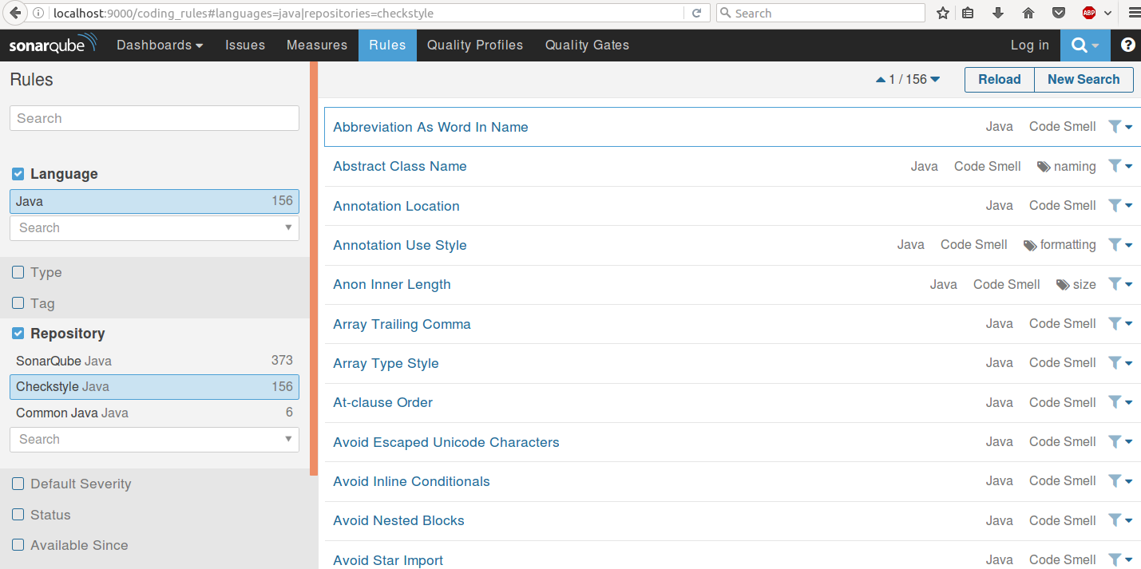
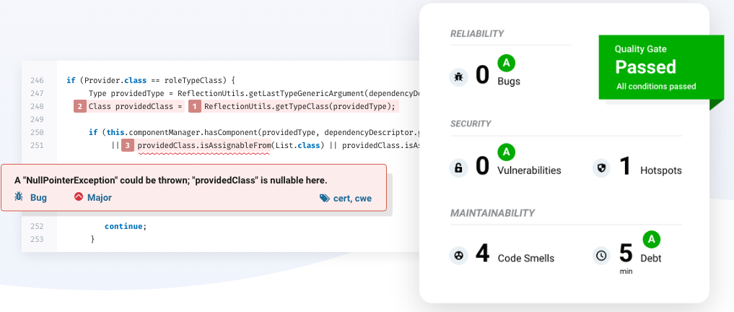
Code quality and security analysis platform
https://www.sonarqube.org/

Slide 49
Technological foundations of software development
Debug, log, test, profile, analyze your software
ICM – Computer Science Major – Course unit on Technological foundations of computer science
M1 Cyber Physical and Social Systems – Course unit on CPS2 engineering and development, Part 2: Technological foundations of software development
Maxime Lefrançois https://maxime-lefrancois.info
online: https://ci.mines-stetienne.fr/cps2/course/tfsd/

Slide 50
... Your turn
Complete the TODO section:
https://ci.mines-stetienne.fr/cps2/course/tfsd/course-5.html#_todos

