Slide 1
Technological foundations of software development
Document, license, publish, maintain your software
ICM – Computer Science Major – Course unit on Technological foundations of computer science
M1 Cyber Physical and Social Systems – Course unit on CPS2 engineering and development, Part 2: Technological foundations of software development
Maxime Lefrançois https://maxime-lefrancois.info
online: https://ci.mines-stetienne.fr/cps2/course/tfsd/

Slide 2
Objectives of the session
This session aims to familiarize you with the methods and tools for Document, license, publish, maintain your software.
In particular, we will cover tools for Java, Python, JavaScript.

Slide 3
Technological foundations of software development
Document, license, publish, maintain your software
Part 1: Documenting your code
ICM – Computer Science Major – Course unit on Technological foundations of computer science
M1 Cyber Physical and Social Systems – Course unit on CPS2 engineering and development, Part 2: Technological foundations of software development
Maxime Lefrançois https://maxime-lefrancois.info
online: https://ci.mines-stetienne.fr/cps2/course/tfsd/

Slide 4
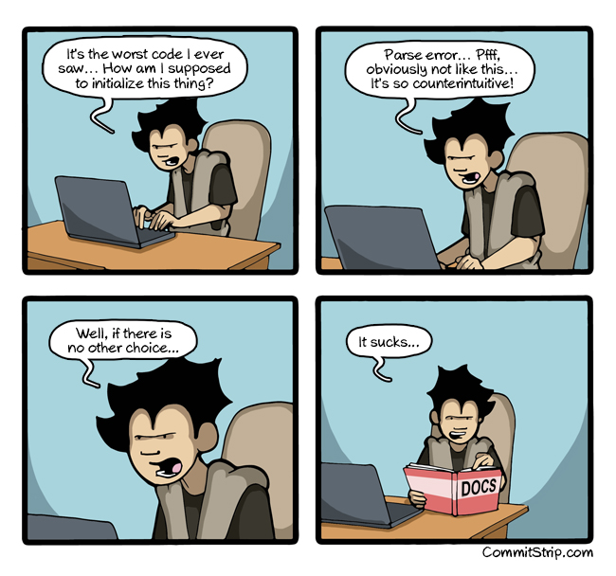
Documenting your code: Why ?
Explain how the program works
Explain how to use the program
https://en.wikipedia.org/wiki/Software_documentation
https://www.commitstrip.com/en/2015/06/29/as-the-last-resort/?

Slide 5
Types of documentation
Requirements - Statements that identify the attributes, capabilities, characteristics or qualities of a system. It is the basis for what will be or has been implemented.
Architecture/Design - An overview of the software. Includes the relationships with an environment and the construction principles to be used in the design of software components.
Technical - Documentation of code, algorithms, interfaces and APIs.
End User - Manuals for the end user, system administrators, and support staff.
Marketing - How to market the product and market demand analysis.

Slide 6
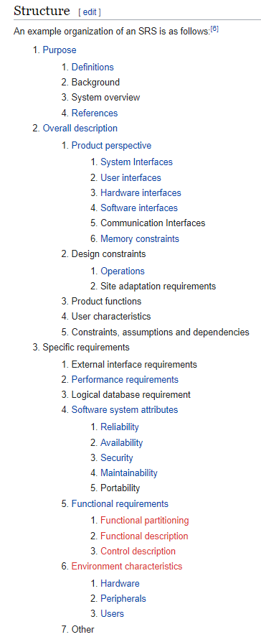
Requirements specification document
Slide from: Software Engineering, part 1.
specification (in software engineering)
“production of a document that can be systematically reviewed, evaluated, and approved”
software requirements specification (SRS)
“structured collection of the essential requirements [functions, performance, design constraints and attributes] of the software and its external interfaces”
— ISO/IEC TR 19759:2015 Software Engineering Body of Knowledge (SWEBOK)
— IEEE 1012-2016 - IEEE Standard for System, Software, and Hardware Verification and Validation
example organization of a SRS document
source: https://en.wikipedia.org/wiki/Software_requirements_specification
see also https://en.wikipedia.org/wiki/Software_requirements_specification

Slide 7
Architecture/design
Software architecture description
the set of practices for expressing, communicating and analysing software architectures (also called architectural rendering), and the result of applying such practices through a work product expressing a software architecture
— ISO/IEC/IEEE 42010 Systems and software engineering — Architecture description
existing languages such as the UML can be used as Architecture description languages for analysis, design, and implementation of software-based systems as well as for modeling business and similar processes.

Slide 8
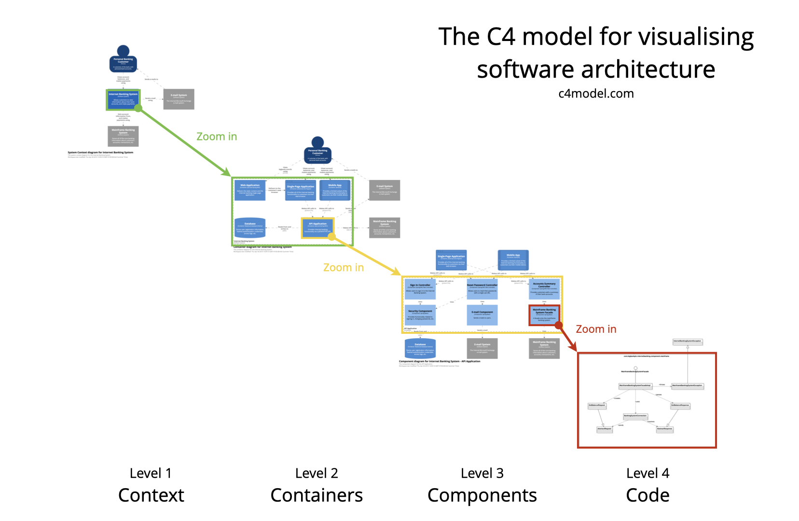
https://c4model.com/

Slide 9
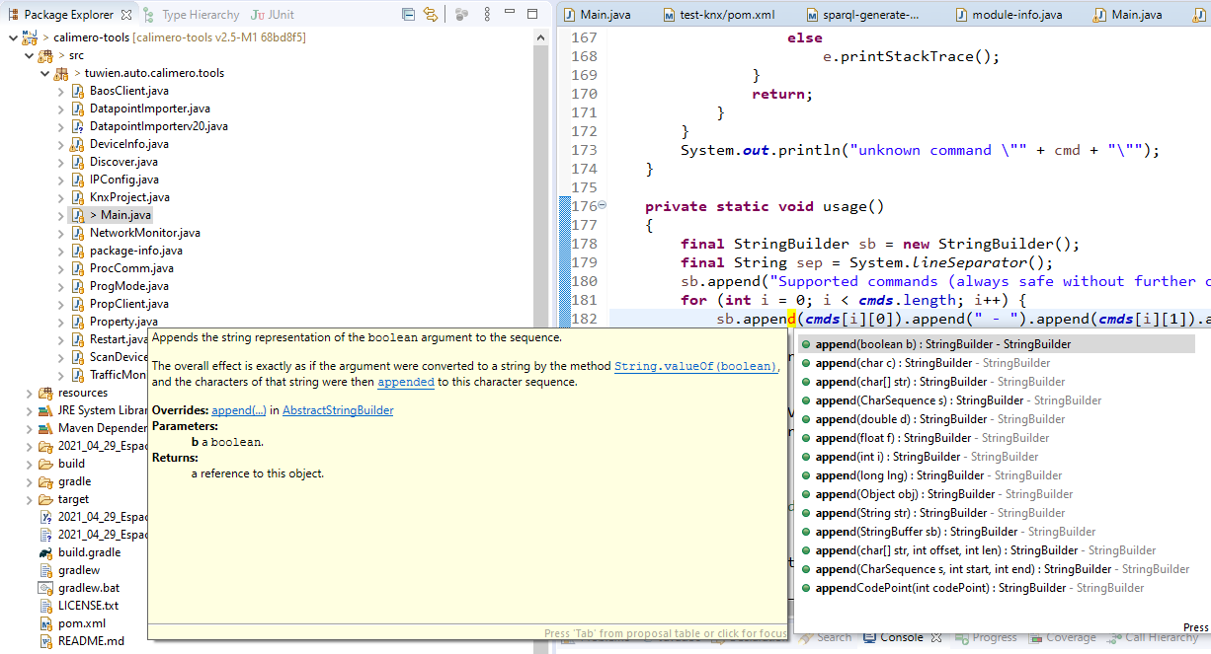
Technical documentation

Slide 10
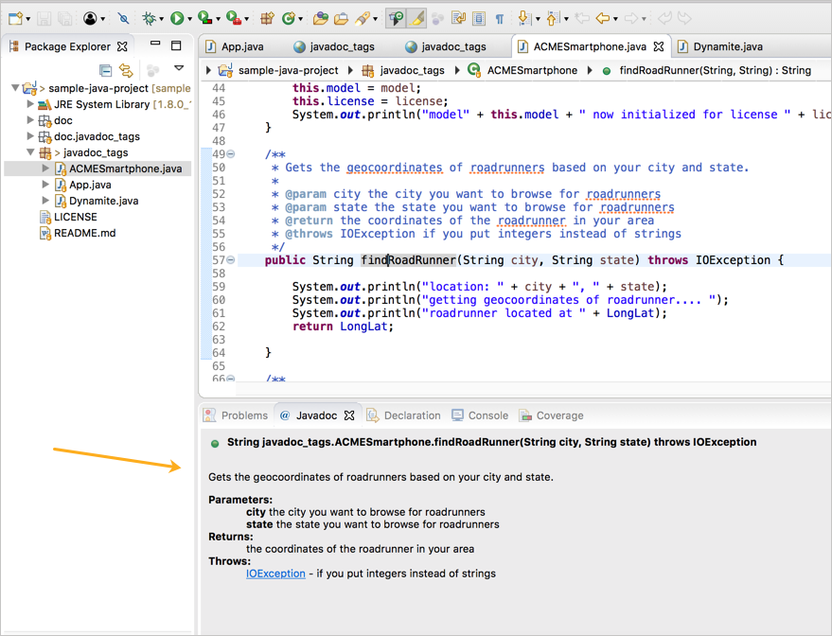

Technical documentation
https://www.oracle.com/java/technologies/javase/javadoc-tool.html

Slide 11
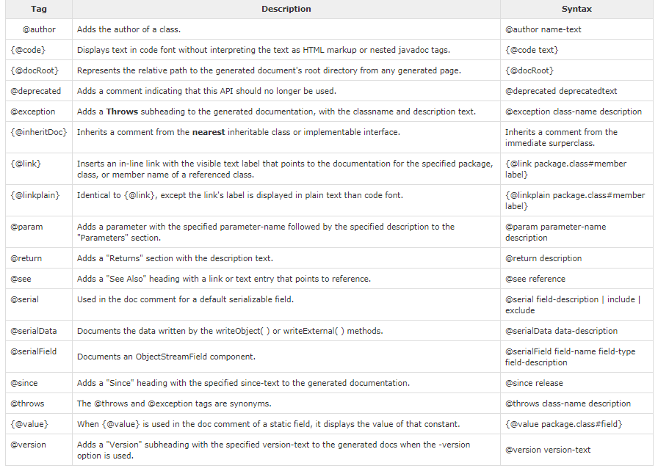

https://www.javaguides.net/2018/12/the-javadoc-tags-explained.html
https://www.oracle.com/java/technologies/javase/javadoc-tool.html

Slide 12
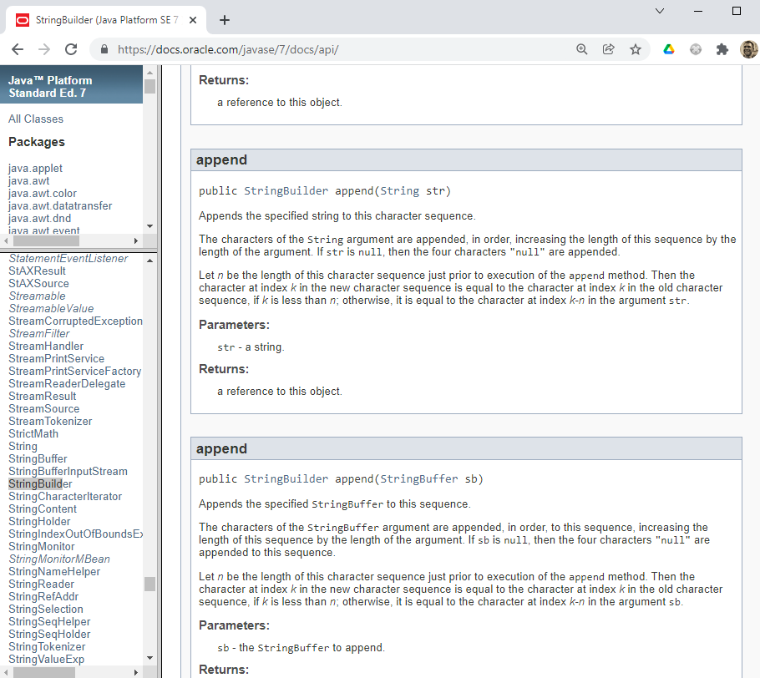
generate HTML pages
generate javadoc jars
https://www.javaguides.net/2018/12/the-javadoc-tags-explained.html
https://www.oracle.com/java/technologies/javase/javadoc-tool.html

Slide 13

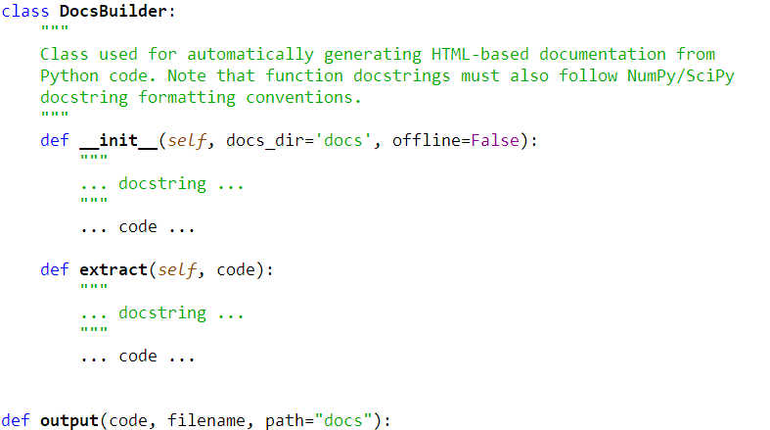
Python docstrings
https://devguide.python.org/documenting/

Slide 14
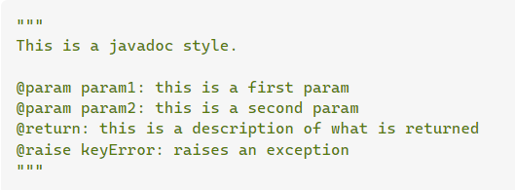
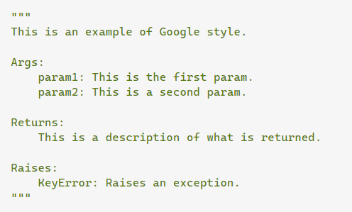
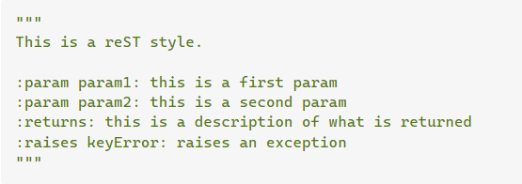
Python doc conventions
deprecated
Epytext
Google
recommended
reStructuredText -> used by Sphinx
https://devguide.python.org/documenting/

Slide 15

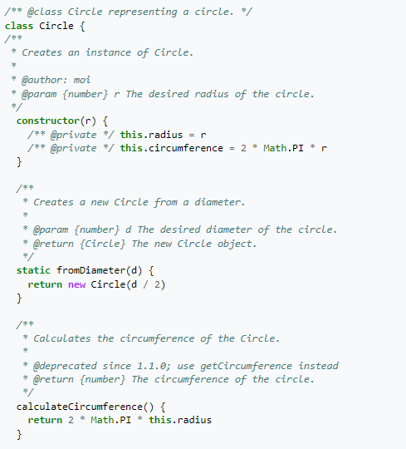
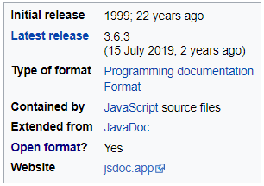
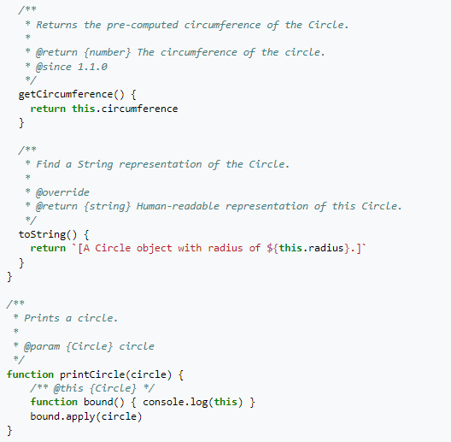
JavaScript documentation: JSDoc
https://en.wikipedia.org/wiki/JSDoc
https://jsdoc.app/

Slide 16
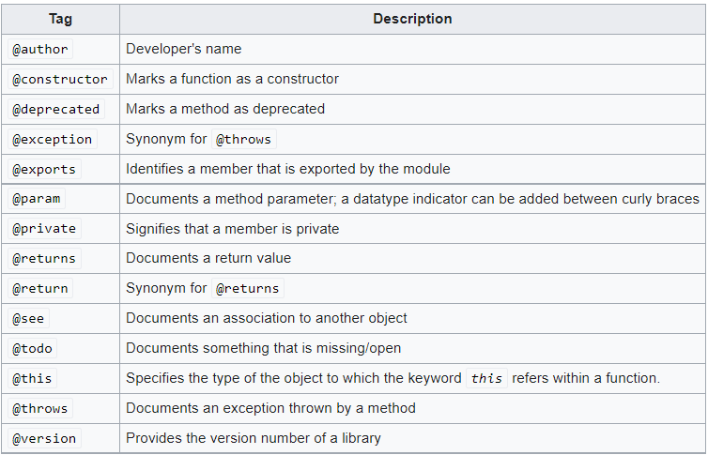
JavaScript documentation: JSDoc
https://en.wikipedia.org/wiki/JSDoc
https://jsdoc.app/

Slide 17
Self-documenting code
Make source code easier to read and understand
Minimize the effort required to maintain or extend legacy systems
Reduce the need for users and developers of a system to consult secondary documentation sources such as code comments or software manuals
Facilitate automation through self-contained knowledge representation

Slide 18
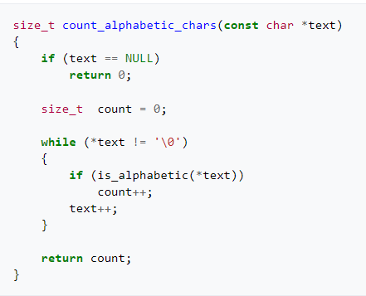
Self-documenting code
Make source code easier to read and understand
Minimize the effort required to maintain or extend legacy systems
Reduce the need for users and developers of a system to consult secondary documentation sources such as code comments or software manuals
Facilitate automation through self-contained knowledge representation

Slide 19
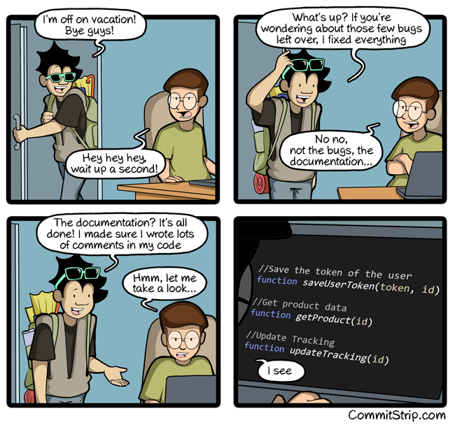
Self-documenting code
Make source code easier to read and understand
Minimize the effort required to maintain or extend legacy systems
Reduce the need for users and developers of a system to consult secondary documentation sources such as code comments or software manuals
Facilitate automation through self-contained knowledge representation
https://www.commitstrip.com/en/2016/07/27/documentation-just-before-vacation/

Slide 20
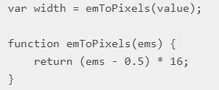
Self-documenting code
1. Move code to function
https://multi-programming.com/blog/self-documenting-code

Slide 21


Self-documenting code
2. Expression is replaced with a variable
https://multi-programming.com/blog/self-documenting-code

Slide 22
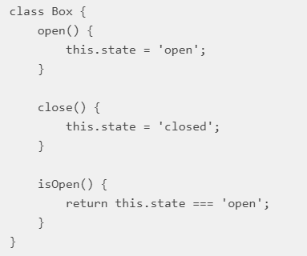
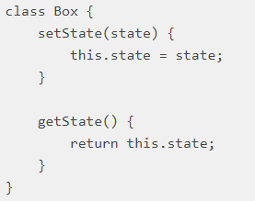
Self-documenting code
3. Class and module interfaces
https://multi-programming.com/blog/self-documenting-code

Slide 23
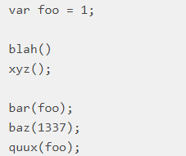
Self-documenting code
4. Group your code
https://multi-programming.com/blog/self-documenting-code

Slide 24
Self-documenting code
5. Give another name to the function
Omit to use obscure words:
Use active verbs like ”send”:
https://multi-programming.com/blog/self-documenting-code

Slide 25
Self-documenting code
6. Give other names to variables
Do not use silly variable names
a, b, c, variable1, other, …
7. Follow the same naming conventions
https://multi-programming.com/blog/self-documenting-code

Slide 26


Self-documenting code
8. Avoid utilizing syntax tricks
https://multi-programming.com/blog/self-documenting-code

Slide 27

Self-documenting code
9. Use named constants
const BUY_HAPPINESS = 42;
10. Omit boolean flags
https://multi-programming.com/blog/self-documenting-code

Slide 28
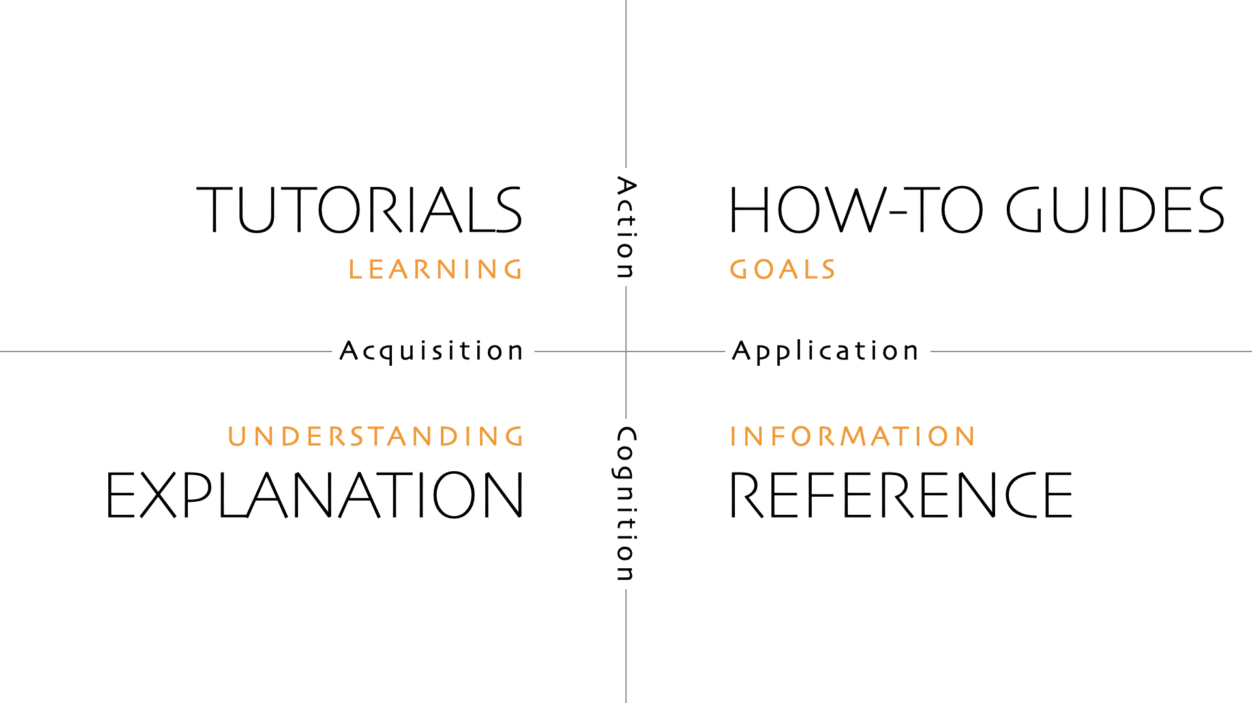
Documentation for the end user Diátaxis A systematic approach to technical documentation authoring.
https://diataxis.fr/

Slide 29
Documentation for the end user Diátaxis A systematic approach to technical documentation authoring.
Describes how the program is installed and used
Tutorials: A tutorial is an experience that takes place under the guidance of a tutor. A tutorial is always learning-oriented.
How-to guides: How-to guides are directions that guide the reader through a problem or towards a result. How-to guides are goal-oriented.
References: Reference guides are technical descriptions of the machinery and how to operate it. Reference material is information-oriented.
Explanations: Explanation is a discursive treatment of a subject, that permits reflection. Explanation is understanding-oriented.

Slide 30
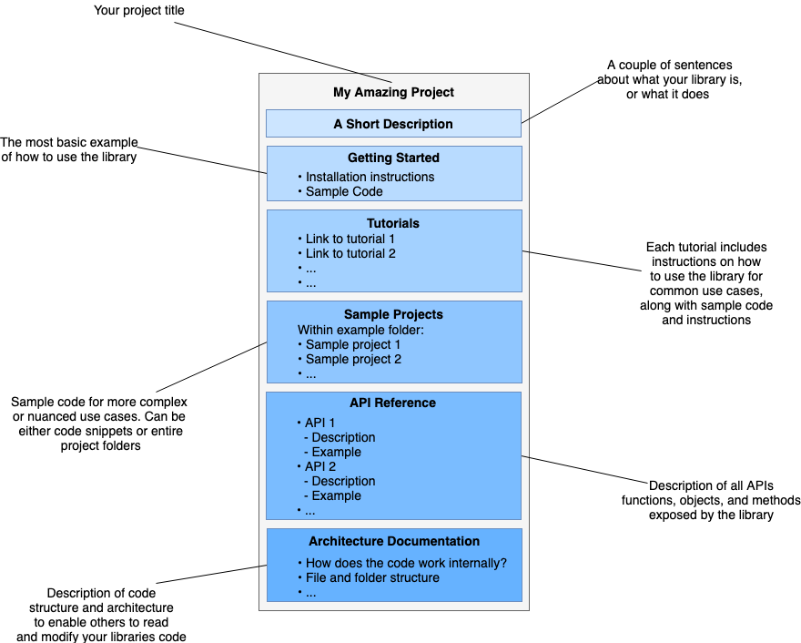
To summarize
https://www.sohamkamani.com/blog/how-to-write-good-documentation/

Slide 31
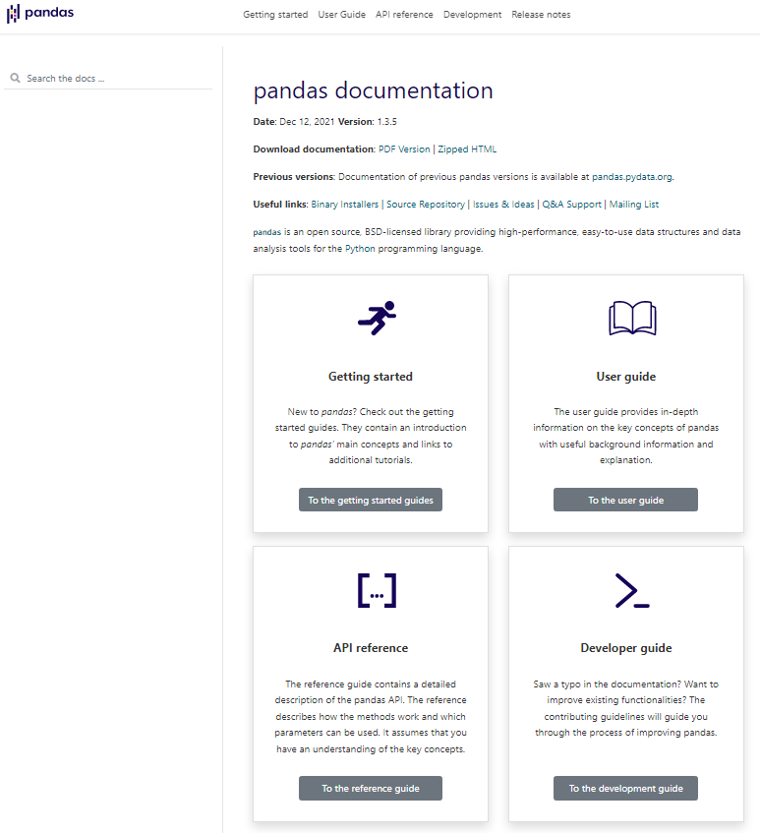
Case study 1
https://pandas.pydata.org/docs/

Slide 32
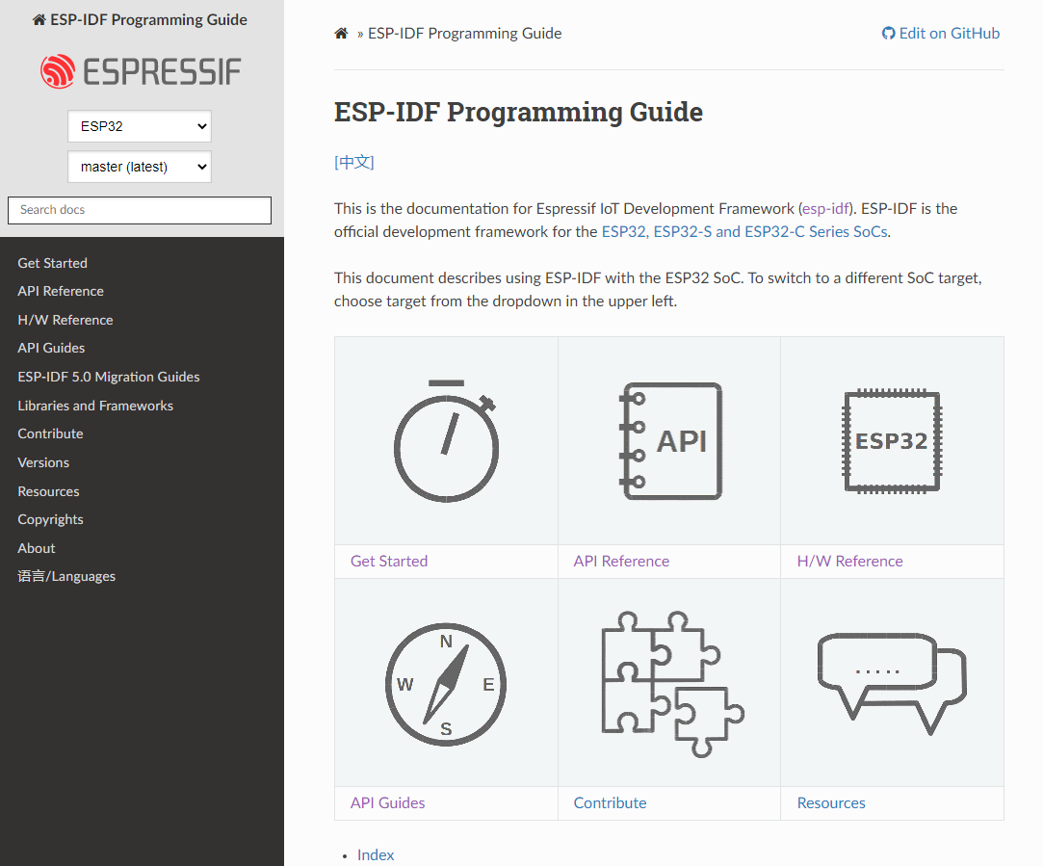
Case study 2
https://docs.espressif.com/projects/esp-idf/

Slide 33
The README file
A description of what the project is for.
What is this repo or project? (You can reuse the repo description you used earlier because this section doesn’t have to be long.)
How does it work?
Who will use this repo or project?
What is the goal of this project?
Instructions for how to develop, use, and test the code.
Instructions for how people can help.
List the licensing information for your project.
List the contact information for your team as well as where to ask questions.
see https://github.com/18F/open-source-guide/blob/18f-pages/pages/making-readmes-readable.md

Slide 34
To read for MCQ test
The Diátaxis systematic approach to creating better documentation:
Tutorials
How-to guides
Reference
Explanation

Slide 35
Technological foundations of software development
Document, license, publish, maintain your software
Part 2: Software licenses
ICM – Computer Science Major – Course unit on Technological foundations of computer science
M1 Cyber Physical and Social Systems – Course unit on CPS2 engineering and development, Part 2: Technological foundations of software development
Maxime Lefrançois https://maxime-lefrancois.info
online: https://ci.mines-stetienne.fr/cps2/course/tfsd/

Slide 36
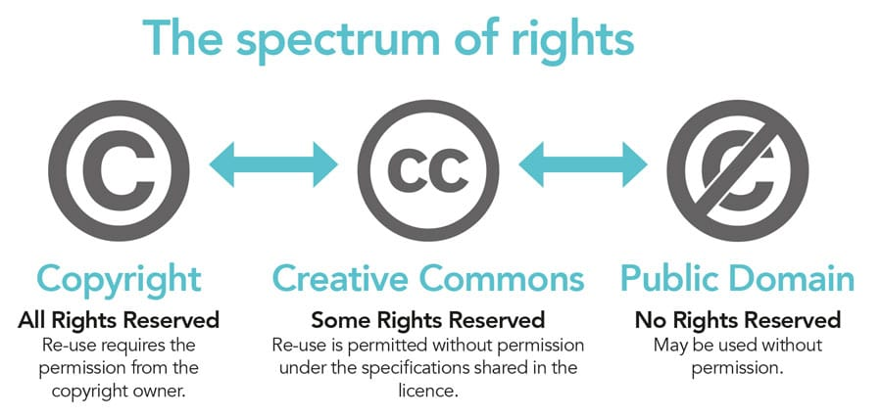
Creative Commons
Set of licenses for published works
https://researchoutreach.org/articles/thought-leaders/license-to-share-how-the-creative-commons-licensing-system-encourages-the-remixing-and-reuse-of-published-materials/

Slide 37
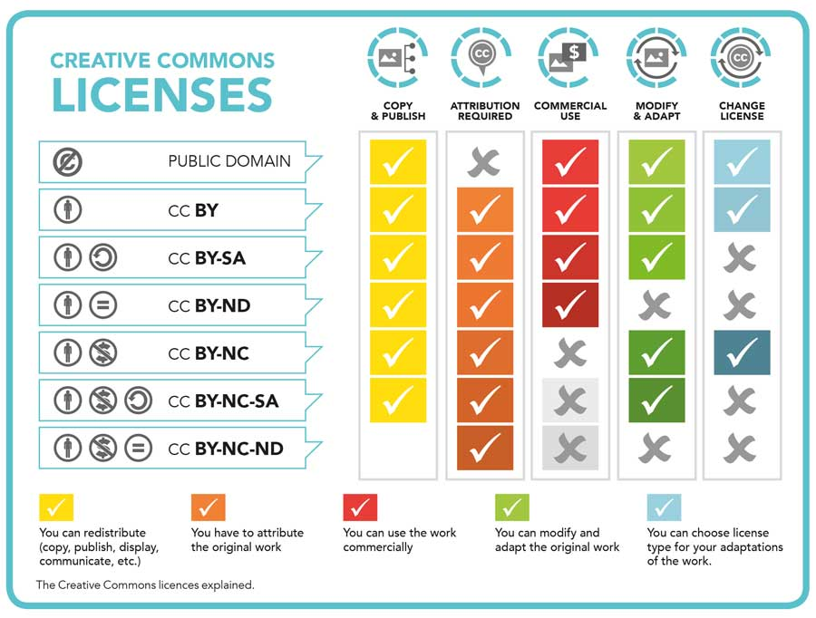
https://researchoutreach.org/articles/thought-leaders/license-to-share-how-the-creative-commons-licensing-system-encourages-the-remixing-and-reuse-of-published-materials/

Slide 38
Software license
Contract by which the owner of the copyright on a computer program defines with his co-contractor (operator or user) the conditions under which this program can be used, distributed or modified.

Slide 39
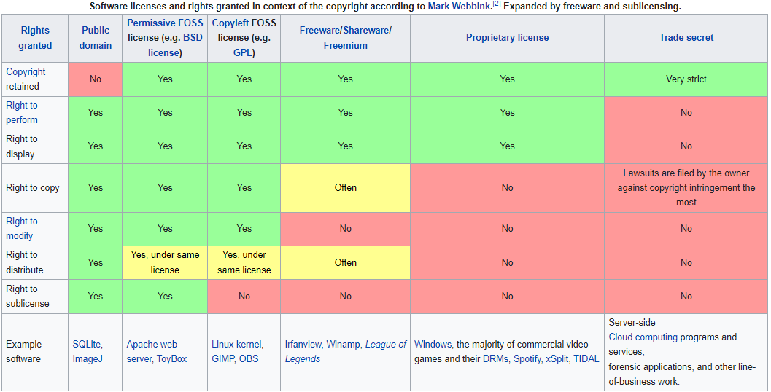
Software license

Slide 40
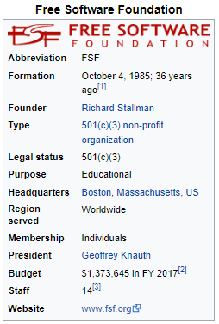
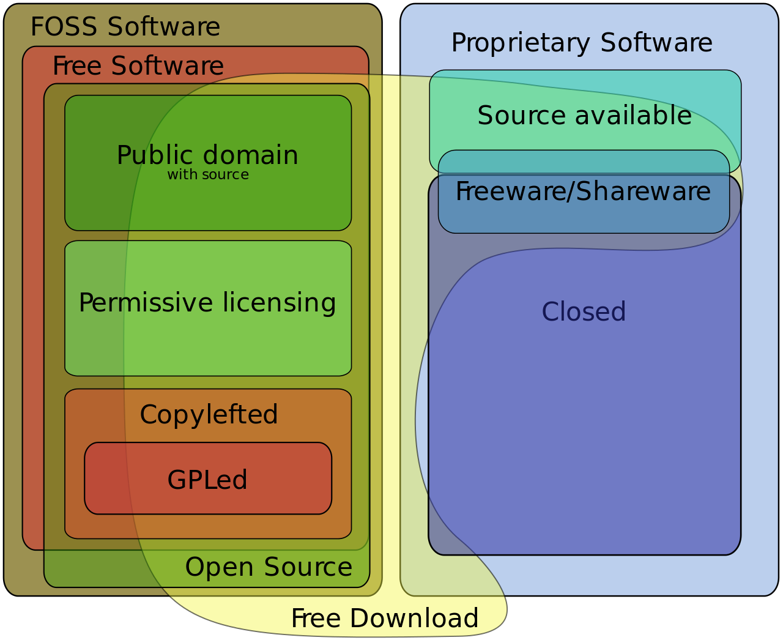
Free software foundation
(GNU project)

Slide 41

Open Source licenses
Open source licenses are licenses that comply with the Open Source Definition https://opensource.org/osd
— in brief, they allow software to be freely used, modified, and shared.
Apache License 2.0
BSD 3-Clause "New" or "Revised" license
BSD 2-Clause "Simplified" or "FreeBSD" license
GNU General Public License (GPL)
GNU Library or "Lesser" General Public License (LGPL)
MIT license
Mozilla Public License 2.0
Common Development and Distribution License
Eclipse Public License version 2.0
...

Slide 42
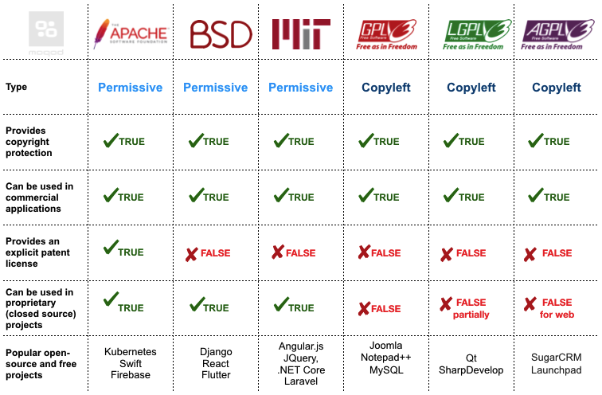
FOSS Licenses (free and open-source software)
https://moqod-software.medium.com/understanding-open-source-and-free-software-licensing-c0fa600106c9

Slide 43
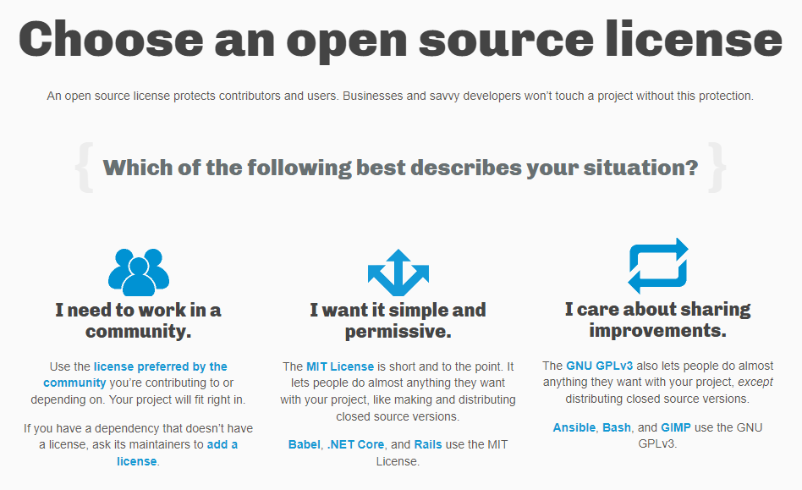
Licensing a repository
https://choosealicense.com/

Slide 44
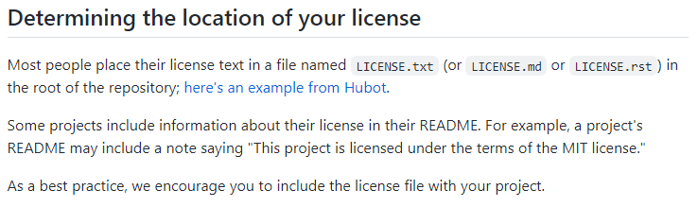
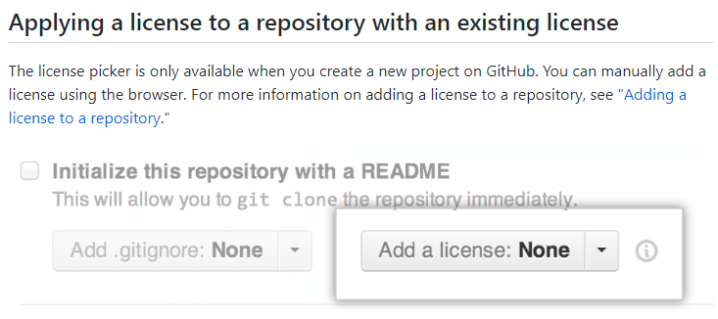
Display the license in your Git repository
https://docs.github.com/en/repositories/managing-your-repositorys-settings-and-features/customizing-your-repository/licensing-a-repository

Slide 45
Technological foundations of software development
Document, license, publish, maintain your software
Part 3: Publish your software
ICM – Computer Science Major – Course unit on Technological foundations of computer science
M1 Cyber Physical and Social Systems – Course unit on CPS2 engineering and development, Part 2: Technological foundations of software development
Maxime Lefrançois https://maxime-lefrancois.info
online: https://ci.mines-stetienne.fr/cps2/course/tfsd/

Slide 46
Publish your software
Software publishing is a term that describes the overall process of designing and distributing a software package or collection of software packages.
https://www.computerhope.com/jargon/s/softpubl.htm

Slide 47
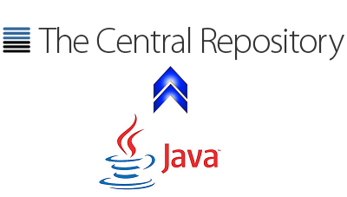
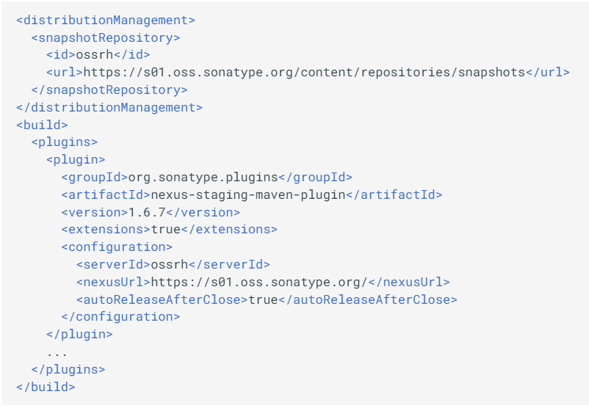
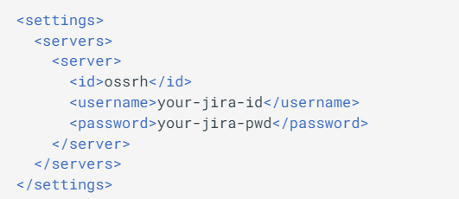
Package repositories
Guide to start publishing your code: https://central.sonatype.org/publish/publish-guide/
sign up
generate artifacts: binaries, source, javadoc
sign your artifacts (GPG)
publish : > mvn clean deploy nexus-staging:release
example with Maven: in the pom.xml
example with Maven: in the ~/.m2/settings.xml

Slide 48
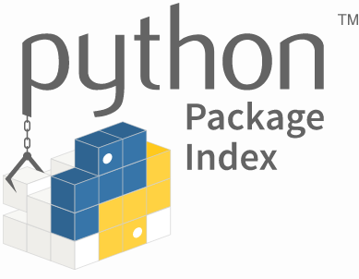
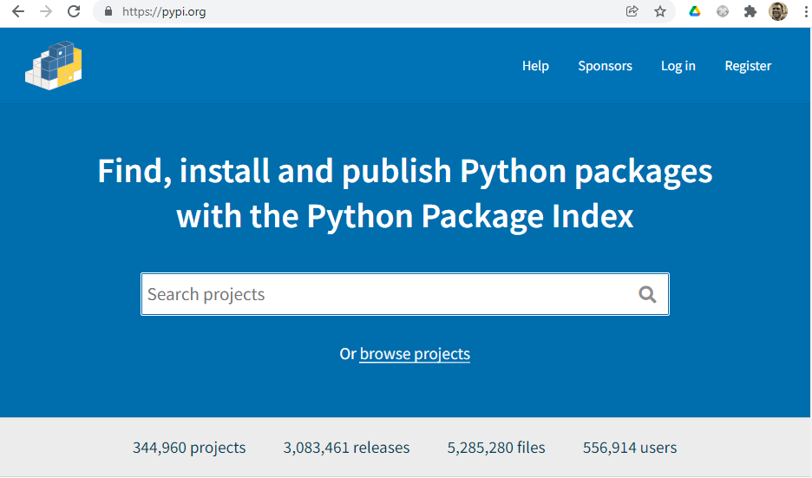
Package repositories
Guide to start publishing your code: https://packaging.python.org/en/latest/tutorials/packaging-projects/

Slide 49
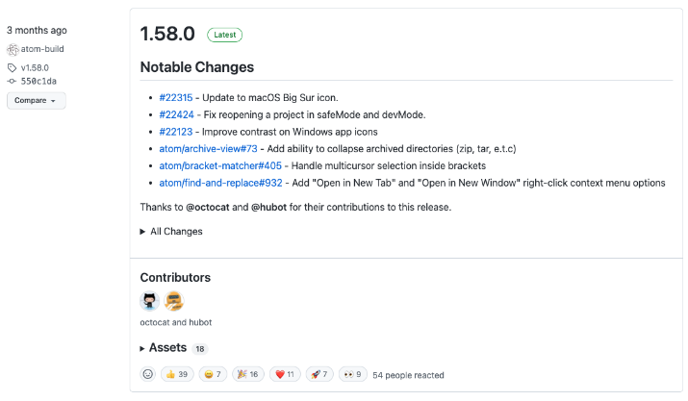
Publish on github/gitlab
https://docs.github.com/en/repositories/releasing-projects-on-github/managing-releases-in-a-repository

Slide 50
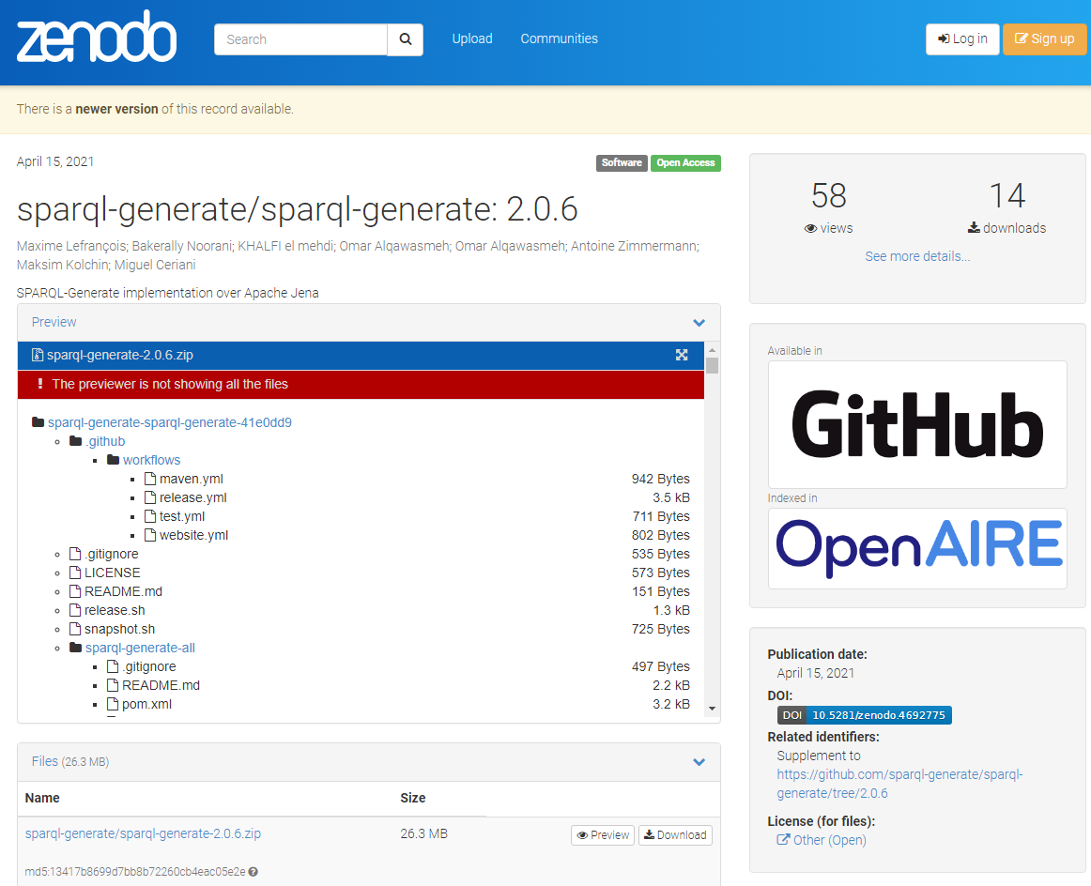
Researchers: get a DOI with Zenodo
Digital Object Identifiers (DOIs)
For academics, you can now publish your software (or data) and obtain a permanent identifier so that it can be cited in scientific publications
https://docs.github.com/en/repositories/archiving-a-github-repository/referencing-and-citing-content

Slide 51
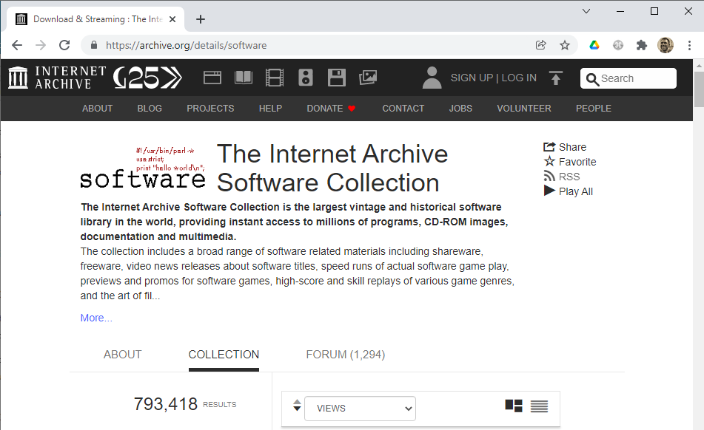
Software archives

Slide 52
Technological foundations of software development
Document, license, publish, maintain your software
Part 4: Maintaining your software
ICM – Computer Science Major – Course unit on Technological foundations of computer science
M1 Cyber Physical and Social Systems – Course unit on CPS2 engineering and development, Part 2: Technological foundations of software development
Maxime Lefrançois https://maxime-lefrancois.info
online: https://ci.mines-stetienne.fr/cps2/course/tfsd/

Slide 53
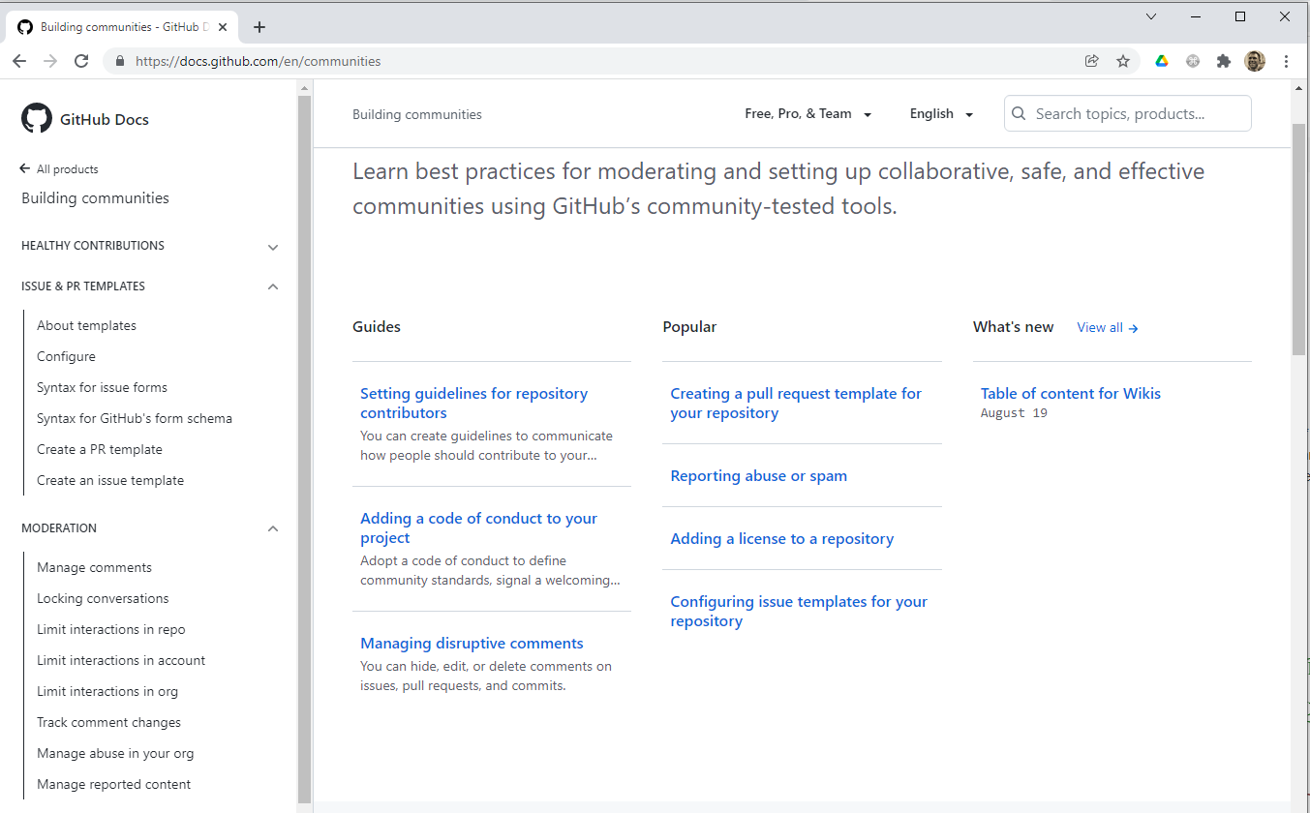
Maintain your software and get the most out of your users

Slide 54
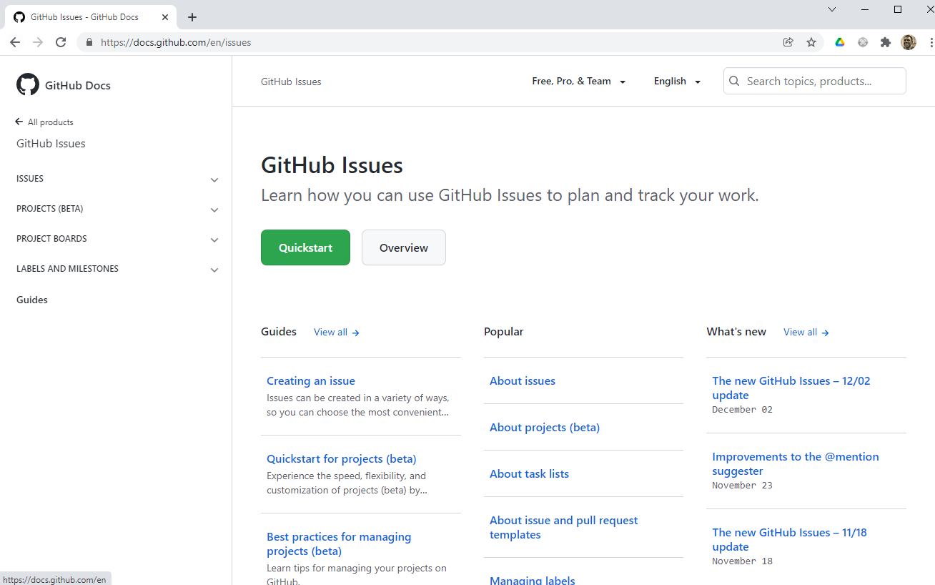
Issues
Branches
Milestones
Project boards
...

Slide 55
Technological foundations of software development
Document, license, publish, maintain your software
ICM – Computer Science Major – Course unit on Technological foundations of computer science
M1 Cyber Physical and Social Systems – Course unit on CPS2 engineering and development, Part 2: Technological foundations of software development
Maxime Lefrançois https://maxime-lefrancois.info
online: https://ci.mines-stetienne.fr/cps2/course/tfsd/

Slide 56
... Your turn
Complete the TODO section:
https://ci.mines-stetienne.fr/cps2/course/tfsd/course-6.html#_todos

