Slide 1
Technological foundations of software development
Run your software anywhere with Docker
ICM – Computer Science Major – Course unit on Technological foundations of computer science
M1 Cyber Physical and Social Systems – Course unit on CPS2 engineering and development, Part 2: Technological foundations of software development
Maxime Lefrançois https://maxime-lefrancois.info
online: https://ci.mines-stetienne.fr/cps2/course/tfsd/

Slide 2
Objectives of the session
This session aims to familiarize you with Docker: an open source software that can package an application and its dependencies into an isolated container, which can be run on any server

Slide 3
Technological foundations of software development
Run your software anywhere with Docker
Part 1: Virtualization and Containerization
ICM – Computer Science Major – Course unit on Technological foundations of computer science
M1 Cyber Physical and Social Systems – Course unit on CPS2 engineering and development, Part 2: Technological foundations of software development
Maxime Lefrançois https://maxime-lefrancois.info
online: https://ci.mines-stetienne.fr/cps2/course/tfsd/

Slide 4
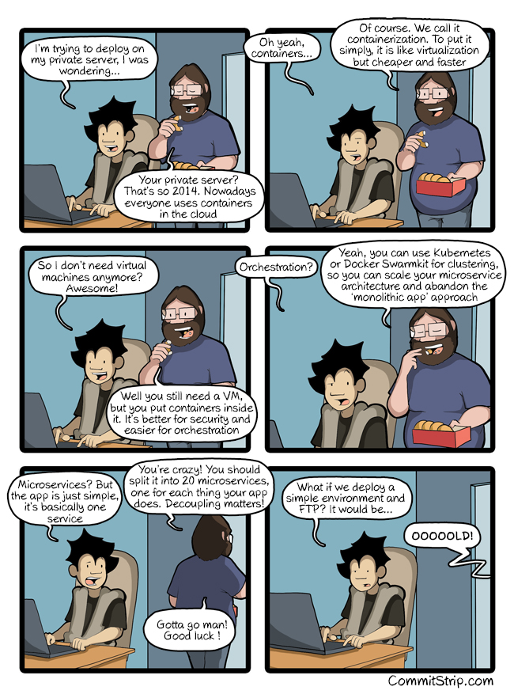
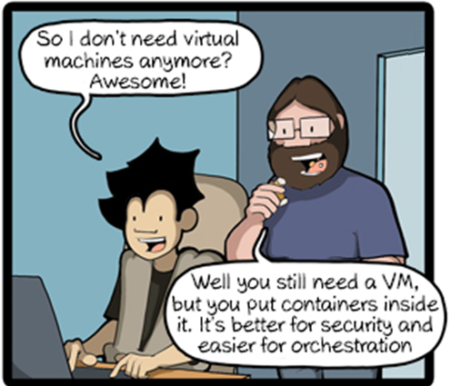
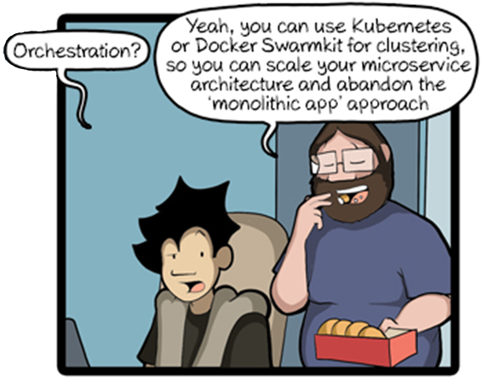
https://www.commitstrip.com/en/2016/12/10/a-server-thats-so-2014/?

Slide 5
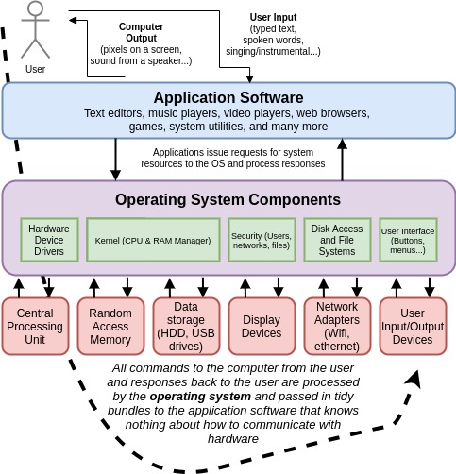
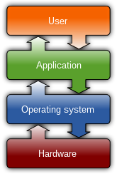
Operating system
https://en.wikipedia.org/wiki/Operating_system
Operating systems connect applications (programs) with system hardware resources, such as disk drives, networks, and user input/output components.
Because all applications rely on the operating system, it is often called the "platform".
ex: Linux, Windows, OSX.

Slide 6
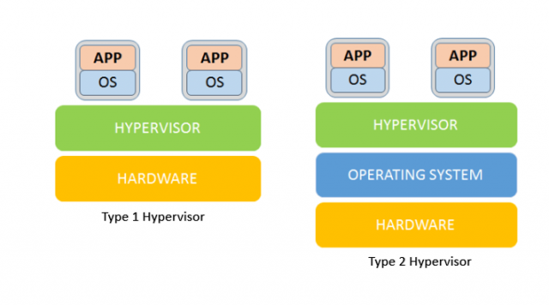
Virtualization (started ~1960s)
A Hypervisor, or virtual machine monitor is a software that creates and runs virtual machines (VM)
It allocates resources (CPU, memory, storage) from the host machine to the guest machines
Type 1 hypervisors
“native or bare-metal hypervisors”
Ex: KVM, Microsoft Hyper-V, VMware vSphere
Type 2 hypervisors
“hosted hypervisors”
Ex: VMware Workstation, Oracle VirtualBox

Slide 7
Virtualization
Pros:
Less physical hardware: one machine for many OS
Central location to manage all asset
More eco-friendly: avoid idle machines
Secure isolation: isolating applications so that an ill-behaved application can’t compromise other applications or its host.
Persistent compatibility: allowing host and application to evolve separately. Changes in the host don’t break applications.
Execution continuity: A running application isn’t tied to the computer on which it was started, but can be moved from computer to computer across space and time within a single run. (VMotion)
Cons:
Resource overheads in terms of disk footprint, memory, CPU
Administrative costs
Single point of physical failure

Slide 8
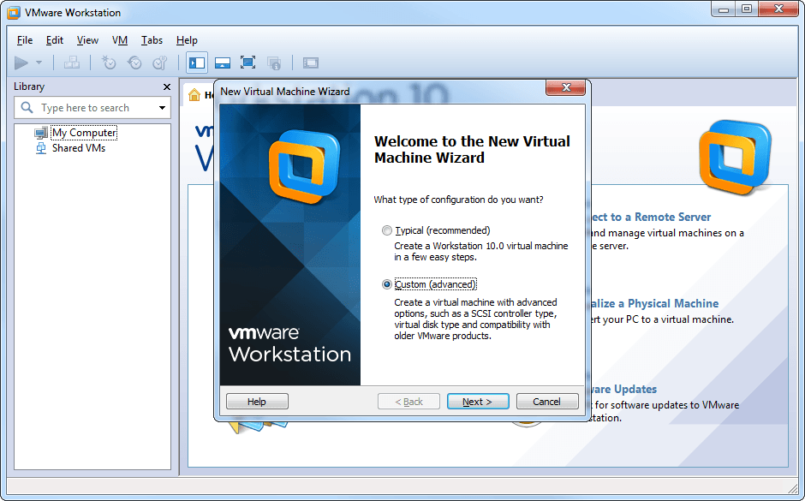
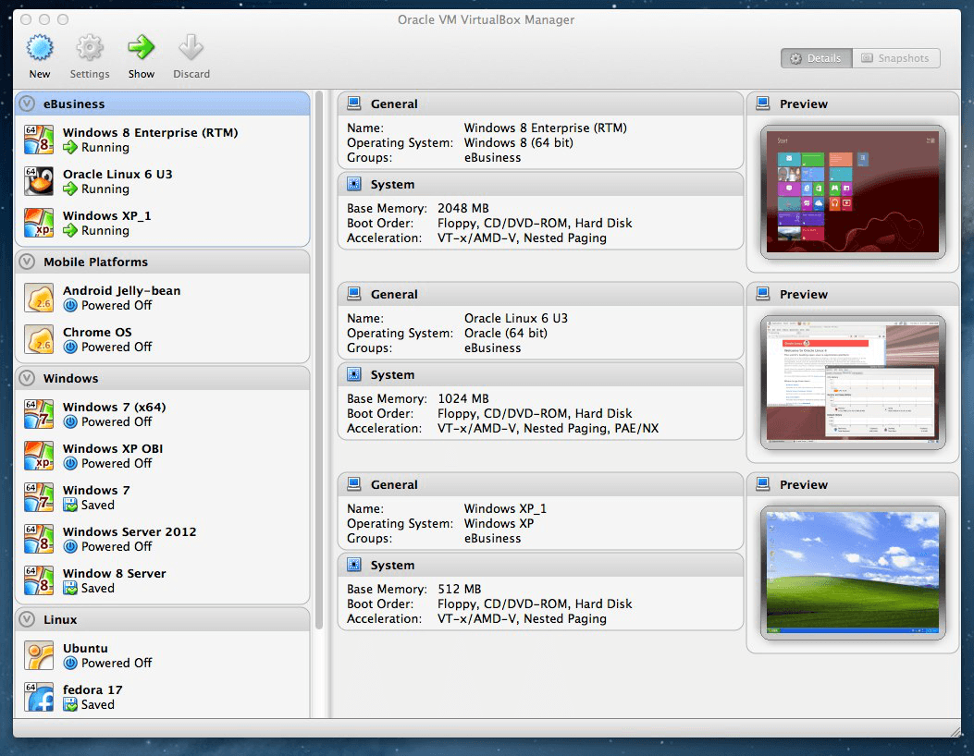
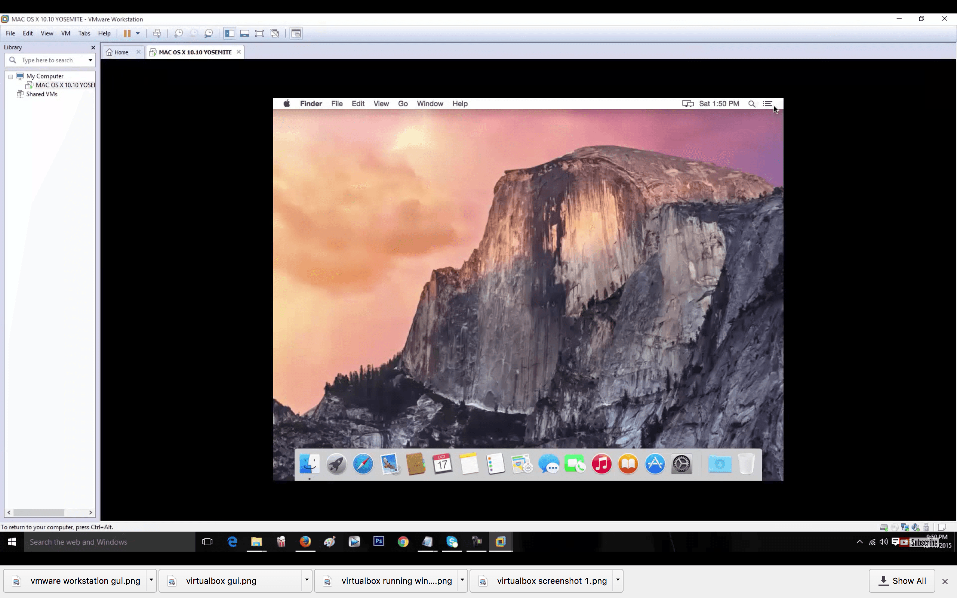
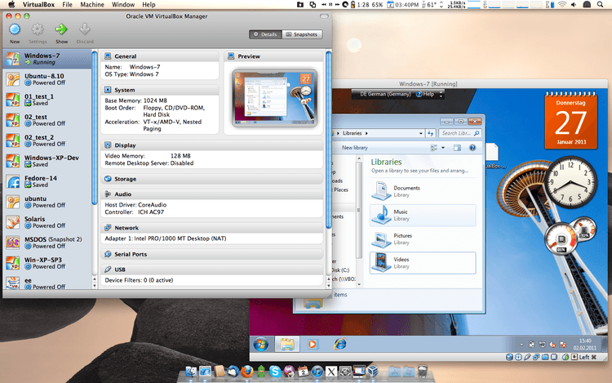
Type 2 hypervisors
VMWare VM manager
VirtualBox VM manager
VMware Workstation running Mac OS X on a Windows 10 computer.
VirtualBox running Windows 7 on a Mac OS X computer.

Slide 9
Type 2 hypervisors:
VirtualBox Vs. VMware: Comparison Table
Comparison | VirtualBox | VMware
Software Virtualization | Yes | No
Hardware Virtualization | Yes | Yes
Host Operating Systems | Linux, Windows, Solaris, macOS, FreeBSD | Linux, Windows + macOS (requires VMware Fusion)
Guest Operating Systems | Linux, Windows, Solaris, macOS, FreeBSD | Linux, Windows, Solaris, FreeBSD + macOS (with VMware Fusion)
User Interface | Graphical User Interface (GLI) and Command Line Interface (CLI) | Graphical User Interface (GLI) and Command Line Interface (CLI)
Snapshots | Yes | Snapshots only supported on paid virtualization products, not on VMware Workstation Player
Virtual Disk Format | VDI, VMDK, VHD, HDD | VMDK
Virtual Disk Allocation Type | Preallocated: fixed disks; Dynamically allocated: dynamically allocated disks; | Preallocated: provisioned disks; Dynamically allocated: thin provisioned disks;
Virtual Network Models | Not attached, NAT, NAT Network, Bridged adapter, Internal network, Host-only adapter, Generic (UDP, VDE) | NAT, Bridged, Host-only + Virtual network editor (on VMware workstation and Fusion Pro)
USB Devices Support | USB 2.0/3.0 support requires the Extension Pack (free) | Out of the box USB device support
3D Graphics | Up to OpenGL 3.0 and Direct3D 9; Max of 128 MB of video memory; 3D acceleration enabled manually | Up to OpenGL 3.3, DirectX 10; Max of 2GB of video memory; 3D acceleration enabled by default
Integrations | VMDK, Microsoft’s VHD, HDD, QED, Vagrant, Docker | Requires additional conversion utility for more VM types; VMware VSphere and Cloud Air (on VMware Workstation)
VirtualBox Guest Additions vs. VMware Tools | Installed with the VBoxGuestAdditions.iso file | Install with a .iso file used for the given VM (linux.iso, windows.iso, etc.)
API for Developers | API and SDK | Different APIs and SDKs
Cost and Licenses | Free, under the GNU General Public License | VMware Workstation Player is free, while other VMware products require a paid license
https://phoenixnap.com/kb/virtualbox-vs-vmware , Feb 2021

Slide 10
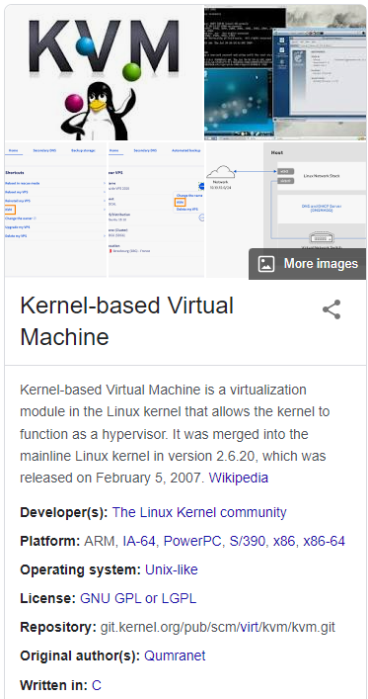
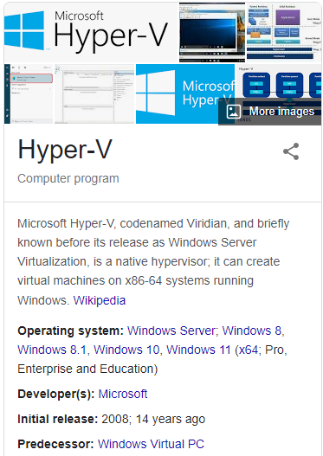
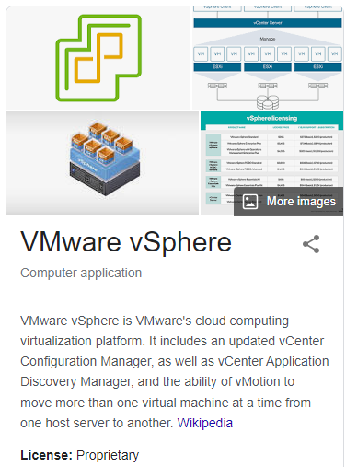
Type 1 hypervisors
+ other

Slide 11
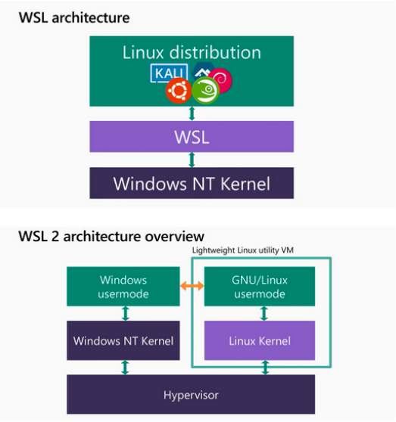
Ex: Windows Subsystem for Linux
Type 1 ? Type 2 ?

Slide 12
Ex: Windows Subsystem for Linux
Type 2:
uses « picoprocess » hypervisors
Type 1:
uses Microsoft Hyper-V hypervisor

Slide 13
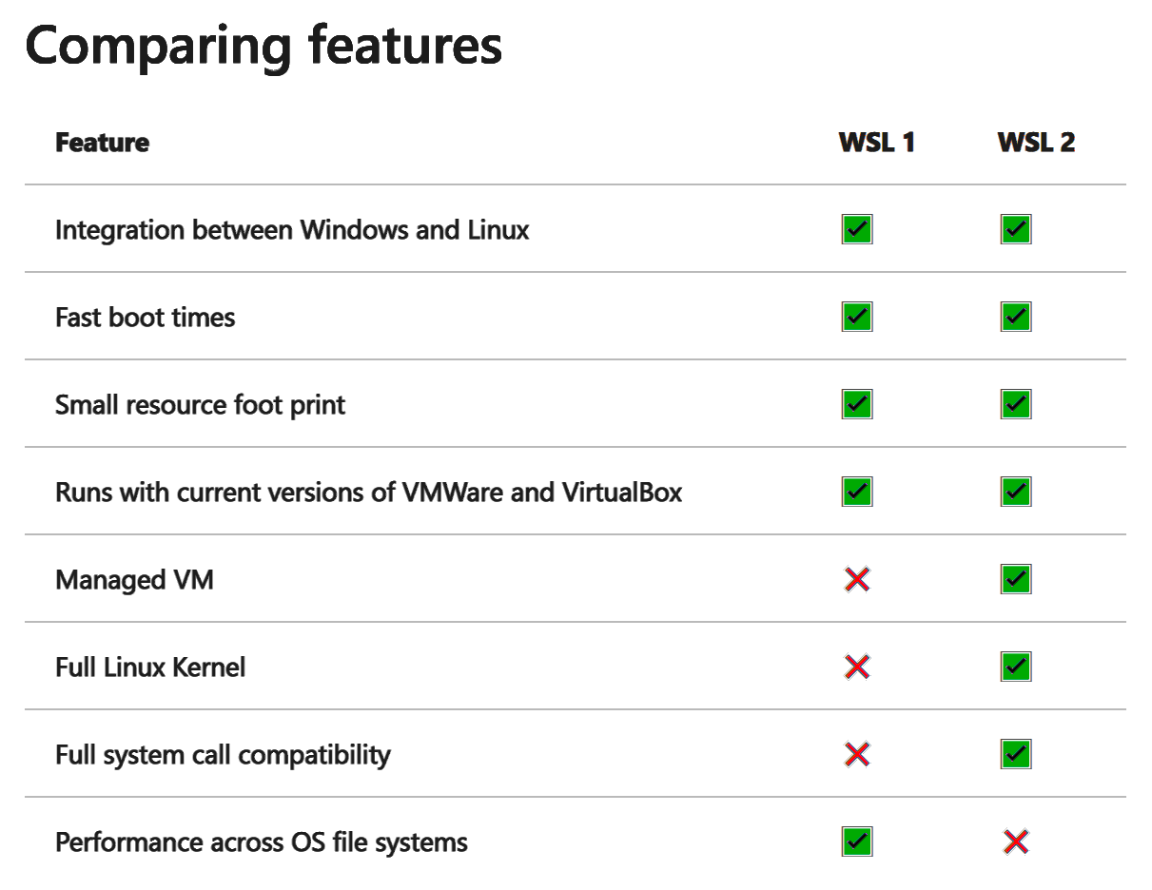
Ex: Windows Subsystem for Linux

Slide 14
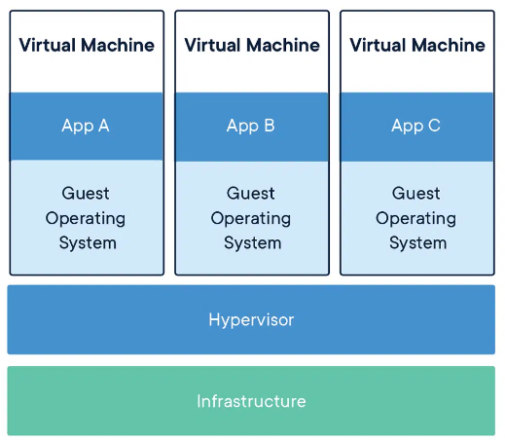
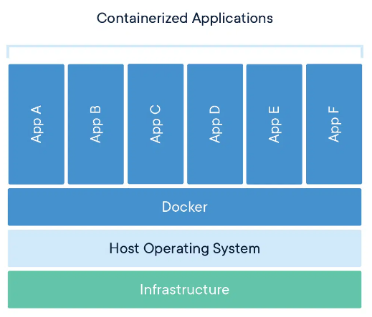
Virtual machines vs Containers
https://www.docker.com/resources/what-container/

Slide 15
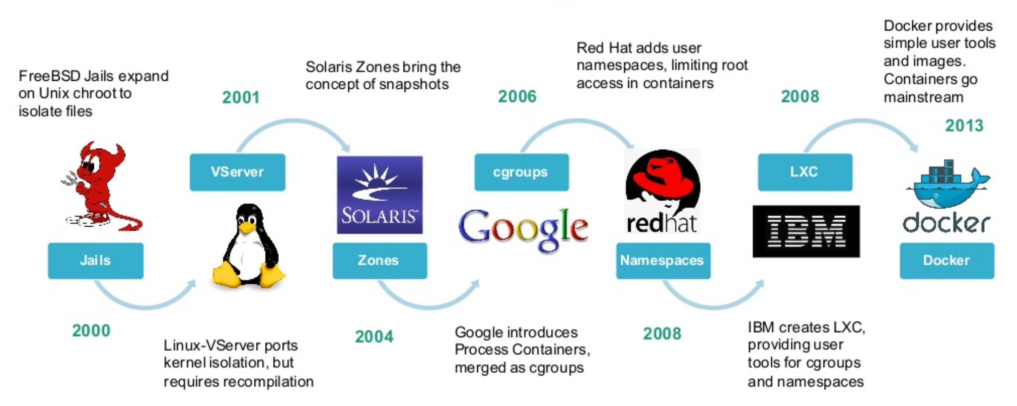
History of containers
https://borosan.gitbook.io/docker-handbook/containerization-history

Slide 16
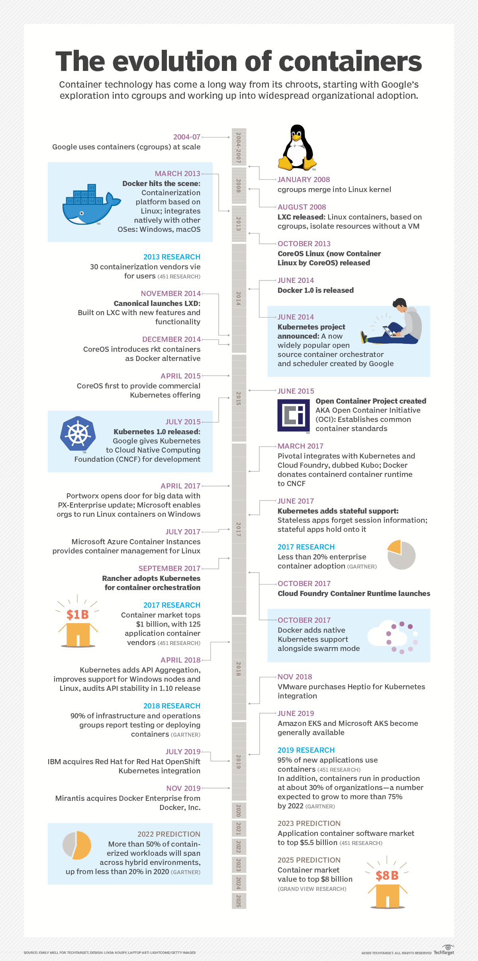

Slide 20
Technological foundations of software development
Run your software anywhere with Docker
Part 2: Docker
ICM – Computer Science Major – Course unit on Technological foundations of computer science
M1 Cyber Physical and Social Systems – Course unit on CPS2 engineering and development, Part 2: Technological foundations of software development
Maxime Lefrançois https://maxime-lefrancois.info
online: https://ci.mines-stetienne.fr/cps2/course/tfsd/

Slide 21
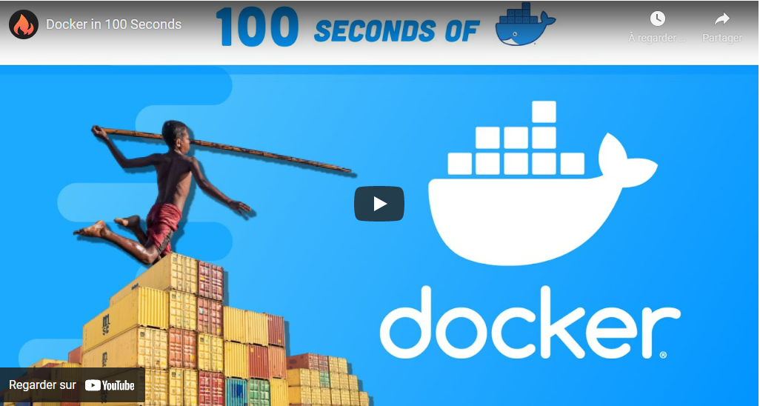
Docker containers in 100 seconds

Slide 22
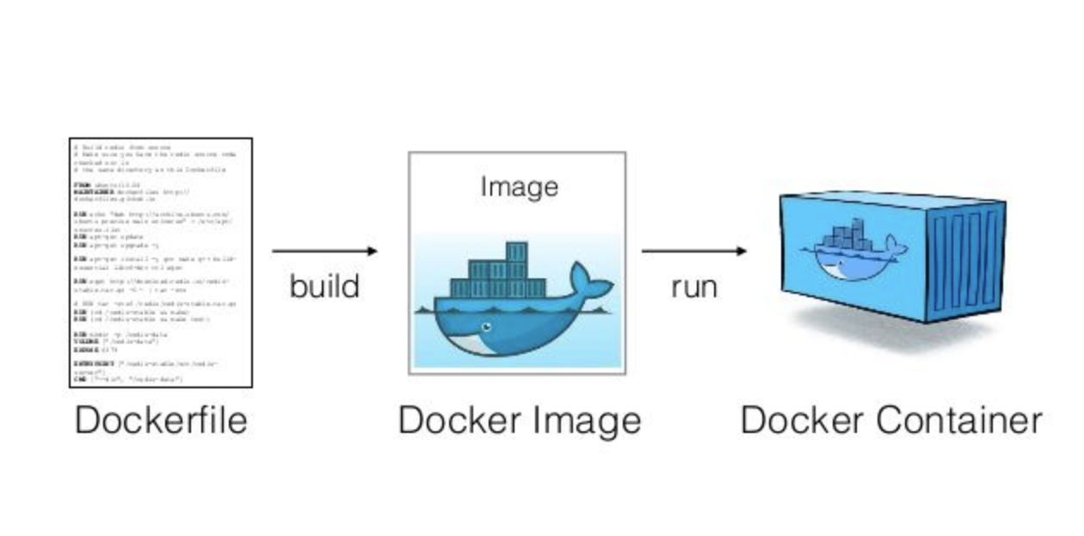
Dockerfile, Image, and Container
Docker is a platform to build images and run containers. There exists other tools !
Dockerfile is a recipe guiding how to build the image
A container is a running instance of an image
https://medium.com/platformer-blog/practical-guide-on-writing-a-dockerfile-for-your-application-89376f88b3b5

Slide 23
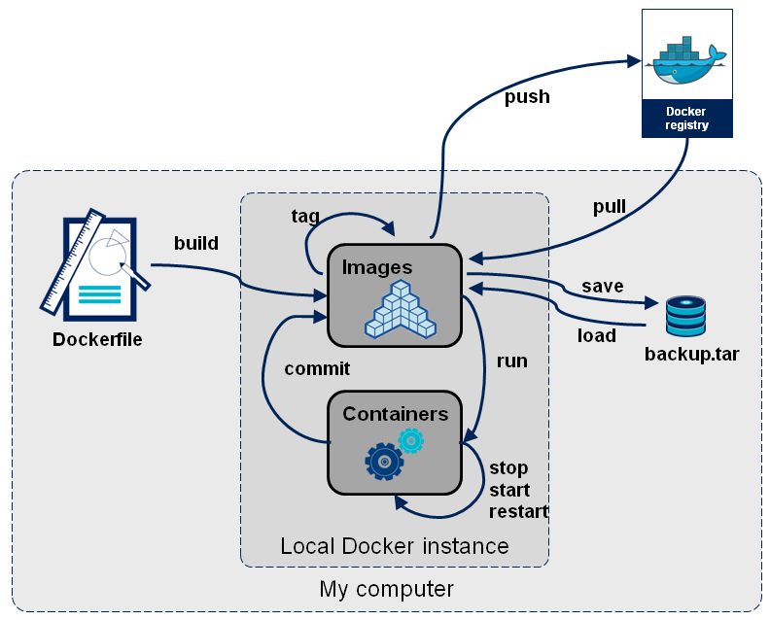
Docker image workflow
https://learn.gencore.bio.nyu.edu/containerization-with-docker/

Slide 24
Technological foundations of software development
Run your software anywhere with Docker
Part 2: Docker
Part 2.1: Image Transfer
ICM – Computer Science Major – Course unit on Technological foundations of computer science
M1 Cyber Physical and Social Systems – Course unit on CPS2 engineering and development, Part 2: Technological foundations of software development
Maxime Lefrançois https://maxime-lefrancois.info
online: https://ci.mines-stetienne.fr/cps2/course/tfsd/

Slide 25
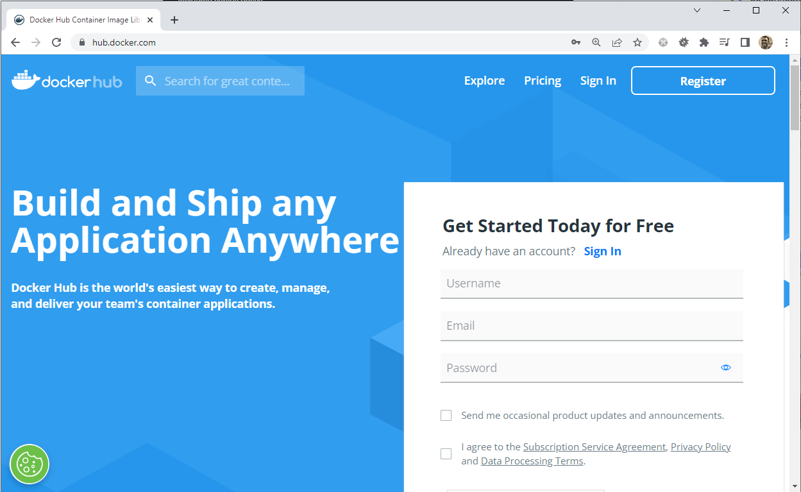
Find images on Docker Hub
URL : https://hub.docker.com/

Slide 26
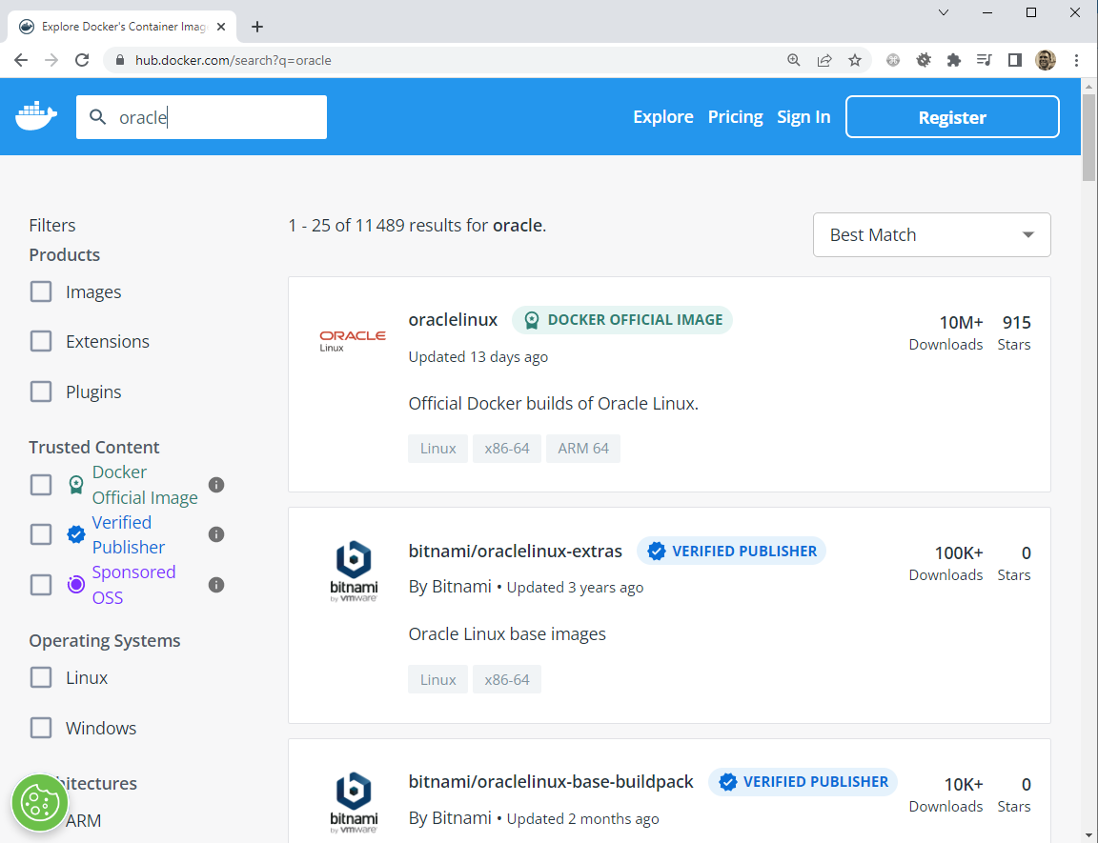



Find images on Docker Hub
Docker Official Images are a curated set of Docker open source and "drop-in" solution repositories.
High-quality images from publishers verified by Docker. These products are published and maintained directly by a commercial entity. These images are not subject to rate limiting.
Docker Sponsored Open Source Software. These are images published and maintained by open-source projects that are sponsored by Docker through our open source program.

Slide 27
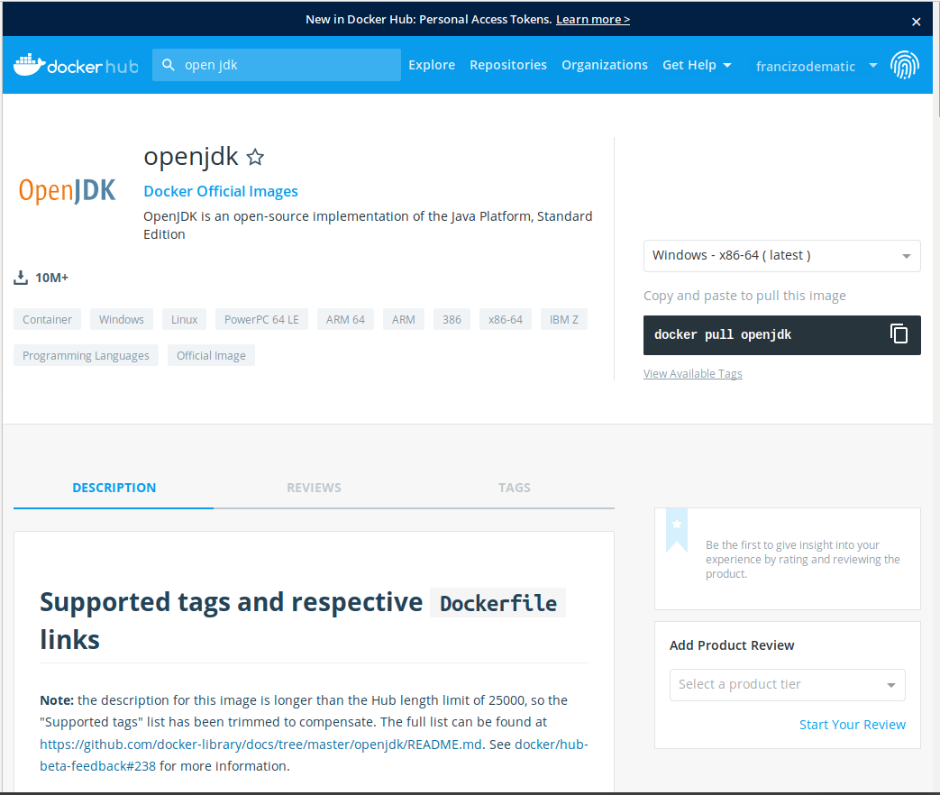
Pull an image
$ docker pull <name of the image in Docker Hub>

Slide 28
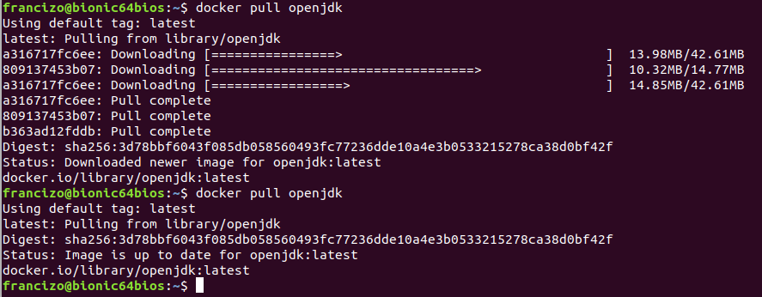
Pull an image
$ docker pull openjdk

Slide 29
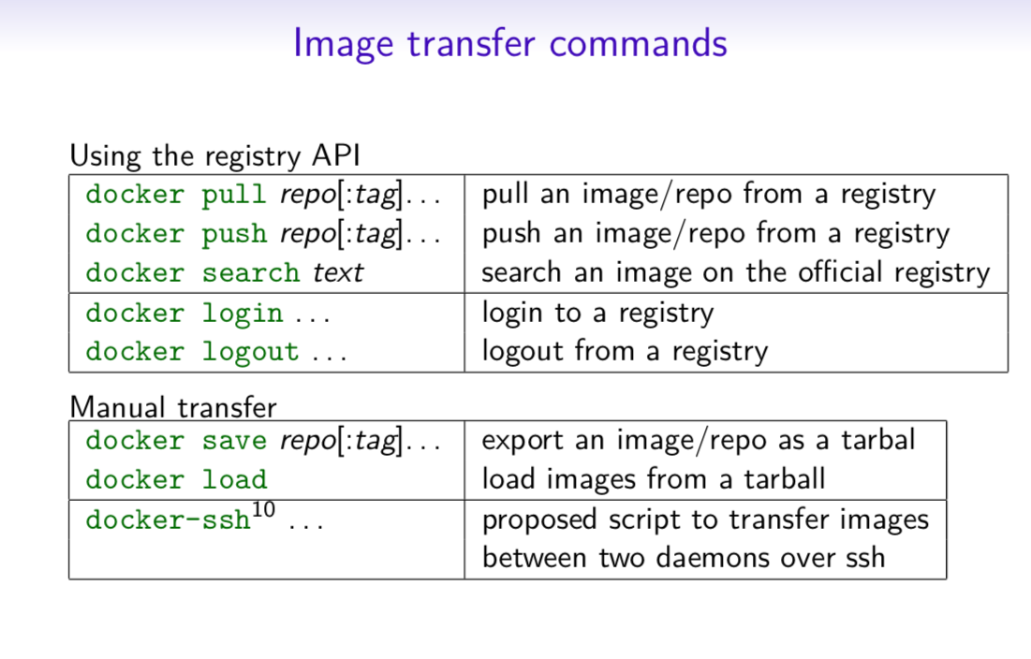
https://dockerlabs.collabnix.com/docker/cheatsheet/

Slide 30
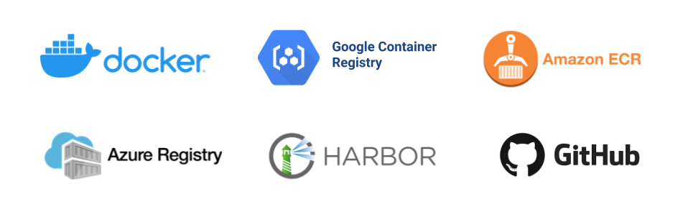

Other container registries
(GA 2013)
(GA 2015)
Amazon Elastic Container Registry (ECR)
GA 2015
(GA 2017)
By VMware, (GA 2014)
(GA 2019)
Open source

Slide 31
Technological foundations of software development
Run your software anywhere with Docker
Part 2: Docker
Part 2.2: Images anatomy and management
ICM – Computer Science Major – Course unit on Technological foundations of computer science
M1 Cyber Physical and Social Systems – Course unit on CPS2 engineering and development, Part 2: Technological foundations of software development
Maxime Lefrançois https://maxime-lefrancois.info
online: https://ci.mines-stetienne.fr/cps2/course/tfsd/

Slide 32
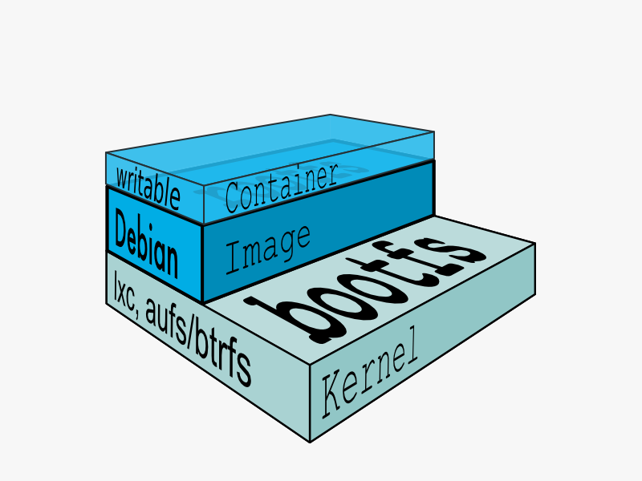
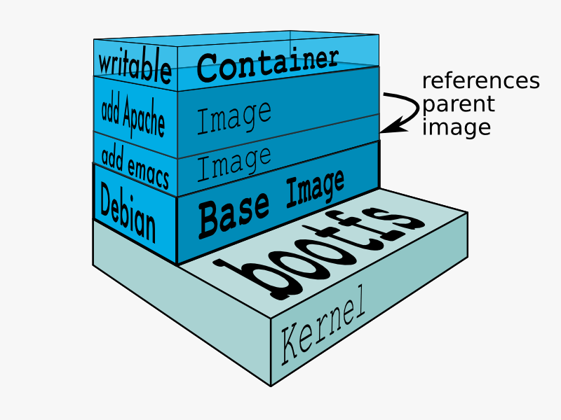
Anatomy of images
Docker images are the basis of containers. An image is an ordered collection of root filesystem changes and the corresponding execution parameters for use within a container runtime. An image typically contains a union of layered filesystems stacked on top of each other. An image does not have state and it never changes.

Slide 33
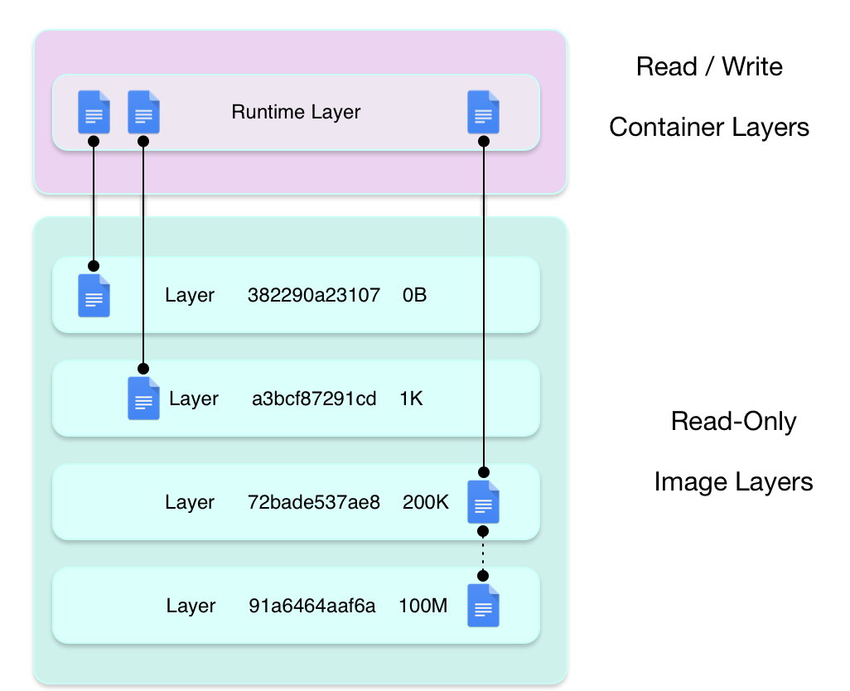
Containers use union file systems
Docker uses a copy-on-write technique and a union file system for both images and containers to optimize resources and speed performance.
Copies of an entity share the same instance and each one makes only specific changes to its unique layer.
Multiple containers can share access to the same image, and make container-specific changes on a writable layer which is deleted when the container is removed. This speeds up container start times and performance.
Images are essentially layers of filesystems typically predicated on a base image under a writable layer, and built up with layers of differences from the base image. This minimizes the footprint of the image and enables shared development.
Different union file systems implementations:
unionFS, overlay, overlay2, aufs, zfs,…
https://docs.docker.com/glossary/#copy-on-write

Slide 34
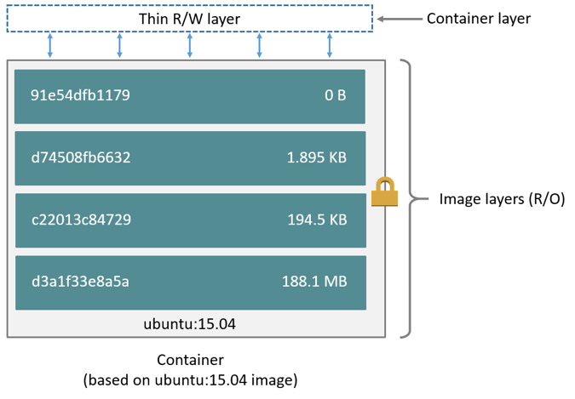
Image identifiers

Slide 35
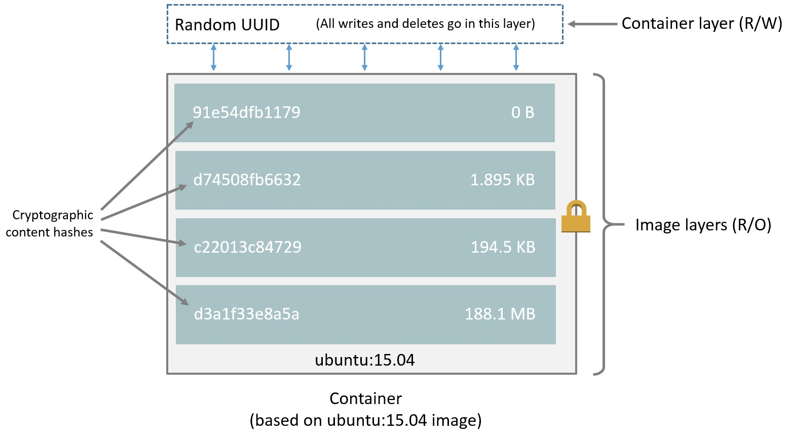
Image identifiers (since Docker 1.10)
Avoids ID collisions
Guarantees data integrity
Easier to share images

Slide 36
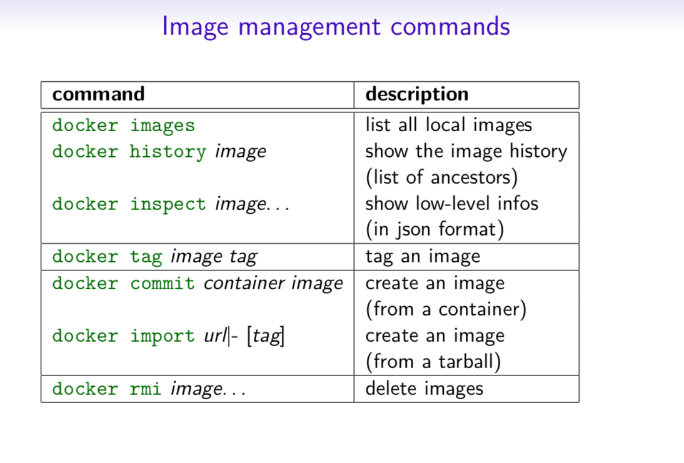
https://dockerlabs.collabnix.com/docker/cheatsheet/

Slide 37
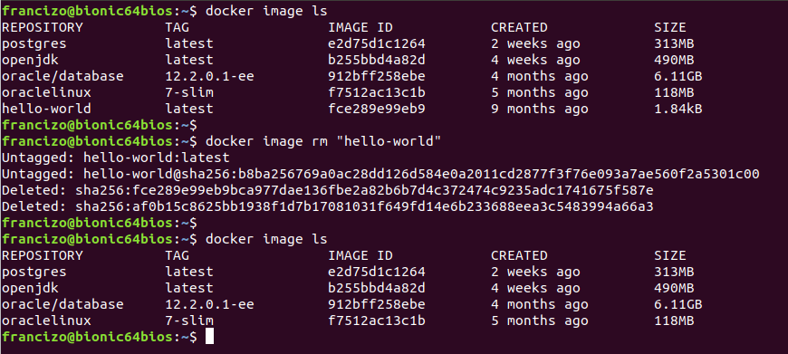
Example: manage images
$ docker image ls
or
$ docker images
$ docker image rm <name|ID>
or
$ docker rmi <name|ID>

Slide 38
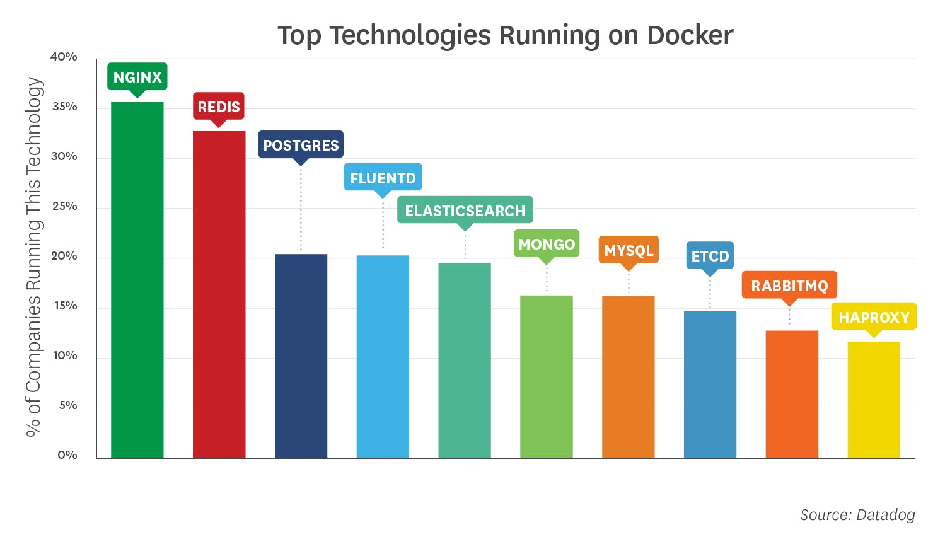

Slide 39
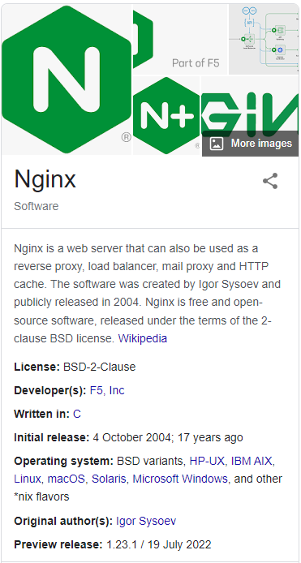

Slide 40
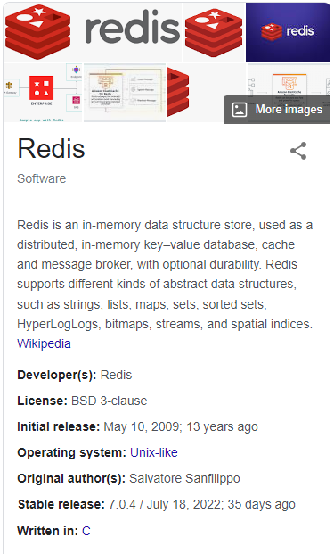

Slide 41
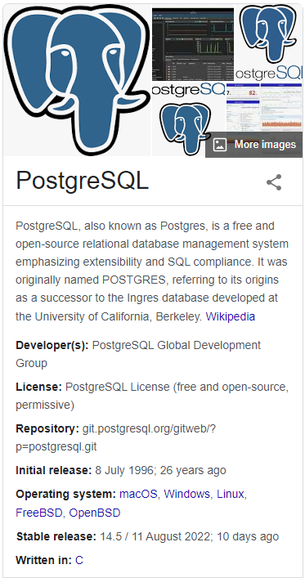

Slide 42
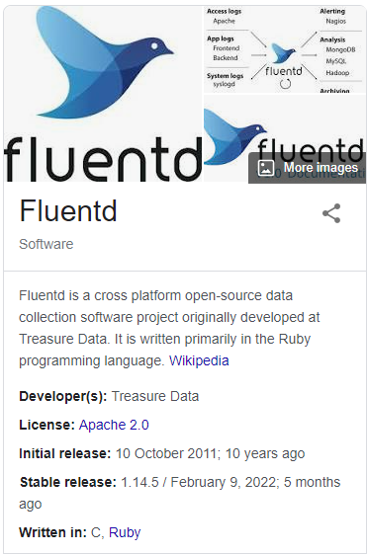

Slide 43
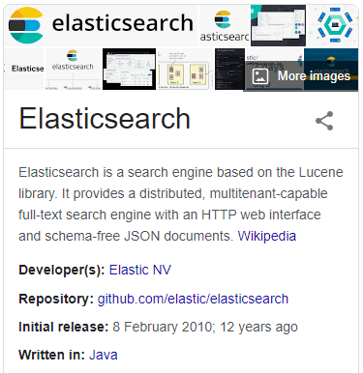

Slide 44
Technological foundations of software development
Run your software anywhere with Docker
Part 2: Docker
Part 2.3: Managing containers
ICM – Computer Science Major – Course unit on Technological foundations of computer science
M1 Cyber Physical and Social Systems – Course unit on CPS2 engineering and development, Part 2: Technological foundations of software development
Maxime Lefrançois https://maxime-lefrancois.info
online: https://ci.mines-stetienne.fr/cps2/course/tfsd/

Slide 45
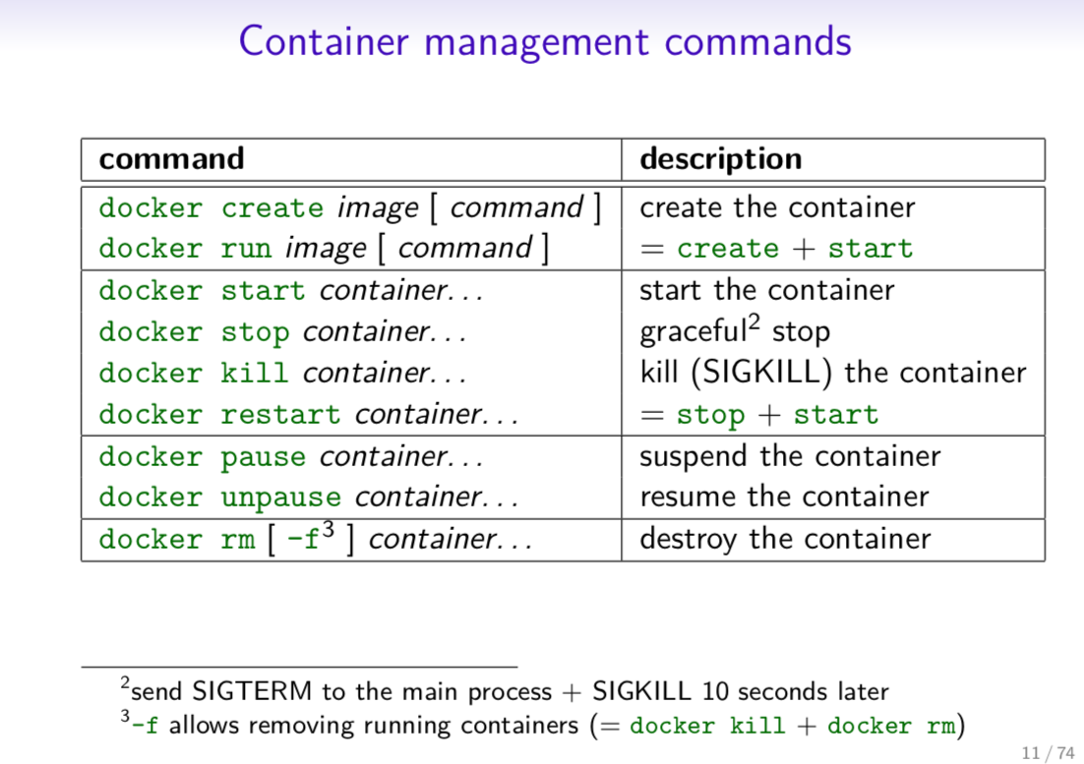
https://dockerlabs.collabnix.com/docker/cheatsheet/

Slide 46
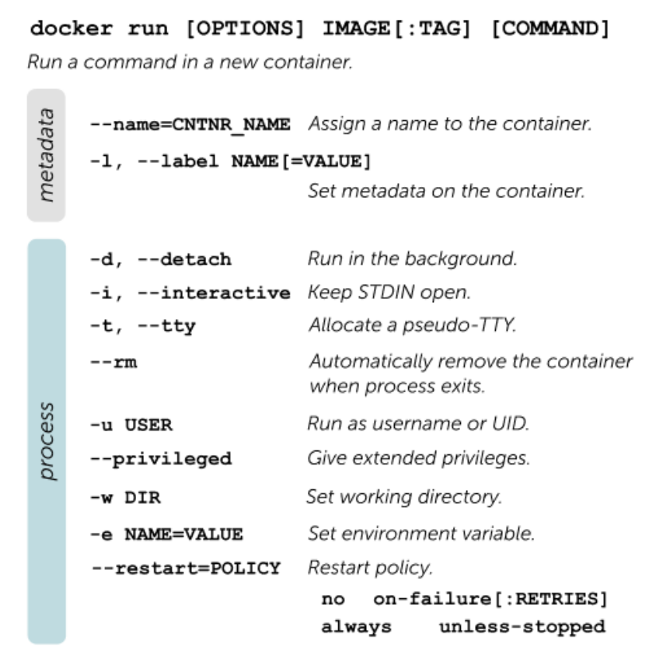
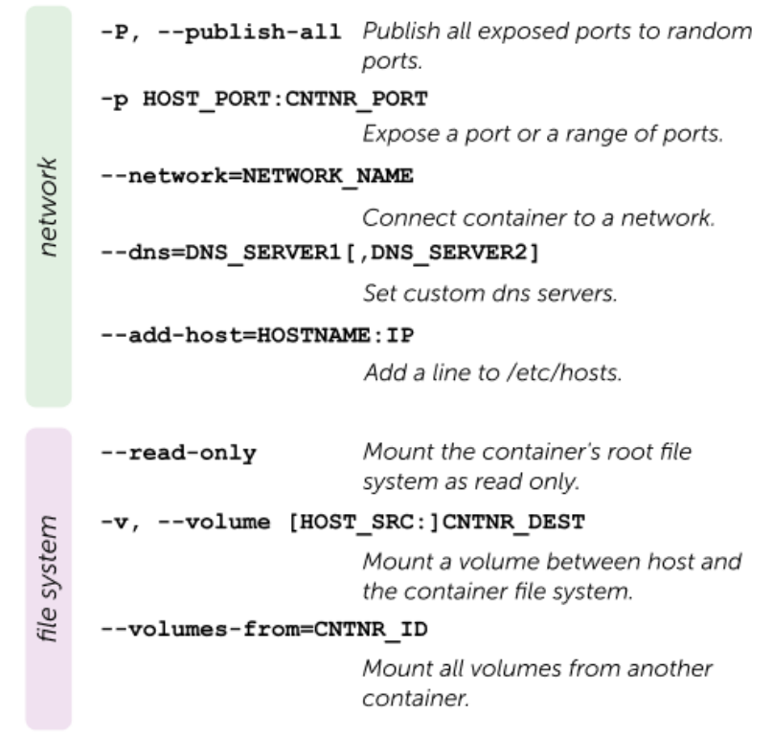
docker run and options

Slide 47
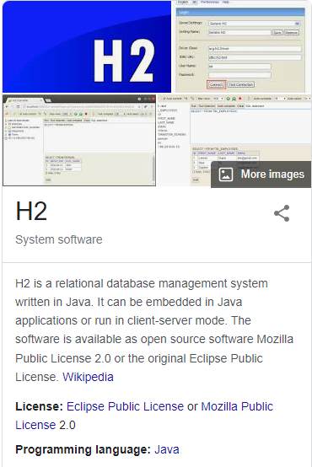
Example: pull and run a h2 database
Documentation at https://hub.docker.com/r/oscarfonts/h2
Get the image:
docker pull oscarfonts/h2
Run as a service, exposing ports 1521 (TCP database server) and 81 (web interface) and mapping DATA_DIR to host:
docker run -d \
-p 1521:1521 \
-p 81:81 \
-v /path/to/local/data_dir:/opt/h2-data \
--name=MyH2Instance \
oscarfonts/h2

Slide 48
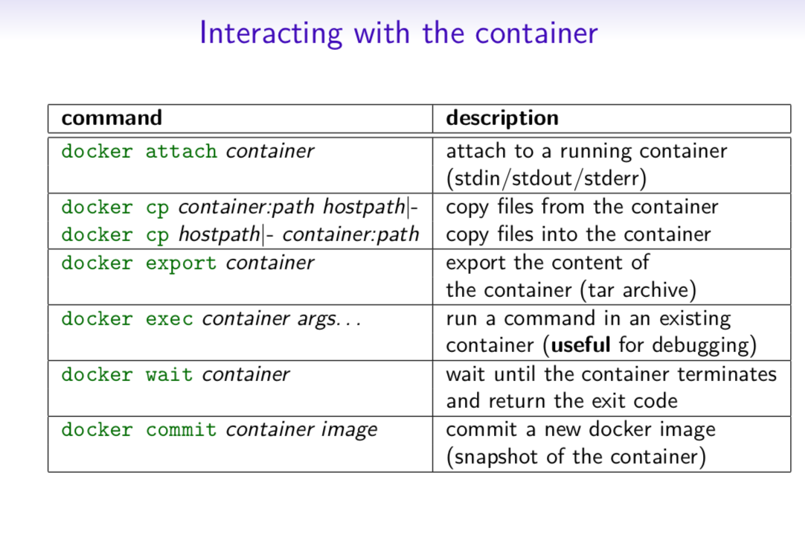
https://dockerlabs.collabnix.com/docker/cheatsheet/

Slide 49
Run docker exec on a running container
First, start a container
$ docker run --name ubuntu_bash --rm -i -t ubuntu bash
This will create a container named ubuntu_bash and start a Bash session.
Next, execute a command on the container.
$ docker exec -d ubuntu_bash touch /tmp/execWorks
This will create a new file /tmp/execWorks inside the running container ubuntu_bash, in the background.
Next, execute an interactive bash shell on the container.
$ docker exec -it ubuntu_bash bash
This will create a new Bash session in the container ubuntu_bash.

Slide 50
docker cp: copy local files in the container
Copy a local file into container
$ docker cp ./some_file CONTAINER:/work
Copy files from container to local path
$ docker cp CONTAINER:/var/logs/ /tmp/app_logs
Copy a file from container to stdout. Please note cp command produces a tar stream
$ docker cp CONTAINER:/var/logs/app.log - | tar x -O | grep "ERROR"
https://docs.docker.com/engine/reference/commandline/cp/

Slide 51
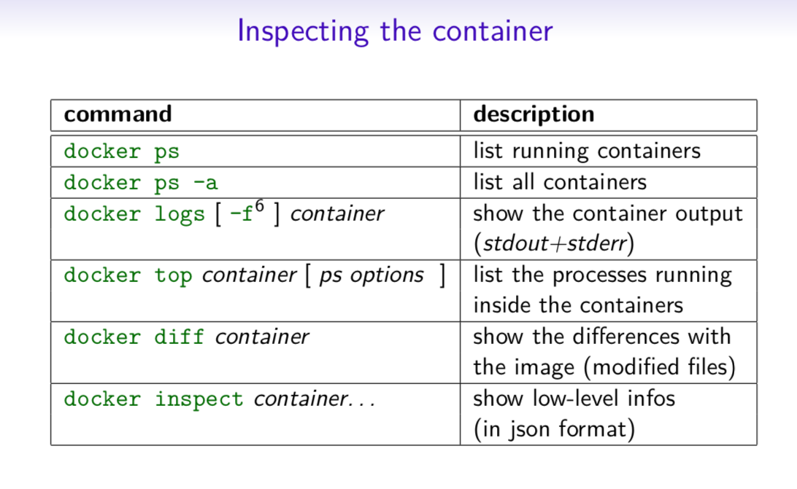
https://dockerlabs.collabnix.com/docker/cheatsheet/

Slide 52
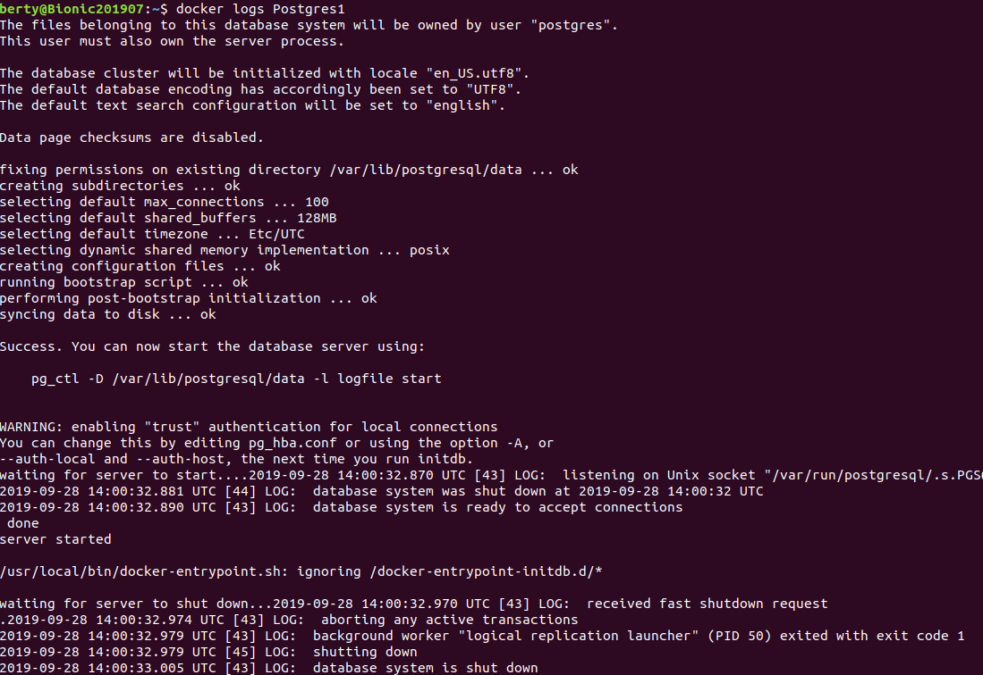
Example: show logs of a container

Slide 53
Technological foundations of software development
Run your software anywhere with Docker
Part 2: Docker
Part 2.4: Image specification and build
ICM – Computer Science Major – Course unit on Technological foundations of computer science
M1 Cyber Physical and Social Systems – Course unit on CPS2 engineering and development, Part 2: Technological foundations of software development
Maxime Lefrançois https://maxime-lefrancois.info
online: https://ci.mines-stetienne.fr/cps2/course/tfsd/

Slide 54
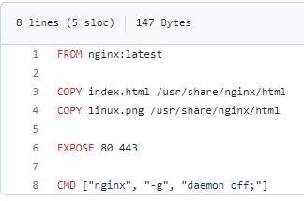
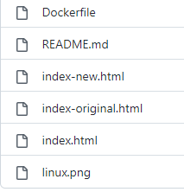


Build and run an image
Example https://github.com/dockersamples/linux_tweet_app
docker build -t linux_tweet_app .
docker container run --detach -p 80:80 linux_tweet_app

Slide 55


Dockerfile instructions
Reference: https://docs.docker.com/engine/reference/builder/
https://dockerlabs.collabnix.com/docker/cheatsheet/

Slide 56

Technological foundations of software development
Run your software anywhere with Docker
Part 2: Docker
Part 2.5: Multi-container applications
ICM – Computer Science Major – Course unit on Technological foundations of computer science
M1 Cyber Physical and Social Systems – Course unit on CPS2 engineering and development, Part 2: Technological foundations of software development
Maxime Lefrançois https://maxime-lefrancois.info
online: https://ci.mines-stetienne.fr/cps2/course/tfsd/

Slide 57


Docker compose
https://docs.docker.com/compose/
Compose is a tool for defining and running multi-container Docker applications
docker-compose.yml configuration file , and docker-compose (now docker compose) cli
https://azuremarketplace.microsoft.com/fr-fr/marketplace/apps/cloud-infrastructure-services.docker-compose-ubuntu20?tab=Overview

Slide 58

Docker compose
https://docs.docker.com/compose/
Compose is a tool for defining and running multi-container Docker applications
docker-compose.yml configuration file , and docker-compose (now docker compose) cli
Service name
Build configuration for creating container image from source
Exposes container ports
HOST_PORT:CONTAINER_PORT
Defines mount host paths or named volumes accessible by service containers
VOLUME:CONTAINER_PATH
https://devhints.io/docker-compose

Slide 59


https://devhints.io/docker-compose

Slide 60

Networking
myapp/docker-compose.yml
When you run docker compose up, the following happens:
  A network called myapp_default is created.
  A container is created using web’s configuration. It joins the network myapp_default under the name web.
  A container is created using db’s configuration. It joins the network myapp_default under the name db.

Slide 61
Technological foundations of software development
Run your software anywhere with Docker
Part 3: Docker alternatives and the containers ecosystem
ICM – Computer Science Major – Course unit on Technological foundations of computer science
M1 Cyber Physical and Social Systems – Course unit on CPS2 engineering and development, Part 2: Technological foundations of software development
Maxime Lefrançois https://maxime-lefrancois.info
online: https://ci.mines-stetienne.fr/cps2/course/tfsd/

Slide 62

Docker < v1.11
Docker centralized all containers under the same process containerd.io ==> Single Point of Failure
  the containerd.io process owns all child processes (running container)
  if containerd.io stops/crashes, all child processes are lost
a single user runs containers with root privileges and full access to the host system ==> Security issues
all images are downloaded and stored in the same folder /var/lib/docker/image/overlay2/imagedb/content/sha256

Slide 63

Container innovation
2. response: Creation Open Cloud Initiative
  Work on security
  Standardize image format + cli
Threat:
  Better than Docker security-wise
  Alternative image format + cli
https://dev.to/manishfoodtechs/rootless-docker-kick-docker-hackers-and-make-docker-more-secure-new-concept-70g

Slide 64


The Open Container Initiative
Runtime Specification
(runtime-spec)
Image Specification
(image-spec)
The runc low-level container runtime

Slide 65


Slide 66

Docker v1.11.0 (2017)

Slide 67

Alternatives to Docker: podman (2018)
Transfer, inspect, delete OCI images once they're built, even remotely
daemonless container engine for developing, managing, and running OCI containers
alias docker=podman
build OCI compliant container images
https://ios.dz/from-docker-to-podman/#podman--un-puissant-alternatif

Slide 68

Other container runtimes
Kubernetes is deprecating Docker as a container runtime after v1.20. (announcement 2020)
discontinued
not interoperable
One lightweight option promoted by kubernetes
Was there before Docker
No support for images
Still very active, stay tuned. See for example https://cto.ai/blog/overview-of-different-container-runtimes/ (dec. 2021)

Slide 69
Technological foundations of software development
Run your software anywhere with Docker
Part 4: Container orchestration in the cloud
ICM – Computer Science Major – Course unit on Technological foundations of computer science
M1 Cyber Physical and Social Systems – Course unit on CPS2 engineering and development, Part 2: Technological foundations of software development
Maxime Lefrançois https://maxime-lefrancois.info
online: https://ci.mines-stetienne.fr/cps2/course/tfsd/

Slide 70


Kubernetes (K8s)

Slide 71

Kubernetes (K8s) in 100 seconds

Slide 72


Docker
Kubernetes
Containers, isolated environment for application
Automated building and deploying applications – CI
Container platform for configuring building and distribution containers
Infrastructure for managing multiple containers
Automated scheduling and management of application containers
Ecosystem for managing a cluster of multiple containers

Slide 73

Architecture of a
Kubernetes cluster
Details: https://www.redhat.com/en/topics/containers/kubernetes-architecture

Slide 74


Docker Swarm (under development)

Slide 75

Simplified containers ecosystem
https://twitter.com/raphink/status/973552094169968640

Slide 76


https://raw.githubusercontent.com/cncf/trailmap/master/CNCF_TrailMap_latest.png

Slide 77

Cloud native landscape
You are viewing 1,130 cards with a total of 3,274,957 stars,
market cap of $21.5T and funding of $51.7B.
https://landscape.cncf.io/images/landscape.png

Slide 78
Technological foundations of software development
Run your software anywhere with Docker
ICM – Computer Science Major – Course unit on Technological foundations of computer science
M1 Cyber Physical and Social Systems – Course unit on CPS2 engineering and development, Part 2: Technological foundations of software development
Maxime Lefrançois https://maxime-lefrancois.info
online: https://ci.mines-stetienne.fr/cps2/course/tfsd/

Slide 79
... Your turn
Complete the TODO section:
https://ci.mines-stetienne.fr/cps2/course/tfsd/course-7.html#_todos

