Slide 1
Technological foundations of software development
Integrate and deploy your software continuously
ICM – Computer Science Major – Course unit on Technological foundations of computer science
M1 Cyber Physical and Social Systems – Course unit on CPS2 engineering and development, Part 2: Technological foundations of software development
Maxime Lefrançois https://maxime-lefrancois.info
online: https://ci.mines-stetienne.fr/cps2/course/tfsd/

Slide 2
Objectives of the session
This session is designed to get you familiar with methods and tools for continuous software integration and deployment.
In particular, we will cover Gitlab CI/CD, and Github Actions

Slide 3
Technological foundations of software development
Integrate and deploy your software continuously
Part 1: DevOps
ICM – Computer Science Major – Course unit on Technological foundations of computer scienceopment
M1 Cyber Physical and Social Systems – Course unit on CPS2 engineering and development, Part 2: Technological foundations of software development
Maxime Lefrançois https://maxime-lefrancois.info
online: https://ci.mines-stetienne.fr/cps2/course/tfsd/

Slide 4
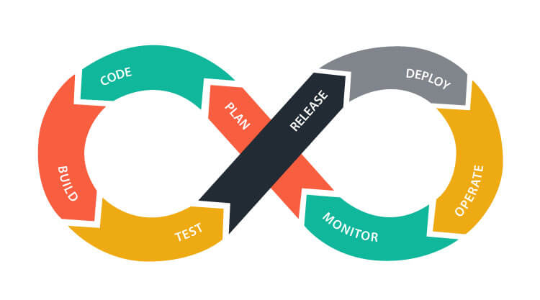

DevOps
DevOps is a set of practices that combines software development (Dev) and IT operations (Ops). It aims to shorten the systems development life cycle and provide continuous delivery with high software quality. DevOps is complementary with Agile software development; several DevOps aspects came from the Agile methodology.
— Contributors, Wikipedia https://en.wikipedia.org/wiki/DevOps
There are many variants
https://theagileadmin.com/what-is-devops/

Slide 5
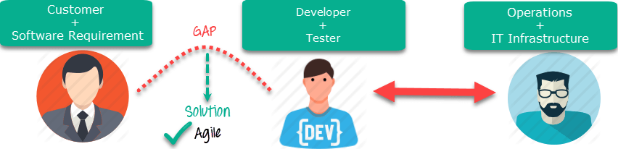
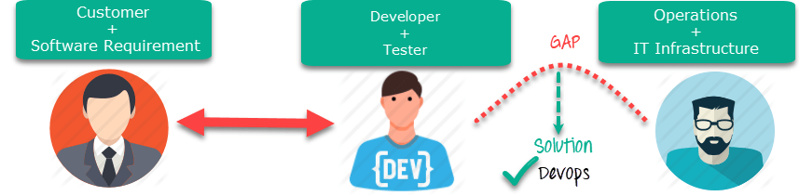
Agile vs DevOps
DevOps is a practice of bringing development and operations teams together whereas Agile is an iterative approach that focuses on collaboration, customer feedback and small rapid releases.
DevOps focuses on constant testing and delivery while the Agile process focuses on constant changes.
DevOps requires relatively a large team while Agile requires a small team.
DevOps leverages both shifts left and right principles, on the other hand, Agile leverage shift-left principle.
The target area of Agile is Software development whereas the Target area of DevOps is to give end-to-end business solutions and fast delivery.
DevOps focuses more on operational and business readiness whereas Agile focuses on functional and non-function readiness.
Source: https://www.guru99.com/agile-vs-devops.html

Slide 6
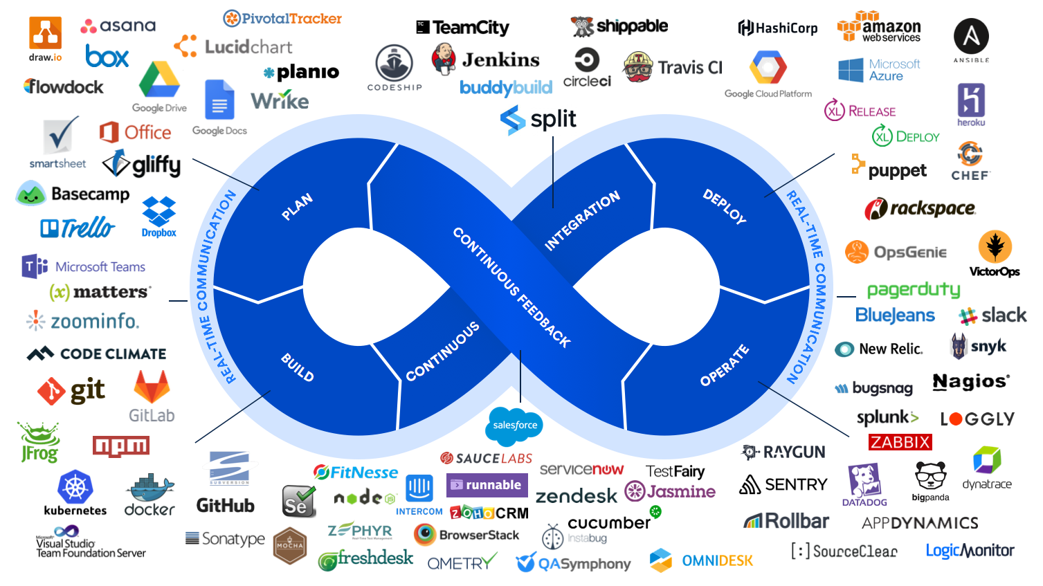
https://s32860.pcdn.co/wp-content/uploads/2019/11/devops-hero-1-87966cfbc9c5713ae047551c7b22985c.png

Slide 7
Definitions
Continuous Integration
for every change submitted to an application - even to development branches - it’s built and tested automatically and continuously, ensuring the introduced changes pass all tests, guidelines, and code compliance standards you established for your app.
Continuous Delivery
not only built and tested at every code change pushed to the codebase, but, as an additional step, it’s also deployed continuously, though the deployments are triggered manually
Continuous Deployment
instead of deploying your application manually, you set it to be deployed automatically. It does not require human intervention at all to have your application deployed
https://docs.gitlab.com/ee/ci/introduction/

Slide 8
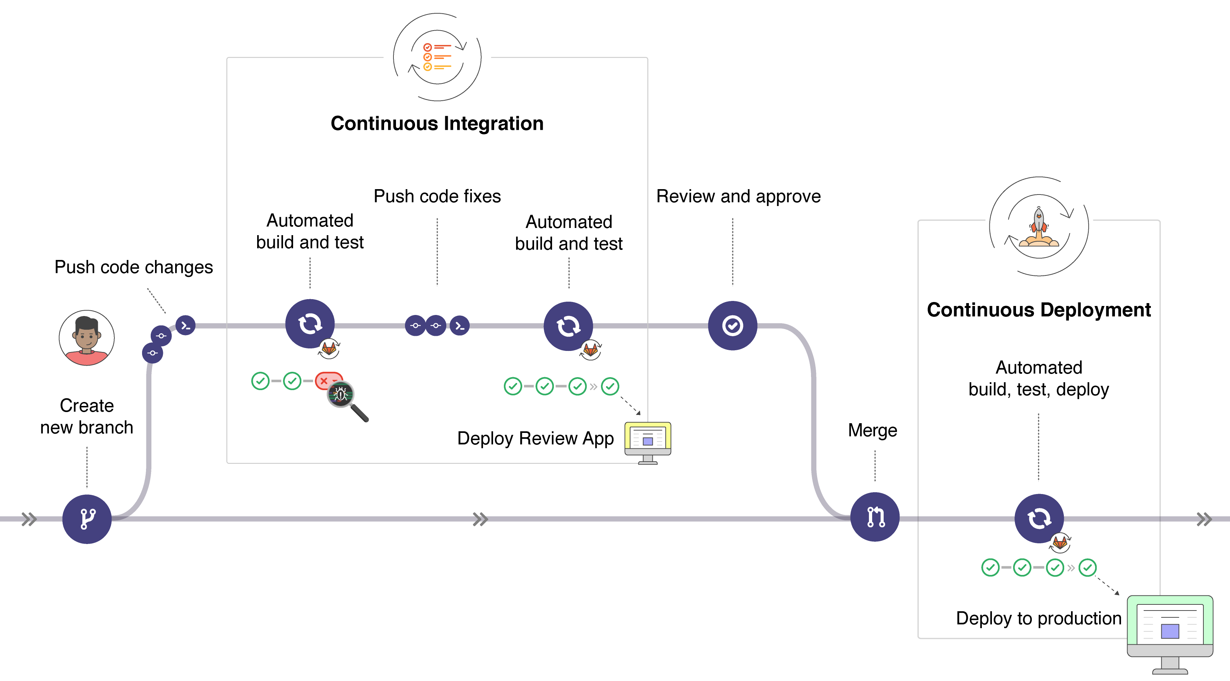
https://docs.gitlab.com/ee/ci/introduction/

Slide 9
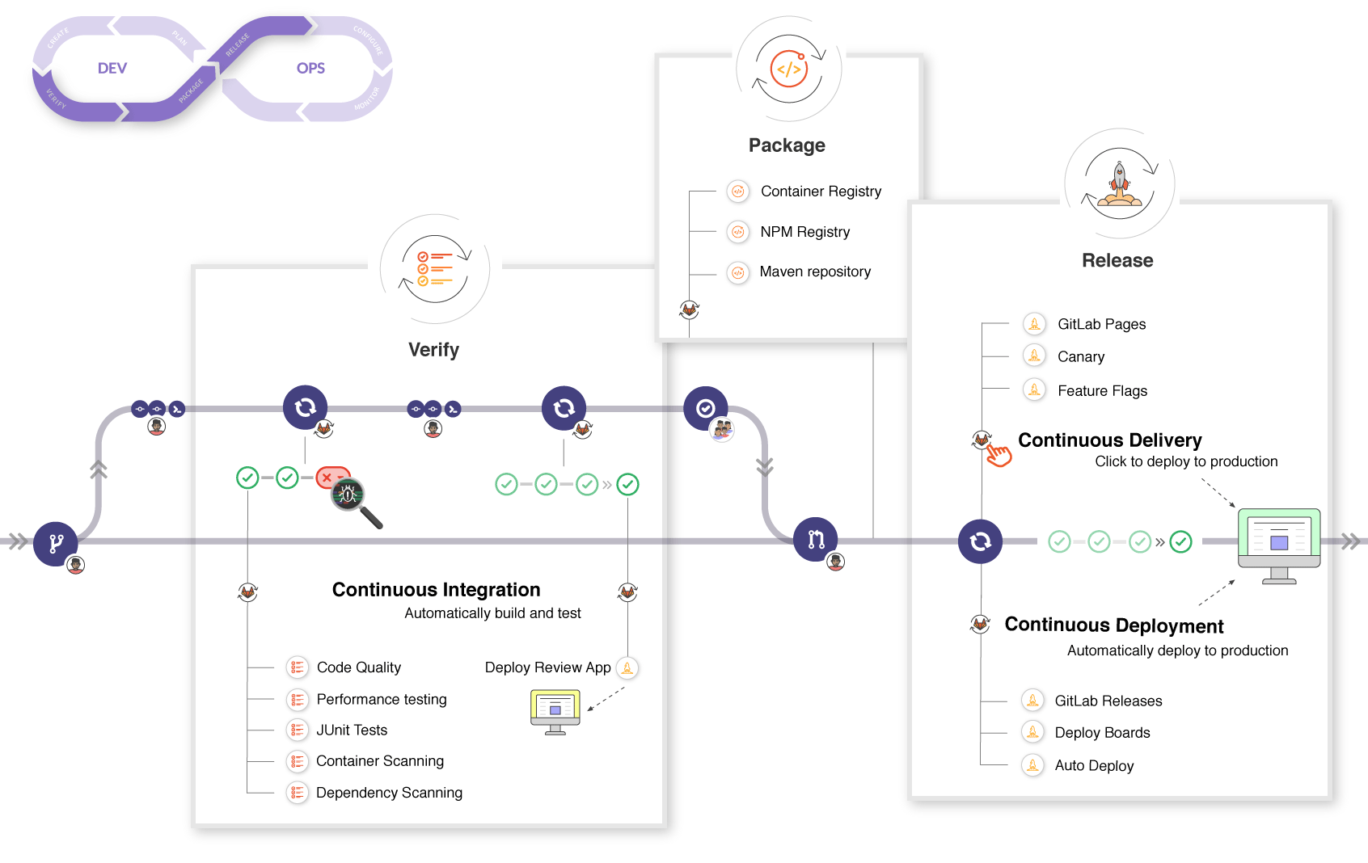

Slide 10
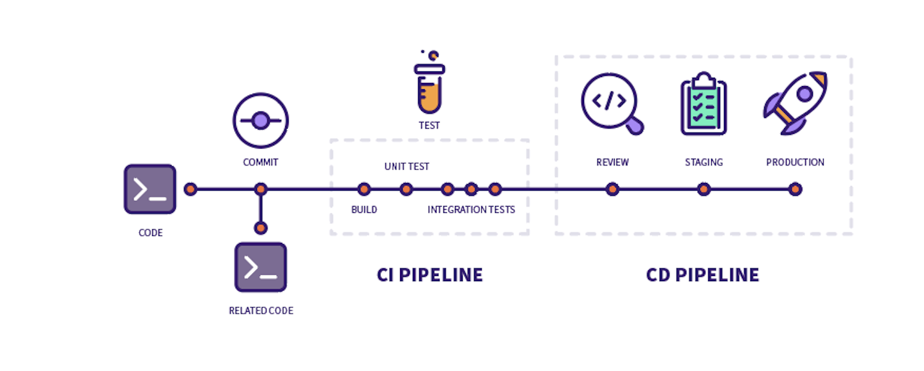

Slide 11





Many tools for CI/CD …
Circle CI
2011
https://circleci.com/
YAML
Travis CI
2011
http://travis-ci.com/
YAML
Jenkins
2011
https://jenkins.io/
Groovy
GitLab CI/CD
2013
https://gitlab.com/
YAML
GitHub Actions
2018
https://github.com/features/actions
YAML
… and others

Slide 12

… all supporting Docker (2013)
Circle CI
2011
https://circleci.com/
YAML
Supports Docker
Travis CI
2011
http://travis-ci.com/
YAML
Supports Docker
Jenkins
2011
https://jenkins.io/
Groovy
Supports Docker
GitLab CI/CD
2013
https://gitlab.com/
YAML
Supports Docker
GitHub Actions
2018
https://github.com/features/actions
YAML
Supports Docker

Slide 13
Technological foundations of software development
Intégrer et déployer son logiciel en continue
Part 2: Gitlab CI/CD
ICM – Computer Science Major – Course unit on Technological foundations of computer scienceopment
M1 Cyber Physical and Social Systems – Course unit on CPS2 engineering and development, Part 2: Technological foundations of software development
Maxime Lefrançois https://maxime-lefrancois.info
online: https://ci.mines-stetienne.fr/cps2/course/tfsd/

Slide 14
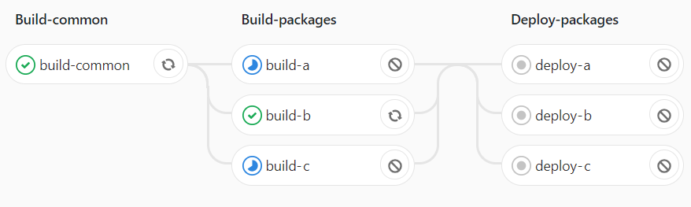
Pipelines
Stage
Pipeline
Job
https://docs.gitlab.com/ee/ci/introduction/

Slide 15
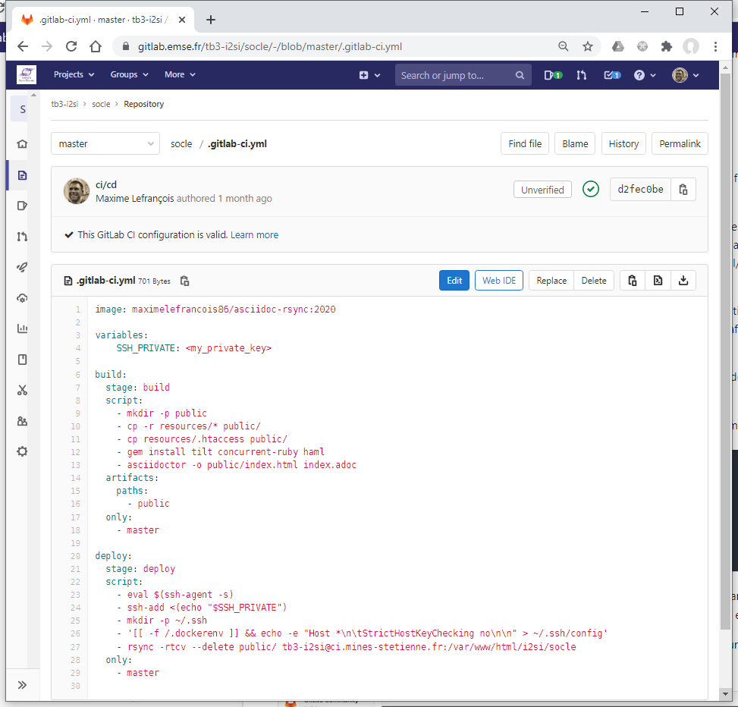
Pipelines
Stages
By default:
Build
Test
Deploy

Slide 16
Pipelines
Stages
By default:
Build
Test
Deploy
Jobs
YAML key names

Slide 17
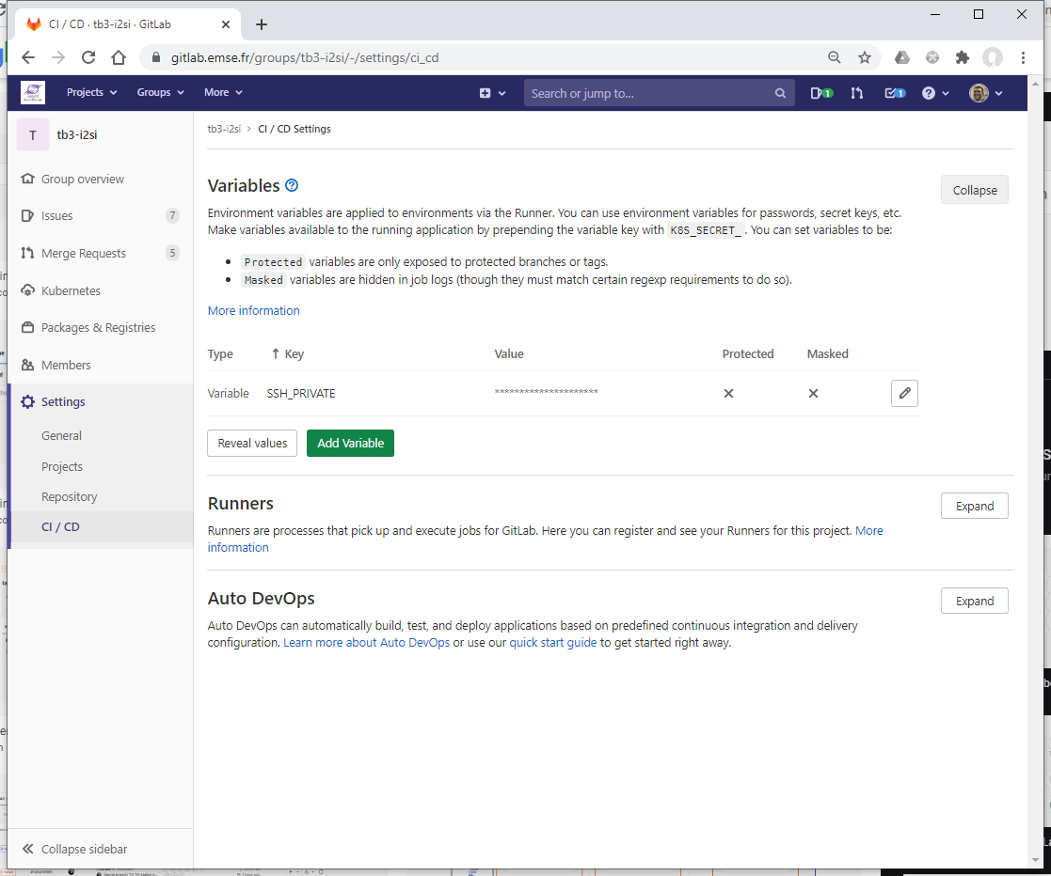
Env variables
Variables
At the project level
Group level
By default https://docs.gitlab.com/ee/ci/variables/predefined_variables.html
https://docs.gitlab.com/ee/ci/variables/README.html

Slide 18
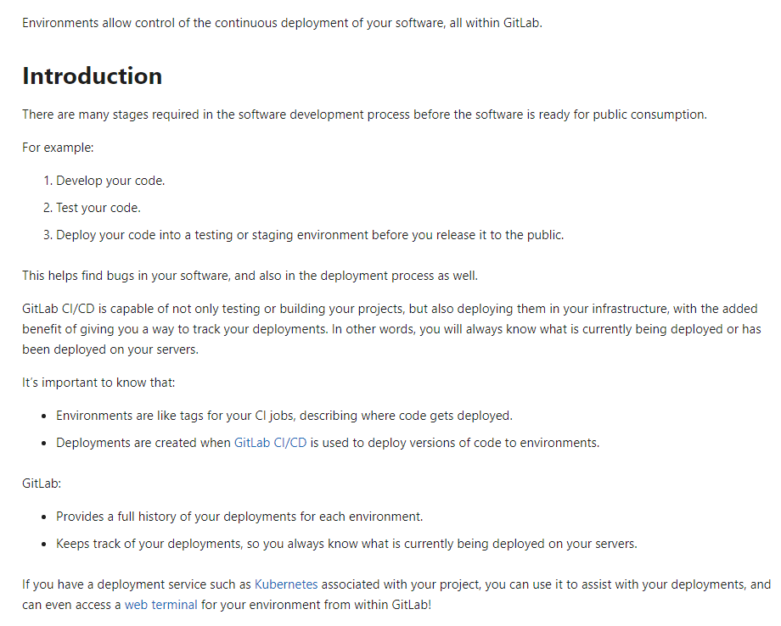
Environments
https://docs.gitlab.com/ee/ci/environments/index.html

Slide 19
Configuration of the pipeline execution
Scheduled execution
Configuration in the .gitlab-ci.yml file
Configuration for a Job
  tags: to choose the “runner”
  stage: in which stage the job is run
  variables: define job variables on a job level.
  dependencies: list of jobs whose artifacts will be used
  when: When to run job. Also available: when:manual and when:delayed.
  allow_failure: false (by default), true
  script: the shell script(s) to execute.
  only: limit when jobs are created. Also available: only:refs, only:kubernetes, only:variables, and only:changes.
  except: limit when jobs are not created. Also available: except:refs, except:kubernetes, except:variables, and except:changes.
  image: docker image to use name:tag
  services: use Docker services images. Also available: services:name, services:alias, services:entrypoint, and services:command.
https://docs.gitlab.com/ee/ci/yaml/

Slide 20
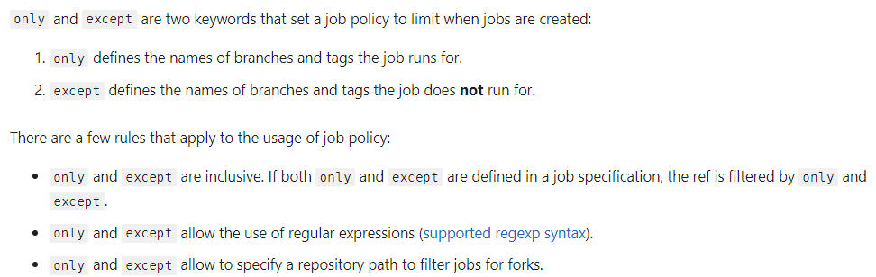
Configuration of the pipeline execution
Scheduled execution
Configuration in the .gitlab-ci.yml file
Configuration for a Job
  only: limit when jobs are created. Also available: only:refs, only:kubernetes, only:variables, and only:changes.
  except: limit when jobs are not created. Also available: except:refs, except:kubernetes, except:variables, and except:changes.
https://docs.gitlab.com/ee/ci/yaml/

Slide 21
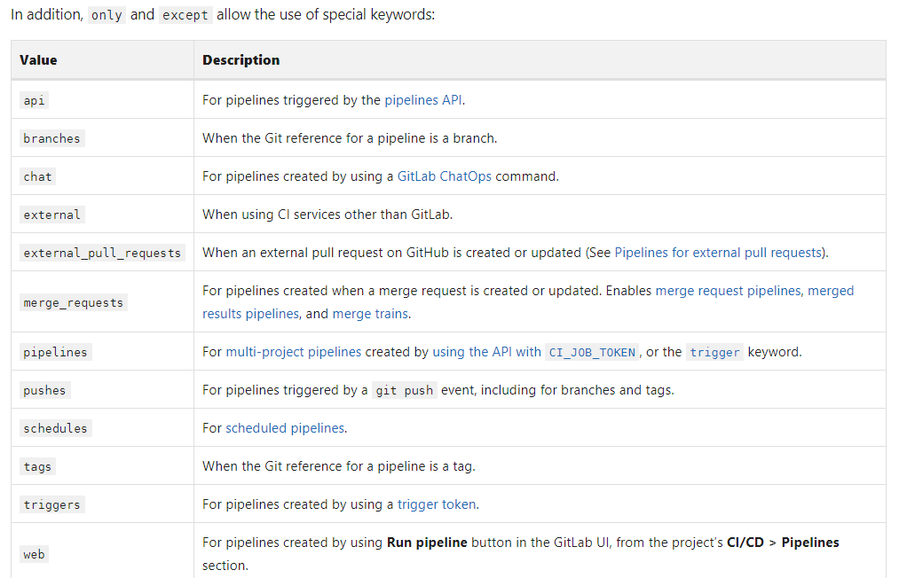
Configuration of the pipeline execution
Scheduled execution
Configuration in the .gitlab-ci.yml file
Configuration for a Job
  only: limit when jobs are created. Also available: only:refs, only:kubernetes, only:variables, and only:changes.
  except: limit when jobs are not created. Also available: except:refs, except:kubernetes, except:variables, and except:changes.
https://docs.gitlab.com/ee/ci/yaml/

Slide 22
Configuration of the pipeline execution
Scheduled execution
Configuration in the .gitlab-ci.yml file
Configuration for a Job
  image: docker image to use name:tag
  services: use Docker services images. Also available: services:name, services:alias, services:entrypoint, and services:command.
https://docs.gitlab.com/ee/ci/yaml/

Slide 23
Configuration de l’exécution du pipeline
Scheduled execution
Configuration in the .gitlab-ci.yml file
Configuration for a Job
  before_script
  after_script
  cache: List of files that should be cached between subsequent runs. Also available: cache:paths, cache:key, cache:untracked, cache:when, and cache:policy.
  variables
  image: defines the default image
  services : defines the default services
https://docs.gitlab.com/ee/ci/yaml/

Slide 24
Job artifacts: Output, use, and reuse job artifacts.
Artifacts
Archive available on success.
Configuration (sub-list): artifacts:paths, artifacts:exclude, artifacts:expose_as, artifacts:name, artifacts:untracked, artifacts:when, artifacts:expire_in, and artifacts:reports.
https://docs.gitlab.com/ee/ci/pipelines/job_artifacts.html

Slide 25
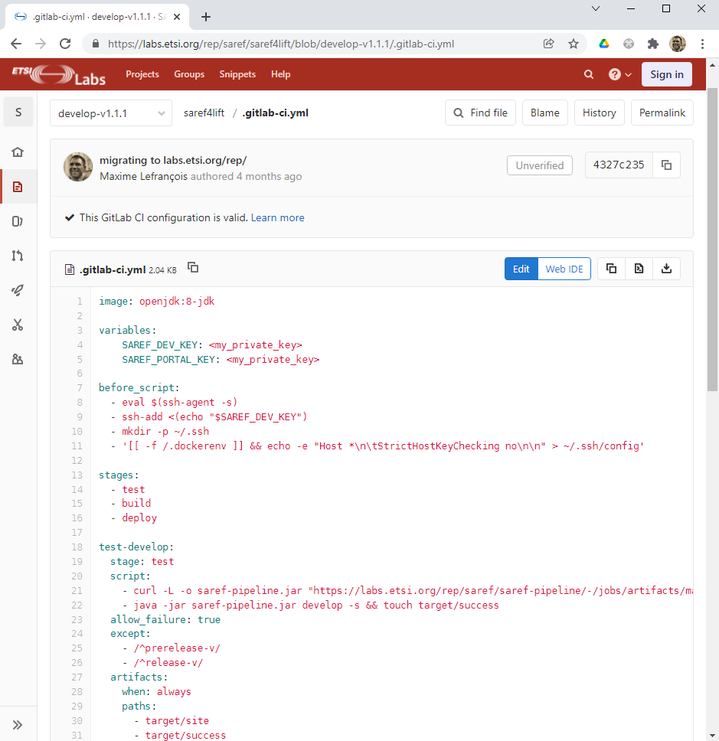
Example
https://saref.etsi.org/sources/saref4lift/

Slide 26
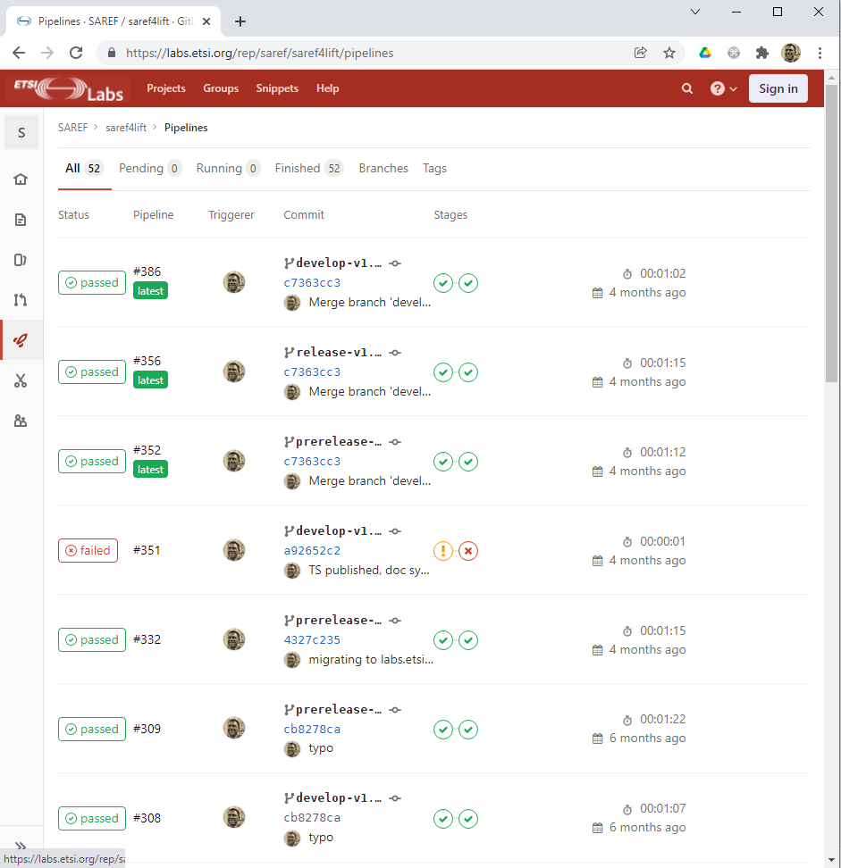
Example
https://saref.etsi.org/sources/saref4lift/

Slide 27
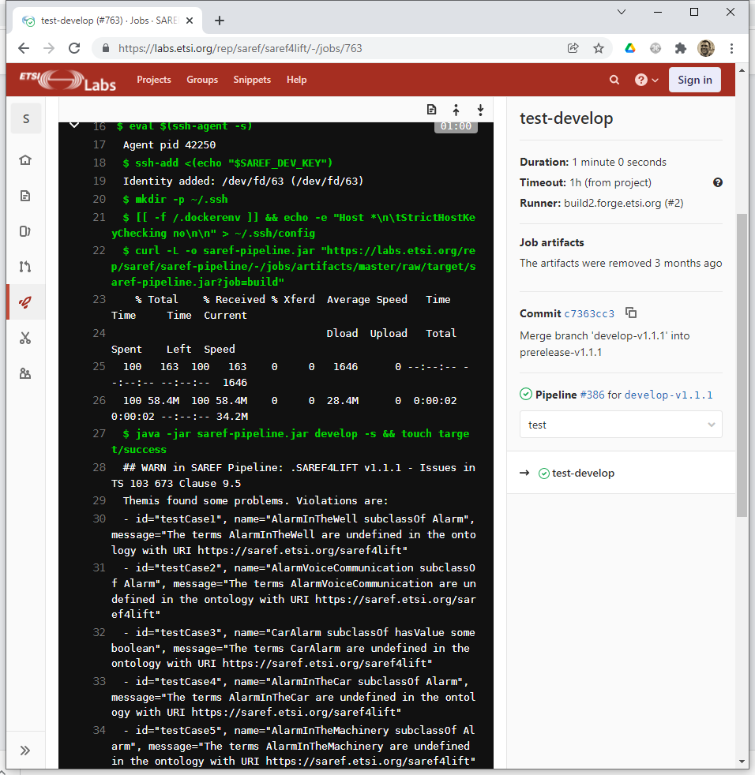
Example
https://saref.etsi.org/sources/saref4lift/

Slide 28
Technological foundations of software development
Integrate and deploy your software continuously
Part 3: GitHub Actions
ICM – Computer Science Major – Course unit on Technological foundations of computer scienceopment
M1 Cyber Physical and Social Systems – Course unit on CPS2 engineering and development, Part 2: Technological foundations of software development
Maxime Lefrançois https://maxime-lefrancois.info
online: https://ci.mines-stetienne.fr/cps2/course/tfsd/

Slide 29
GitHub Actions: GitHub's response
Circle CI
2011
https://circleci.com/
YAML
Supports Docker
Travis CI
2011
http://travis-ci.com/
YAML
Supports Docker
Jenkins
2011
https://jenkins.io/
Groovy
Supports Docker
GitLab CI/CD
2013
https://gitlab.com/
YAML
Supports Docker
GitHub Actions
2018
https://github.com/features/actions
YAML
Supports Docker

Slide 30
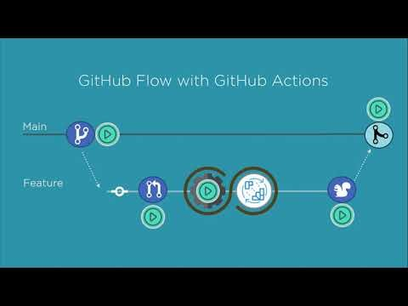

Slide 31
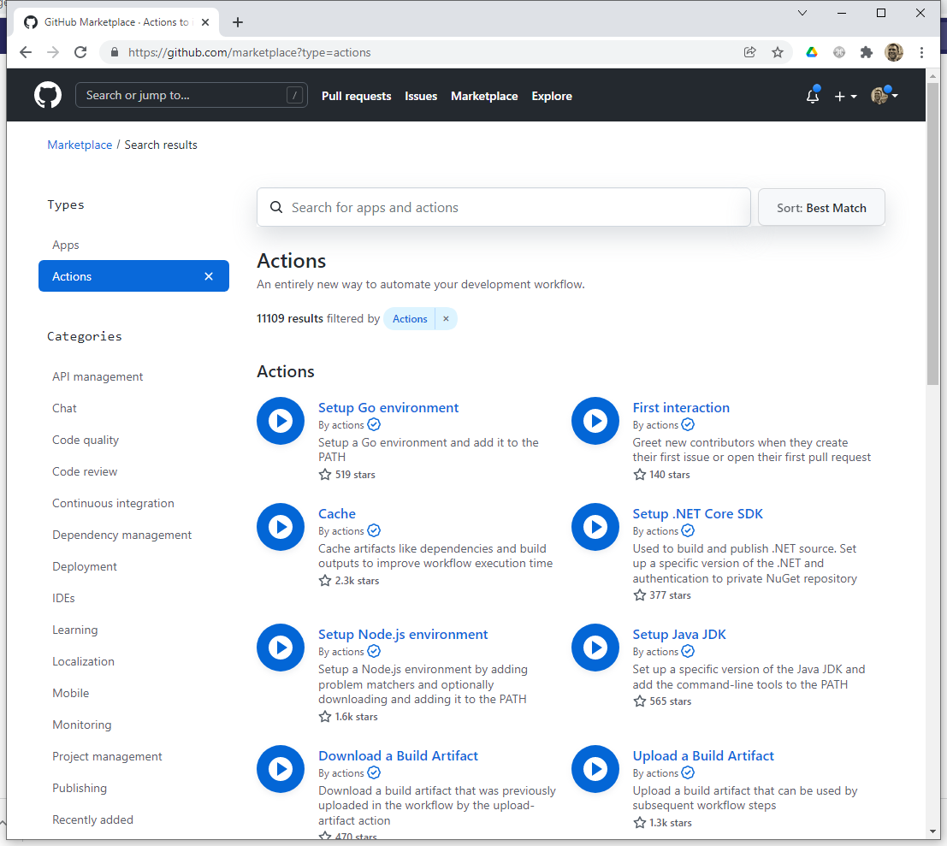
Find actions

Slide 32
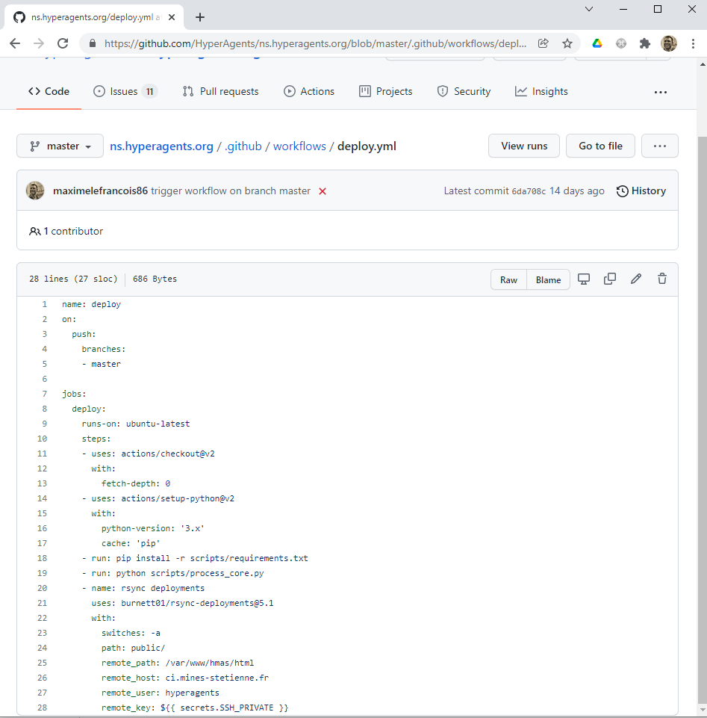
Example
https://github.com/HyperAgents/ns.hyperagents.org/

Slide 33
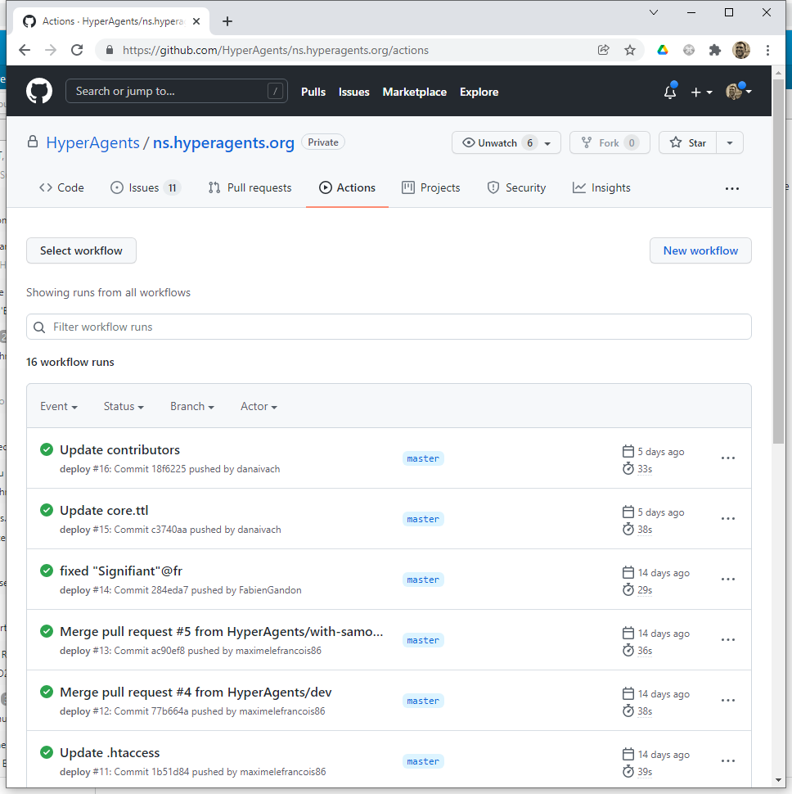
Example
https://github.com/HyperAgents/ns.hyperagents.org/

Slide 34
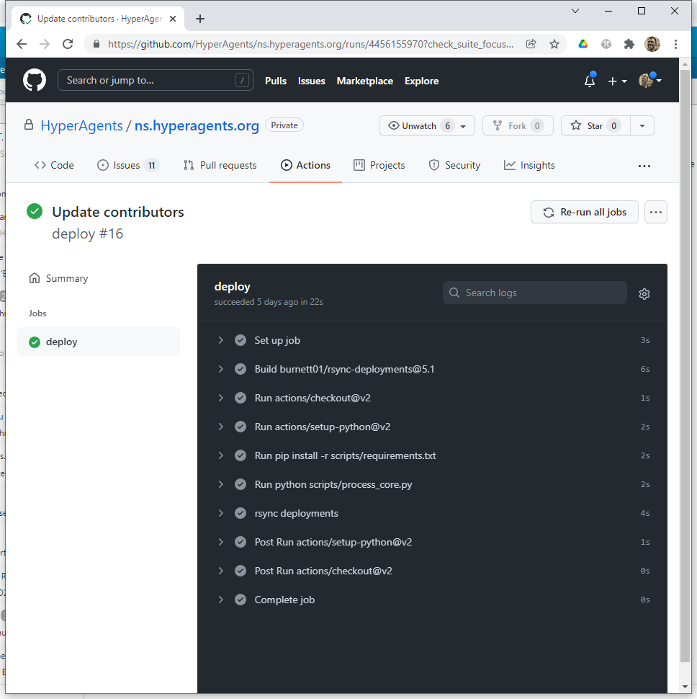
Example
https://github.com/HyperAgents/ns.hyperagents.org/

Slide 35
Technological foundations of software development
Integrate and deploy your software continuously
ICM – Computer Science Major – Course unit on Technological foundations of computer scienceopment
M1 Cyber Physical and Social Systems – Course unit on CPS2 engineering and development, Part 2: Technological foundations of software development
Maxime Lefrançois https://maxime-lefrancois.info
online: https://ci.mines-stetienne.fr/cps2/course/tfsd/

Slide 36
... Your turn
Complete the TODO section:
https://ci.mines-stetienne.fr/cps2/course/tfsd/course-8.html#_todos

