Slide 1
Modelling knowledge
Antoine Zimmermann

Slide 2
Introduction
Why modelling knowledge?
defining the structure of data files is not sufficient to understand the content
make knowledge explicit
make it independent from a specific system
→ reusable in different systems
derive implicit information from explicit knowledge and facts

Slide 3
Introduction
Examples :
An app for finding parking spaces in any city that provides open parking data
an app for learning how to cook and invent new recipes, and a recipe search engine require knowledge about cooking and recipes.
a stock management application and an e-commerce website require knowledge about products and services.

Slide 4
Introduction
Knowledge vs. data vs. information
Data are just values (e.g., 37.2, “foo”, 2015-04-23), possibly in a structure (e.g., a table)
Information is what data is when interpreted by way of knowledge (e.g., 37.2 is the temperature in °C in a person’s body at a certain time)
Knowledge is what makes data into information (I know that the sensor is a thermometer that has just stayed in John’s rectum)

Slide 5
Introduction
General knowledge
(e.g., A novel is a narrative)
Specific data (e.g., Harry Potter and the Philosopher's Stone is a novel)
Conclusions (e.g., Harry Potter and the Philosopher's Stone is a narrative)
+
=

Slide 6
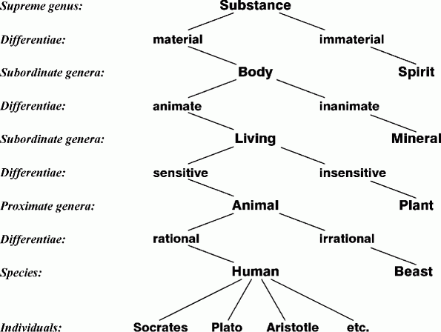
Classification systems
Tree of Portphyry, 3rd century AD, representing Aristotle categories

Slide 7
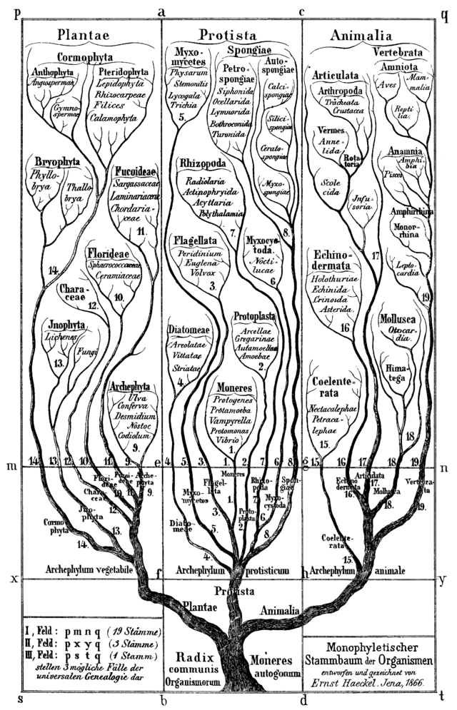
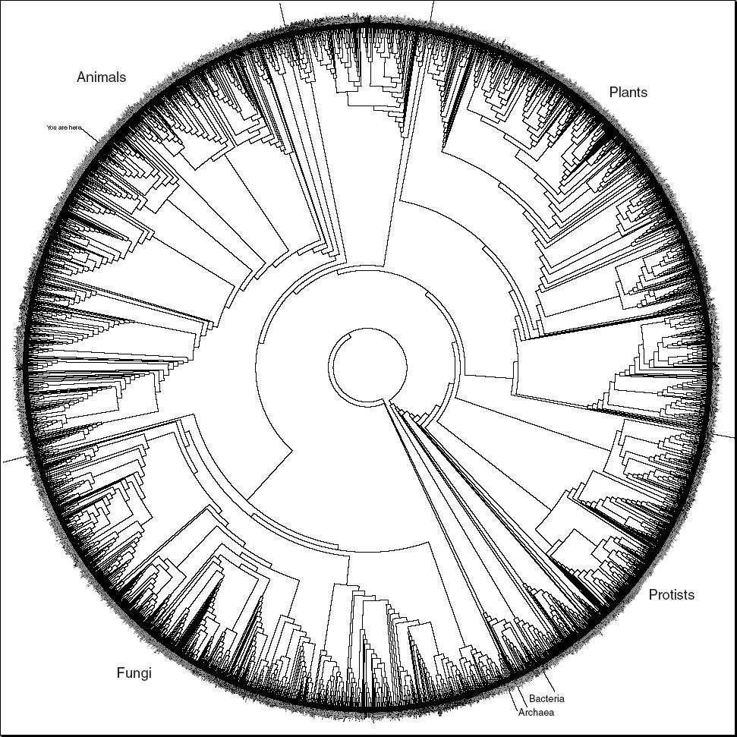
Classification systems
Biological taxonomy

Slide 8
Classification systems
Library classification (e.g., Dewey classification)
500 Natural sciences and mathematics
510 Mathematics
516 Geometry
516.3 Analytic geometries
516.37 Metric differential geometries
516.375 Finsler Geometry

Slide 9
Classification systems
General knowledge: Persons are Living-beings
Specific data: Aristotle is a Person
Conclusion: Aristotle is a Living-being
In first order logic:
∀x.Person(x) ⇒ Living-being(x)
Person(Aristotle)
⊨
Living-being(Aristotle)

Slide 10
Formal semantics in FOL
A set of class names CNames
A subclass relation <
Subsumption assertions C < D with C, D in CNames
A classification is a set of subsumption assertions
A subsumption assertion C < D can be translated in first order logic as follows:
∀x.C(x) ⇒ D(x)

Slide 11
Formal semantics in Model theory
An interpretation I consists of:
a non-empty set Δ^{I} (the domain of interpretation or universe of I)
A function I(⋅) : CNames → P(Δ^{I}) (the interpretation function)
I satisfies a subsumption assertion C < D iff I(C) ⊆ I(D)

Slide 12
Classification systems: guidelines
A name can only be used for one class
A word does not necessarily correspond to a class and vice versa
Use consistent naming convention (e.g., capital letters, singular nouns or noun phrases)
Define classes by analogy: similar structure, similar features

Slide 13
Classification systems: exercise
Define a classification of vehicles

Slide 14
Classification options
Binary classification: is / is not (has / has not)
e.g., Motorised vs. NotMotorised
Fixed sets classifications:
e.g., FlyingVehicle, GroundVehicle, WaterVehicle
Classes for each discrete values
e.g., 1WheeledVehicle, 2WheeledVehicle, 3WheelVehicle, etc.
Classes for ranges
e.g., 10to20HorsePower, 20to100HorsePower, etc.

Slide 15
Graph-based knowledge representation
Classes are not enough to represent most knowledge
Relations between entities are required
What parts are in a vehicle? A car has an engine
What values for an attribute? A car is 5.2 m long

Slide 16
Graph-based knowledge representation
Representing entities and their relationships:
mind maps
topic maps
semantic networks
conceptual graphs
RDF

Slide 17
Graph-based knowledge representation
Semantic networks: Describe particular entities
e.g., John knows Sam and is the son of Henry
In FOL: knows(John,Sam) ∧ son-of(John,Henry)
knows
John
son-of
Sam
Henry

Slide 18
Formal semantics in FOL (1)
A set of entity names ENames
A set of relation names RNames
Relation assertions e1 R e2 with e1, e2 in ENames and R in RNames
A semantic network is a set of relation assertions
A relation assertion e1 R e2 can be translated in first order logic as follows: R(e1,e2)

Slide 19
Graph-based knowledge representation
Exercises:
describe omelette recipe as a semantic network
how to describe the omelette that I made yesterday?

Slide 20
Graph-based knowledge representation
Add two special relationships
is-a (between an entity and a class it belongs to)
kind-of (between a class and a superclass)
kind-of
Person
Living-being
is-a
is-a
John
son-of
Henry

Slide 21
Graph-based knowledge representation
Meaning of is-a and kind-of
We would like that this graph:
logically implies:
kind-of
Person
Living-being
is-a
is-a
John
son-of
Henry
John
is-a
Living-being

Slide 22
Graph-based knowledge representation
Meaning of is-a and kind-of
First interpretation:
means in FOL: C(e) for any e and C
and
means: ∀x.C(x) ⇒ D(x)
Problem: in this case, C is a predicate symbol and e is a constant but in the graph, they are both nodes. Nodes that are classes should be distinguished from nodes that are entities
e
is-a
C
kind-of
C
D

Slide 23
Formal semantics in FOL (1st option)
A set of entity names ENames
A set of relation names RNames
A set of class names CNames
Relation assertions e1 R e2 with e1, e2 in ENames and R in RNames
Type assertions C(e) with C in CNames and e in Enames
Class subsumptions C < D with C and D in CNames
A semantic network is a set of relation and type assertions with a set of class subsumptions
A relation assertion e1 R e2 can be translated in first order logic as follows: R(e1,e2)
A type assertion C(e) can be translated in first order logic as follows: C(e)
A class subsumption C < D can be translated in FOL as in classifications

Slide 24
Graph-based knowledge representation
Meaning of is-a and kind-of
Second interpretation:
if
then
In FOL: ∀e∀C∀D.is-a(e,C) ∧ kind-of(C,D) ⇒ is-a(e,D)
e
is-a
C
kind-of
D
e
is-a
D

Slide 25
Formal semantics in FOL (2nd option)
A set of entity names ENames
A set of relation names RNames ∪ {is-a, kind-of}
Relation assertions e1 R e2 with e1, e2 in ENames and R in RNames
A semantic network is a set of relation assertions with a set of class subsumptions
A relation assertion e1 R e2 can be translated in first order logic as follows: R(e1,e2)
Additionally, we must have the following FOL formula:
∀e∀C∀D.is-a(e,C) ∧ kind-of(C,D) ⇒ is-a(e,D)

Slide 26
Formal semantics in Model theory (1st option)
An interpretation I consists of:
a non-empty set Δ^{I} (the domain of interpretation or universe of I)
A function I_{e}(⋅) : ENames → Δ^{I}
A function I_{c}(⋅) : CNames → P(Δ^{I})
A function I_{r}(⋅) : RNames → P(Δ^{I}×Δ^{I})
I satisfies a relation assertion e1 R e2 iff (I_{e}(e1), I_{e}(e2)) ∈ I_{r}(R)
I satisfies a type assertion e is-a C iff I_{e}(e) ⊆ I_{c}(C)
I satisfies a subsumption assertion C kind-of D iff I_{c}(C) ⊆ I_{c}(D)

Slide 27
Formal semantics in Model theory (2nd option)
An interpretation I consists of:
a non-empty set Δ^{I} (the domain of interpretation or universe of I)
A function I_{e}(⋅) : ENames → Δ^{I}
A function I_{r}(⋅) : RNames → P(Δ^{I}×Δ^{I})
such that:
I_{r}(kind-of) is transitive, reflexive, and antisymmetric;
if (x,y) ∈ I_{r}(is-a) and (y,z) ∈ I_{r}(kind-of) then (x,z) ∈ I_{r}(is-a)
I satisfies a relation assertion e1 R e2 iff (I_{e}(e1), I_{e}(e2)) ∈ I_{r}(R)

Slide 28
Graph-based knowledge representation
Exercise:
Complete your description of the cooking knowledge model with is-a and kind-of

Slide 29
Visible use of graph-based K.R.
Google’s Knowledge Graph
Similar things in Bing, Yahoo, Yandex, etc.
See https://bit.ly/2HydkJO, https://bit.ly/2HbppFz, https://binged.it/2vqsrjF, https://bit.ly/2HaOKPF, etc.

Slide 30
Graph-based tools
List of graph database systems:
https://en.wikipedia.org/wiki/Graph_database

Slide 31
References
Knowledge Representation and Reasoning. Brachman and Levesque. Morgan Kaufmann Publishers, 2004. 381 pages.
Handbook of Knowledge Representation. Van Harmelen, Lifschitz, Porter. Elsevier 2008. 1005 pages.

