Slide 1
Modelling knowledge Part 4
Antoine Zimmermann

Slide 2
Content
Introduction ✓
Classification ✓
Graph-based knowledge representation ✓
Object oriented knowledge representation ✓
Description logic ✓(almost)
Rule-based knowledge representation

Slide 3
Description Logics: even more expressiveness
Allow literal values with datatypes: numbers, character strings, dates
Special properties that relate individuals to literal values
Constraints on these properties similar to roles:
Existential restriction: ∃p.D (e.g., ∃birthday.Date)
Universal restriction: ∀p.D (e.g., ∀temperature.Float)
At-least restriction: ≥n p.D (e.g., ≥1 name.String)
At-most restriction: ≤n p.D (e.g., ≤1 login.String)

Slide 4
Description Logics: even more expressiveness
Allow constraints on datatypes
FortyNiners ⊑ ∃birthday.Date[≤1849-01-01]
HypertensionPatient ⊑ ∃bloodPressure.Float[≥140]

Slide 5
Description Logics "in the wild"
A knowledge model of a domain is also called an ontology
Ontologies in DLs can be saved in files using the OWL format (Web Ontology Language)
Many (thousands) OWL files can be found on the Web
OWL files can be visualised and edited with an ontology editor such as Protégé (http://protege.stanford.edu/).
The Linked Open Vocabulary directory: http://lov.okfn.org/dataset/lov/
Ontology Design Patterns: http://ontologydesignpatterns.org/
Biomedical ontologies (OBO foundry): http://www.obofoundry.org/

Slide 6
Rule-based knowledge representation
If <condition>
Then <conclusion>
Often, rule-based systems are used in decision-making applications:
If <condition>
Then <action>

Slide 7
Rule-based knowledge representation
The <condition> is a formula in a certain formalism where portions of the formula are replaced by variables
The <conclusion> is a formula in a formalism (usually the same as the one in the <condition>) where portions of the formula are replaced by variables from the <condition>

Slide 8
Meaning of a rule
Rules are interpreted with respect to a set of facts
Facts are formulas in the formalism of the <condition>, without variables.
If variables in the <condition> can be replaced by symbols to form facts, then the <conclusion> with variables replaced in the same way form a formula that must be considered true.

Slide 9
Example: classification
If then facts:
Conclusions:
?x
?x
Life
?y
?z
Animalia
?z
Vertebrae
Homo
Life
Animalia
Life
Plantae
Vertebrae
Homo
…
…

Slide 10
Example: classification (valid rule)
If then
This rule is always true in a classification
We say it is valid
?x
?x
?y
?z
?z

Slide 11
Example: classification (not valid rule)
If then
The base formalism of the rule (class hierarchy) cannot express intersection, but a rule on classifications can.
Rules based on a formalism are more expressive than the formalism
Person
Female
Woman
?x
?x

Slide 12
Example: graphs
hasUncle
If then
Exercise: describe family relationships using similar rules (grand parents, siblings, cousins, etc.)
?x
hasParent
?y
hasBrother
?z
?x
?z

Slide 13
Example: graphs
hasUncle
If then
Exercise: describe family relationships using similar rules (grand parents, siblings, cousins, etc.)
?x
hasParent
?y
hasBrother
?z
?x
?z

Slide 14
Example: description logic rules
If ∃worksAt.University(?x) and
supervises(?x,?y) and
PhDStudent(?y)
Then hasProfessor(?y,?x)

Slide 15
Example: valid rule in DL
If ?x ⊑ ∃?r.?y and ?y ⊑?z and ∃?r.?z ⊑ ?t
Then ?x ⊑ ?t

Slide 16
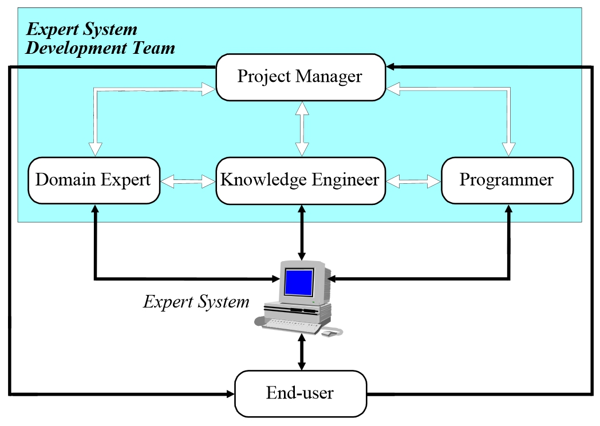
Typical application of rule-based knowledge
Expert systems
From Negnevitsky, 2002

Slide 17
Modelling in First Order Logic (and beyond)
The presented formalisms are restrictions of FOL
Some things cannot be expressed with
FOL can be used to model a domain in a very expressive way (or if it seems more "natural")
But sometimes FOL is not expressive enough
e.g. expressing the fact that a set is finite
Use higher order logics (e.g., second order logic)

Slide 18
Other formalisms
Even more modelling possibilities:
Modelling with uncertainty: fuzzy logics, probabilistic logics, possibilistic logics, multi-valued logics
Modelling context: contextual logics, annotated logics, temporal logics
Modelling knowledge about knowledge: epistemic logics
Modelling beliefs: doxastic logics
Modelling obligation/permission: deontic logics

Slide 19
Examples of knowledge models (W3C standards)
PROV-O: a provenance ontology http://www.w3.org/TR/prov-o/
Organization ontology
http://www.w3.org/TR/vocab-org/
Time ontology
https://www.w3.org/TR/owl-time/
Semantic Sensor Networks
https://www.w3.org/TR/vocab-ssn/

Slide 20
Examples of knowledge models
FRBR: Functional Requirements for Bibliographic Records http://www.loc.gov/cds/downloads/FRBR.PDF
Exercise: use FRBR to model the following situation
« The copy of the book Germinal by Émile Zola, translated to English by Roger Pearson and published by Penguin Books in 2004, sitting on the shelves of the public library of Perpignan »

Slide 21
Enterprise knowledge models
Schema.org (generic meta data for web content indexing) http://schema.org/
GoodRelations (e-commerce ontology)
http://www.heppnetz.de/projects/goodrelations/
Vehicle Sale Ontology
http://www.heppnetz.de/ontologies/vso/ns
Volkswagen’s Car Options Ontology
http://www.volkswagen.co.uk/vocabularies/coo/ns
The BBC’s ontologies
https://www.bbc.co.uk/ontologies

Slide 22
References
Rule-based expert systems. Negnevitsky, 2002. ftp://ftp.dca.fee.unicamp.br/pub/docs/vonzuben/ea072_2s06/notas_de_aula/Lecture02.pdf
Rule Interchange Format
https://www.w3.org/TR/rif-overview/
Semantic Web Rule Language (SWRL)
https://www.w3.org/Submission/SWRL/

